Slide 1
StudyMafia.Org
Oncogene
Submitted To: Submitted By:
Studymafia.org Studymafia.org

Slide 2
Table Contents
Definition
Introduction
History of Oncogene
Functions of Oncogene
Proto-oncogene
Factors Affecting Proto-oncogene
Classification of Oncogene
Conclusion
2
Notes:
SAY: Before we wrap up the course, let’s review what we have learned today.
During this course, we have
<READ the bullets from the slide.>
GO to next slide.

Slide 3
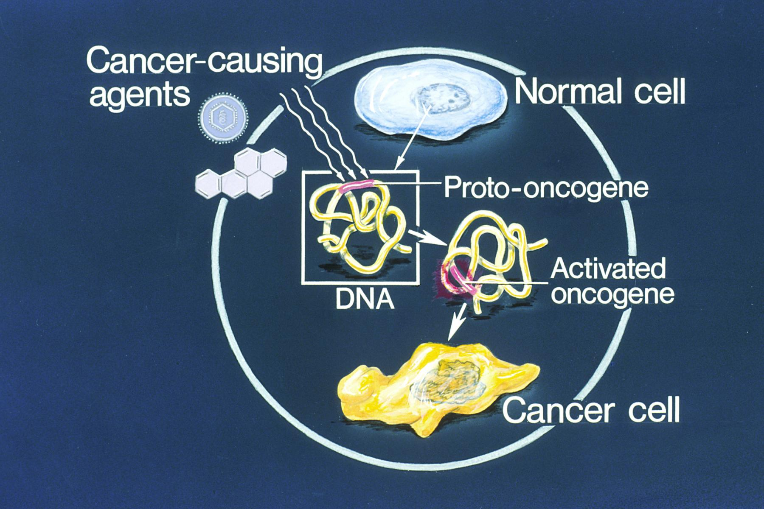
Definition
An oncogene is a gene that has the potential to cause cancer. In tumor cells, these genes are often mutated, or expressed at high levels
3
Notes:
SAY: Before we wrap up the course, let’s review what we have learned today.
During this course, we have
<READ the bullets from the slide.>
GO to next slide.

Slide 4
Introduction
Most oncogenes began as proto-oncogenes: normal genes involved in cell growth and proliferation or inhibition of apoptosis.
If, through mutation, normal genes promoting cellular growth are up-regulated (gain-of-function mutation), they will predispose the cell to cancer; thus, they are termed "oncogenes".
Usually multiple oncogenes, along with mutated apoptotic or tumor suppressor genes will all act in concert to cause cancer.
4
Notes:
SAY: Before we wrap up the course, let’s review what we have learned today.
During this course, we have
<READ the bullets from the slide.>
GO to next slide.

Slide 5
5
Notes:
SAY: Before we wrap up the course, let’s review what we have learned today.
During this course, we have
<READ the bullets from the slide.>
GO to next slide.

Slide 6
History of Oncogene
The theory of oncogenes was foreshadowed by the German biologist Theodor Boveri in his 1914 book Zur Frage der Entstehung Maligner Tumoren (Concerning the Origin of Malignant Tumors) in which he predicted the existence of oncogenes.
Later on, the term "oncogene" was rediscovered in 1969 by National Cancer Institute scientists George Todaro and Robert Huebner.
●●●
6
Notes:
SAY:
The purpose of epidemiology in public health practice is to
discover the agent, host, and environmental factors that affect health;
determine the relative importance of causes of illness, disability, and death;
identify those segments of the population that have the greatest risk from specific causes of ill health; and
evaluate the effectiveness of health programs and services in improving population health.
GO to next slide.

Slide 7
History of Oncogene
The first confirmed oncogene was discovered in 1970 and was termed SRC (pronounced "sarc" as it is short for sarcoma). SRC was first discovered as an oncogene in a chicken retrovirus.
Bishop and Varmus were awarded the Nobel Prize in Physiology or Medicine in 1989 for their discovery of the cellular origin of retroviral oncogenes.
●●●
7
Notes:
SAY:
The purpose of epidemiology in public health practice is to
discover the agent, host, and environmental factors that affect health;
determine the relative importance of causes of illness, disability, and death;
identify those segments of the population that have the greatest risk from specific causes of ill health; and
evaluate the effectiveness of health programs and services in improving population health.
GO to next slide.

Slide 8
History of Oncogene
The resultant protein encoded by an oncogene is termed oncoprotein.
Oncogenes play an important role in the regulation or synthesis of proteins linked to tumorigenic cell growth.
Some oncoproteins are accepted and used as tumor markers.
8
Notes:
SAY:
The purpose of epidemiology in public health practice is to
discover the agent, host, and environmental factors that affect health;
determine the relative importance of causes of illness, disability, and death;
identify those segments of the population that have the greatest risk from specific causes of ill health; and
evaluate the effectiveness of health programs and services in improving population health.
GO to next slide.

Slide 9
Functions of Oncogene
●●●
9
Notes:
SAY:
The purpose of epidemiology in public health practice is to
discover the agent, host, and environmental factors that affect health;
determine the relative importance of causes of illness, disability, and death;
identify those segments of the population that have the greatest risk from specific causes of ill health; and
evaluate the effectiveness of health programs and services in improving population health.
GO to next slide.

Slide 10
Proto-oncogene
A proto-oncogene is a normal gene that could become an oncogene due to mutations or increased expression.
Proto-oncogenes code for proteins that help to regulate the cell growth and differentiation.
Proto-oncogenes are often involved in signal transduction and execution of mitogenic signals, usually through their protein products.
●●●
10
Notes:
SAY:
The purpose of epidemiology in public health practice is to
discover the agent, host, and environmental factors that affect health;
determine the relative importance of causes of illness, disability, and death;
identify those segments of the population that have the greatest risk from specific causes of ill health; and
evaluate the effectiveness of health programs and services in improving population health.
GO to next slide.

Slide 11
Proto-oncogene
Upon acquiring an activating mutation, a proto-oncogene becomes a tumor-inducing agent, an oncogene.
Examples of proto-oncogenes include RAS, WNT, MYC, ERK, and TRK. The MYC gene is implicated in Burkitt's lymphoma, which starts when a chromosomal translocation moves an enhancer sequence within the vicinity of the MYC gene.
●●●
11
Notes:
SAY:
The purpose of epidemiology in public health practice is to
discover the agent, host, and environmental factors that affect health;
determine the relative importance of causes of illness, disability, and death;
identify those segments of the population that have the greatest risk from specific causes of ill health; and
evaluate the effectiveness of health programs and services in improving population health.
GO to next slide.

Slide 12
Proto-oncogene
The MYC gene codes for widely used transcription factors. When the enhancer sequence is wrongly placed, these transcription factors are produced at much higher rates.
Another example of an oncogene is the Bcr-Abl gene found on the Philadelphia chromosome, a piece of genetic material seen in Chronic Myelogenous Leukemia caused by the translocation of pieces from chromosomes 9 and 22.
12
Notes:
SAY:
The purpose of epidemiology in public health practice is to
discover the agent, host, and environmental factors that affect health;
determine the relative importance of causes of illness, disability, and death;
identify those segments of the population that have the greatest risk from specific causes of ill health; and
evaluate the effectiveness of health programs and services in improving population health.
GO to next slide.

Slide 13
Factors Affecting Proto-oncogene
13
Notes:
SAY:
The purpose of epidemiology in public health practice is to
discover the agent, host, and environmental factors that affect health;
determine the relative importance of causes of illness, disability, and death;
identify those segments of the population that have the greatest risk from specific causes of ill health; and
evaluate the effectiveness of health programs and services in improving population health.
GO to next slide.

Slide 14
Classification of Oncogene
There are several systems for classifying oncogenes,but there is not yet a widely accepted standard.
They are sometimes grouped both spatially (moving from outside the cell inwards) and chronologically (parallelling the "normal" process of signal transduction).
●●●
14
Notes:
SAY:
The purpose of epidemiology in public health practice is to
discover the agent, host, and environmental factors that affect health;
determine the relative importance of causes of illness, disability, and death;
identify those segments of the population that have the greatest risk from specific causes of ill health; and
evaluate the effectiveness of health programs and services in improving population health.
GO to next slide.

Slide 15
Classification of Oncogene
●●●
15
Notes:
SAY:
The purpose of epidemiology in public health practice is to
discover the agent, host, and environmental factors that affect health;
determine the relative importance of causes of illness, disability, and death;
identify those segments of the population that have the greatest risk from specific causes of ill health; and
evaluate the effectiveness of health programs and services in improving population health.
GO to next slide.

Slide 16
Classification of Oncogene
16
Notes:
SAY:
The purpose of epidemiology in public health practice is to
discover the agent, host, and environmental factors that affect health;
determine the relative importance of causes of illness, disability, and death;
identify those segments of the population that have the greatest risk from specific causes of ill health; and
evaluate the effectiveness of health programs and services in improving population health.
GO to next slide.

Slide 17
Conclusion
A mutated (changed) form of a type of gene called a proto-oncogene, which is involved in normal cell growth and division.
When a proto-oncogene is changed so that too many copies are made or it becomes more active than normal, it is called an oncogene.
17
Notes:
SAY:
The purpose of epidemiology in public health practice is to
discover the agent, host, and environmental factors that affect health;
determine the relative importance of causes of illness, disability, and death;
identify those segments of the population that have the greatest risk from specific causes of ill health; and
evaluate the effectiveness of health programs and services in improving population health.
GO to next slide.

Slide 18
Thanks To StudyMafia.org

