Slide 1
StudyMafia.Org
Neurogenic Bladder
Submitted To: Submitted By:
Studymafia.org Studymafia.org

Slide 2
Table Contents
Definition
Introduction
Symptoms of Neurogenic Bladder
Causes of Neurogenic Bladder
Complications of Neurogenic Bladder
Diagnosis of Neurogenic Bladder
Treatment of Neurogenic Bladder
Conclusion
2
Notes:
SAY: Before we wrap up the course, let’s review what we have learned today.
During this course, we have
<READ the bullets from the slide.>
GO to next slide.

Slide 3
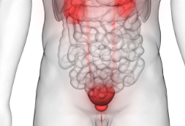
Definition
Your bladder relies on muscles to contract and release when you’re ready to urinate.
3
Notes:
SAY: Before we wrap up the course, let’s review what we have learned today.
During this course, we have
<READ the bullets from the slide.>
GO to next slide.

Slide 4
Introduction
Your brain typically regulates this process, but sometimes the message that you need to urinate isn’t sent from your brain to your bladder.
This is a condition known as neurogenic bladder. Treatment for this condition can help you regain control.
4
Notes:
SAY: Before we wrap up the course, let’s review what we have learned today.
During this course, we have
<READ the bullets from the slide.>
GO to next slide.

Slide 5
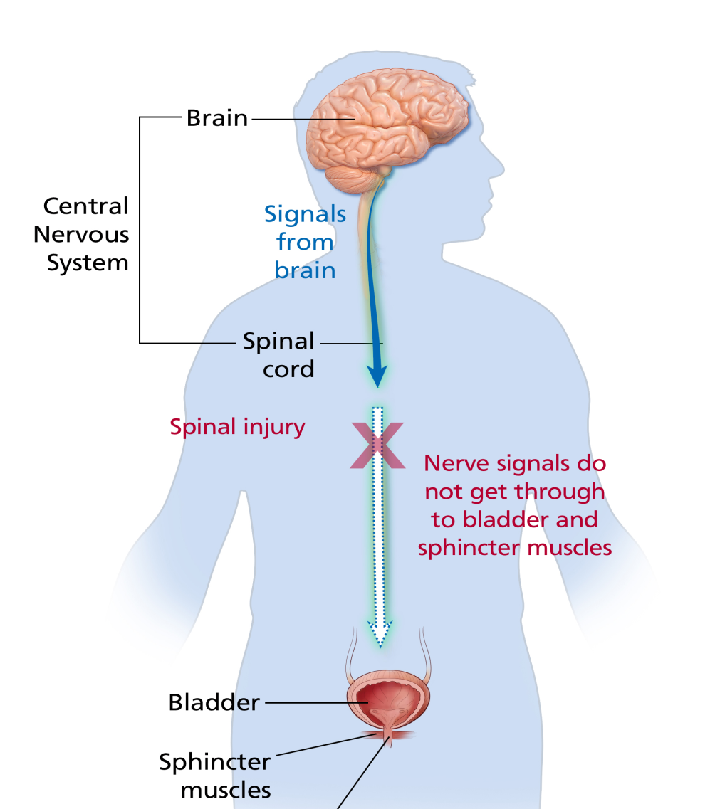
Symptoms of Neurogenic
Bladder
5
Notes:
SAY: Before we wrap up the course, let’s review what we have learned today.
During this course, we have
<READ the bullets from the slide.>
GO to next slide.

Slide 6
Causes of Neurogenic
Bladder
Examples of brain disorders that can cause neurogenic bladder include:
Alzheimer’s disease
Tumors of the brain or spinal cord
Multiple sclerosis
Parkinson’s disease
Injury to the spinal cord
Spinal cord birth defects, such as spina bifida
Stroke
●●●
6
Notes:
SAY:
The purpose of epidemiology in public health practice is to
discover the agent, host, and environmental factors that affect health;
determine the relative importance of causes of illness, disability, and death;
identify those segments of the population that have the greatest risk from specific causes of ill health; and
evaluate the effectiveness of health programs and services in improving population health.
GO to next slide.

Slide 7
Causes of Neurogenic
Bladder
Conditions that affect the bladder muscles include:
Diabetes, which can cause nerve damage
Long-term alcohol abuse
Pelvic surgery, which can cause nerve damage
Spinal nerve damage
7
Notes:
SAY:
The purpose of epidemiology in public health practice is to
discover the agent, host, and environmental factors that affect health;
determine the relative importance of causes of illness, disability, and death;
identify those segments of the population that have the greatest risk from specific causes of ill health; and
evaluate the effectiveness of health programs and services in improving population health.
GO to next slide.

Slide 8
Complications of Neurogenic
Bladder
Because this condition causes you to lose the sensation to urinate, your bladder can fill beyond typical capacity and leak.
But your bladder may not empty fully. This is called urinary retention.
●●●
8
Notes:
SAY:
The purpose of epidemiology in public health practice is to
discover the agent, host, and environmental factors that affect health;
determine the relative importance of causes of illness, disability, and death;
identify those segments of the population that have the greatest risk from specific causes of ill health; and
evaluate the effectiveness of health programs and services in improving population health.
GO to next slide.

Slide 9
Complications of Neurogenic
Bladder
Urinary retention increases your risk of a UTI. Infection can result when urine remains in your bladder or kidneys for too long.
Frequent urinary tract and kidney infections can lead to damage over time. This can ultimately lead to kidney failure, which can be fatal.
9
Notes:
SAY:
The purpose of epidemiology in public health practice is to
discover the agent, host, and environmental factors that affect health;
determine the relative importance of causes of illness, disability, and death;
identify those segments of the population that have the greatest risk from specific causes of ill health; and
evaluate the effectiveness of health programs and services in improving population health.
GO to next slide.

Slide 10
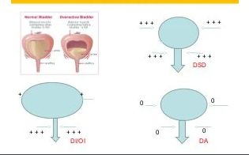

Slide 11
Diagnosis of Neurogenic
Bladder
In addition to reviewing your medical history and conducting a physical exam,
These may include:
A cystometrogram to test bladder function and capacity
An electromyography to test bladder muscle tone and coordination
Spinal and brain imaging
Kidney and bladder imaging
11
Notes:
SAY:
The purpose of epidemiology in public health practice is to
discover the agent, host, and environmental factors that affect health;
determine the relative importance of causes of illness, disability, and death;
identify those segments of the population that have the greatest risk from specific causes of ill health; and
evaluate the effectiveness of health programs and services in improving population health.
GO to next slide.

Slide 12
Treatment of Neurogenic
Bladder
Electrical stimulation therapy
Another treatment option is electrical stimulation therapy. This therapy involves placing small electrodes on the bladder. When stimulated, the electrodes can send impulses to the brain, telling it you need to urinate.
●●●
12
Notes:
SAY:
The purpose of epidemiology in public health practice is to
discover the agent, host, and environmental factors that affect health;
determine the relative importance of causes of illness, disability, and death;
identify those segments of the population that have the greatest risk from specific causes of ill health; and
evaluate the effectiveness of health programs and services in improving population health.
GO to next slide.

Slide 13
Treatment of Neurogenic
Bladder
Medications
There are no medications to treat or control neurogenic bladder specifically. However, some medications can reduce or enhance muscle contractions.
Catheterization
In some instances, your doctor may recommend catheterization to ensure complete bladder emptying.
●●●
13
Notes:
SAY:
The purpose of epidemiology in public health practice is to
discover the agent, host, and environmental factors that affect health;
determine the relative importance of causes of illness, disability, and death;
identify those segments of the population that have the greatest risk from specific causes of ill health; and
evaluate the effectiveness of health programs and services in improving population health.
GO to next slide.

Slide 14
Treatment of Neurogenic
Bladder
Surgery
Your doctor can insert an artificial sphincter into your body that compresses the urethra to prevent urinary leakage which can then be manually released to allow emptying of the bladder. Other surgical options include bladder reconstruction surgery which may help with bladder control.
14
Notes:
SAY:
The purpose of epidemiology in public health practice is to
discover the agent, host, and environmental factors that affect health;
determine the relative importance of causes of illness, disability, and death;
identify those segments of the population that have the greatest risk from specific causes of ill health; and
evaluate the effectiveness of health programs and services in improving population health.
GO to next slide.

Slide 15
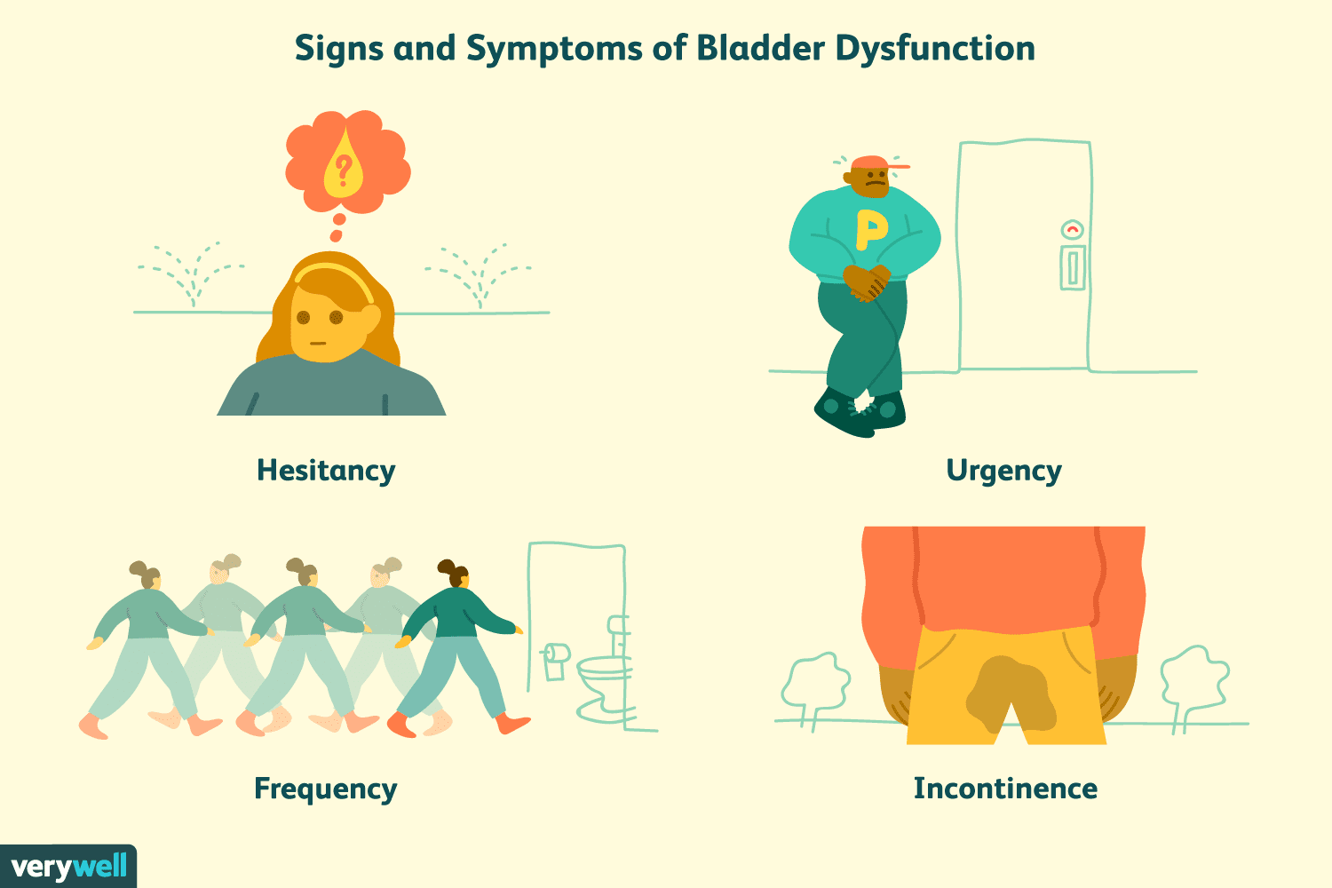

Slide 16
Conclusion
In neurogenic bladder, the nerves that carry messages back-and-forth between the bladder and the spinal cord and brain don't work the way they should.
Damage or changes in the nervous system and infection can cause neurogenic bladder.
16
Notes:
SAY:
The purpose of epidemiology in public health practice is to
discover the agent, host, and environmental factors that affect health;
determine the relative importance of causes of illness, disability, and death;
identify those segments of the population that have the greatest risk from specific causes of ill health; and
evaluate the effectiveness of health programs and services in improving population health.
GO to next slide.

Slide 17
References
Google.com
Wikipedia.org
Studymafia.org
Slidespanda.com

Slide 18
Thanks To StudyMafia.org

