Slide 1
StudyMafia.Org
Muscle Contraction
Submitted To: Submitted By:
Studymafia.org Studymafia.org

Slide 2
Table Contents
Introduction
Why Muscle Contraction?
Types of Muscle Contraction
Mechanisms of Muscle Contraction
Conclusion
2
Notes:
SAY: Before we wrap up the course, let’s review what we have learned today.
During this course, we have
<READ the bullets from the slide.>
GO to next slide.

Slide 3
Introduction
Muscle contraction is the tightening, shortening, or lengthening of muscles when you do some activity.
It can happen when you hold or pick up something, or when you stretch or exercise with weights. Muscle contraction is often followed by muscle relaxation, when contracted muscles return to their normal state.
3
Notes:
SAY: Before we wrap up the course, let’s review what we have learned today.
During this course, we have
<READ the bullets from the slide.>
GO to next slide.

Slide 4
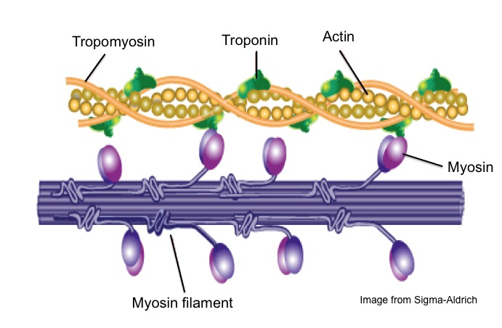
4
Notes:
SAY: Before we wrap up the course, let’s review what we have learned today.
During this course, we have
<READ the bullets from the slide.>
GO to next slide.

Slide 5
Why Muscle Contraction
Muscles serve several purposes in your body. Your muscles contract for any number of reasons, but they primarily do the following:‌
Offer stability to your joints and connective tissues – Your muscles lengthen and shorten, sometimes involuntarily, as your body needs them.
●●●
5
Notes:
SAY:
The purpose of epidemiology in public health practice is to
discover the agent, host, and environmental factors that affect health;
determine the relative importance of causes of illness, disability, and death;
identify those segments of the population that have the greatest risk from specific causes of ill health; and
evaluate the effectiveness of health programs and services in improving population health.
GO to next slide.

Slide 6
Why Muscle Contraction
Produce heat to maintain your body temperature – Around 40% of your body’s temperature converts into muscle work. Shivering is your body’s response to feeling cold, and your skeletal muscles activate to warm your body.‌
Maintain posture – Muscles help you maintain a position like sitting or standing. ‌
6
Notes:
SAY:
The purpose of epidemiology in public health practice is to
discover the agent, host, and environmental factors that affect health;
determine the relative importance of causes of illness, disability, and death;
identify those segments of the population that have the greatest risk from specific causes of ill health; and
evaluate the effectiveness of health programs and services in improving population health.
GO to next slide.

Slide 7
Types of Muscle Contraction
Concentric Contractions:
This type of contraction happens when your muscle is actively shortened. Your muscle tightens when you activate it to lift something heavier than normal, which generates tension.‌
●●●
7
Notes:
SAY:
The purpose of epidemiology in public health practice is to
discover the agent, host, and environmental factors that affect health;
determine the relative importance of causes of illness, disability, and death;
identify those segments of the population that have the greatest risk from specific causes of ill health; and
evaluate the effectiveness of health programs and services in improving population health.
GO to next slide.

Slide 8
Types of Muscle Contraction
Eccentric Contractions.
This type of contraction happens when your muscle is actively lengthened during normal activity. An example of this is walking because your quadriceps muscles are active when your heel touches the ground and your knee is bending or straightening out in stride. ‌
●●●
8
Notes:
SAY:
The purpose of epidemiology in public health practice is to
discover the agent, host, and environmental factors that affect health;
determine the relative importance of causes of illness, disability, and death;
identify those segments of the population that have the greatest risk from specific causes of ill health; and
evaluate the effectiveness of health programs and services in improving population health.
GO to next slide.

Slide 9
Types of Muscle Contraction
Isometric Contraction.
This type of muscle contraction happens when your muscle is actively held at a set length. Instead of lengthening and shortening as it would during some activities, you hold it in a position that requires a specific length once activated.
●●●
9
Notes:
SAY:
The purpose of epidemiology in public health practice is to
discover the agent, host, and environmental factors that affect health;
determine the relative importance of causes of illness, disability, and death;
identify those segments of the population that have the greatest risk from specific causes of ill health; and
evaluate the effectiveness of health programs and services in improving population health.
GO to next slide.

Slide 10
Types of Muscle Contraction
Passive Stretch.
This type of muscle contraction happens when your muscle is passively lengthened. For example, you lean down to touch your toes. There’s no additional weight that your hamstring muscle needs to hold or lift by applying force, but it still stretches from the movement.
10
Notes:
SAY:
The purpose of epidemiology in public health practice is to
discover the agent, host, and environmental factors that affect health;
determine the relative importance of causes of illness, disability, and death;
identify those segments of the population that have the greatest risk from specific causes of ill health; and
evaluate the effectiveness of health programs and services in improving population health.
GO to next slide.

Slide 11
Mechanism of Muscle Contraction
Step 1:
Muscle contraction is initiated by signals that travel along the axon and reach the neuromuscular junction or motor end plate. The neuromuscular junction is a junction between a neuron and the sarcolemma of the muscle fibre.
As a result, Acetylcholine (a neurotransmitter) is released into the synaptic cleft by generating an action potential in the sarcolemma.
●●●
11
Notes:
SAY:
The purpose of epidemiology in public health practice is to
discover the agent, host, and environmental factors that affect health;
determine the relative importance of causes of illness, disability, and death;
identify those segments of the population that have the greatest risk from specific causes of ill health; and
evaluate the effectiveness of health programs and services in improving population health.
GO to next slide.

Slide 12
Mechanism of Muscle Contraction
Step 2:
The generation of this action potential releases calcium ions from the sarcoplasmic reticulum in the sarcoplasm.
Step 3:
The increased calcium ions in the sarcoplasm leads to the activation of actin sites. Calcium ions bind to the troponin on actin filaments and remove the tropomyosin, wrapped around actin filaments.
●●●
12
Notes:
SAY:
The purpose of epidemiology in public health practice is to
discover the agent, host, and environmental factors that affect health;
determine the relative importance of causes of illness, disability, and death;
identify those segments of the population that have the greatest risk from specific causes of ill health; and
evaluate the effectiveness of health programs and services in improving population health.
GO to next slide.

Slide 13
Mechanism of Muscle Contraction
Step 4:
In this stage, the myosin head attaches to the exposed site of actin and forms cross bridges by utilizing energy from ATP hydrolysis. The actin filaments are pulled. As a result, the H-zone reduces. It is at this stage that the contraction of the muscle occurs.
●●●
13
Notes:
SAY:
The purpose of epidemiology in public health practice is to
discover the agent, host, and environmental factors that affect health;
determine the relative importance of causes of illness, disability, and death;
identify those segments of the population that have the greatest risk from specific causes of ill health; and
evaluate the effectiveness of health programs and services in improving population health.
GO to next slide.

Slide 14
Mechanism of Muscle Contraction
Step 5:
After muscle contraction, the myosin head pulls the actin filament and releases ADP along with inorganic phosphate. ATP molecules bind and detach myosin and the cross bridges are broken.
●●●
14
Notes:
SAY:
The purpose of epidemiology in public health practice is to
discover the agent, host, and environmental factors that affect health;
determine the relative importance of causes of illness, disability, and death;
identify those segments of the population that have the greatest risk from specific causes of ill health; and
evaluate the effectiveness of health programs and services in improving population health.
GO to next slide.

Slide 15
Mechanism of Muscle Contraction
Stage 6:
This process of formation and breaking down of cross-bridges continues until there is a drop in the stimulus, which causes an increase in calcium. As a result, the concentration of calcium ions decreases, thereby masking the actin filaments and leading to muscle relaxation.
15
Notes:
SAY:
The purpose of epidemiology in public health practice is to
discover the agent, host, and environmental factors that affect health;
determine the relative importance of causes of illness, disability, and death;
identify those segments of the population that have the greatest risk from specific causes of ill health; and
evaluate the effectiveness of health programs and services in improving population health.
GO to next slide.

Slide 16
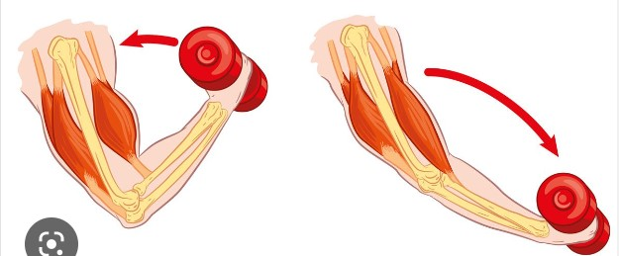

Slide 17
Conclusion
Muscle contraction is the tightening, shortening, or lengthening of muscles when you do some activity. It can happen when you hold or pick up something, or when you stretch or exercise with weights.
Muscle contraction is often followed by muscle relaxation, when contracted muscles return to their normal state.25
17
Notes:
SAY:
The purpose of epidemiology in public health practice is to
discover the agent, host, and environmental factors that affect health;
determine the relative importance of causes of illness, disability, and death;
identify those segments of the population that have the greatest risk from specific causes of ill health; and
evaluate the effectiveness of health programs and services in improving population health.
GO to next slide.

Slide 18
Thanks To StudyMafia.org

