Slide 1
StudyMafia.Org
Marasmus
Submitted To: Submitted By:
Studymafia.org Studymafia.org

Slide 2
Table Contents
Definition
Introduction
Symptoms of Marasmus
Diagnosis of Marasmus
Treatment of Marasmus
Prevention of Marasmus
Conclusion
2
Notes:
SAY: Before we wrap up the course, let’s review what we have learned today.
During this course, we have
<READ the bullets from the slide.>
GO to next slide.

Slide 3
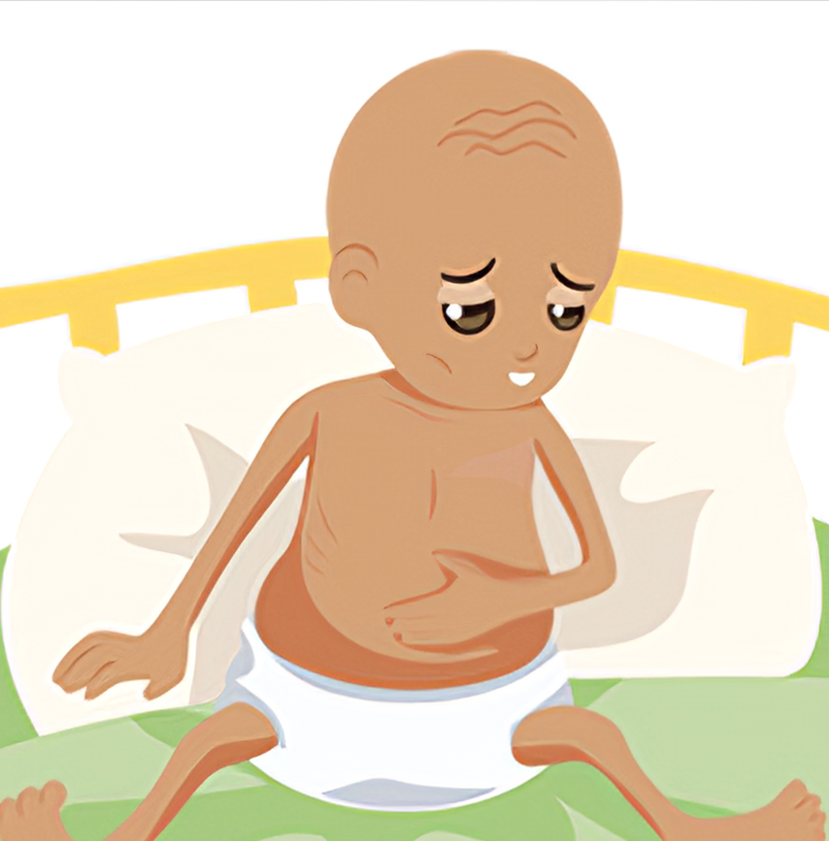
Definition
Marasmus is severe undernutrition — a deficiency in all the macronutrients that the body requires to function, including carbohydrates, protein and fats.
3
Notes:
SAY: Before we wrap up the course, let’s review what we have learned today.
During this course, we have
<READ the bullets from the slide.>
GO to next slide.

Slide 4
Introduction
Marasmus is a deficiency of all macronutrients: carbohydrates, fats, and protein.
If you have marasmus, you lack the fuel necessary to maintain normal body functions.
People with marasmus are visibly depleted, severely underweight and emaciated. Children may be stunted in size and development. Prolonged marasmus leads to starvation.
4
Notes:
SAY: Before we wrap up the course, let’s review what we have learned today.
During this course, we have
<READ the bullets from the slide.>
GO to next slide.

Slide 5
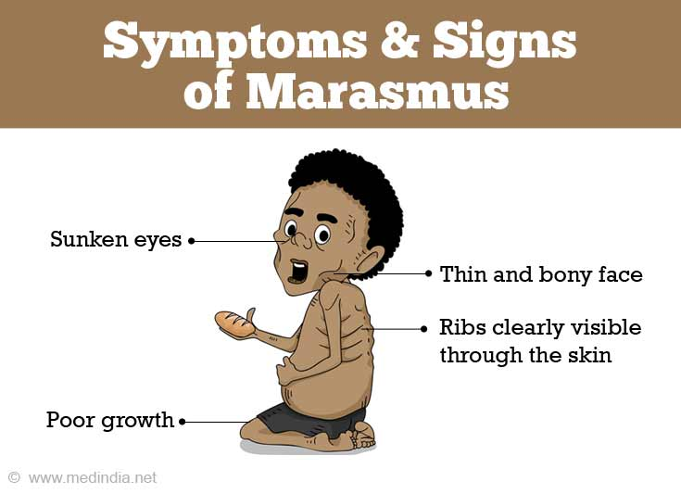
Symptoms of Marasmus
●●●
5
Notes:
SAY:
The purpose of epidemiology in public health practice is to
discover the agent, host, and environmental factors that affect health;
determine the relative importance of causes of illness, disability, and death;
identify those segments of the population that have the greatest risk from specific causes of ill health; and
evaluate the effectiveness of health programs and services in improving population health.
GO to next slide.

Slide 6
Symptoms of Marasmus
Visible wasting of fat and muscle.
Prominent skeleton.
Head appears large for the body.
Face may appear old and wizened.
Dry, loose skin (skin atrophy).
Dry, brittle hair or hair loss.
Sunken fontanelles in infants.
Lethargy, apathy and weakness.
Weight loss of more than 40%.
BMI below 16.
6
Notes:
SAY:
The purpose of epidemiology in public health practice is to
discover the agent, host, and environmental factors that affect health;
determine the relative importance of causes of illness, disability, and death;
identify those segments of the population that have the greatest risk from specific causes of ill health; and
evaluate the effectiveness of health programs and services in improving population health.
GO to next slide.

Slide 7
Diagnosis of Marasmus
Healthcare providers will begin by physically examining the person’s body.
Marasmus has some telltale physical features, the primary one being the visible wasting of fat and muscle.
People with marasmus appear emaciated. The loss of fat and muscle under the skin may cause the skin to hang loose in folds
●●●
7
Notes:
SAY:
The purpose of epidemiology in public health practice is to
discover the agent, host, and environmental factors that affect health;
determine the relative importance of causes of illness, disability, and death;
identify those segments of the population that have the greatest risk from specific causes of ill health; and
evaluate the effectiveness of health programs and services in improving population health.
GO to next slide.

Slide 8
Diagnosis of Marasmus
Beyond appearances, healthcare providers will measure the height or length of the person’s body and the circumference of their upper arm.
Healthcare providers use a few different charts to measure a child’s or adult’s weight-to-height ratio against medical standards, depending on their age.
●●●
8
Notes:
SAY:
The purpose of epidemiology in public health practice is to
discover the agent, host, and environmental factors that affect health;
determine the relative importance of causes of illness, disability, and death;
identify those segments of the population that have the greatest risk from specific causes of ill health; and
evaluate the effectiveness of health programs and services in improving population health.
GO to next slide.

Slide 9
Diagnosis of Marasmus
Marasmus is defined differently on different charts, but it is always significantly below average.
To use a chart more people are familiar with, marasmus would score below a 16 on the BMI (body mass index).
The purpose of the scoring is mostly to confirm the diagnosis and rate how severe it is.
9
Notes:
SAY:
The purpose of epidemiology in public health practice is to
discover the agent, host, and environmental factors that affect health;
determine the relative importance of causes of illness, disability, and death;
identify those segments of the population that have the greatest risk from specific causes of ill health; and
evaluate the effectiveness of health programs and services in improving population health.
GO to next slide.

Slide 10
10
Notes:
SAY: Before we wrap up the course, let’s review what we have learned today.
During this course, we have
<READ the bullets from the slide.>
GO to next slide.

Slide 11
Treatment of Marasmus
Stage 1: Rehydration and stabilization
The first stage of treatment is focused on treating dehydration, electrolyte imbalances and micronutrient deficiencies to prepare the body for refeeding.
●●●
11
Notes:
SAY:
The purpose of epidemiology in public health practice is to
discover the agent, host, and environmental factors that affect health;
determine the relative importance of causes of illness, disability, and death;
identify those segments of the population that have the greatest risk from specific causes of ill health; and
evaluate the effectiveness of health programs and services in improving population health.
GO to next slide.

Slide 12
Treatment of Marasmus
Stage 2: Nutritional rehabilitation
Refeeding begins slowly with liquid formulas that carefully balance carbohydrates, proteins and fats.
For inpatients, healthcare providers prefer tube feeding because it allows for gradual but continuous nutrition.
●●●
12
Notes:
SAY:
The purpose of epidemiology in public health practice is to
discover the agent, host, and environmental factors that affect health;
determine the relative importance of causes of illness, disability, and death;
identify those segments of the population that have the greatest risk from specific causes of ill health; and
evaluate the effectiveness of health programs and services in improving population health.
GO to next slide.

Slide 13
Treatment of Marasmus
Stage 3: Follow-up and prevention
Since marasmus can recur, a complete treatment protocol includes education and outgoing support for the patient and/or their caregiver before they are discharged.
13
Notes:
SAY:
The purpose of epidemiology in public health practice is to
discover the agent, host, and environmental factors that affect health;
determine the relative importance of causes of illness, disability, and death;
identify those segments of the population that have the greatest risk from specific causes of ill health; and
evaluate the effectiveness of health programs and services in improving population health.
GO to next slide.

Slide 14
Prevention of Marasmus
Fighting poverty.
Eliminating food deserts.
Improving nutritional education.
Controlling widespread infectious diseases.
Improving sanitation in developing countries.
Improving elder care in developed countries.
14
Notes:
SAY:
The purpose of epidemiology in public health practice is to
discover the agent, host, and environmental factors that affect health;
determine the relative importance of causes of illness, disability, and death;
identify those segments of the population that have the greatest risk from specific causes of ill health; and
evaluate the effectiveness of health programs and services in improving population health.
GO to next slide.

Slide 15
15
Notes:
SAY:
The purpose of epidemiology in public health practice is to
discover the agent, host, and environmental factors that affect health;
determine the relative importance of causes of illness, disability, and death;
identify those segments of the population that have the greatest risk from specific causes of ill health; and
evaluate the effectiveness of health programs and services in improving population health.
GO to next slide.

Slide 16
Conclusion
Marasmus results from an overall deficit of calories. Food deprivation is enough to induce it, but its effects are much more complicated than that.
That’s because marasmus is not simply hunger — it's a series of progressive adaptations that the body makes to try to survive hunger.
16
Notes:
SAY:
The purpose of epidemiology in public health practice is to
discover the agent, host, and environmental factors that affect health;
determine the relative importance of causes of illness, disability, and death;
identify those segments of the population that have the greatest risk from specific causes of ill health; and
evaluate the effectiveness of health programs and services in improving population health.
GO to next slide.

Slide 17
Thanks To StudyMafia.org

