Slide 1
StudyMafia.Org
Laws Of
Thermodynamics
Submitted To: Submitted By:
Studymafia.org Studymafia.org

Slide 2
Table Contents
Definition
Introduction
Types of Thermodynamics
Laws of Thermodynamics
Examples of Thermodynamics
Conclusion
2
Notes:
SAY: Before we wrap up the course, let’s review what we have learned today.
During this course, we have
<READ the bullets from the slide.>
GO to next slide.

Slide 3
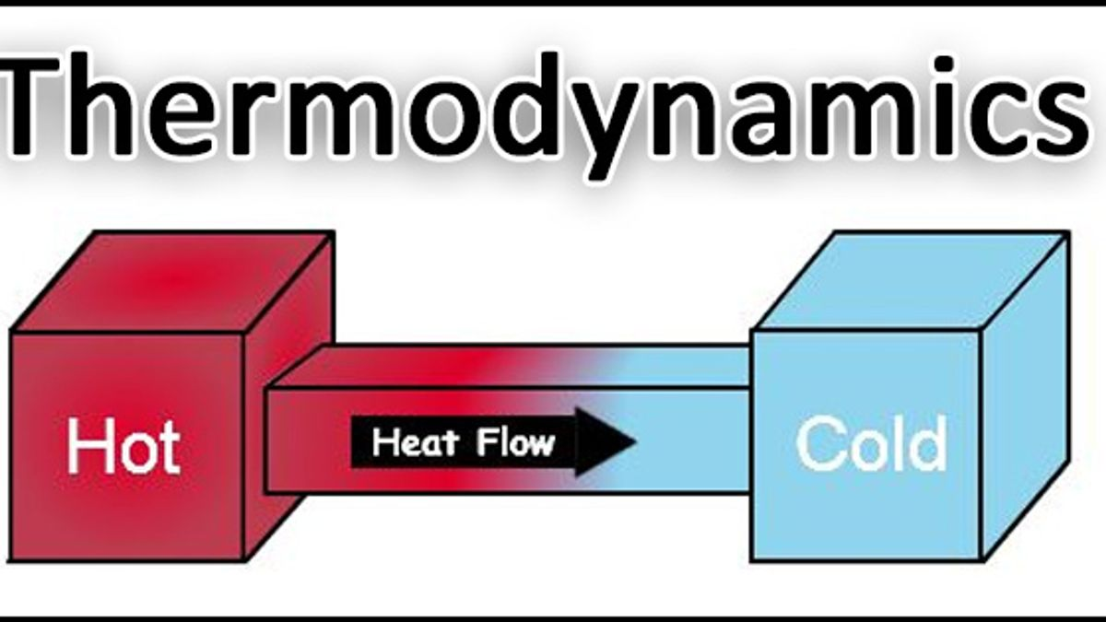
Definition
Thermodynamics deals with the concepts of heat and temperature and the inter-conversion of heat and other forms of energy
3
Notes:
SAY: Before we wrap up the course, let’s review what we have learned today.
During this course, we have
<READ the bullets from the slide.>
GO to next slide.

Slide 4
Introduction
Thermal energy is the energy that comes from heat. This heat is generated by the movement of tiny particles within an object, and the faster these particles move, the more heat is generated.
The four laws of thermodynamics govern the behaviour of these quantities and provide a quantitative description. William Thomson, in 1749, coined the term thermodynamics.
4
Notes:
SAY: Before we wrap up the course, let’s review what we have learned today.
During this course, we have
<READ the bullets from the slide.>
GO to next slide.

Slide 5
5
Notes:
SAY: Before we wrap up the course, let’s review what we have learned today.
During this course, we have
<READ the bullets from the slide.>
GO to next slide.

Slide 6
Types of Thermodynamics
Classical Thermodynamics
In classical thermodynamics, the behaviour of matter is analysed with a macroscopic approach.
Units such as temperature and pressure are taken into consideration, which helps the individuals calculate other properties and predict the characteristics of the matter undergoing the process.
●●●
6
Notes:
SAY:
The purpose of epidemiology in public health practice is to
discover the agent, host, and environmental factors that affect health;
determine the relative importance of causes of illness, disability, and death;
identify those segments of the population that have the greatest risk from specific causes of ill health; and
evaluate the effectiveness of health programs and services in improving population health.
GO to next slide.

Slide 7
Types of Thermodynamics
Statistical Thermodynamics
In statistical thermodynamics, every molecule is under the spotlight, i.e. the properties of every molecule and how they interact are taken into consideration to characterise the behaviour of a group of molecules.
●●●
7
Notes:
SAY:
The purpose of epidemiology in public health practice is to
discover the agent, host, and environmental factors that affect health;
determine the relative importance of causes of illness, disability, and death;
identify those segments of the population that have the greatest risk from specific causes of ill health; and
evaluate the effectiveness of health programs and services in improving population health.
GO to next slide.

Slide 8
Types of Thermodynamics
Chemical Thermodynamics
Chemical thermodynamics is the study of how work and heat relate to each other in chemical reactions and in changes of states.
Equilibrium Thermodynamics
Equilibrium thermodynamics is the study of transformations of energy and matter as they approach the state of equilibrium.
8
Notes:
SAY:
The purpose of epidemiology in public health practice is to
discover the agent, host, and environmental factors that affect health;
determine the relative importance of causes of illness, disability, and death;
identify those segments of the population that have the greatest risk from specific causes of ill health; and
evaluate the effectiveness of health programs and services in improving population health.
GO to next slide.

Slide 9
Laws of Thermodynamics
Thermodynamics laws define the fundamental physical quantities like energy, temperature and entropy that characterize thermodynamic systems at thermal equilibrium.
These thermodynamics laws represent how these quantities behave under various circumstances.
●●●
9
Notes:
SAY:
The purpose of epidemiology in public health practice is to
discover the agent, host, and environmental factors that affect health;
determine the relative importance of causes of illness, disability, and death;
identify those segments of the population that have the greatest risk from specific causes of ill health; and
evaluate the effectiveness of health programs and services in improving population health.
GO to next slide.

Slide 11
Laws of Thermodynamics
Zeroth Law of Thermodynamics
The Zeroth law of thermodynamics states that if two bodies are individually in equilibrium with a separate third body, then the first two bodies are also in thermal equilibrium with each other.
●●●
11
Notes:
SAY:
The purpose of epidemiology in public health practice is to
discover the agent, host, and environmental factors that affect health;
determine the relative importance of causes of illness, disability, and death;
identify those segments of the population that have the greatest risk from specific causes of ill health; and
evaluate the effectiveness of health programs and services in improving population health.
GO to next slide.

Slide 12
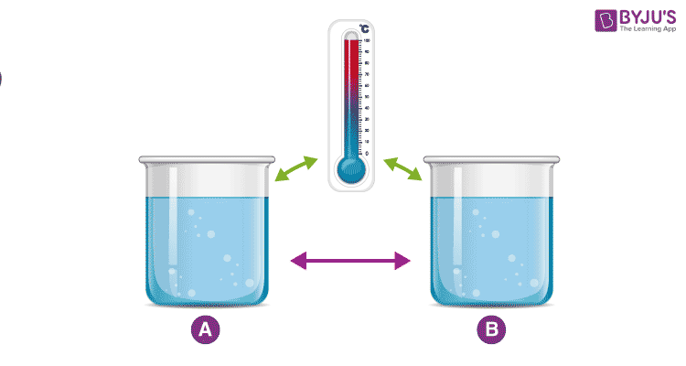

Slide 13
Laws of Thermodynamics
First Law of Thermodynamics
First law of thermodynamics, also known as the law of conservation of energy, states that energy can neither be created nor destroyed, but it can be changed from one form to another.
●●●
13
Notes:
SAY:
The purpose of epidemiology in public health practice is to
discover the agent, host, and environmental factors that affect health;
determine the relative importance of causes of illness, disability, and death;
identify those segments of the population that have the greatest risk from specific causes of ill health; and
evaluate the effectiveness of health programs and services in improving population health.
GO to next slide.

Slide 14
Laws of Thermodynamics
Second Law of Thermodynamics
Second law of thermodynamics states that the entropy in an isolated system always increases. Any isolated system spontaneously evolves towards thermal equilibrium—the state of maximum entropy of the system.
●●●
14
Notes:
SAY:
The purpose of epidemiology in public health practice is to
discover the agent, host, and environmental factors that affect health;
determine the relative importance of causes of illness, disability, and death;
identify those segments of the population that have the greatest risk from specific causes of ill health; and
evaluate the effectiveness of health programs and services in improving population health.
GO to next slide.

Slide 15
Laws of Thermodynamics
Third Law of Thermodynamics
Third law of thermodynamics states that the entropy of a system approaches a constant value as the temperature approaches absolute zero.
15
Notes:
SAY:
The purpose of epidemiology in public health practice is to
discover the agent, host, and environmental factors that affect health;
determine the relative importance of causes of illness, disability, and death;
identify those segments of the population that have the greatest risk from specific causes of ill health; and
evaluate the effectiveness of health programs and services in improving population health.
GO to next slide.

Slide 16
Examples of Thermodynamics
Whether we are sitting in an air-conditioned room or travelling in any vehicle, the application of thermodynamics is everywhere. We have listed a few of these applications below:
Different types of vehicles such as planes, trucks and ships work on the basis of the 2nd law of thermodynamics.
●●●
16
Notes:
SAY:
The purpose of epidemiology in public health practice is to
discover the agent, host, and environmental factors that affect health;
determine the relative importance of causes of illness, disability, and death;
identify those segments of the population that have the greatest risk from specific causes of ill health; and
evaluate the effectiveness of health programs and services in improving population health.
GO to next slide.

Slide 17
Examples of Thermodynamics
The three modes of heat transfer work on the basis of thermodynamics. The heat transfer concepts are widely used in radiators, heaters and coolers.
Thermodynamics is involved in the study of different types of power plants such as nuclear power plants, thermal power plants.
17
Notes:
SAY:
The purpose of epidemiology in public health practice is to
discover the agent, host, and environmental factors that affect health;
determine the relative importance of causes of illness, disability, and death;
identify those segments of the population that have the greatest risk from specific causes of ill health; and
evaluate the effectiveness of health programs and services in improving population health.
GO to next slide.

Slide 18
Conclusion
Thermodynamics is the science of heat as a special form of energy exchange. It is thus a branch of energetics, the general science of the forms and interchanges of energy
From a thermodynamic standpoint energy can be exchanged in two fundamental ways: in the form of work or in the form of heat.
18
Notes:
SAY:
The purpose of epidemiology in public health practice is to
discover the agent, host, and environmental factors that affect health;
determine the relative importance of causes of illness, disability, and death;
identify those segments of the population that have the greatest risk from specific causes of ill health; and
evaluate the effectiveness of health programs and services in improving population health.
GO to next slide.

Slide 19
Thanks To StudyMafia.org

