Slide 1
StudyMafia.Org
Kidney
Transplantation
Submitted To: Submitted By:
Studymafia.org Studymafia.org

Slide 2
Table Contents
Definition
Introduction
Causes of Kidney Transplantation
Types of Kidney Transplantation
Why Kidney Transplantation
When Kidney Transplantation
Points To Remember
Conclusion
2
Notes:
SAY: Before we wrap up the course, let’s review what we have learned today.
During this course, we have
<READ the bullets from the slide.>
GO to next slide.

Slide 3
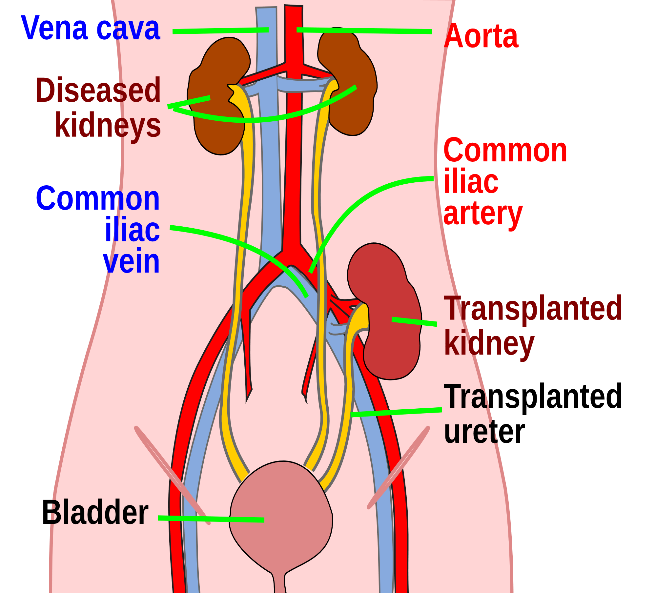
Definition
A kidney transplant is a surgery to place a healthy kidney from a living or deceased donor into a person whose kidneys no longer function properly.
3
Notes:
SAY: Before we wrap up the course, let’s review what we have learned today.
During this course, we have
<READ the bullets from the slide.>
GO to next slide.

Slide 4
Introduction
When kidneys lose this filtering ability, harmful levels of fluid and waste accumulate in the body, which can raise blood pressure and result in kidney failure (end-stage renal disease).
End-stage renal disease occurs when the kidneys have lost about 90% of their ability to function normally.
4
Notes:
SAY: Before we wrap up the course, let’s review what we have learned today.
During this course, we have
<READ the bullets from the slide.>
GO to next slide.

Slide 5
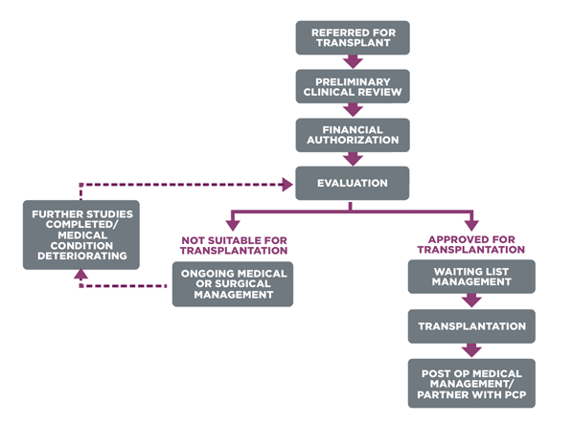
5
Notes:
SAY: Before we wrap up the course, let’s review what we have learned today.
During this course, we have
<READ the bullets from the slide.>
GO to next slide.

Slide 6
Causes of Kidney Transplantation
Diabetes
Chronic, uncontrolled high blood pressure
Chronic glomerulonephritis — an inflammation and eventual scarring of the tiny filters within the kidneys
Polycystic kidney disease
6
Notes:
SAY:
The purpose of epidemiology in public health practice is to
discover the agent, host, and environmental factors that affect health;
determine the relative importance of causes of illness, disability, and death;
identify those segments of the population that have the greatest risk from specific causes of ill health; and
evaluate the effectiveness of health programs and services in improving population health.
GO to next slide.

Slide 7
Types of Kidney Transplantation
Deceased-donor kidney transplant
A deceased-donor kidney transplant is when a kidney from someone who has recently died is removed with consent of the family or from a donor card and placed in a recipient whose kidneys have failed and no longer function properly and is in need of kidney transplantation.
●●●
7
Notes:
SAY:
The purpose of epidemiology in public health practice is to
discover the agent, host, and environmental factors that affect health;
determine the relative importance of causes of illness, disability, and death;
identify those segments of the population that have the greatest risk from specific causes of ill health; and
evaluate the effectiveness of health programs and services in improving population health.
GO to next slide.

Slide 8
Types of ContraceptivMethods
Living-donor kidney transplant
A living-donor kidney transplant is when a kidney from a living donor is removed and placed into a recipient whose kidneys no longer function properly.
●●●
8
Notes:
SAY:
The purpose of epidemiology in public health practice is to
discover the agent, host, and environmental factors that affect health;
determine the relative importance of causes of illness, disability, and death;
identify those segments of the population that have the greatest risk from specific causes of ill health; and
evaluate the effectiveness of health programs and services in improving population health.
GO to next slide.

Slide 9
Types of ContraceptivMethods
Preemptive kidney transplant
A preemptive kidney transplant is when you receive a kidney transplant before your kidney function deteriorates to the point of needing dialysis to replace the normal filtering function of the kidneys.
9
Notes:
SAY:
The purpose of epidemiology in public health practice is to
discover the agent, host, and environmental factors that affect health;
determine the relative importance of causes of illness, disability, and death;
identify those segments of the population that have the greatest risk from specific causes of ill health; and
evaluate the effectiveness of health programs and services in improving population health.
GO to next slide.

Slide 10
Why Kidney Transplantation
Lower risk of rejection of the donor kidney
Improved survival rates
Improved quality of life
Lower treatment costs
Avoidance of dialysis and its related dietary restrictions and health complications
●●●
10
Notes:
SAY:
The purpose of epidemiology in public health practice is to
discover the agent, host, and environmental factors that affect health;
determine the relative importance of causes of illness, disability, and death;
identify those segments of the population that have the greatest risk from specific causes of ill health; and
evaluate the effectiveness of health programs and services in improving population health.
GO to next slide.

Slide 11
Why Kidney Transplantation
Level of kidney function
Overall health
Any chronic medical conditions that might affect the success of transplant
Availability of donor kidney
Ability to follow medical instructions and take anti-rejection medications for the rest of your life
11
Notes:
SAY:
The purpose of epidemiology in public health practice is to
discover the agent, host, and environmental factors that affect health;
determine the relative importance of causes of illness, disability, and death;
identify those segments of the population that have the greatest risk from specific causes of ill health; and
evaluate the effectiveness of health programs and services in improving population health.
GO to next slide.

Slide 12
When Kidney Transplantation
End-stage renal failure and be on dialysis.
Late-stage chronic kidney disease, approaching the need for dialysis.
A life expectancy of at least five years.
A full understanding of postoperative instructions and care.
●●●
12
Notes:
SAY:
The purpose of epidemiology in public health practice is to
discover the agent, host, and environmental factors that affect health;
determine the relative importance of causes of illness, disability, and death;
identify those segments of the population that have the greatest risk from specific causes of ill health; and
evaluate the effectiveness of health programs and services in improving population health.
GO to next slide.

Slide 13
When Kidney Transplantation
While most kidney transplant recipients are between the ages of 45 and 65, there really is no upper age limit.
However, to ensure the best results, your healthcare provider will likely look for a donor who is close to your own age.
13
Notes:
SAY:
The purpose of epidemiology in public health practice is to
discover the agent, host, and environmental factors that affect health;
determine the relative importance of causes of illness, disability, and death;
identify those segments of the population that have the greatest risk from specific causes of ill health; and
evaluate the effectiveness of health programs and services in improving population health.
GO to next slide.

Slide 14
Points To Remember
Avoid lifting heavy objects and strenuous physical work for at least six to eight weeks following surgery.
It’s important that you don’t lift anything heavier than 20 pounds for two to three months, and nothing heavier than 40 pounds for four to six months from the date of your surgery.
●●●
14
Notes:
SAY:
The purpose of epidemiology in public health practice is to
discover the agent, host, and environmental factors that affect health;
determine the relative importance of causes of illness, disability, and death;
identify those segments of the population that have the greatest risk from specific causes of ill health; and
evaluate the effectiveness of health programs and services in improving population health.
GO to next slide.

Slide 15
Points To Remember
Avoid driving for at least six weeks following surgery.
Plan ahead so a friend or family member can help out during this time.
When you’re in a moving vehicle, always use your seat belt.
●●●
15
Notes:
SAY:
The purpose of epidemiology in public health practice is to
discover the agent, host, and environmental factors that affect health;
determine the relative importance of causes of illness, disability, and death;
identify those segments of the population that have the greatest risk from specific causes of ill health; and
evaluate the effectiveness of health programs and services in improving population health.
GO to next slide.

Slide 16
Points To Remember
Exercise. Your provider will recommend beginning with stretching exercises and walking.
Other excellent exercises include jogging, hiking, bicycling, tennis, golf, swimming and aerobics.
All of these can help you regain your strength and you can start gradually after your incision has healed.
16
Notes:
SAY:
The purpose of epidemiology in public health practice is to
discover the agent, host, and environmental factors that affect health;
determine the relative importance of causes of illness, disability, and death;
identify those segments of the population that have the greatest risk from specific causes of ill health; and
evaluate the effectiveness of health programs and services in improving population health.
GO to next slide.

Slide 17
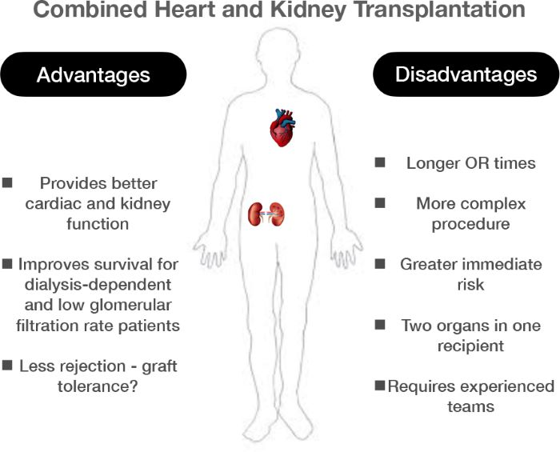

Slide 18
Conclusion
A kidney transplant is a surgery done to replace a diseased kidney with a healthy kidney from a donor.
The kidney may come from a deceased organ donor or from a living donor.
Family members or others who are a good match may be able to donate one of their kidneys.
18
Notes:
SAY:
The purpose of epidemiology in public health practice is to
discover the agent, host, and environmental factors that affect health;
determine the relative importance of causes of illness, disability, and death;
identify those segments of the population that have the greatest risk from specific causes of ill health; and
evaluate the effectiveness of health programs and services in improving population health.
GO to next slide.

Slide 19
Thanks To StudyMafia.org

