Slide 1
StudyMafia.Org
Immunoelectroesis
Submitted To: Submitted By:
Studymafia.org Studymafia.org

Slide 2
Table Contents
Definition
Introduction
Principle of Immunoelectrophoresis
Procedure of Immunoelectrophoresis
Results of Immunoelectrophoresis
Applications of Immunoelectrophoresis
Advantages of Immunoelectrophoresis
Disadvantages of Immunoelectrophoresis
Conclusion
2
Notes:
SAY: Before we wrap up the course, let’s review what we have learned today.
During this course, we have
<READ the bullets from the slide.>
GO to next slide.

Slide 3
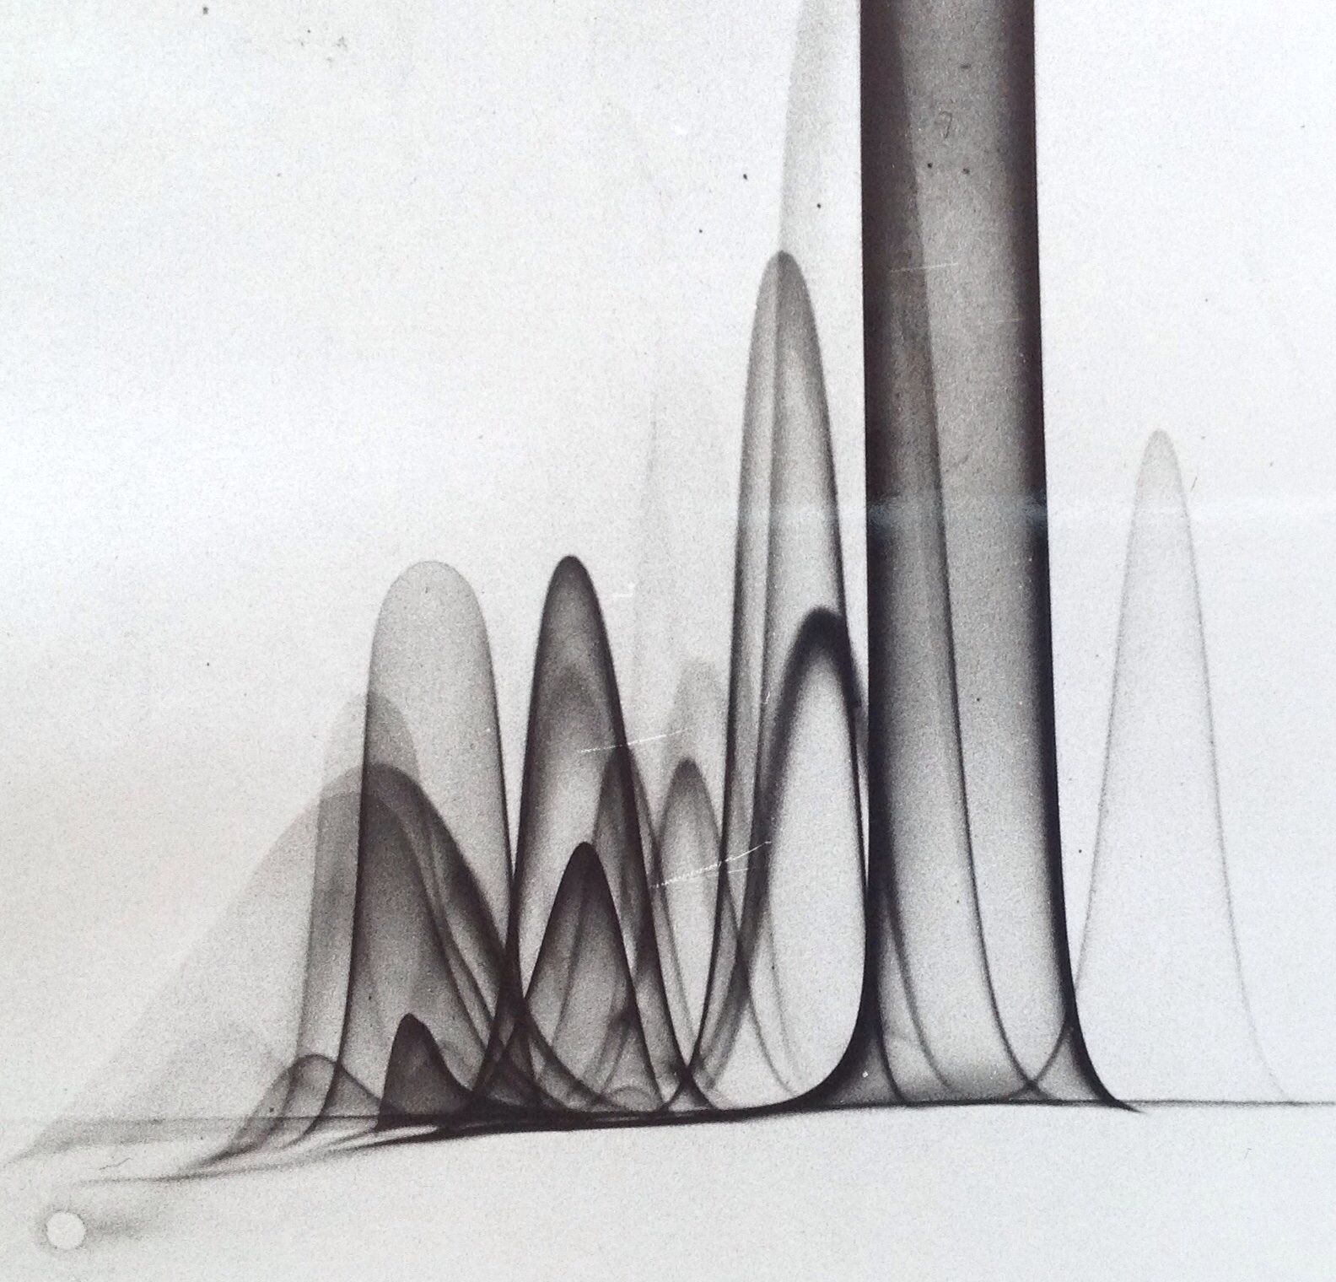
Definition
Immunoelectrophoresis refers to precipitation in agar under an electric field. It is a process of a combination of immuno-diffusion and electrophoresis.
3
Notes:
SAY: Before we wrap up the course, let’s review what we have learned today.
During this course, we have
<READ the bullets from the slide.>
GO to next slide.

Slide 4
Introduction
Antigens are placed into wells cut in a gel (without antibody) and electrophoresed. A trough is then cut in the gel into which antibodies are placed.
The antibodies diffuse laterally to meet diffusing antigens, and lattice formation and precipitation occur permitting determination of the nature of the antigens.
The term “immunoelectrophoresis” was first coined by Grabar and Williams in 1953.
4
Notes:
SAY: Before we wrap up the course, let’s review what we have learned today.
During this course, we have
<READ the bullets from the slide.>
GO to next slide.

Slide 5
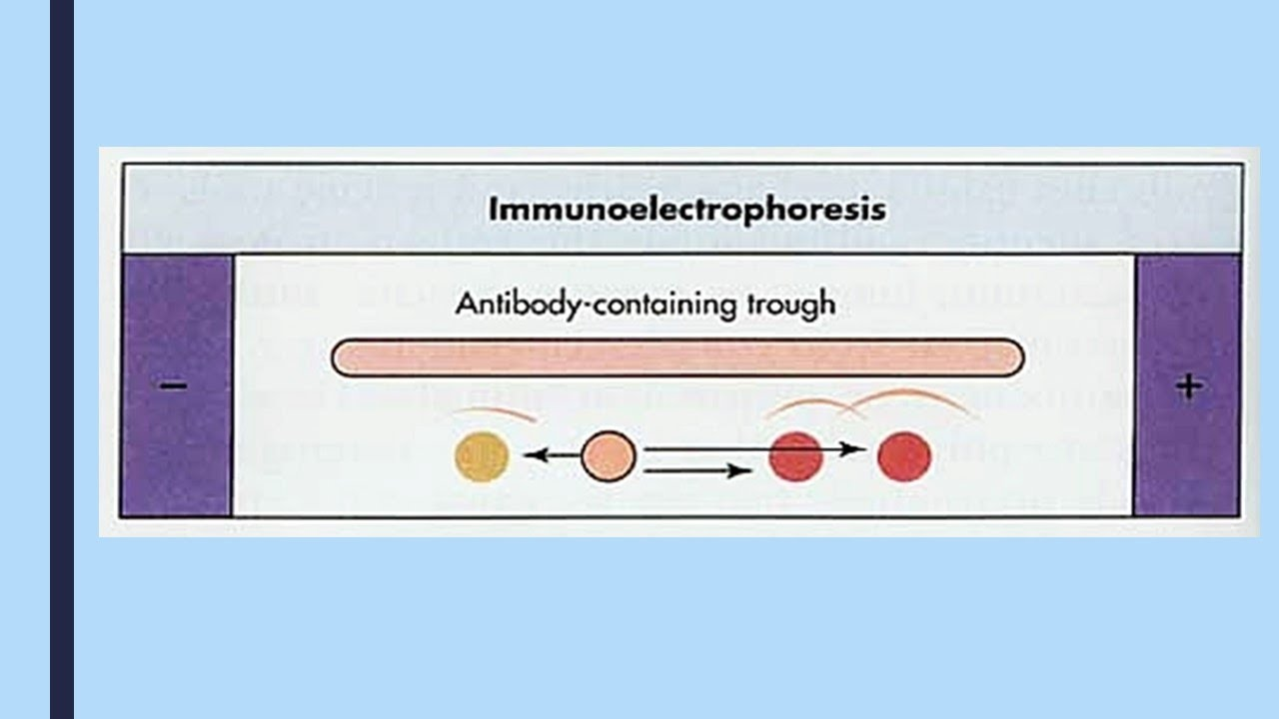
5
Notes:
SAY: Before we wrap up the course, let’s review what we have learned today.
During this course, we have
<READ the bullets from the slide.>
GO to next slide.

Slide 6
Principle of Immunoelectrophoresis
When an electric current is applied to a slide layered with gel, the antigen mixture placed in wells is separated into individual antigen components according to their charge and size.
Following electrophoresis, the separated antigens are reacted with specific antisera placed in troughs parallel to the electrophoretic migration and diffusion is allowed to occur.
●●●
6
Notes:
SAY:
The purpose of epidemiology in public health practice is to
discover the agent, host, and environmental factors that affect health;
determine the relative importance of causes of illness, disability, and death;
identify those segments of the population that have the greatest risk from specific causes of ill health; and
evaluate the effectiveness of health programs and services in improving population health.
GO to next slide.

Slide 7
Principle of Immunoelectrophoresis
Antiserum present in the trough moves toward the antigen components resulting in the formation of separate precipitin lines in 18-24 hrs, each indicating reaction between individual proteins with its antibody.
7
Notes:
SAY:
The purpose of epidemiology in public health practice is to
discover the agent, host, and environmental factors that affect health;
determine the relative importance of causes of illness, disability, and death;
identify those segments of the population that have the greatest risk from specific causes of ill health; and
evaluate the effectiveness of health programs and services in improving population health.
GO to next slide.

Slide 8
Procedure of Immunoelectrophoresis
Agarose gel is prepared on a glass slide put in a horizontal position.
Using the sample template, wells are borne on the application zone carefully.
The sample is diluted 2:3 with protein diluent solution (20μl antigen solution +10 μl diluent).
●●●
8
Notes:
SAY:
The purpose of epidemiology in public health practice is to
discover the agent, host, and environmental factors that affect health;
determine the relative importance of causes of illness, disability, and death;
identify those segments of the population that have the greatest risk from specific causes of ill health; and
evaluate the effectiveness of health programs and services in improving population health.
GO to next slide.

Slide 9
Procedure of Immunoelectrophoresis
Using a 5 μl pipette, 5 μl of control and sample is applied across each corresponding slit (Control slit and Sample slit).
The gel is placed into the electrophoresis chamber with the samples on the cathodic side, and electrophoresis runs for 20 mins/ 100 volts.
●●●
9
Notes:
SAY:
The purpose of epidemiology in public health practice is to
discover the agent, host, and environmental factors that affect health;
determine the relative importance of causes of illness, disability, and death;
identify those segments of the population that have the greatest risk from specific causes of ill health; and
evaluate the effectiveness of health programs and services in improving population health.
GO to next slide.

Slide 10
Procedure of Immunoelectrophoresis
After electrophoresis completes, 20 μl of the corresponding antiserum is added to troughs in a moist chamber and incubated for 18- 20 hours at room temperature in a horizontal position.
The agarose gel is placed on a horizontal position and dried with blotter sheets.
●●●
10
Notes:
SAY:
The purpose of epidemiology in public health practice is to
discover the agent, host, and environmental factors that affect health;
determine the relative importance of causes of illness, disability, and death;
identify those segments of the population that have the greatest risk from specific causes of ill health; and
evaluate the effectiveness of health programs and services in improving population health.
GO to next slide.

Slide 11
Procedure of Immunoelectrophoresis
The gel in saline solution is soaked for 10 minutes and the drying and washing repeated twice again.
The gel is dried at a temperature less than 70°C and may be stained with protein staining solution for about 3 minutes followed by decolorizing the gel for 5 minutes in distaining solution baths.
The gel is dried and results evaluated.
11
Notes:
SAY:
The purpose of epidemiology in public health practice is to
discover the agent, host, and environmental factors that affect health;
determine the relative importance of causes of illness, disability, and death;
identify those segments of the population that have the greatest risk from specific causes of ill health; and
evaluate the effectiveness of health programs and services in improving population health.
GO to next slide.

Slide 12
Results of Immunoelectrophoresis
The presence of elliptical precipitin arcs represents antigen-antibody interaction.
The absence of the formation of precipitate suggests no reaction.
Different antigens (proteins) can be identified based on the intensity, shape, and position of the precipitation lines.
12
Notes:
SAY:
The purpose of epidemiology in public health practice is to
discover the agent, host, and environmental factors that affect health;
determine the relative importance of causes of illness, disability, and death;
identify those segments of the population that have the greatest risk from specific causes of ill health; and
evaluate the effectiveness of health programs and services in improving population health.
GO to next slide.

Slide 13
Applications of Immunoelectrophoresis
The test helps in the identification and approximate quantization of various proteins present in the serum. Immunoelectrophoresis created a breakthrough in protein identification and in immunology.
Immunoelectrophoresis is used in patients with suspected monoclonal and polyclonal gammopathies.
●●●
13
Notes:
SAY:
The purpose of epidemiology in public health practice is to
discover the agent, host, and environmental factors that affect health;
determine the relative importance of causes of illness, disability, and death;
identify those segments of the population that have the greatest risk from specific causes of ill health; and
evaluate the effectiveness of health programs and services in improving population health.
GO to next slide.

Slide 14
Applications of Immunoelectrophoresis
The method is used to detect normal as well as abnormal proteins, such as myeloma proteins in human serum.
Used to analyze complex protein mixtures containing different antigens.
Immunoelectrophoresis is an older method for qualitative analysis of M-proteins in serum and urine.
●●●
14
Notes:
SAY:
The purpose of epidemiology in public health practice is to
discover the agent, host, and environmental factors that affect health;
determine the relative importance of causes of illness, disability, and death;
identify those segments of the population that have the greatest risk from specific causes of ill health; and
evaluate the effectiveness of health programs and services in improving population health.
GO to next slide.

Slide 15
Applications of Immunoelectrophoresis
The medical diagnostic use is of value where certain proteins are suspected of being absent (e.g., hypogammaglobulinemia) or overproduced (e.g., multiple myeloma).
This method is useful to monitor antigen and antigen-antibody purity and to identify a single antigen in a mixture of antigens.
15
Notes:
SAY:
The purpose of epidemiology in public health practice is to
discover the agent, host, and environmental factors that affect health;
determine the relative importance of causes of illness, disability, and death;
identify those segments of the population that have the greatest risk from specific causes of ill health; and
evaluate the effectiveness of health programs and services in improving population health.
GO to next slide.

Slide 16
Advantages of Immunoelectrophoresis
Immunoelectrophoresis is a powerful analytical technique with high resolving power as it combines the separation of antigens by electrophoresis with immunodiffusion against an antiserum.
The main advantage of immunoelectrophoresis is that a number of antigens can be identified in serum.
16
Notes:
SAY:
The purpose of epidemiology in public health practice is to
discover the agent, host, and environmental factors that affect health;
determine the relative importance of causes of illness, disability, and death;
identify those segments of the population that have the greatest risk from specific causes of ill health; and
evaluate the effectiveness of health programs and services in improving population health.
GO to next slide.

Slide 17
Limitations of Immunoelectrophoresis
Immunoelectrophoresis is slower, less sensitive, and more difficult to interpret than Immunofixation electrophoresis.
IEP fails to detect some small monoclonal M-proteins because the most rapidly migrating immunoglobulins present in the highest concentrations may obscure the presence of small M-proteins.
17
Notes:
SAY:
The purpose of epidemiology in public health practice is to
discover the agent, host, and environmental factors that affect health;
determine the relative importance of causes of illness, disability, and death;
identify those segments of the population that have the greatest risk from specific causes of ill health; and
evaluate the effectiveness of health programs and services in improving population health.
GO to next slide.

Slide 18
Conclusion
Immunoelectrophoresis is a potent analytical technique with great resolving power because it combines electrophoresis separation of antigens with immunodiffusion against an antiserum.
The improved resolution aids in the immunological analysis of serum proteins.
18
Notes:
SAY:
The purpose of epidemiology in public health practice is to
discover the agent, host, and environmental factors that affect health;
determine the relative importance of causes of illness, disability, and death;
identify those segments of the population that have the greatest risk from specific causes of ill health; and
evaluate the effectiveness of health programs and services in improving population health.
GO to next slide.

Slide 19
Thanks To StudyMafia.org

