Slide 1
StudyMafia.Org
Hypersenstivity Reactions
Submitted To: Submitted By:
Studymafia.org Studymafia.org

Slide 2
Table Contents
Definition
Introduction
Facts About Hypersenstivity Reactions
Types of Hypersenstivity Reactions
Conclusion
2
Notes:
SAY: Before we wrap up the course, let’s review what we have learned today.
During this course, we have
<READ the bullets from the slide.>
GO to next slide.

Slide 3
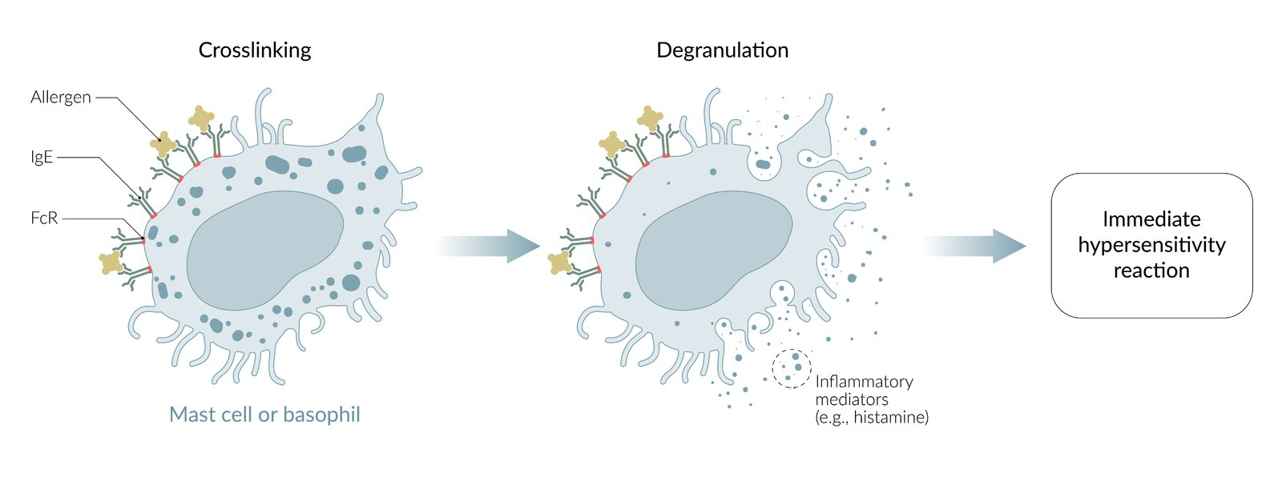
Definition
Hypersensitivity reactions are an overreaction of the immune system to an antigen which would not normally trigger an immune response.
3
Notes:
SAY: Before we wrap up the course, let’s review what we have learned today.
During this course, we have
<READ the bullets from the slide.>
GO to next slide.

Slide 4
Introduction
The antigen may be something which would in most people be ignored – peanuts, for example, or it may originate from the body. In either case, the damage and clinical symptoms result from the body’s response to the substance rather than damage caused by the substance itself.
Overreaction to self-antigens is normally due to a failure in central tolerance, and this failure can also have genetically-inheritable features.
4
Notes:
SAY: Before we wrap up the course, let’s review what we have learned today.
During this course, we have
<READ the bullets from the slide.>
GO to next slide.

Slide 5
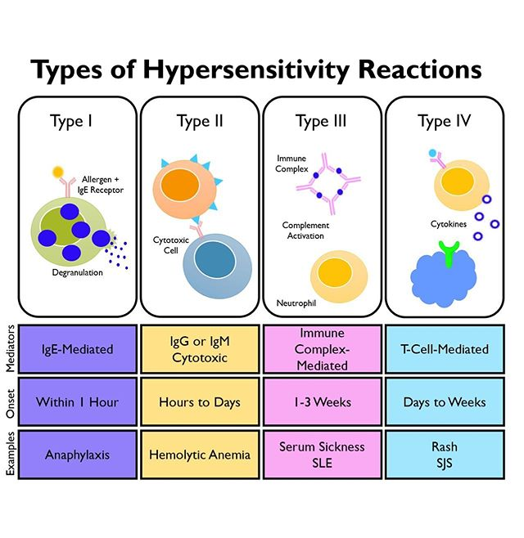
5
Notes:
SAY: Before we wrap up the course, let’s review what we have learned today.
During this course, we have
<READ the bullets from the slide.>
GO to next slide.

Slide 6
Types of Hypersenstivity Reactions
Type 1
In Type 1 hypersensitivity reactions mast-cell activation is induced by secretion of IgE antibodies. Initial exposure to the antigen causes the priming of Th2 cells, and their release of IL-4 causes the B cells to switch their production of IgM to IgE antibodies which are antigen-specific. The IgE antibodies bind to mast cells and basophils, sensitising them to the antigen.
●●●
6
Notes:
SAY:
The purpose of epidemiology in public health practice is to
discover the agent, host, and environmental factors that affect health;
determine the relative importance of causes of illness, disability, and death;
identify those segments of the population that have the greatest risk from specific causes of ill health; and
evaluate the effectiveness of health programs and services in improving population health.
GO to next slide.

Slide 7
Types of Hypersenstivity Reactions
Type 2
Type 2 hypersensitivity reactions are mediated by antibodies targeting antigens on cell surfaces. When cell surface antigens are presented to T cells, an immune response is started, targeting the cells to which the antigens are attached.
●●●
7
Notes:
SAY:
The purpose of epidemiology in public health practice is to
discover the agent, host, and environmental factors that affect health;
determine the relative importance of causes of illness, disability, and death;
identify those segments of the population that have the greatest risk from specific causes of ill health; and
evaluate the effectiveness of health programs and services in improving population health.
GO to next slide.

Slide 8
Types of Hypersenstivity Reactions
Type 3
Type 3 hypersensitivity reactions are mediated by antigen-antibody complexes in the circulation that may be deposited in and damage tissues.
The complexes may become lodged in the basement membranes of tissues which have particularly high rates of blood filtration. For example, the kidney and synovial joints being common targets.
●●●
8
Notes:
SAY:
The purpose of epidemiology in public health practice is to
discover the agent, host, and environmental factors that affect health;
determine the relative importance of causes of illness, disability, and death;
identify those segments of the population that have the greatest risk from specific causes of ill health; and
evaluate the effectiveness of health programs and services in improving population health.
GO to next slide.

Slide 9
Types of Hypersenstivity Reactions
Type 4
Type 4 hypersensitivity reactions are mediated by antigen-specific activated T-cells. When the antigen enters the body, it is processed by antigen-presenting cells and presented together with the MHC II to a Th1 cell.
9
Notes:
SAY:
The purpose of epidemiology in public health practice is to
discover the agent, host, and environmental factors that affect health;
determine the relative importance of causes of illness, disability, and death;
identify those segments of the population that have the greatest risk from specific causes of ill health; and
evaluate the effectiveness of health programs and services in improving population health.
GO to next slide.

Slide 10
Facts About Hypersenstivity Reactions
Hypersensitivity reactions are very common. Fifteen percent of the world population will be affected by a type of allergic reaction during their lives. In the second half of this century, allergic diseases have increased.
The cause of the increase is unknown, but it may reflect lifestyle changes, decreased breastfeeding, and air pollution.
●●●
10
Notes:
SAY:
The purpose of epidemiology in public health practice is to
discover the agent, host, and environmental factors that affect health;
determine the relative importance of causes of illness, disability, and death;
identify those segments of the population that have the greatest risk from specific causes of ill health; and
evaluate the effectiveness of health programs and services in improving population health.
GO to next slide.

Slide 11
Facts About Hypersenstivity Reactions
The hygiene hypothesis proposes that since IgE is no longer needed to protect against parasites in the Western world, the IgE-mast cell axis has evolved into a type I hypersensitivity reaction.
European data estimate that 0.3% of the population will be troubled by anaphylaxis at some point in their lives
●●●
11
Notes:
SAY:
The purpose of epidemiology in public health practice is to
discover the agent, host, and environmental factors that affect health;
determine the relative importance of causes of illness, disability, and death;
identify those segments of the population that have the greatest risk from specific causes of ill health; and
evaluate the effectiveness of health programs and services in improving population health.
GO to next slide.

Slide 12
Facts About Hypersenstivity Reactions
In addition, 1 out of 3000 inpatients in the United States experiences a severe allergic reaction every year.
However, the prevalence of bronchial asthma was 1.5% in Korea. Fernández-Soto in 2018 reported that fungal infections could be as high as 50% in inner cities and constitute a risk factor predisposing to the development of allergic bronchial asthma.
12
Notes:
SAY:
The purpose of epidemiology in public health practice is to
discover the agent, host, and environmental factors that affect health;
determine the relative importance of causes of illness, disability, and death;
identify those segments of the population that have the greatest risk from specific causes of ill health; and
evaluate the effectiveness of health programs and services in improving population health.
GO to next slide.

Slide 13
Conclusion
Hypersensitivity reactions are exaggerated or inappropriate immunologic responses occurring in response to an antigen or allergen.
Type I, II and III hypersensitivity reactions are known as immediate hypersensitivity reactions because they occur within 24 hours of exposure to the antigen or allergen.
13
Notes:
SAY:
The purpose of epidemiology in public health practice is to
discover the agent, host, and environmental factors that affect health;
determine the relative importance of causes of illness, disability, and death;
identify those segments of the population that have the greatest risk from specific causes of ill health; and
evaluate the effectiveness of health programs and services in improving population health.
GO to next slide.

Slide 14
Thanks To StudyMafia.org

