Slide 1
StudyMafia.Org
Ecosystem
Submitted To: Submitted By:
Studymafia.org Studymafia.org

Slide 2
Table Contents
Definition
Introduction
Structure of Ecosystem
Functions of Ecosystem
Types of Ecosystem
Conclusion
2
Notes:
SAY: Before we wrap up the course, let’s review what we have learned today.
During this course, we have
<READ the bullets from the slide.>
GO to next slide.

Slide 3
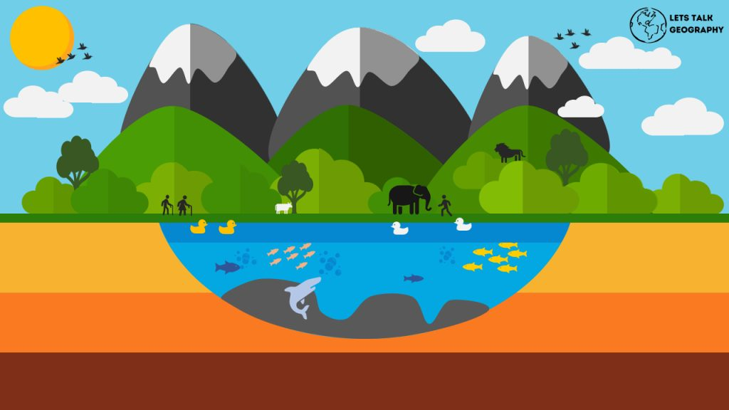
Definition
An ecosystem is a structural and functional unit of ecology where the living organisms interact with each other and the surrounding environment
3
Notes:
SAY: Before we wrap up the course, let’s review what we have learned today.
During this course, we have
<READ the bullets from the slide.>
GO to next slide.

Slide 4
Introduction
In other words, an ecosystem is a chain of interactions between organisms and their environment. The term “Ecosystem” was first coined by A.G.Tansley, an English botanist, in 1935.
The structure of an ecosystem is characterised by the organisation of both biotic and abiotic components. This includes the distribution of energy in our environment. It also includes the climatic conditions prevailing in that particular environment.
4
Notes:
SAY: Before we wrap up the course, let’s review what we have learned today.
During this course, we have
<READ the bullets from the slide.>
GO to next slide.

Slide 5
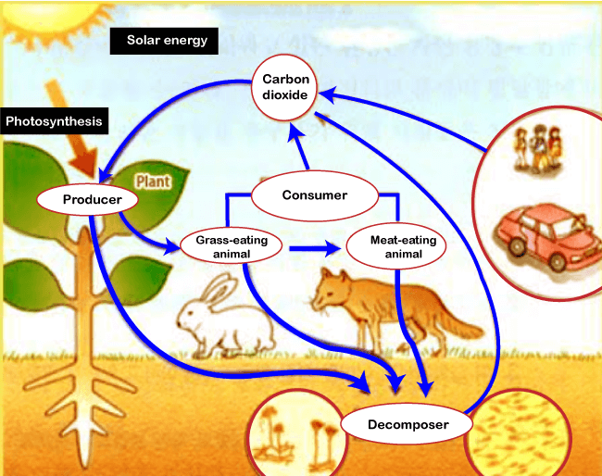
5
Notes:
SAY: Before we wrap up the course, let’s review what we have learned today.
During this course, we have
<READ the bullets from the slide.>
GO to next slide.

Slide 6
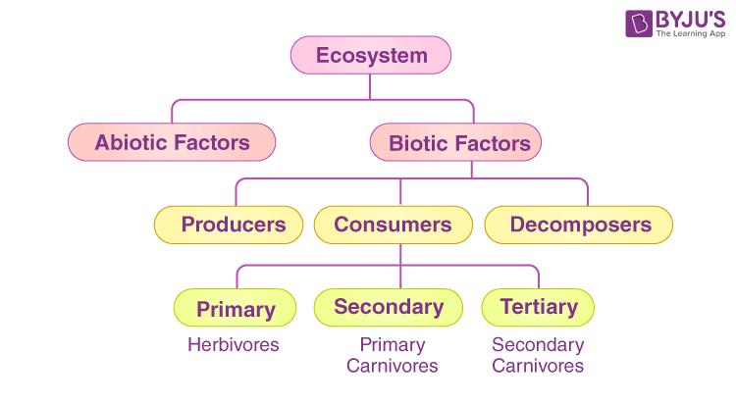
Structure of Ecosystem
The structure of an ecosystem can be split into two main components
●●●
6
Notes:
SAY:
The purpose of epidemiology in public health practice is to
discover the agent, host, and environmental factors that affect health;
determine the relative importance of causes of illness, disability, and death;
identify those segments of the population that have the greatest risk from specific causes of ill health; and
evaluate the effectiveness of health programs and services in improving population health.
GO to next slide.

Slide 7
Structure of Ecosystem
Biotic components refer to all living components in an ecosystem. Based on nutrition, biotic components can be categorised into autotrophs, heterotrophs and saprotrophs (or decomposers).
Producers include all autotrophs such as plants. They are called autotrophs as they can produce food through the process of photosynthesis
●●●
7
Notes:
SAY:
The purpose of epidemiology in public health practice is to
discover the agent, host, and environmental factors that affect health;
determine the relative importance of causes of illness, disability, and death;
identify those segments of the population that have the greatest risk from specific causes of ill health; and
evaluate the effectiveness of health programs and services in improving population health.
GO to next slide.

Slide 8
Structure of Ecosystem
Consumers or heterotrophs are organisms that depend on other organisms for food.
Primary consumers are always herbivores as they rely on producers for food.
Secondary consumers depend on primary consumers for energy.
Tertiary consumers are organisms that depend on secondary consumers for food.
Quaternary consumers are present in some food chains.
●●●
8
Notes:
SAY:
The purpose of epidemiology in public health practice is to
discover the agent, host, and environmental factors that affect health;
determine the relative importance of causes of illness, disability, and death;
identify those segments of the population that have the greatest risk from specific causes of ill health; and
evaluate the effectiveness of health programs and services in improving population health.
GO to next slide.

Slide 9
Structure of Ecosystem
Decomposers
It include saprophytes such as fungi and bacteria. They directly thrive on the dead and decaying organic matter.
Decomposers are essential for the ecosystem as they help in recycling nutrients to be reused by plants.
●●●
9
Notes:
SAY:
The purpose of epidemiology in public health practice is to
discover the agent, host, and environmental factors that affect health;
determine the relative importance of causes of illness, disability, and death;
identify those segments of the population that have the greatest risk from specific causes of ill health; and
evaluate the effectiveness of health programs and services in improving population health.
GO to next slide.

Slide 10
Structure of Ecosystem
Abiotic Components
Abiotic components are the non-living component of an ecosystem.
It includes air, water, soil, minerals, sunlight, temperature, nutrients, wind, altitude, turbidity, etc.
10
Notes:
SAY:
The purpose of epidemiology in public health practice is to
discover the agent, host, and environmental factors that affect health;
determine the relative importance of causes of illness, disability, and death;
identify those segments of the population that have the greatest risk from specific causes of ill health; and
evaluate the effectiveness of health programs and services in improving population health.
GO to next slide.

Slide 11
Functions of Ecosystem
It regulates the essential ecological processes, supports life systems and renders stability.
It is also responsible for the cycling of nutrients between biotic and abiotic components.
It maintains a balance among the various trophic levels in the ecosystem.
It cycles the minerals through the biosphere.
The abiotic components help in the synthesis of organic components that involve the exchange of energy.
11
Notes:
SAY:
The purpose of epidemiology in public health practice is to
discover the agent, host, and environmental factors that affect health;
determine the relative importance of causes of illness, disability, and death;
identify those segments of the population that have the greatest risk from specific causes of ill health; and
evaluate the effectiveness of health programs and services in improving population health.
GO to next slide.

Slide 12
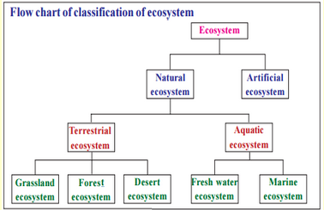
Types of Ecosystem
●●●
12
Notes:
SAY:
The purpose of epidemiology in public health practice is to
discover the agent, host, and environmental factors that affect health;
determine the relative importance of causes of illness, disability, and death;
identify those segments of the population that have the greatest risk from specific causes of ill health; and
evaluate the effectiveness of health programs and services in improving population health.
GO to next slide.

Slide 13
Types of Ecosystem
Terrestrial ecosystems are exclusively land-based ecosystems. There are different types of terrestrial ecosystems distributed around various geological zones.
Forest Ecosystem
Grassland Ecosystem
Tundra Ecosystem
Desert Ecosystem
●●●
13
Notes:
SAY:
The purpose of epidemiology in public health practice is to
discover the agent, host, and environmental factors that affect health;
determine the relative importance of causes of illness, disability, and death;
identify those segments of the population that have the greatest risk from specific causes of ill health; and
evaluate the effectiveness of health programs and services in improving population health.
GO to next slide.

Slide 14
Types of Ecosystem
Forest Ecosystem
A forest ecosystem consists of several plants, particularly trees, animals and microorganisms that live in coordination with the abiotic factors of the environment.
Forests help in maintaining the temperature of the earth and are the major carbon sink.
●●●
14
Notes:
SAY:
The purpose of epidemiology in public health practice is to
discover the agent, host, and environmental factors that affect health;
determine the relative importance of causes of illness, disability, and death;
identify those segments of the population that have the greatest risk from specific causes of ill health; and
evaluate the effectiveness of health programs and services in improving population health.
GO to next slide.

Slide 15
Types of Ecosystem
Grassland Ecosystem
In a grassland ecosystem, the vegetation is dominated by grasses and herbs.
Temperate grasslands and tropical or savanna grasslands are examples of grassland ecosystems.
●●●
15
Notes:
SAY:
The purpose of epidemiology in public health practice is to
discover the agent, host, and environmental factors that affect health;
determine the relative importance of causes of illness, disability, and death;
identify those segments of the population that have the greatest risk from specific causes of ill health; and
evaluate the effectiveness of health programs and services in improving population health.
GO to next slide.

Slide 16
Types of Ecosystem
Tundra Ecosystem
Tundra ecosystems are devoid of trees and are found in cold climates or where rainfall is scarce.
These are covered with snow for most of the year. Tundra type of ecosystem is found in the Arctic or mountain tops.
●●●
16
Notes:
SAY:
The purpose of epidemiology in public health practice is to
discover the agent, host, and environmental factors that affect health;
determine the relative importance of causes of illness, disability, and death;
identify those segments of the population that have the greatest risk from specific causes of ill health; and
evaluate the effectiveness of health programs and services in improving population health.
GO to next slide.

Slide 17
Types of Ecosystem
Desert Ecosystem
Deserts are found throughout the world.
These are regions with little rainfall and scarce vegetation.
The days are hot, and the nights are cold.
●●●
17
Notes:
SAY:
The purpose of epidemiology in public health practice is to
discover the agent, host, and environmental factors that affect health;
determine the relative importance of causes of illness, disability, and death;
identify those segments of the population that have the greatest risk from specific causes of ill health; and
evaluate the effectiveness of health programs and services in improving population health.
GO to next slide.

Slide 18
Types of Ecosystem
Aquatic Ecosystem
Aquatic ecosystems are ecosystems present in a body of water. These can be further divided into two types, namely:
Freshwater Ecosystem
Marine Ecosystem
●●●
18
Notes:
SAY:
The purpose of epidemiology in public health practice is to
discover the agent, host, and environmental factors that affect health;
determine the relative importance of causes of illness, disability, and death;
identify those segments of the population that have the greatest risk from specific causes of ill health; and
evaluate the effectiveness of health programs and services in improving population health.
GO to next slide.

Slide 19
Types of Ecosystem
Freshwater Ecosystem
The freshwater ecosystem is an aquatic ecosystem that includes lakes, ponds, rivers, streams and wetlands.
These have no salt content in contrast with the marine ecosystem.
●●●
19
Notes:
SAY:
The purpose of epidemiology in public health practice is to
discover the agent, host, and environmental factors that affect health;
determine the relative importance of causes of illness, disability, and death;
identify those segments of the population that have the greatest risk from specific causes of ill health; and
evaluate the effectiveness of health programs and services in improving population health.
GO to next slide.

Slide 20
Types of Ecosystem
Marine Ecosystem
The marine ecosystem includes seas and oceans.
These have a more substantial salt content and greater biodiversity in comparison to the freshwater ecosystem.
20
Notes:
SAY:
The purpose of epidemiology in public health practice is to
discover the agent, host, and environmental factors that affect health;
determine the relative importance of causes of illness, disability, and death;
identify those segments of the population that have the greatest risk from specific causes of ill health; and
evaluate the effectiveness of health programs and services in improving population health.
GO to next slide.

Slide 21
Conclusion
An ecosystem is a geographic area where plants, animals, and other organisms, as well as weather and landscape, work together to form a bubble of life.
Ecosystems contain biotic or living, parts, as well as abiotic factors, or nonliving parts. Biotic factors include plants, animals, and other organisms.
21
Notes:
SAY:
The purpose of epidemiology in public health practice is to
discover the agent, host, and environmental factors that affect health;
determine the relative importance of causes of illness, disability, and death;
identify those segments of the population that have the greatest risk from specific causes of ill health; and
evaluate the effectiveness of health programs and services in improving population health.
GO to next slide.

Slide 22
Thanks To StudyMafia.org

