Slide 1
StudyMafia.Org
E-Banking
Submitted To: Submitted By:
Studymafia.org Studymafia.org

Slide 2
Table Contents
Definition
Introduction
Types of E-Banking
Types of Banking Sites
Services Under E-Banking
Significance of E-Banking
Importance of E-Banking
Conclusion
2
Notes:
SAY: Before we wrap up the course, let’s review what we have learned today.
During this course, we have
<READ the bullets from the slide.>
GO to next slide.

Slide 3
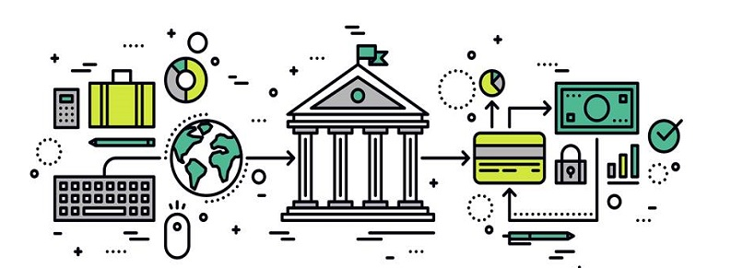
Definition
Banks give administrations or bank services to draw in clients, from giving advances, issuing of debit cards and credit cards, computerised monetary services, and surprisingly personal services or administrations.
3
Notes:
SAY: Before we wrap up the course, let’s review what we have learned today.
During this course, we have
<READ the bullets from the slide.>
GO to next slide.

Slide 4
Introduction
Electronic banking has many names like web-based banking, e-banking, virtual banking, or web banking, and online banking.
It is just the utilisation of telecommunications networks and electronic networks for conveying different financial services and products.
Through e-banking, a client can acquire his record and manage numerous exchanges utilising his cell phone or personal computer.
4
Notes:
SAY: Before we wrap up the course, let’s review what we have learned today.
During this course, we have
<READ the bullets from the slide.>
GO to next slide.

Slide 5
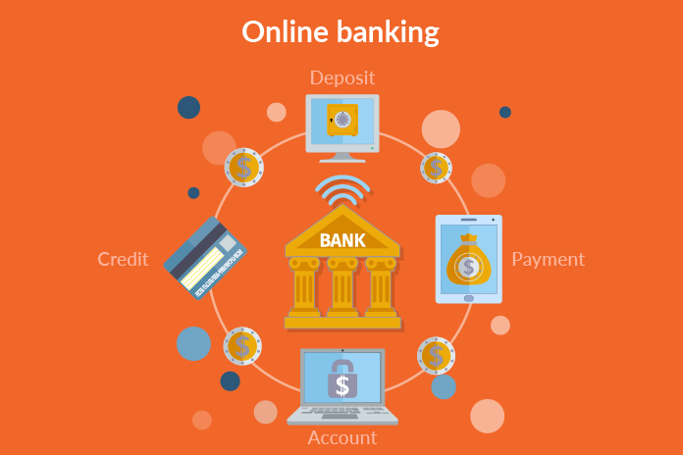
5
Notes:
SAY: Before we wrap up the course, let’s review what we have learned today.
During this course, we have
<READ the bullets from the slide.>
GO to next slide.

Slide 6
Types of E-Banking
Type 1:
This is the essential degree of administrations or services that banks offer through their sites.
Through this assistance, the bank offers data, information regarding its services and products to clients.
Further, a few banks might respond to an inquiry through email as well.
●●●
6
Notes:
SAY:
The purpose of epidemiology in public health practice is to
discover the agent, host, and environmental factors that affect health;
determine the relative importance of causes of illness, disability, and death;
identify those segments of the population that have the greatest risk from specific causes of ill health; and
evaluate the effectiveness of health programs and services in improving population health.
GO to next slide.

Slide 7
Types of E-Banking
Type 2:
In this category, banks permit their clients to submit directions or applications for various administrations, check their record balance, and so on.
Be that as it may, banks don’t allow their clients to do any fund-based exchanges with respect to their records or accounts.
●●●
7
Notes:
SAY:
The purpose of epidemiology in public health practice is to
discover the agent, host, and environmental factors that affect health;
determine the relative importance of causes of illness, disability, and death;
identify those segments of the population that have the greatest risk from specific causes of ill health; and
evaluate the effectiveness of health programs and services in improving population health.
GO to next slide.

Slide 8
Types of E-Banking
Type 3:
In the third category, banks permit their clients to work or operate their records or accounts for bill payments, purchase and redeem securities and fund transfers, and so on.
Further, many new banks convey banking administrations principally through the other electronic conveyance channels or web.
8
Notes:
SAY:
The purpose of epidemiology in public health practice is to
discover the agent, host, and environmental factors that affect health;
determine the relative importance of causes of illness, disability, and death;
identify those segments of the population that have the greatest risk from specific causes of ill health; and
evaluate the effectiveness of health programs and services in improving population health.
GO to next slide.

Slide 9
Types of Banking Sites
Transactional Websites:
These sites permit clients to go through with exchanges on the bank’s site. Further, these exchanges can go from a plain retail account balance request to huge business-to-business liquid assets transfers.
The accompanying table records some normal wholesale and retail e-banking administrations presented by financial institutions and by banks.
●●●
9
Notes:
SAY:
The purpose of epidemiology in public health practice is to
discover the agent, host, and environmental factors that affect health;
determine the relative importance of causes of illness, disability, and death;
identify those segments of the population that have the greatest risk from specific causes of ill health; and
evaluate the effectiveness of health programs and services in improving population health.
GO to next slide.

Slide 10
Types of Banking Sites
Wholesale services by banks:
Include Account management, Cash management, Small business loan applications, Approvals or advances, Commercial wire transfer, Business-to-business payments, Employee benefit, and Pension administration.
●●●
10
Notes:
SAY:
The purpose of epidemiology in public health practice is to
discover the agent, host, and environmental factors that affect health;
determine the relative importance of causes of illness, disability, and death;
identify those segments of the population that have the greatest risk from specific causes of ill health; and
evaluate the effectiveness of health programs and services in improving population health.
GO to next slide.

Slide 11
Types of Banking Sites
Retail services by banks:
Include Account management, Bill payment, New account opening, Consumer wire transfers, Investment and brokerage services, Loan application and approval, and Account Aggregation.
11
Notes:
SAY:
The purpose of epidemiology in public health practice is to
discover the agent, host, and environmental factors that affect health;
determine the relative importance of causes of illness, disability, and death;
identify those segments of the population that have the greatest risk from specific causes of ill health; and
evaluate the effectiveness of health programs and services in improving population health.
GO to next slide.

Slide 12
Services Under E-Banking
Mobile Banking:
Mobile banking (otherwise called M-banking) is a name utilised for performing account exchanges or transactions, bill payments, credit applications, balance checks, and other financial exchanges through a mobile phone like a Personal Digital Assistant (PDA) or cell phone.
●●●
12
Notes:
SAY:
The purpose of epidemiology in public health practice is to
discover the agent, host, and environmental factors that affect health;
determine the relative importance of causes of illness, disability, and death;
identify those segments of the population that have the greatest risk from specific causes of ill health; and
evaluate the effectiveness of health programs and services in improving population health.
GO to next slide.

Slide 13
Services Under E-Banking
Electronic Clearing System (ECS):
The Electronic Clearing System is a creative provision for occupied individuals. With this provision, an individual’s credit card bill is consequently charged from the same individual’s savings bank account, so one doesn’t have to stress over missed or late payments.
●●●
13
Notes:
SAY:
The purpose of epidemiology in public health practice is to
discover the agent, host, and environmental factors that affect health;
determine the relative importance of causes of illness, disability, and death;
identify those segments of the population that have the greatest risk from specific causes of ill health; and
evaluate the effectiveness of health programs and services in improving population health.
GO to next slide.

Slide 14
Services Under E-Banking
Smart Cards:
A smart card is a card that stores data on a microchip or memory chip or a microprocessor in lieu of the magnetic stripe found on debit cards and credit cards. Smart cards are not utilised for transferring or moving monetary data alone, but also they can be utilised for an assortment of identification grounds.
●●●
14
Notes:
SAY:
The purpose of epidemiology in public health practice is to
discover the agent, host, and environmental factors that affect health;
determine the relative importance of causes of illness, disability, and death;
identify those segments of the population that have the greatest risk from specific causes of ill health; and
evaluate the effectiveness of health programs and services in improving population health.
GO to next slide.

Slide 15
Services Under E-Banking
Electronic Fund Transfers (ETFs):
Electronic fund transfer (EFT) is the electronic exchange of cash starting with an individual account in the bank to another individual account of the same bank, or within or with other financial institutions or with multiple institutions, by means of personal computers based frameworks, without the immediate intercession of bank staff.
●●●
15
Notes:
SAY:
The purpose of epidemiology in public health practice is to
discover the agent, host, and environmental factors that affect health;
determine the relative importance of causes of illness, disability, and death;
identify those segments of the population that have the greatest risk from specific causes of ill health; and
evaluate the effectiveness of health programs and services in improving population health.
GO to next slide.

Slide 16
Services Under E-Banking
Telephone Banking:
Telephone banking is an assistance given by a bank or other monetary foundation or other financial institutions, that empower clients to perform via telephone a scope of monetary exchanges which don’t include cash or financial instruments, without the need to visit an ATM or a bank branch.
●●●
16
Notes:
SAY:
The purpose of epidemiology in public health practice is to
discover the agent, host, and environmental factors that affect health;
determine the relative importance of causes of illness, disability, and death;
identify those segments of the population that have the greatest risk from specific causes of ill health; and
evaluate the effectiveness of health programs and services in improving population health.
GO to next slide.

Slide 17
Services Under E-Banking
Internet banking:
Web-based banking is an assistance presented by banks that permits account holders to get their record information by means of the web or the internet. Web-based banking or Internet banking is otherwise called “Web banking” or “Online banking.”
●●●
17
Notes:
SAY:
The purpose of epidemiology in public health practice is to
discover the agent, host, and environmental factors that affect health;
determine the relative importance of causes of illness, disability, and death;
identify those segments of the population that have the greatest risk from specific causes of ill health; and
evaluate the effectiveness of health programs and services in improving population health.
GO to next slide.

Slide 18
Services Under E-Banking
Home banking:
Home banking is the most common way of concluding the monetary exchange from one’s own home as opposed to using a bank’s branch. It incorporates making account requests, moving cash, covering bills, applying for credits, and directing deposits.
18
Notes:
SAY:
The purpose of epidemiology in public health practice is to
discover the agent, host, and environmental factors that affect health;
determine the relative importance of causes of illness, disability, and death;
identify those segments of the population that have the greatest risk from specific causes of ill health; and
evaluate the effectiveness of health programs and services in improving population health.
GO to next slide.

Slide 19
Significance of E-Banking
Importance to clients:
Lower cost per exchange: Since the client doesn’t need to visit the branch for each exchange, it saves him both time and cash.
No topographical hindrances: In conventional financial frameworks, geological distances could hamper specific financial exchanges.
Convenience: A client can get to his record or bank account and execute from any place at any time.
●●●
19
Notes:
SAY:
The purpose of epidemiology in public health practice is to
discover the agent, host, and environmental factors that affect health;
determine the relative importance of causes of illness, disability, and death;
identify those segments of the population that have the greatest risk from specific causes of ill health; and
evaluate the effectiveness of health programs and services in improving population health.
GO to next slide.

Slide 20
Significance of E-Banking
Importance to Businesses:
Better efficiency:
Electronic banking further develops usefulness. It permits the computerisation of ordinary, regularly scheduled payments and provides further banking activities to upgrade the efficiency of the business.
●●●
20
Notes:
SAY:
The purpose of epidemiology in public health practice is to
discover the agent, host, and environmental factors that affect health;
determine the relative importance of causes of illness, disability, and death;
identify those segments of the population that have the greatest risk from specific causes of ill health; and
evaluate the effectiveness of health programs and services in improving population health.
GO to next slide.

Slide 21
Significance of E-Banking
Lower costs:
Usually, costs in financial relationships and connections depend on the assets used. Assuming that a specific business needs more help with deposits, wire transfers, and so on, then, at that point, the bank charges its higher expenses.
●●●
21
Notes:
SAY:
The purpose of epidemiology in public health practice is to
discover the agent, host, and environmental factors that affect health;
determine the relative importance of causes of illness, disability, and death;
identify those segments of the population that have the greatest risk from specific causes of ill health; and
evaluate the effectiveness of health programs and services in improving population health.
GO to next slide.

Slide 22
Significance of E-Banking
Lesser errors:
Electronic financial diminishes mistakes in normal financial exchanges. Awful penmanship, mixed-up data or information, and so on can cause mistakes that can be exorbitant.
Diminished misrepresentation:
Electronic banking gives an advanced impression to all representatives who reserve the privilege to alter banking exercises
●●●
22
Notes:
SAY:
The purpose of epidemiology in public health practice is to
discover the agent, host, and environmental factors that affect health;
determine the relative importance of causes of illness, disability, and death;
identify those segments of the population that have the greatest risk from specific causes of ill health; and
evaluate the effectiveness of health programs and services in improving population health.
GO to next slide.

Slide 23
Significance of E-Banking
Account reviews:
Business proprietors and assigned staff individuals can get to the records rapidly utilising a web-based financial interface. This permits them to audit the record action and, furthermore, guarantee the smooth working of the account.
23
Notes:
SAY:
The purpose of epidemiology in public health practice is to
discover the agent, host, and environmental factors that affect health;
determine the relative importance of causes of illness, disability, and death;
identify those segments of the population that have the greatest risk from specific causes of ill health; and
evaluate the effectiveness of health programs and services in improving population health.
GO to next slide.

Slide 24
Importance of E-Banking
Lesser exchange costs: Electronic exchanges are the least expensive methods of exchange.
A decreased edge for human blunder: Since the data is handed-off electronically, there is no space for human mistakes or errors.
Lesser desk work: Advanced records decrease desk work, paperwork, and make the cycle simpler to deal with. Likewise, it is ecological.
●●●
24
Notes:
SAY:
The purpose of epidemiology in public health practice is to
discover the agent, host, and environmental factors that affect health;
determine the relative importance of causes of illness, disability, and death;
identify those segments of the population that have the greatest risk from specific causes of ill health; and
evaluate the effectiveness of health programs and services in improving population health.
GO to next slide.

Slide 25
Importance of E-Banking
Decreased fixed expenses: A lesser requirement for branches which converts into a lower fixed expense.
More steadfast clients: Since e-banking administrations or services are convenient to the clients, banks experience higher reliability from their clients.
25
Notes:
SAY:
The purpose of epidemiology in public health practice is to
discover the agent, host, and environmental factors that affect health;
determine the relative importance of causes of illness, disability, and death;
identify those segments of the population that have the greatest risk from specific causes of ill health; and
evaluate the effectiveness of health programs and services in improving population health.
GO to next slide.

Slide 26
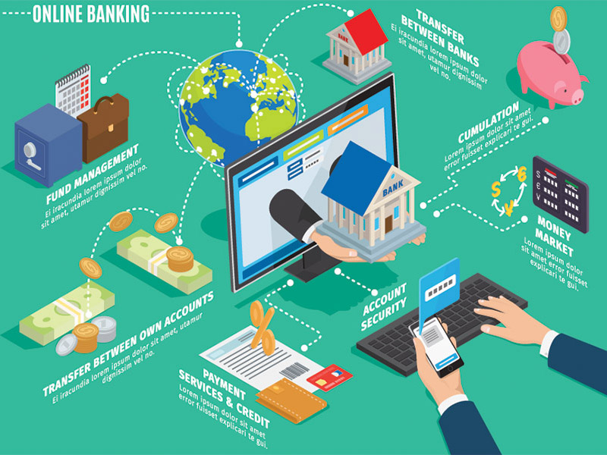

Slide 27
Conclusion
E-banking offers a higher level of convenience for managing one's finances.
However, it continues to present challenges to financial security and personal privacy.
27
Notes:
SAY:
The purpose of epidemiology in public health practice is to
discover the agent, host, and environmental factors that affect health;
determine the relative importance of causes of illness, disability, and death;
identify those segments of the population that have the greatest risk from specific causes of ill health; and
evaluate the effectiveness of health programs and services in improving population health.
GO to next slide.

Slide 28
Thanks To StudyMafia.org

