Slide 1
StudyMafia.Org
Dysphagia
Submitted To: Submitted By:
Studymafia.org Studymafia.org

Slide 2
Table Contents
Definition
Introduction
Types of Dysphagia
Symptoms of Dysphagia
Causes of Dysphagia
Risk Factors of Dysphagia
Complications of Dysphagia
Prevention of Dysphagia
Conclusion
2
Notes:
SAY: Before we wrap up the course, let’s review what we have learned today.
During this course, we have
<READ the bullets from the slide.>
GO to next slide.

Slide 3
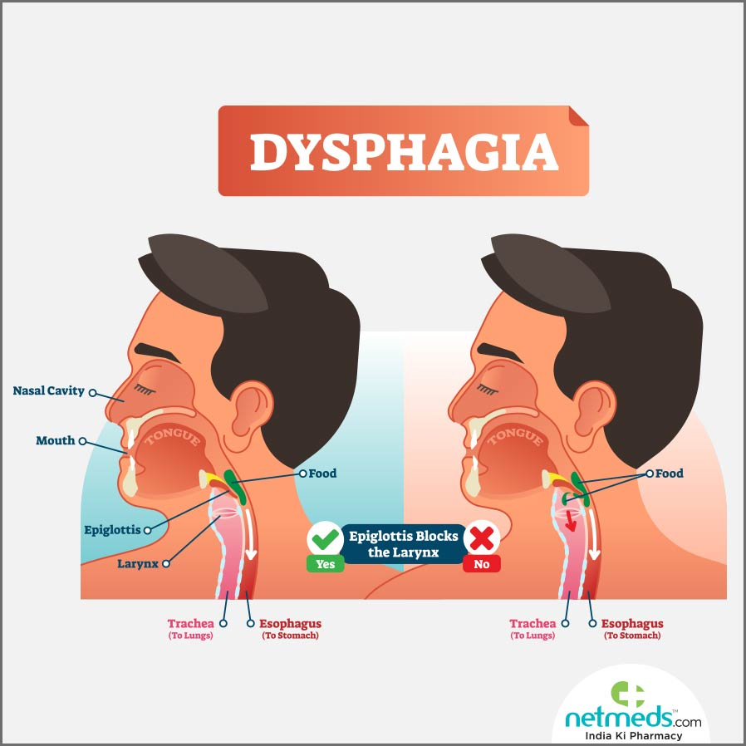
Definition
Dysphagia is difficulty swallowing — taking more time and effort to move food or liquid from your mouth to your stomach
3
Notes:
SAY: Before we wrap up the course, let’s review what we have learned today.
During this course, we have
<READ the bullets from the slide.>
GO to next slide.

Slide 4
Introduction
Occasional difficulty swallowing, such as when you eat too fast or don't chew your food well enough, usually isn't cause for concern. But persistent dysphagia can be a serious medical condition requiring treatment.
Dysphagia can occur at any age, but it's more common in older adults. The causes of swallowing problems vary, and treatment depends on the cause.
4
Notes:
SAY: Before we wrap up the course, let’s review what we have learned today.
During this course, we have
<READ the bullets from the slide.>
GO to next slide.

Slide 5
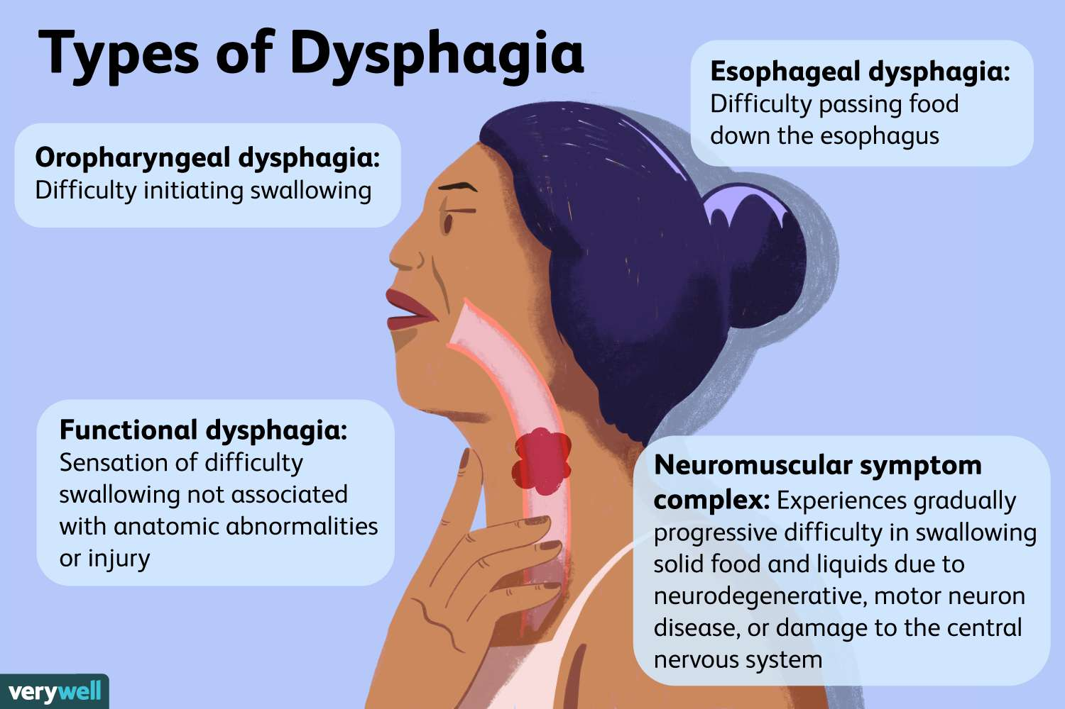

Slide 6
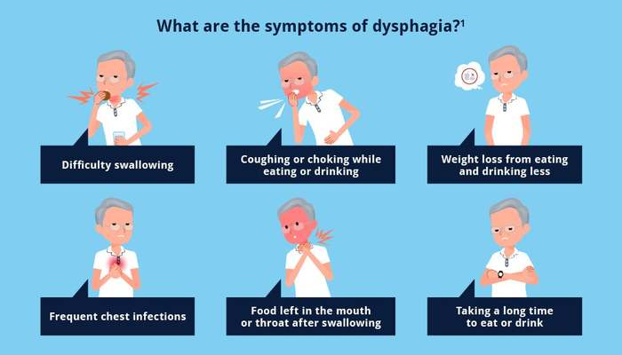
Symptoms of Dysphagia
●●●
6
Notes:
SAY:
The purpose of epidemiology in public health practice is to
discover the agent, host, and environmental factors that affect health;
determine the relative importance of causes of illness, disability, and death;
identify those segments of the population that have the greatest risk from specific causes of ill health; and
evaluate the effectiveness of health programs and services in improving population health.
GO to next slide.

Slide 7
Causes of Dysphagia
Achalasia.
When the lower esophageal muscle (sphincter) doesn't relax properly to let food enter the stomach, it can cause food to come back up into the throat. Muscles in the wall of the esophagus might be weak as well, a condition that tends to worsen over time.
●●●
7
Notes:
SAY:
The purpose of epidemiology in public health practice is to
discover the agent, host, and environmental factors that affect health;
determine the relative importance of causes of illness, disability, and death;
identify those segments of the population that have the greatest risk from specific causes of ill health; and
evaluate the effectiveness of health programs and services in improving population health.
GO to next slide.

Slide 8
Causes of Dysphagia
Diffuse spasm.
This condition causes high-pressure, poorly coordinated contractions of the esophagus, usually after swallowing. Diffuse spasm affects the involuntary muscles in the walls of the lower esophagus.
●●●
8
Notes:
SAY:
The purpose of epidemiology in public health practice is to
discover the agent, host, and environmental factors that affect health;
determine the relative importance of causes of illness, disability, and death;
identify those segments of the population that have the greatest risk from specific causes of ill health; and
evaluate the effectiveness of health programs and services in improving population health.
GO to next slide.

Slide 9
Causes of Dysphagia
Esophageal stricture.
A narrowed esophagus (stricture) can trap large pieces of food. Tumors or scar tissue, often caused by gastroesophageal reflux disease (GERD), can cause narrowing.
●●●
9
Notes:
SAY:
The purpose of epidemiology in public health practice is to
discover the agent, host, and environmental factors that affect health;
determine the relative importance of causes of illness, disability, and death;
identify those segments of the population that have the greatest risk from specific causes of ill health; and
evaluate the effectiveness of health programs and services in improving population health.
GO to next slide.

Slide 10
Causes of Dysphagia
Foreign bodies.
Sometimes food or another object can partially block the throat or esophagus. Older adults with dentures and people who have difficulty chewing their food may be more likely to have a piece of food become lodged in the throat or esophagus.
●●●
10
Notes:
SAY:
The purpose of epidemiology in public health practice is to
discover the agent, host, and environmental factors that affect health;
determine the relative importance of causes of illness, disability, and death;
identify those segments of the population that have the greatest risk from specific causes of ill health; and
evaluate the effectiveness of health programs and services in improving population health.
GO to next slide.

Slide 11
Causes of Dysphagia
Scleroderma.
Development of scar-like tissue, causing stiffening and hardening of tissues, can weaken the lower esophageal sphincter. As a result, acid backs up into the esophagus and causes frequent heartburn.
●●●
11
Notes:
SAY:
The purpose of epidemiology in public health practice is to
discover the agent, host, and environmental factors that affect health;
determine the relative importance of causes of illness, disability, and death;
identify those segments of the population that have the greatest risk from specific causes of ill health; and
evaluate the effectiveness of health programs and services in improving population health.
GO to next slide.

Slide 12
Causes of Dysphagia
Esophageal tumors.
Difficulty swallowing tends to get progressively worse when esophageal tumors are present due to narrowing of the esophagus.
Esophageal ring.
A thin area of narrowing in the lower esophagus can cause difficulty swallowing solid foods off and on.
●●●
12
Notes:
SAY:
The purpose of epidemiology in public health practice is to
discover the agent, host, and environmental factors that affect health;
determine the relative importance of causes of illness, disability, and death;
identify those segments of the population that have the greatest risk from specific causes of ill health; and
evaluate the effectiveness of health programs and services in improving population health.
GO to next slide.

Slide 13
Causes of Dysphagia
Eosinophilic esophagitis.
This condition, which might be related to a food allergy, is caused by too many cells called eosinophils in the esophagus.
Radiation therapy.
This cancer treatment can lead to inflammation and scarring of the esophagus.
●●●
13
Notes:
SAY:
The purpose of epidemiology in public health practice is to
discover the agent, host, and environmental factors that affect health;
determine the relative importance of causes of illness, disability, and death;
identify those segments of the population that have the greatest risk from specific causes of ill health; and
evaluate the effectiveness of health programs and services in improving population health.
GO to next slide.

Slide 14
Causes of Dysphagia
GERD.
Damage to esophageal tissues from stomach acid backing up into the esophagus can lead to spasm or scarring and narrowing of the lower esophagus.
14
Notes:
SAY:
The purpose of epidemiology in public health practice is to
discover the agent, host, and environmental factors that affect health;
determine the relative importance of causes of illness, disability, and death;
identify those segments of the population that have the greatest risk from specific causes of ill health; and
evaluate the effectiveness of health programs and services in improving population health.
GO to next slide.

Slide 15
Risk Factors of Dysphagia
Aging.
Due to natural aging and normal wear and tear on the esophagus as well as a greater risk of certain conditions, such as stroke. But dysphagia isn't considered a normal sign of aging.
Certain health conditions.
People with certain neurological or nervous system disorders are more likely to have difficulty swallowing.
15
Notes:
SAY:
The purpose of epidemiology in public health practice is to
discover the agent, host, and environmental factors that affect health;
determine the relative importance of causes of illness, disability, and death;
identify those segments of the population that have the greatest risk from specific causes of ill health; and
evaluate the effectiveness of health programs and services in improving population health.
GO to next slide.

Slide 16
Complications of Dysphagia
Malnutrition, weight loss and dehydration: Dysphagia can make it difficult to take in enough nourishment and fluids.
Aspiration pneumonia: Food or liquid entering the airway during attempts to swallow can cause aspiration pneumonia as a result of the food introducing bacteria into the lungs.
●●●
16
Notes:
SAY:
The purpose of epidemiology in public health practice is to
discover the agent, host, and environmental factors that affect health;
determine the relative importance of causes of illness, disability, and death;
identify those segments of the population that have the greatest risk from specific causes of ill health; and
evaluate the effectiveness of health programs and services in improving population health.
GO to next slide.

Slide 17
Complications of Dysphagia
Choking: Food stuck in the throat can cause choking. If food completely blocks the airway and no one intervenes with a successful Heimlich maneuver, death can occur.
17
Notes:
SAY:
The purpose of epidemiology in public health practice is to
discover the agent, host, and environmental factors that affect health;
determine the relative importance of causes of illness, disability, and death;
identify those segments of the population that have the greatest risk from specific causes of ill health; and
evaluate the effectiveness of health programs and services in improving population health.
GO to next slide.

Slide 18
Prevention of Dysphagia
Although swallowing difficulties can't be prevented, you can reduce your risk of occasional difficulty swallowing by eating slowly and chewing your food well.
However, if you have signs or Causes of dysphagia, see your health care provider.
18
Notes:
SAY:
The purpose of epidemiology in public health practice is to
discover the agent, host, and environmental factors that affect health;
determine the relative importance of causes of illness, disability, and death;
identify those segments of the population that have the greatest risk from specific causes of ill health; and
evaluate the effectiveness of health programs and services in improving population health.
GO to next slide.

Slide 19
Conclusion
Dysphagia is the medical term for swallowing difficulties.
Some people with dysphagia have problems swallowing certain foods or liquids, while others can't swallow at all. Other signs of dysphagia include: coughing or choking when eating or drinking. bringing food back up, sometimes through the nose.
19
Notes:
SAY:
The purpose of epidemiology in public health practice is to
discover the agent, host, and environmental factors that affect health;
determine the relative importance of causes of illness, disability, and death;
identify those segments of the population that have the greatest risk from specific causes of ill health; and
evaluate the effectiveness of health programs and services in improving population health.
GO to next slide.

Slide 20
Thanks To StudyMafia.org

