Slide 1
StudyMafia.Org
Duchenne Muscular Dystrophy
Submitted To: Submitted By:
Studymafia.org Studymafia.org

Slide 2
Table Contents
Definition
Introduction
Symptoms of Duchenne muscular dystrophy
Causes of Duchenne muscular dystrophy
Progression of Duchenne muscular dystrophy
Average Lifespan of Duchenne
Treatment of Duchenne muscular dystrophy
Conclusion
2
Notes:
SAY: Before we wrap up the course, let’s review what we have learned today.
During this course, we have
<READ the bullets from the slide.>
GO to next slide.

Slide 3
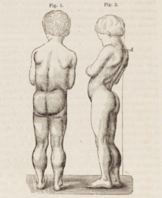
Definition
Duchenne muscular dystrophy is a genetic disorder characterized by the progressive loss of muscle. It is a multi-systemic condition, affecting many parts of the body, which results in deterioration of the skeletal, heart, and lung muscles.
3
Notes:
SAY: Before we wrap up the course, let’s review what we have learned today.
During this course, we have
<READ the bullets from the slide.>
GO to next slide.

Slide 4
Introduction
Duchenne is caused by a change in the dystrophin gene. Without dystrophin, muscles are not able to function or repair themselves properly.
Because the dystrophin gene is found on the X-chromosome, it primarily affects males, while females are typically carriers.
However, some females can manifest varying ranges of physical symptoms of Duchenne and are therefore called “manifesting carriers”.
4
Notes:
SAY: Before we wrap up the course, let’s review what we have learned today.
During this course, we have
<READ the bullets from the slide.>
GO to next slide.

Slide 5
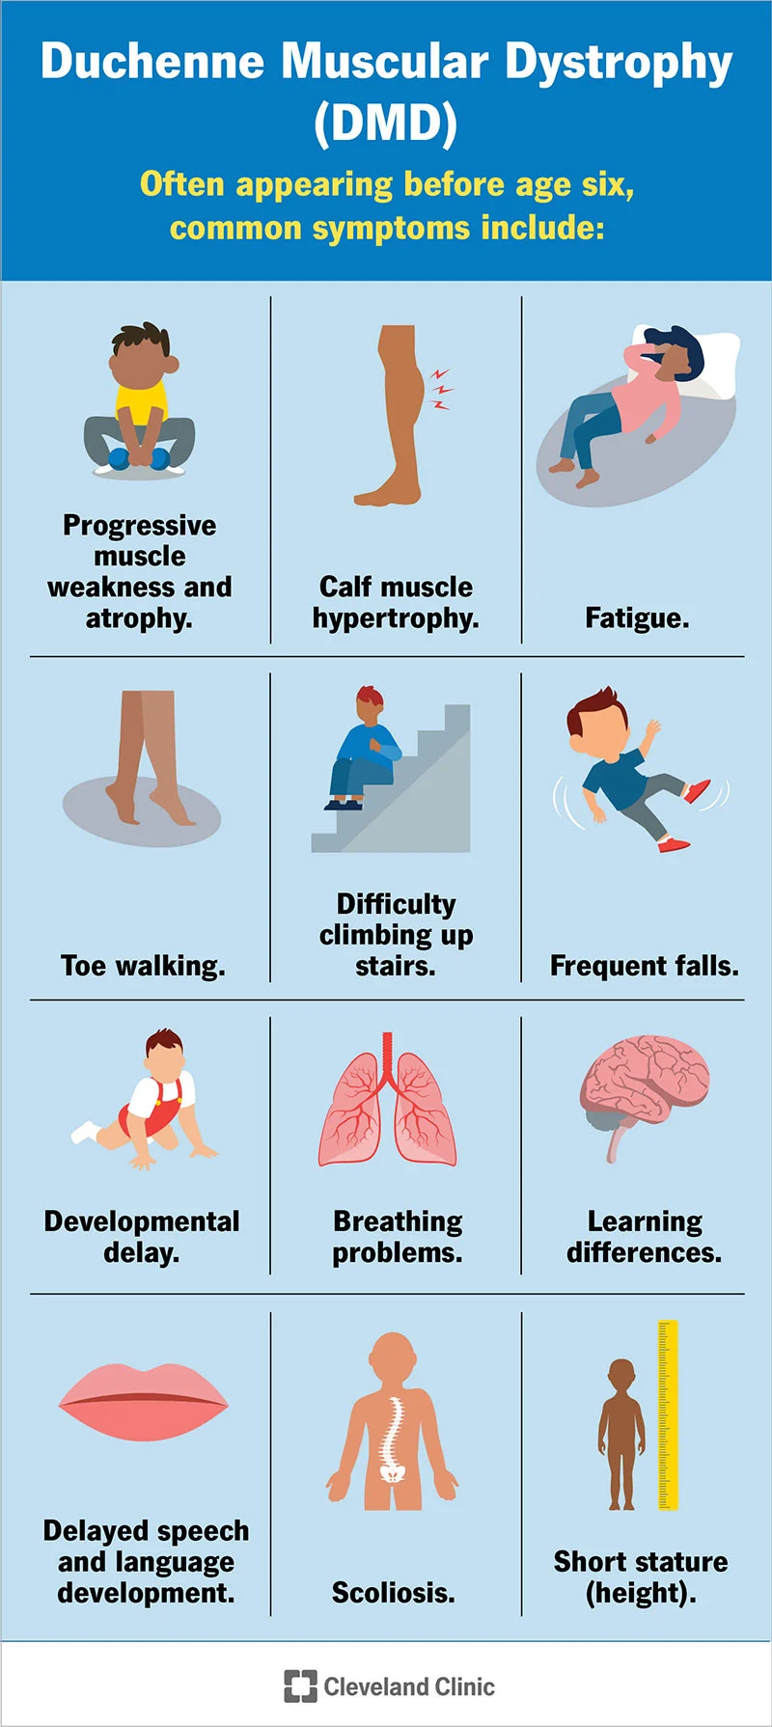
Symptoms of Duchenne Muscular Dystrophy
●●●
5
Notes:
SAY:
The purpose of epidemiology in public health practice is to
discover the agent, host, and environmental factors that affect health;
determine the relative importance of causes of illness, disability, and death;
identify those segments of the population that have the greatest risk from specific causes of ill health; and
evaluate the effectiveness of health programs and services in improving population health.
GO to next slide.

Slide 6
Causes of Duchenne
Muscular Dystrophy
Duchenne is caused by a mutation in the gene that encodes for dystrophin, a protein that is essential to the proper functioning of our muscles.
Without dystrophin, muscles are not able to function or repair themselves properly. The loss of muscle then results in a loss of strength and function.
●●●
6
Notes:
SAY:
The purpose of epidemiology in public health practice is to
discover the agent, host, and environmental factors that affect health;
determine the relative importance of causes of illness, disability, and death;
identify those segments of the population that have the greatest risk from specific causes of ill health; and
evaluate the effectiveness of health programs and services in improving population health.
GO to next slide.

Slide 7
Causes of Duchenne
Muscular Dystrophy
Duchenne can be passed from parent to child, or it can be the result of random spontaneous genetic mutations, which may occur during any pregnancy.
In fact, about one out of every three cases occurs in families with no previous history of Duchenne. In other words, it can affect anyone, and crosses all races and cultures.
7
Notes:
SAY:
The purpose of epidemiology in public health practice is to
discover the agent, host, and environmental factors that affect health;
determine the relative importance of causes of illness, disability, and death;
identify those segments of the population that have the greatest risk from specific causes of ill health; and
evaluate the effectiveness of health programs and services in improving population health.
GO to next slide.

Slide 8
PROGRESSION OF DUCHENNE
Duchenne progresses differently for every person. Even siblings with the same mutation may have a very different progression of symptoms.
Muscle loss is first noticed in childhood, with loss of strength, function, and flexibility in the hips, thighs, shoulders, and pelvis. In the teens, these losses begin progressing to the arms, lower legs, and trunk
●●●
8
Notes:
SAY:
The purpose of epidemiology in public health practice is to
discover the agent, host, and environmental factors that affect health;
determine the relative importance of causes of illness, disability, and death;
identify those segments of the population that have the greatest risk from specific causes of ill health; and
evaluate the effectiveness of health programs and services in improving population health.
GO to next slide.

Slide 9
PROGRESSION OF DUCHENNE
Because there is also an absence of dystrophin in the muscles of the heart and lungs, heart function and breathing are also affected.
In addition, some people can have issues with learning and behavior, resulting from a lack of dystrophin in the brain.
●●●
9
Notes:
SAY:
The purpose of epidemiology in public health practice is to
discover the agent, host, and environmental factors that affect health;
determine the relative importance of causes of illness, disability, and death;
identify those segments of the population that have the greatest risk from specific causes of ill health; and
evaluate the effectiveness of health programs and services in improving population health.
GO to next slide.

Slide 10
PROGRESSION OF DUCHENNE
The progression of symptoms through Duchenne are on a spectrum, from late onset/very mild symptoms to early onset/severe symptoms.
Regular visits with your neuromuscular team will help you to monitor the progression of this disease, and how it can best be treated along the way.
10
Notes:
SAY:
The purpose of epidemiology in public health practice is to
discover the agent, host, and environmental factors that affect health;
determine the relative importance of causes of illness, disability, and death;
identify those segments of the population that have the greatest risk from specific causes of ill health; and
evaluate the effectiveness of health programs and services in improving population health.
GO to next slide.

Slide 11
AVERAGE LIFESPAN OF DUCHENNE
With improved care, more people with Duchenne are living into their early 30s and beyond.
With clinical care continuing to improve, as well as clinical trials, research, and therapies on the horizon, we are hoping to enhance both the quality and quantity of life with Duchenne to a much older age.
11
Notes:
SAY:
The purpose of epidemiology in public health practice is to
discover the agent, host, and environmental factors that affect health;
determine the relative importance of causes of illness, disability, and death;
identify those segments of the population that have the greatest risk from specific causes of ill health; and
evaluate the effectiveness of health programs and services in improving population health.
GO to next slide.

Slide 12
Treatment of Duchenne Muscular Dystrophy
No curative treatment exists for DMD. Treatments are aimed at the specific symptoms present in each individual.
Treatment options should include physical therapy and active and passive exercise to build muscle strength and prevent contractures.
●●●
12
Notes:
SAY:
The purpose of epidemiology in public health practice is to
discover the agent, host, and environmental factors that affect health;
determine the relative importance of causes of illness, disability, and death;
identify those segments of the population that have the greatest risk from specific causes of ill health; and
evaluate the effectiveness of health programs and services in improving population health.
GO to next slide.

Slide 13
Treatment of Duchenne Muscular Dystrophy
Surgery may be recommended in some patients to treat contractures or scoliosis. Braces may be used to prevent the development of contractures.
The use of mechanical aids (e.g., canes, braces, and wheelchairs) may become necessary to aid walking (ambulation).
●●●
13
Notes:
SAY:
The purpose of epidemiology in public health practice is to
discover the agent, host, and environmental factors that affect health;
determine the relative importance of causes of illness, disability, and death;
identify those segments of the population that have the greatest risk from specific causes of ill health; and
evaluate the effectiveness of health programs and services in improving population health.
GO to next slide.

Slide 14
Treatment of Duchenne Muscular Dystrophy
Corticosteroids are used as standard of care to treat individuals with DMD. These drugs slow the progression of muscle weakness in affected individuals and delay the loss of ambulation by 2-3 years.
Two common corticosteroid drugs used to treat individuals with DMD are prednisone and deflazacort (which is not available in the United States).
14
Notes:
SAY:
The purpose of epidemiology in public health practice is to
discover the agent, host, and environmental factors that affect health;
determine the relative importance of causes of illness, disability, and death;
identify those segments of the population that have the greatest risk from specific causes of ill health; and
evaluate the effectiveness of health programs and services in improving population health.
GO to next slide.

Slide 15
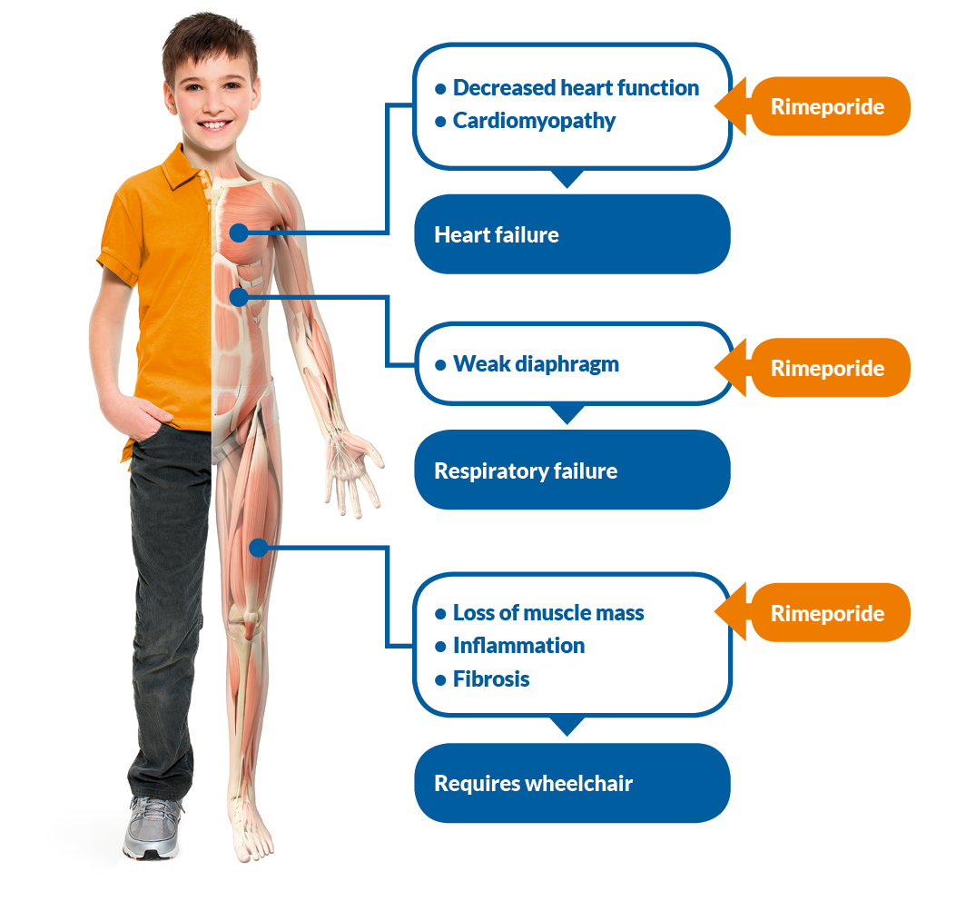

Slide 16
Conclusion
Duchenne muscular dystrophy is a form of muscular dystrophy. It worsens quickly. Other muscular dystrophies (including Becker muscular dystrophy) get worse much more slowly.
Duchenne muscular dystrophy is caused by a defective gene for dystrophin (a protein in the muscles).
16
Notes:
SAY:
The purpose of epidemiology in public health practice is to
discover the agent, host, and environmental factors that affect health;
determine the relative importance of causes of illness, disability, and death;
identify those segments of the population that have the greatest risk from specific causes of ill health; and
evaluate the effectiveness of health programs and services in improving population health.
GO to next slide.

Slide 17
Thanks To StudyMafia.org

