Slide 1
StudyMafia.Org
Down Syndrome
Submitted To: Submitted By:
Studymafia.org Studymafia.org

Slide 2
Table Contents
Definition
Introduction
Symptoms of Down Syndrome
Causes of Down Syndrome
Risk-Factors of Down Syndrome
Complications of Down Syndrome
Treatment of Down Syndrome
Conclusion
2
Notes:
SAY: Before we wrap up the course, let’s review what we have learned today.
During this course, we have
<READ the bullets from the slide.>
GO to next slide.

Slide 3
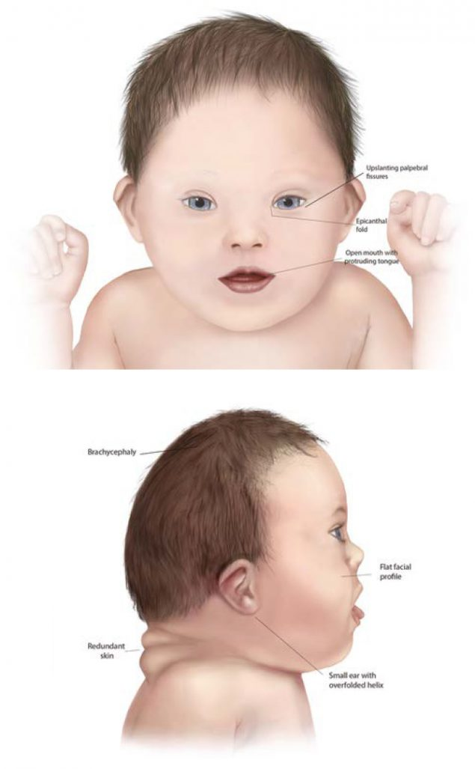
Definition
Down syndrome is a genetic disorder caused when abnormal cell division results in an extra full or partial copy of chromosome 21.
3
Notes:
SAY: Before we wrap up the course, let’s review what we have learned today.
During this course, we have
<READ the bullets from the slide.>
GO to next slide.

Slide 4
Introduction
This extra genetic material causes the developmental changes and physical features of Down syndrome.
Down syndrome varies in severity among individuals, causing lifelong intellectual disability and developmental delays. It's the most common genetic chromosomal disorder and cause of learning disabilities in children. It also commonly causes other medical abnormalities, including heart and gastrointestinal disorders.
4
Notes:
SAY: Before we wrap up the course, let’s review what we have learned today.
During this course, we have
<READ the bullets from the slide.>
GO to next slide.

Slide 5
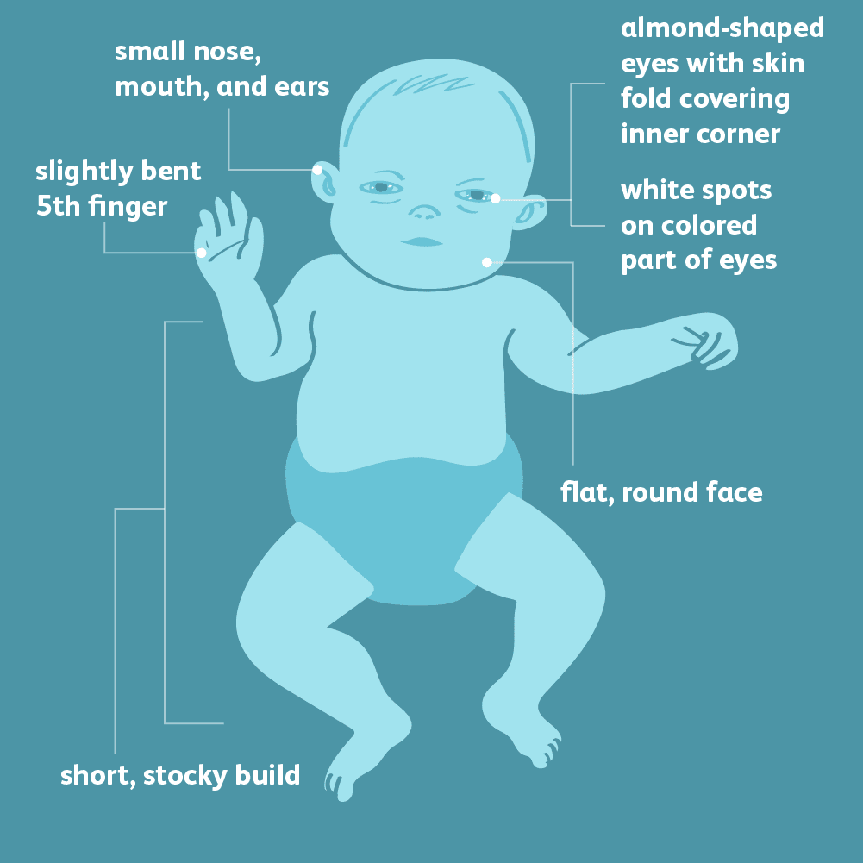
Symptoms of Down Syndrome
5
Notes:
SAY: Before we wrap up the course, let’s review what we have learned today.
During this course, we have
<READ the bullets from the slide.>
GO to next slide.

Slide 6
Causes of Down Syndrome
Human cells normally contain 23 pairs of chromosomes. One chromosome in each pair comes from your father, the other from your mother.
Down syndrome results when abnormal cell division involving chromosome 21 occurs. These cell division abnormalities result in an extra partial or full chromosome 21.
●●●
6
Notes:
SAY:
The purpose of epidemiology in public health practice is to
discover the agent, host, and environmental factors that affect health;
determine the relative importance of causes of illness, disability, and death;
identify those segments of the population that have the greatest risk from specific causes of ill health; and
evaluate the effectiveness of health programs and services in improving population health.
GO to next slide.

Slide 7
Causes of Down Syndrome
Trisomy 21.
About 95 percent of the time, Down syndrome is caused by trisomy 21 — the person has three copies of chromosome 21, instead of the usual two copies, in all cells. This is caused by abnormal cell division during the development of the sperm cell or the egg cell.
●●●
7
Notes:
SAY:
The purpose of epidemiology in public health practice is to
discover the agent, host, and environmental factors that affect health;
determine the relative importance of causes of illness, disability, and death;
identify those segments of the population that have the greatest risk from specific causes of ill health; and
evaluate the effectiveness of health programs and services in improving population health.
GO to next slide.

Slide 8
Causes of Down Syndrome
Mosaic Down syndrome.
In this rare form of Down syndrome, a person has only some cells with an extra copy of chromosome 21. This mosaic of normal and abnormal cells is caused by abnormal cell division after fertilization.
●●●
8
Notes:
SAY:
The purpose of epidemiology in public health practice is to
discover the agent, host, and environmental factors that affect health;
determine the relative importance of causes of illness, disability, and death;
identify those segments of the population that have the greatest risk from specific causes of ill health; and
evaluate the effectiveness of health programs and services in improving population health.
GO to next slide.

Slide 9
Causes of Down Syndrome
Translocation Down syndrome.
Down syndrome can also occur when a portion of chromosome 21 becomes attached (translocated) onto another chromosome, before or at conception. These children have the usual two copies of chromosome 21.
●●●
9
Notes:
SAY:
The purpose of epidemiology in public health practice is to
discover the agent, host, and environmental factors that affect health;
determine the relative importance of causes of illness, disability, and death;
identify those segments of the population that have the greatest risk from specific causes of ill health; and
evaluate the effectiveness of health programs and services in improving population health.
GO to next slide.

Slide 10
Causes of Down Syndrome
Most of the time, Down syndrome isn't inherited. It's caused by a mistake in cell division during early development of the fetus.
Translocation Down syndrome can be passed from parent to child.
●●●
10
Notes:
SAY:
The purpose of epidemiology in public health practice is to
discover the agent, host, and environmental factors that affect health;
determine the relative importance of causes of illness, disability, and death;
identify those segments of the population that have the greatest risk from specific causes of ill health; and
evaluate the effectiveness of health programs and services in improving population health.
GO to next slide.

Slide 11
Causes of Down Syndrome
When balanced translocations are inherited, the mother or father has some rearranged genetic material from chromosome 21 on another chromosome, but no extra genetic material.
This means he or she has no signs or symptoms of Down syndrome, but can pass an unbalanced translocation on to children, causing Down syndrome in the children.
11
Notes:
SAY:
The purpose of epidemiology in public health practice is to
discover the agent, host, and environmental factors that affect health;
determine the relative importance of causes of illness, disability, and death;
identify those segments of the population that have the greatest risk from specific causes of ill health; and
evaluate the effectiveness of health programs and services in improving population health.
GO to next slide.

Slide 12
Risk-Factors of Down Syndrome
Advancing maternal age. A woman's chances of giving birth to a child with Down syndrome increase with age because older eggs have a greater risk of improper chromosome division. A woman's risk of conceiving a child with Down syndrome increases after 35 years of age.
●●●
12
Notes:
SAY:
The purpose of epidemiology in public health practice is to
discover the agent, host, and environmental factors that affect health;
determine the relative importance of causes of illness, disability, and death;
identify those segments of the population that have the greatest risk from specific causes of ill health; and
evaluate the effectiveness of health programs and services in improving population health.
GO to next slide.

Slide 13
Risk-Factors of Down Syndrome
Being carriers of the genetic translocation for Down syndrome. Both men and women can pass the genetic translocation for Down syndrome on to their children.
Having had one child with Down syndrome. Parents who have one child with Down syndrome and parents who have a translocation themselves are at an increased risk of having another child with Down syndrome.
13
Notes:
SAY:
The purpose of epidemiology in public health practice is to
discover the agent, host, and environmental factors that affect health;
determine the relative importance of causes of illness, disability, and death;
identify those segments of the population that have the greatest risk from specific causes of ill health; and
evaluate the effectiveness of health programs and services in improving population health.
GO to next slide.

Slide 14
Complications of Down Syndrome
Heart defects. About half the children with Down syndrome are born with some type of congenital heart defect.
Gastrointestinal (GI) defects. GI abnormalities occur in some children with Down syndrome and may include abnormalities of the intestines, esophagus, trachea and anus.
●●●
14
Notes:
SAY:
The purpose of epidemiology in public health practice is to
discover the agent, host, and environmental factors that affect health;
determine the relative importance of causes of illness, disability, and death;
identify those segments of the population that have the greatest risk from specific causes of ill health; and
evaluate the effectiveness of health programs and services in improving population health.
GO to next slide.

Slide 15
Complications of Down Syndrome
Immune disorders. Because of abnormalities in their immune systems, people with Down syndrome are at increased risk of developing autoimmune disorders.
Sleep apnea. Because of soft tissue and skeletal changes that lead to the obstruction of their airways, children and adults with Down syndrome are at greater risk of obstructive sleep apnea.
●●●
15
Notes:
SAY:
The purpose of epidemiology in public health practice is to
discover the agent, host, and environmental factors that affect health;
determine the relative importance of causes of illness, disability, and death;
identify those segments of the population that have the greatest risk from specific causes of ill health; and
evaluate the effectiveness of health programs and services in improving population health.
GO to next slide.

Slide 16
Complications of Down Syndrome
Obesity. People with Down syndrome have a greater tendency to be obese compared with the general population.
Spinal problems. Some people with Down syndrome may have a misalignment of the top two vertebrae in the neck (atlantoaxial instability).
●●●
16
Notes:
SAY:
The purpose of epidemiology in public health practice is to
discover the agent, host, and environmental factors that affect health;
determine the relative importance of causes of illness, disability, and death;
identify those segments of the population that have the greatest risk from specific causes of ill health; and
evaluate the effectiveness of health programs and services in improving population health.
GO to next slide.

Slide 17
Complications of Down Syndrome
Leukemia. Young children with Down syndrome have an increased risk of leukemia.
Dementia. People with Down syndrome have a greatly increased risk of dementia — signs and symptoms may begin around age 50. Having Down syndrome also increases the risk of developing Alzheimer's disease.
●●●
17
Notes:
SAY:
The purpose of epidemiology in public health practice is to
discover the agent, host, and environmental factors that affect health;
determine the relative importance of causes of illness, disability, and death;
identify those segments of the population that have the greatest risk from specific causes of ill health; and
evaluate the effectiveness of health programs and services in improving population health.
GO to next slide.

Slide 18
Treatment of Down Syndrome
Early intervention for infants and children with Down syndrome can make a major difference in improving their quality of life.
Team care
If your child has Down syndrome, you'll likely rely on a team of specialists that can provide medical care and help him or her develop skills as fully as possible.
●●●
18
Notes:
SAY:
The purpose of epidemiology in public health practice is to
discover the agent, host, and environmental factors that affect health;
determine the relative importance of causes of illness, disability, and death;
identify those segments of the population that have the greatest risk from specific causes of ill health; and
evaluate the effectiveness of health programs and services in improving population health.
GO to next slide.

Slide 19
Treatment of Down Syndrome
Depending on your child's particular needs, your team may include some of these experts:
Primary care pediatrician to coordinate and provide routine childhood care
Pediatric cardiologist
Pediatric gastroenterologist
Pediatric endocrinologist
Developmental pediatrician
Pediatric neurologist
Pediatric ear, nose and throat (ENT) specialist
Pediatric eye doctor (ophthalmologist)
19
Notes:
SAY:
The purpose of epidemiology in public health practice is to
discover the agent, host, and environmental factors that affect health;
determine the relative importance of causes of illness, disability, and death;
identify those segments of the population that have the greatest risk from specific causes of ill health; and
evaluate the effectiveness of health programs and services in improving population health.
GO to next slide.

Slide 20
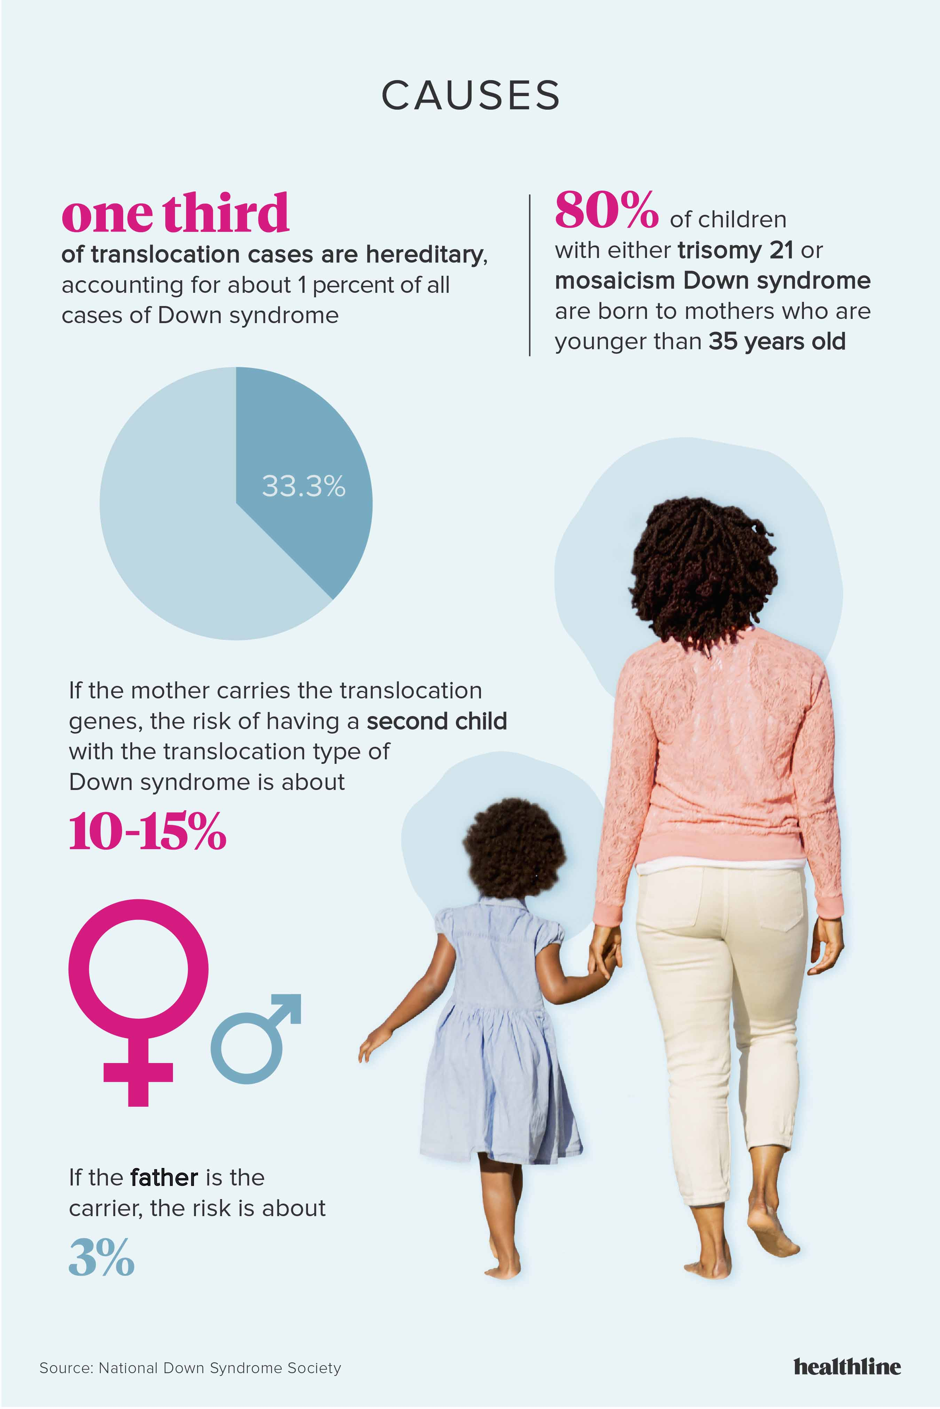

Slide 21
Conclusion
Down syndrome is a common genetic disorder with multisystem involvement.
Congenital heart diseases, hypothyroidism and recurrent respiratory infections were the common medical problems identified in this.
21
Notes:
SAY:
The purpose of epidemiology in public health practice is to
discover the agent, host, and environmental factors that affect health;
determine the relative importance of causes of illness, disability, and death;
identify those segments of the population that have the greatest risk from specific causes of ill health; and
evaluate the effectiveness of health programs and services in improving population health.
GO to next slide.

Slide 22
References
Google.com
Wikipedia.org
Studymafia.org
Slidespanda.com

Slide 23
Thanks To StudyMafia.org

