Slide 1
StudyMafia.Org
Diabetes
Submitted To: Submitted By:
Studymafia.org Studymafia.org

Slide 2
Table Contents
Definition
Introduction
Symptoms of Diabetes
Types of Diabetes
Risk-Factors of Diabetes
Causes of Diabetes
Complications of Diabetes
Treatment of Diabetes
Conclusion
2
Notes:
SAY: Before we wrap up the course, let’s review what we have learned today.
During this course, we have
<READ the bullets from the slide.>
GO to next slide.

Slide 3
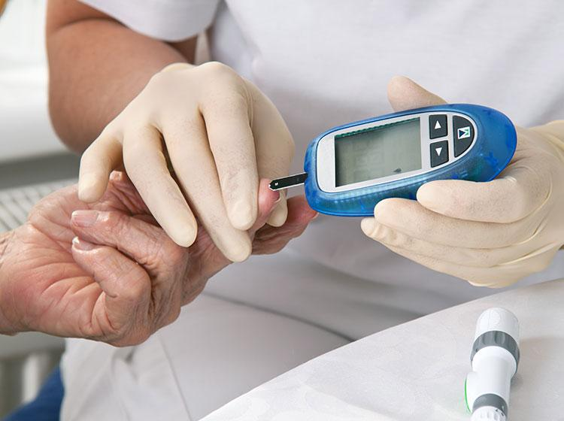
Definition
Diabetes happens when your body isn't able to take up sugar (glucose) into its cells and use it for energy.
3
Notes:
SAY: Before we wrap up the course, let’s review what we have learned today.
During this course, we have
<READ the bullets from the slide.>
GO to next slide.

Slide 4
Introduction
There are different types of diabetes, each with different causes, but they all share the common problem of having too much glucose in your bloodstream.
Poorly controlled diabetes can lead to serious consequences, causing damage to a wide range of your body's organs and tissues – including your heart, kidneys, eyes and nerves.
4
Notes:
SAY: Before we wrap up the course, let’s review what we have learned today.
During this course, we have
<READ the bullets from the slide.>
GO to next slide.

Slide 5
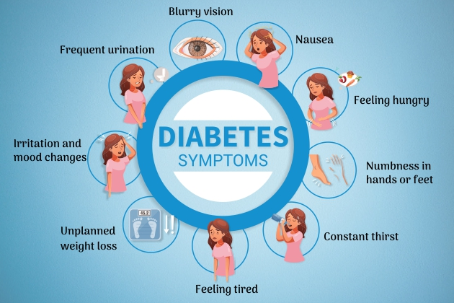
Symptoms of Diabetes
●●●
5
Notes:
SAY:
The purpose of epidemiology in public health practice is to
discover the agent, host, and environmental factors that affect health;
determine the relative importance of causes of illness, disability, and death;
identify those segments of the population that have the greatest risk from specific causes of ill health; and
evaluate the effectiveness of health programs and services in improving population health.
GO to next slide.

Slide 6
Types of Diabetes
Type 1 diabetes:
This type is an autoimmune disease, meaning your body attacks itself. In this case, the insulin-producing cells in your pancreas are destroyed. Up to 10% of people who have diabetes have Type 1.
It’s usually diagnosed in children and young adults (but can develop at any age). It was once better known as “juvenile” diabetes.
●●●
6
Notes:
SAY:
The purpose of epidemiology in public health practice is to
discover the agent, host, and environmental factors that affect health;
determine the relative importance of causes of illness, disability, and death;
identify those segments of the population that have the greatest risk from specific causes of ill health; and
evaluate the effectiveness of health programs and services in improving population health.
GO to next slide.

Slide 7
Types of Diabetes
Type 2 diabetes:
With this type, your body either doesn’t make enough insulin or your body’s cells don’t respond normally to the insulin. This is the most common type of diabetes. Up to 95% of people with diabetes have Type 2.
It usually occurs in middle-aged and older people. Other common names for Type 2 include adult-onset diabetes and insulin-resistant diabetes.
●●●
7
Notes:
SAY:
The purpose of epidemiology in public health practice is to
discover the agent, host, and environmental factors that affect health;
determine the relative importance of causes of illness, disability, and death;
identify those segments of the population that have the greatest risk from specific causes of ill health; and
evaluate the effectiveness of health programs and services in improving population health.
GO to next slide.

Slide 8
Types of Diabetes
Prediabetes:
This type is the stage before Type 2 diabetes. Your blood glucose levels are higher than normal but not high enough to be officially diagnosed with Type 2 diabetes.
●●●
8
Notes:
SAY:
The purpose of epidemiology in public health practice is to
discover the agent, host, and environmental factors that affect health;
determine the relative importance of causes of illness, disability, and death;
identify those segments of the population that have the greatest risk from specific causes of ill health; and
evaluate the effectiveness of health programs and services in improving population health.
GO to next slide.

Slide 9
Types of Diabetes
Gestational diabetes:
This type develops in some women during their pregnancy. Gestational diabetes usually goes away after pregnancy. However, if you have gestational diabetes you're at higher risk of developing Type 2 diabetes later on in life.
9
Notes:
SAY:
The purpose of epidemiology in public health practice is to
discover the agent, host, and environmental factors that affect health;
determine the relative importance of causes of illness, disability, and death;
identify those segments of the population that have the greatest risk from specific causes of ill health; and
evaluate the effectiveness of health programs and services in improving population health.
GO to next slide.

Slide 10
Risk-Factors of Diabetes
Having a family history (parent or sibling) of Type 1 diabetes.
Injury to the pancreas (such as by infection, tumor, surgery or accident).
Presence of autoantibodies (antibodies that mistakenly attack your own body’s tissues or organs).
Being physically inactive.
Being age 45 or older.
●●●
10
Notes:
SAY:
The purpose of epidemiology in public health practice is to
discover the agent, host, and environmental factors that affect health;
determine the relative importance of causes of illness, disability, and death;
identify those segments of the population that have the greatest risk from specific causes of ill health; and
evaluate the effectiveness of health programs and services in improving population health.
GO to next slide.

Slide 11
Risk-Factors of Diabetes
Family history (parent or sibling) of prediabetes or Type 2 diabetes.
Being Black, Hispanic, Native American, Asian-American race or Pacific Islander.
Having overweight/obesity.
Having high blood pressure.
Having low HDL cholesterol (the “good” cholesterol) and high triglyceride level.
●●●
11
Notes:
SAY:
The purpose of epidemiology in public health practice is to
discover the agent, host, and environmental factors that affect health;
determine the relative importance of causes of illness, disability, and death;
identify those segments of the population that have the greatest risk from specific causes of ill health; and
evaluate the effectiveness of health programs and services in improving population health.
GO to next slide.

Slide 12
Risk-Factors of Diabetes
Family history (parent or sibling) of prediabetes or Type 2 diabetes.
Being African-American, Hispanic, Native American or Asian-American.
Having overweight/obesity before your pregnancy.
Being over 25 years of age.
12
Notes:
SAY:
The purpose of epidemiology in public health practice is to
discover the agent, host, and environmental factors that affect health;
determine the relative importance of causes of illness, disability, and death;
identify those segments of the population that have the greatest risk from specific causes of ill health; and
evaluate the effectiveness of health programs and services in improving population health.
GO to next slide.

Slide 13
Causes of Diabetes
Causes of Type 1 diabetes:
This is an immune system disease. Your body attacks and destroys insulin-producing cells in your pancreas.
Without insulin to allow glucose to enter your cells, glucose builds up in your bloodstream.
●●●
13
Notes:
SAY:
The purpose of epidemiology in public health practice is to
discover the agent, host, and environmental factors that affect health;
determine the relative importance of causes of illness, disability, and death;
identify those segments of the population that have the greatest risk from specific causes of ill health; and
evaluate the effectiveness of health programs and services in improving population health.
GO to next slide.

Slide 14
Causes of Diabetes
Cause of Type 2 diabetes and prediabetes:
Your body’s cells don't allow insulin to work as it should to let glucose into its cells. Your body's cells have become resistant to insulin.
Your pancreas can’t keep up and make enough insulin to overcome this resistance. Glucose levels rise in your bloodstream.
●●●
14
Notes:
SAY:
The purpose of epidemiology in public health practice is to
discover the agent, host, and environmental factors that affect health;
determine the relative importance of causes of illness, disability, and death;
identify those segments of the population that have the greatest risk from specific causes of ill health; and
evaluate the effectiveness of health programs and services in improving population health.
GO to next slide.

Slide 15
Causes of Diabetes
Gestational diabetes:
Hormones produced by the placenta during your pregnancy make your body’s cells more resistant to insulin.
Your pancreas can’t make enough insulin to overcome this resistance. Too much glucose remains in your bloodstream.
15
Notes:
SAY:
The purpose of epidemiology in public health practice is to
discover the agent, host, and environmental factors that affect health;
determine the relative importance of causes of illness, disability, and death;
identify those segments of the population that have the greatest risk from specific causes of ill health; and
evaluate the effectiveness of health programs and services in improving population health.
GO to next slide.

Slide 16
Complications of Diabetes
Cardiovascular issues including coronary artery disease, chest pain, heart attack, stroke, high blood pressure, high cholesterol, atherosclerosis (narrowing of the arteries).
Nerve damage (neuropathy) that causes numbing and tingling that starts at toes or fingers then spreads.
●●●
16
Notes:
SAY:
The purpose of epidemiology in public health practice is to
discover the agent, host, and environmental factors that affect health;
determine the relative importance of causes of illness, disability, and death;
identify those segments of the population that have the greatest risk from specific causes of ill health; and
evaluate the effectiveness of health programs and services in improving population health.
GO to next slide.

Slide 17
Complications of Diabetes
Kidney damage (nephropathy) that can lead to kidney failure or the need for dialysis or transplant.
Eye damage (retinopathy) that can lead to blindness; cataracts, glaucoma.
Foot damage including nerve damage, poor blood flow and poor healing of cuts and sores.
●●●
17
Notes:
SAY:
The purpose of epidemiology in public health practice is to
discover the agent, host, and environmental factors that affect health;
determine the relative importance of causes of illness, disability, and death;
identify those segments of the population that have the greatest risk from specific causes of ill health; and
evaluate the effectiveness of health programs and services in improving population health.
GO to next slide.

Slide 18
Complications of Diabetes
Skin infections.
Erectile dysfunction.
Hearing loss.
Depression.
Dementia.
Dental problems.
18
Notes:
SAY:
The purpose of epidemiology in public health practice is to
discover the agent, host, and environmental factors that affect health;
determine the relative importance of causes of illness, disability, and death;
identify those segments of the population that have the greatest risk from specific causes of ill health; and
evaluate the effectiveness of health programs and services in improving population health.
GO to next slide.

Slide 19
Treatment of Diabetes
Diabetes affects your whole body. To best manage diabetes, you’ll need to take steps to keep your risk factors under control and within the normal range, including:
Keep your blood glucose levels as near to normal as possible by following a diet plan, taking prescribed medication and increasing your activity level.
●●●
19
Notes:
SAY:
The purpose of epidemiology in public health practice is to
discover the agent, host, and environmental factors that affect health;
determine the relative importance of causes of illness, disability, and death;
identify those segments of the population that have the greatest risk from specific causes of ill health; and
evaluate the effectiveness of health programs and services in improving population health.
GO to next slide.

Slide 20
Treatment of Diabetes
Maintain your blood cholesterol (HDL and LDL levels) and triglyceride levels as near the normal ranges as possible.
Control your blood pressure. Your blood pressure should not be over 140/90 mmHg.
Exercising regularly. Try to exercise at least 30 minutes most days of the week. Walk, swim or find some activity you enjoy.
●●●
20
Notes:
SAY:
The purpose of epidemiology in public health practice is to
discover the agent, host, and environmental factors that affect health;
determine the relative importance of causes of illness, disability, and death;
identify those segments of the population that have the greatest risk from specific causes of ill health; and
evaluate the effectiveness of health programs and services in improving population health.
GO to next slide.

Slide 21
Treatment of Diabetes
Planning what you eat and following a healthy meal plan. Follow a Mediterranean diet (vegetables, whole grains, beans, fruits, healthy fats, low sugar) or Dash diet.
These diets are high in nutrition and fiber and low in fats and calories. See a registered dietitian for help understanding nutrition and meal planning.
●●●
21
Notes:
SAY:
The purpose of epidemiology in public health practice is to
discover the agent, host, and environmental factors that affect health;
determine the relative importance of causes of illness, disability, and death;
identify those segments of the population that have the greatest risk from specific causes of ill health; and
evaluate the effectiveness of health programs and services in improving population health.
GO to next slide.

Slide 22
Treatment of Diabetes
Exercising regularly. Try to exercise at least 30 minutes most days of the week. Walk, swim or find some activity you enjoy.
Achieving a healthy weight. Work with your healthcare team to develop a weight-loss plan.
Taking medication and insulin, if prescribed, and closely following recommendations on how and when to take it.
22
Notes:
SAY:
The purpose of epidemiology in public health practice is to
discover the agent, host, and environmental factors that affect health;
determine the relative importance of causes of illness, disability, and death;
identify those segments of the population that have the greatest risk from specific causes of ill health; and
evaluate the effectiveness of health programs and services in improving population health.
GO to next slide.

Slide 23
Conclusion
Diabetes mellitus refers to a group of diseases that affect how the body uses blood sugar (glucose).
Glucose is an important source of energy for the cells that make up the muscles and tissues.
It's also the brain's main source of fuel. The main cause of diabetes varies by type.
23
Notes:
SAY:
The purpose of epidemiology in public health practice is to
discover the agent, host, and environmental factors that affect health;
determine the relative importance of causes of illness, disability, and death;
identify those segments of the population that have the greatest risk from specific causes of ill health; and
evaluate the effectiveness of health programs and services in improving population health.
GO to next slide.

Slide 24
Thanks To StudyMafia.org

