Slide 1
StudyMafia.Org
Dengue Fever
Submitted To: Submitted By:
Studymafia.org Studymafia.org

Slide 2
Table Contents
Definition
Introduction
Symptoms of Dengue Fever
Causes of Dengue Fever
Risk-Factors of Dengue Fever
Prevention of Dengue Fever
Diagnosis of Dengue Fever
Treatment of Dengue Fever
Conclusion
2
Notes:
SAY: Before we wrap up the course, let’s review what we have learned today.
During this course, we have
<READ the bullets from the slide.>
GO to next slide.

Slide 3
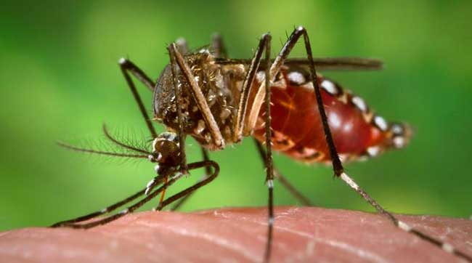
Definition
Dengue (DENG-gey) fever is a mosquito-borne illness that occurs in tropical and subtropical areas of the world.
3
Notes:
SAY: Before we wrap up the course, let’s review what we have learned today.
During this course, we have
<READ the bullets from the slide.>
GO to next slide.

Slide 4
Introduction
Millions of cases of dengue infection occur worldwide each year. But the disease has been spreading to new areas, including local outbreaks in Europe and southern parts of the United States.
Researchers are working on dengue fever vaccines. For now, in areas where dengue fever is common, the best ways to prevent infection are to avoid being bitten by mosquitoes and to take steps to reduce the mosquito population.
4
Notes:
SAY: Before we wrap up the course, let’s review what we have learned today.
During this course, we have
<READ the bullets from the slide.>
GO to next slide.

Slide 5
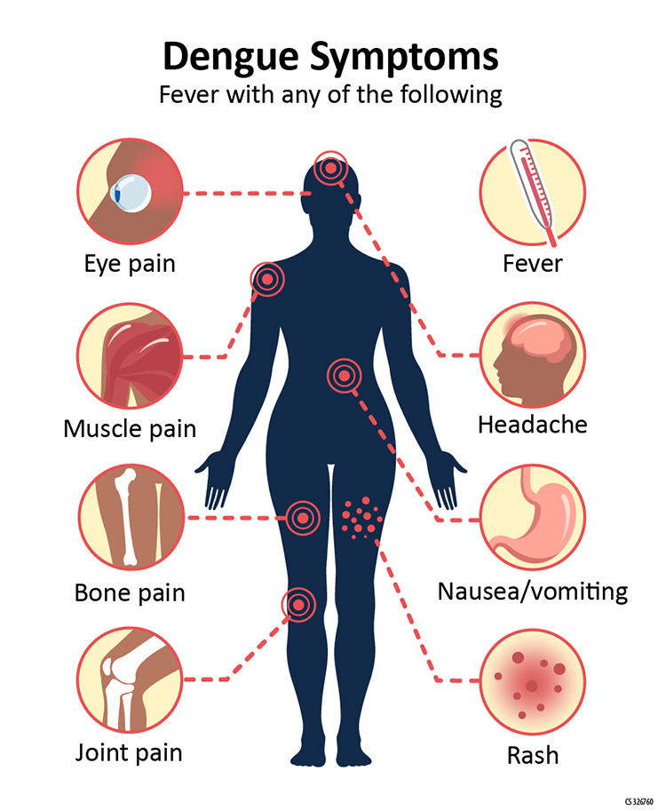
5
Notes:
SAY: Before we wrap up the course, let’s review what we have learned today.
During this course, we have
<READ the bullets from the slide.>
GO to next slide.

Slide 6
Causes of Dengue Fever
Dengue fever is caused by any one of four types of dengue viruses. You can't get dengue fever from being around an infected person. Instead, dengue fever is spread through mosquito bites.
The two types of mosquitoes that most often spread the dengue viruses are common both in and around human lodgings.
●●●
6
Notes:
SAY:
The purpose of epidemiology in public health practice is to
discover the agent, host, and environmental factors that affect health;
determine the relative importance of causes of illness, disability, and death;
identify those segments of the population that have the greatest risk from specific causes of ill health; and
evaluate the effectiveness of health programs and services in improving population health.
GO to next slide.

Slide 7
Causes of Dengue Fever
When a mosquito bites a person infected with a dengue virus, the virus enters the mosquito. Then, when the infected mosquito bites another person, the virus enters that person's bloodstream and causes an infection.
After you've recovered from dengue fever, you have long-term immunity to the type of virus that infected you — but not to the other three dengue fever virus types.
●●●
7
Notes:
SAY:
The purpose of epidemiology in public health practice is to
discover the agent, host, and environmental factors that affect health;
determine the relative importance of causes of illness, disability, and death;
identify those segments of the population that have the greatest risk from specific causes of ill health; and
evaluate the effectiveness of health programs and services in improving population health.
GO to next slide.

Slide 8
Causes of Dengue Fever
This means you can be infected again in the future by one of the other three virus types.
Your risk of developing severe dengue fever increases if you get dengue fever a second, third or fourth time.
8
Notes:
SAY:
The purpose of epidemiology in public health practice is to
discover the agent, host, and environmental factors that affect health;
determine the relative importance of causes of illness, disability, and death;
identify those segments of the population that have the greatest risk from specific causes of ill health; and
evaluate the effectiveness of health programs and services in improving population health.
GO to next slide.

Slide 9
Risk-Factors of Dengue Fever
You live or travel in tropical areas. Being in tropical and subtropical areas increases your risk of exposure to the virus that causes dengue fever.
You have had dengue fever in the past. Previous infection with a dengue fever virus increases your risk of severe symptoms if you get dengue fever again.
●●●
9
Notes:
SAY:
The purpose of epidemiology in public health practice is to
discover the agent, host, and environmental factors that affect health;
determine the relative importance of causes of illness, disability, and death;
identify those segments of the population that have the greatest risk from specific causes of ill health; and
evaluate the effectiveness of health programs and services in improving population health.
GO to next slide.

Slide 10
Risk-Factors of Dengue Fever
Severe dengue fever can cause internal bleeding and organ damage. Blood pressure can drop to dangerous levels, causing shock. In some cases, severe dengue fever can lead to death.
Women who get dengue fever during pregnancy may be able to spread the virus to the baby during childbirth.
10
Notes:
SAY:
The purpose of epidemiology in public health practice is to
discover the agent, host, and environmental factors that affect health;
determine the relative importance of causes of illness, disability, and death;
identify those segments of the population that have the greatest risk from specific causes of ill health; and
evaluate the effectiveness of health programs and services in improving population health.
GO to next slide.

Slide 11
Prevention of Dengue Fever
Vaccine
In areas of the world where dengue fever is common, one dengue fever vaccine (Dengvaxia) is approved for people ages 9 to 45 who have already had dengue fever at least once. The vaccine is given in three doses over the course of 12 months.
●●●
11
Notes:
SAY:
The purpose of epidemiology in public health practice is to
discover the agent, host, and environmental factors that affect health;
determine the relative importance of causes of illness, disability, and death;
identify those segments of the population that have the greatest risk from specific causes of ill health; and
evaluate the effectiveness of health programs and services in improving population health.
GO to next slide.

Slide 12
Prevention of Dengue Fever
Stay in air-conditioned or well-screened housing. The mosquitoes that carry the dengue viruses are most active from dawn to dusk, but they can also bite at night.
Wear protective clothing. When you go into mosquito-infested areas, wear a long-sleeved shirt, long pants, socks and shoes.
●●●
12
Notes:
SAY:
The purpose of epidemiology in public health practice is to
discover the agent, host, and environmental factors that affect health;
determine the relative importance of causes of illness, disability, and death;
identify those segments of the population that have the greatest risk from specific causes of ill health; and
evaluate the effectiveness of health programs and services in improving population health.
GO to next slide.

Slide 13
Prevention of Dengue Fever
Use mosquito repellent. Permethrin can be applied to your clothing, shoes, camping gear and bed netting. You can also buy clothing made with permethrin already in it. For your skin, use a repellent containing at least a 10% concentration of DEET.
●●●
13
Notes:
SAY:
The purpose of epidemiology in public health practice is to
discover the agent, host, and environmental factors that affect health;
determine the relative importance of causes of illness, disability, and death;
identify those segments of the population that have the greatest risk from specific causes of ill health; and
evaluate the effectiveness of health programs and services in improving population health.
GO to next slide.

Slide 14
Prevention of Dengue Fever
Reduce mosquito habitat. The mosquitoes that carry the dengue virus typically live in and around houses, breeding in standing water that can collect in such things as used automobile tires. You can help lower mosquito populations by eliminating habitats where they lay their eggs.
14
Notes:
SAY:
The purpose of epidemiology in public health practice is to
discover the agent, host, and environmental factors that affect health;
determine the relative importance of causes of illness, disability, and death;
identify those segments of the population that have the greatest risk from specific causes of ill health; and
evaluate the effectiveness of health programs and services in improving population health.
GO to next slide.

Slide 15
Diagnosis of Dengue Fever
Diagnosing dengue fever can be difficult because its signs and symptoms can be easily confused with those of other diseases — such as chikungunya, Zika virus, malaria and typhoid fever.
Your doctor will likely ask about your medical and travel history..
15
Notes:
SAY:
The purpose of epidemiology in public health practice is to
discover the agent, host, and environmental factors that affect health;
determine the relative importance of causes of illness, disability, and death;
identify those segments of the population that have the greatest risk from specific causes of ill health; and
evaluate the effectiveness of health programs and services in improving population health.
GO to next slide.

Slide 16
Treatment of Dengue Fever
The over-the-counter (OTC) drug acetaminophen (Tylenol, others) can help reduce muscle pain and fever.
But if you have dengue fever, you should avoid other OTC pain relievers, including aspirin, ibuprofen (Advil, Motrin IB, others) and naproxen sodium (Aleve).
These pain relievers can increase the risk of dengue fever bleeding complications.
●●●
16
Notes:
SAY:
The purpose of epidemiology in public health practice is to
discover the agent, host, and environmental factors that affect health;
determine the relative importance of causes of illness, disability, and death;
identify those segments of the population that have the greatest risk from specific causes of ill health; and
evaluate the effectiveness of health programs and services in improving population health.
GO to next slide.

Slide 17
Treatment of Dengue Fever
If you have severe dengue fever, you may need:
Supportive care in a hospital
Intravenous (IV) fluid and electrolyte replacement
Blood pressure monitoring
Transfusion to replace blood loss
17
Notes:
SAY:
The purpose of epidemiology in public health practice is to
discover the agent, host, and environmental factors that affect health;
determine the relative importance of causes of illness, disability, and death;
identify those segments of the population that have the greatest risk from specific causes of ill health; and
evaluate the effectiveness of health programs and services in improving population health.
GO to next slide.

Slide 18
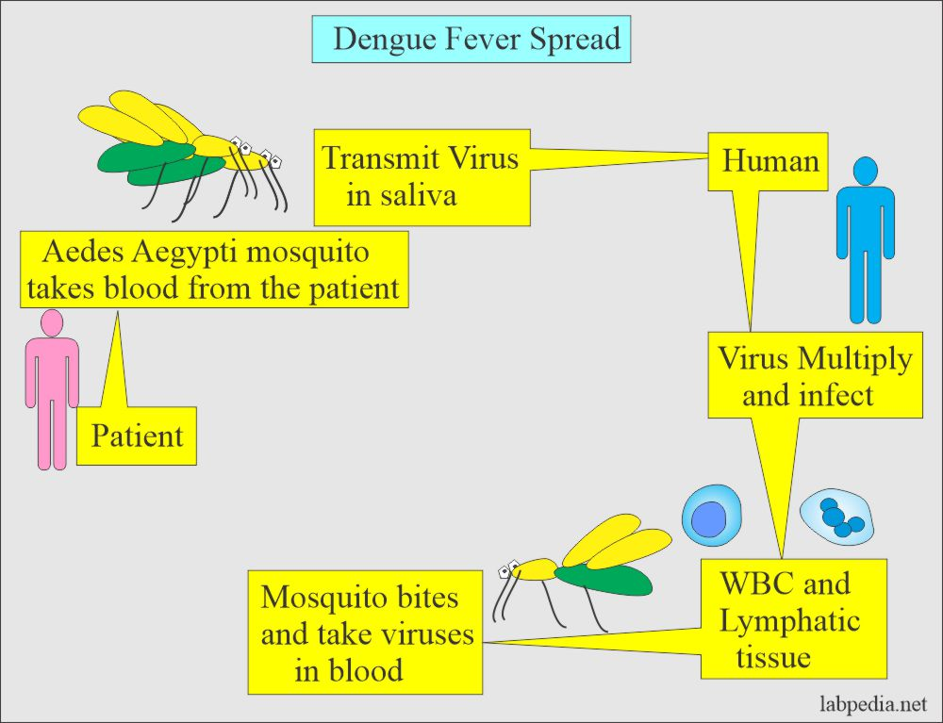

Slide 19
Conclusion
Dengue is a viral infection transmitted to humans through the bite of infected mosquitoes. The primary vectors that transmit the disease are Aedes aegypti mosquitoes and, to a lesser extent, Ae. albopictus.
The virus responsible for causing dengue, is called dengue virus (DENV).
19
Notes:
SAY:
The purpose of epidemiology in public health practice is to
discover the agent, host, and environmental factors that affect health;
determine the relative importance of causes of illness, disability, and death;
identify those segments of the population that have the greatest risk from specific causes of ill health; and
evaluate the effectiveness of health programs and services in improving population health.
GO to next slide.

Slide 20
References
Google.com
Wikipedia.org
Studymafia.org
Slidespanda.com

Slide 21
Thanks To StudyMafia.org

