Slide 1
StudyMafia.Org
Cushing Syndrome
Submitted To: Submitted By:
Studymafia.org Studymafia.org

Slide 2
Table Contents
Definition
Introduction
Symptoms of Cushing Syndrome
Causes of Cushing Syndrome
Complications of Cushing Syndrome
Diagnosis of Cushing Syndrome
Treatment of Cushing Syndrome
Conclusion
2
Notes:
SAY: Before we wrap up the course, let’s review what we have learned today.
During this course, we have
<READ the bullets from the slide.>
GO to next slide.

Slide 3
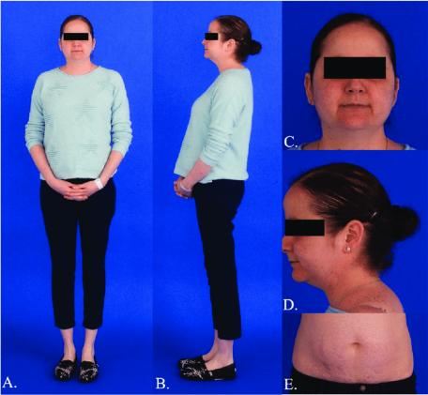
Definition
Cushing syndrome occurs when your body has too much of the hormone cortisol over time.
3
Notes:
SAY: Before we wrap up the course, let’s review what we have learned today.
During this course, we have
<READ the bullets from the slide.>
GO to next slide.

Slide 4
Introduction
This can result from taking oral corticosteroid medication. Or your body might produce too much cortisol.
Too much cortisol can cause some of the hallmark signs of Cushing syndrome — a fatty hump between your shoulders, a rounded face, and pink or purple stretch marks on your skin. Cushing syndrome can also result in high blood pressure, bone loss and, on occasion, type 2 diabetes.
4
Notes:
SAY: Before we wrap up the course, let’s review what we have learned today.
During this course, we have
<READ the bullets from the slide.>
GO to next slide.

Slide 5
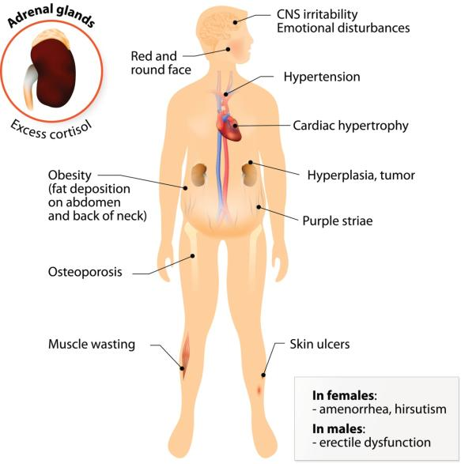
Symptoms of Cushing Syndrome
5
Notes:
SAY: Before we wrap up the course, let’s review what we have learned today.
During this course, we have
<READ the bullets from the slide.>
GO to next slide.

Slide 6
Causes of Cushing Syndrome
Too much of the hormone cortisol in your body causes Cushing syndrome. Cortisol, which is produced in the adrenal glands, plays a variety of roles in your body.
For example, cortisol helps regulate your blood pressure, reduces inflammation, and keeps your heart and blood vessels functioning normally. Cortisol helps your body respond to stress.
●●●
6
Notes:
SAY:
The purpose of epidemiology in public health practice is to
discover the agent, host, and environmental factors that affect health;
determine the relative importance of causes of illness, disability, and death;
identify those segments of the population that have the greatest risk from specific causes of ill health; and
evaluate the effectiveness of health programs and services in improving population health.
GO to next slide.

Slide 7
Causes of Cushing Syndrome
Cushing syndrome can develop from taking oral corticosteroid medications, such as prednisone, in high doses over time.
Oral corticosteroids may be necessary to treat inflammatory diseases, such as rheumatoid arthritis, lupus and asthma. They may also be used to prevent your body from rejecting a transplanted organ.
●●●
7
Notes:
SAY:
The purpose of epidemiology in public health practice is to
discover the agent, host, and environmental factors that affect health;
determine the relative importance of causes of illness, disability, and death;
identify those segments of the population that have the greatest risk from specific causes of ill health; and
evaluate the effectiveness of health programs and services in improving population health.
GO to next slide.

Slide 8
Causes of Cushing Syndrome
A pituitary gland tumor (pituitary adenoma).
A noncancerous (benign) tumor of the pituitary gland, located at the base of the brain, produces an excess amount of ACTH, which in turn stimulates the adrenal glands to make more cortisol. When this form of the syndrome develops, it's called Cushing disease.
●●●
8
Notes:
SAY:
The purpose of epidemiology in public health practice is to
discover the agent, host, and environmental factors that affect health;
determine the relative importance of causes of illness, disability, and death;
identify those segments of the population that have the greatest risk from specific causes of ill health; and
evaluate the effectiveness of health programs and services in improving population health.
GO to next slide.

Slide 9
Causes of Cushing Syndrome
An ACTH-secreting tumor.
Rarely, a tumor that develops in an organ that normally doesn't produce ACTH will begin to secrete this hormone in excess. These tumors, which can be noncancerous (benign) or cancerous (malignant), are usually found in the lungs, pancreas, thyroid or thymus gland.
●●●
9
Notes:
SAY:
The purpose of epidemiology in public health practice is to
discover the agent, host, and environmental factors that affect health;
determine the relative importance of causes of illness, disability, and death;
identify those segments of the population that have the greatest risk from specific causes of ill health; and
evaluate the effectiveness of health programs and services in improving population health.
GO to next slide.

Slide 10
Causes of Cushing Syndrome
A primary adrenal gland disease.
Disorders of the adrenal glands can cause them to produce too much cortisol. The most common is a noncancerous tumor of the adrenal cortex, called an adrenal adenoma, but only a small fraction of adenomas produce too much cortisol.
●●●
10
Notes:
SAY:
The purpose of epidemiology in public health practice is to
discover the agent, host, and environmental factors that affect health;
determine the relative importance of causes of illness, disability, and death;
identify those segments of the population that have the greatest risk from specific causes of ill health; and
evaluate the effectiveness of health programs and services in improving population health.
GO to next slide.

Slide 11
Causes of Cushing Syndrome
Familial Cushing syndrome.
Rarely, people inherit a tendency to develop tumors on one or more of their endocrine glands, affecting cortisol levels and causing Cushing syndrome.
11
Notes:
SAY:
The purpose of epidemiology in public health practice is to
discover the agent, host, and environmental factors that affect health;
determine the relative importance of causes of illness, disability, and death;
identify those segments of the population that have the greatest risk from specific causes of ill health; and
evaluate the effectiveness of health programs and services in improving population health.
GO to next slide.

Slide 12
Complications of Cushing Syndrome
Bone loss (osteoporosis), which can result in unusual bone fractures, such as rib fractures and fractures of the bones in the feet
High blood pressure (hypertension)
Type 2 diabetes
Frequent or unusual infections
Loss of muscle mass and strength
12
Notes:
SAY:
The purpose of epidemiology in public health practice is to
discover the agent, host, and environmental factors that affect health;
determine the relative importance of causes of illness, disability, and death;
identify those segments of the population that have the greatest risk from specific causes of ill health; and
evaluate the effectiveness of health programs and services in improving population health.
GO to next slide.

Slide 13
Diagnosis of Cushing Syndrome
Urine and blood tests. These tests measure hormone levels and show whether your body is producing excessive cortisol.
Saliva test. Cortisol levels normally rise and fall throughout the day. In people without Cushing syndrome, levels of cortisol drop significantly in the evening
●●●
13
Notes:
SAY:
The purpose of epidemiology in public health practice is to
discover the agent, host, and environmental factors that affect health;
determine the relative importance of causes of illness, disability, and death;
identify those segments of the population that have the greatest risk from specific causes of ill health; and
evaluate the effectiveness of health programs and services in improving population health.
GO to next slide.

Slide 14
Diagnosis of Cushing Syndrome
Imaging tests. CT or MRI scans can provide images of your pituitary and adrenal glands to detect abnormalities, such as tumors.
Petrosal sinus sampling. This test can help determine whether the cause of Cushing syndrome is rooted in the pituitary or somewhere else.
14
Notes:
SAY:
The purpose of epidemiology in public health practice is to
discover the agent, host, and environmental factors that affect health;
determine the relative importance of causes of illness, disability, and death;
identify those segments of the population that have the greatest risk from specific causes of ill health; and
evaluate the effectiveness of health programs and services in improving population health.
GO to next slide.

Slide 15
Treatment of Cushing Syndrome
Reducing corticosteroid use
If the cause of Cushing syndrome is long-term use of corticosteroid medications, your doctor may be able to keep your Cushing syndrome signs and symptoms under control by reducing the dosage of the drug over a period of time, while still managing the condition for which you take it
●●●
15
Notes:
SAY:
The purpose of epidemiology in public health practice is to
discover the agent, host, and environmental factors that affect health;
determine the relative importance of causes of illness, disability, and death;
identify those segments of the population that have the greatest risk from specific causes of ill health; and
evaluate the effectiveness of health programs and services in improving population health.
GO to next slide.

Slide 16
Treatment of Cushing Syndrome
Surgery
If the cause of Cushing syndrome is a tumor, your doctor may recommend complete surgical removal.
Radiation therapy
If the surgeon can't totally remove a pituitary tumor, he or she will usually prescribe radiation therapy as well as surgery.
16
Notes:
SAY:
The purpose of epidemiology in public health practice is to
discover the agent, host, and environmental factors that affect health;
determine the relative importance of causes of illness, disability, and death;
identify those segments of the population that have the greatest risk from specific causes of ill health; and
evaluate the effectiveness of health programs and services in improving population health.
GO to next slide.

Slide 17
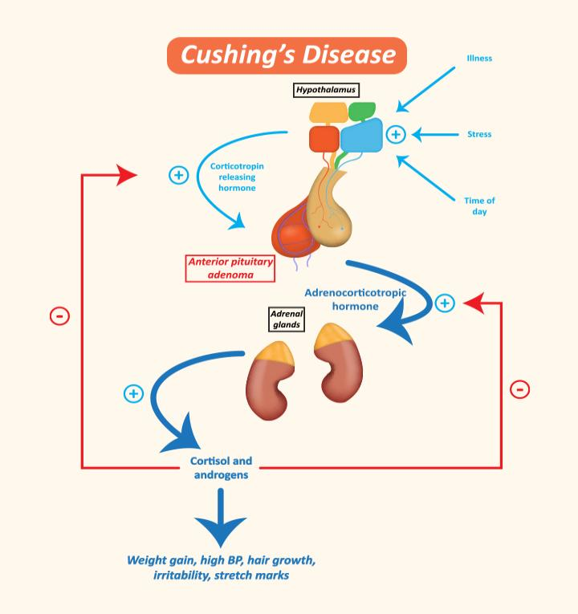

Slide 18
Conclusion
Cushing's syndrome is a rare disorder resulting from prolonged exposure to excess glucocorticoids.
Early diagnosis and treatment of Cushing's syndrome is associated with a decrease in morbidity and mortality.
18
Notes:
SAY:
The purpose of epidemiology in public health practice is to
discover the agent, host, and environmental factors that affect health;
determine the relative importance of causes of illness, disability, and death;
identify those segments of the population that have the greatest risk from specific causes of ill health; and
evaluate the effectiveness of health programs and services in improving population health.
GO to next slide.

Slide 19
References
Google.com
Wikipedia.org
Studymafia.org
Slidespanda.com

Slide 20
Thanks To StudyMafia.org

