Slide 1
StudyMafia.Org
Cyber Attacks
Submitted To: Submitted By:
Studymafia.org Studymafia.org

Slide 2
Table Contents
Definition
Common Cyber Attacks
How To Prevent Cyber Attacks
Conclusion
2
Notes:
SAY: Before we wrap up the course, let’s review what we have learned today.
During this course, we have
<READ the bullets from the slide.>
GO to next slide.

Slide 3
Definition
A cyber attack is a cybercrime that uses one or more computers to target a single or numerous computers or networks.
A cyber attack can be used to intentionally disable machines, steal data, or launch additional attacks from a compromised computer. Ransomware, phishing, malware, and denial of service are just a few of the tools used by cybercriminals to start a cyber attack.
3
Notes:
SAY: Before we wrap up the course, let’s review what we have learned today.
During this course, we have
<READ the bullets from the slide.>
GO to next slide.

Slide 4
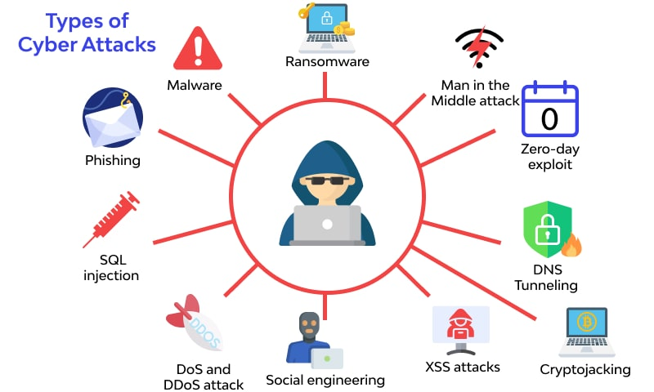
4
Notes:
SAY: Before we wrap up the course, let’s review what we have learned today.
During this course, we have
<READ the bullets from the slide.>
GO to next slide.

Slide 5
Common Cyber Security Attacks
Malware
Malware refers to a wide range of threats, comprising worms, viruses, and spyware.
When a user opens a "planted" harmful link or email attachment, that is used to install malicious code inside the system, malware exploits a vulnerability to breach a network.
The most common type of malware includes viruses, trojans, worms, ransomware, spyware.
●●●
5
Notes:
SAY:
The purpose of epidemiology in public health practice is to
discover the agent, host, and environmental factors that affect health;
determine the relative importance of causes of illness, disability, and death;
identify those segments of the population that have the greatest risk from specific causes of ill health; and
evaluate the effectiveness of health programs and services in improving population health.
GO to next slide.

Slide 6
Common Cyber Security Attacks
Phishing
Phishing attacks are very frequent, and they include sending a large number of counterfeit emails to unsuspecting users while pretending to be from a trustworthy source.
Man-in-the-Middle Attacks
When an attacker intercepts a two-party transaction and inserts himself in the middle, this is known as a middleman attack. By disrupting traffic, cyber intruders can steal and change data from there.
●●●
6
Notes:
SAY:
The purpose of epidemiology in public health practice is to
discover the agent, host, and environmental factors that affect health;
determine the relative importance of causes of illness, disability, and death;
identify those segments of the population that have the greatest risk from specific causes of ill health; and
evaluate the effectiveness of health programs and services in improving population health.
GO to next slide.

Slide 7
Common Cyber Security Attacks
Denial-of-Service
DoS attacks overload resources and bandwidth by flooding systems, servers, and/or networks with traffic. The system is unable to process and fulfill legitimate requests as a result.
SQL Injections
When an attacker uses server query language (SQL) to inject malicious code into a server, the server is forced to divulge protected information.
●●●
7
Notes:
SAY:
The purpose of epidemiology in public health practice is to
discover the agent, host, and environmental factors that affect health;
determine the relative importance of causes of illness, disability, and death;
identify those segments of the population that have the greatest risk from specific causes of ill health; and
evaluate the effectiveness of health programs and services in improving population health.
GO to next slide.

Slide 8
Common Cyber Security Attacks
Cross-site Scripting
In a cross-site scripting attack, malicious scripts are embedded in information from reliable sources. The malicious code is attached to the dynamic content delivered to the victim's browser.
Rootkits
Rootkits are hidden inside legitimate software, allowing them to take control of a system remotely and acquire administrative access.
●●●
8
Notes:
SAY:
The purpose of epidemiology in public health practice is to
discover the agent, host, and environmental factors that affect health;
determine the relative importance of causes of illness, disability, and death;
identify those segments of the population that have the greatest risk from specific causes of ill health; and
evaluate the effectiveness of health programs and services in improving population health.
GO to next slide.

Slide 9
Common Cyber Security Attacks
Zero-day Exploit:
Exploiting the vulnerable systems when it becomes new and recently announced — before a fix is available and/or applied — is known as a Zero-day Exploit. Zero-day attackers take advantage of a newly discovered vulnerability within a brief window of time when no solutions or preventative measures are available.
Password Attack:
Passwords are the most common technique of gaining access to the secured information system, which makes them an appealing target for cybercriminals.
●●●
9
Notes:
SAY:
The purpose of epidemiology in public health practice is to
discover the agent, host, and environmental factors that affect health;
determine the relative importance of causes of illness, disability, and death;
identify those segments of the population that have the greatest risk from specific causes of ill health; and
evaluate the effectiveness of health programs and services in improving population health.
GO to next slide.

Slide 10
Common Cyber Security Attacks
Internet of Things (IoT) Attacks:
Although internet connectivity on nearly any device provides convenience and ease for users, it also presents attackers with a growing—almost infinite—number of access points to exploit and cause havoc.
Attackers can breach an entry point and use it as a gate to exploit other devices in the network because of the interconnectivity of things.
10
Notes:
SAY:
The purpose of epidemiology in public health practice is to
discover the agent, host, and environmental factors that affect health;
determine the relative importance of causes of illness, disability, and death;
identify those segments of the population that have the greatest risk from specific causes of ill health; and
evaluate the effectiveness of health programs and services in improving population health.
GO to next slide.

Slide 11
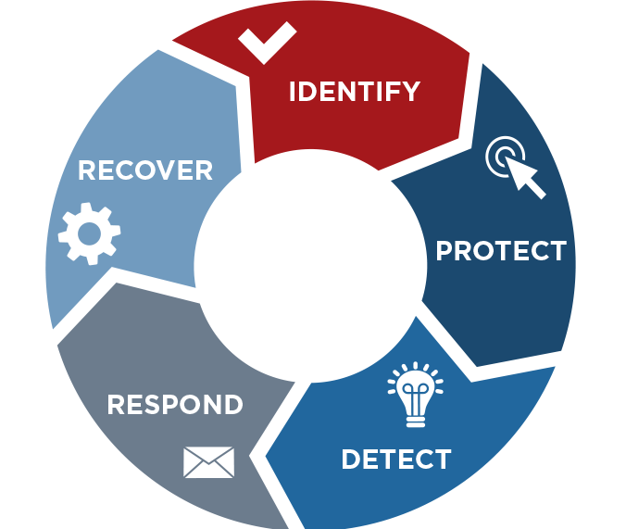
How to Prevent Cyber Attacks?

Slide 12
How to Prevent Cyber Attacks?
Conduct Audits Regularly
Cybersecurity audits provide a comprehensive, 360-degree assessment of your company's security postures.
It recognizes the vulnerabilities, risks, and threats that companies face, as well as the impact that these risks have on network security, physical security, data security, system security, and operational security.
●●●
12
Notes:
SAY:
The purpose of epidemiology in public health practice is to
discover the agent, host, and environmental factors that affect health;
determine the relative importance of causes of illness, disability, and death;
identify those segments of the population that have the greatest risk from specific causes of ill health; and
evaluate the effectiveness of health programs and services in improving population health.
GO to next slide.

Slide 13
How to Prevent Cyber Attacks?
Bring Awareness To Your Staff About Cyber Attacks
The key to a successful security awareness program is ensuring that the appropriate training is given to the appropriate personnel. Cyber threats affect all users; however, some staff has a higher threat profile than others.
For instance, your Finance and HR departments would be regularly targeted because of their privileged access to confidential information.
●●●
13
Notes:
SAY:
The purpose of epidemiology in public health practice is to
discover the agent, host, and environmental factors that affect health;
determine the relative importance of causes of illness, disability, and death;
identify those segments of the population that have the greatest risk from specific causes of ill health; and
evaluate the effectiveness of health programs and services in improving population health.
GO to next slide.

Slide 14
How to Prevent Cyber Attacks?
Keep Your Software System Updated
As your operating system controls all of your computer's functions, it might be a vulnerable target for cybercriminals. Many built-in features in operating systems aid in the prevention of attacks.
The issue, though, is that cyber risks are continually evolving. That is why operating system vendors give updates regularly: To stay on top of the ever-changing threats posed by cybercriminals.
●●●
14
Notes:
SAY:
The purpose of epidemiology in public health practice is to
discover the agent, host, and environmental factors that affect health;
determine the relative importance of causes of illness, disability, and death;
identify those segments of the population that have the greatest risk from specific causes of ill health; and
evaluate the effectiveness of health programs and services in improving population health.
GO to next slide.

Slide 15
How to Prevent Cyber Attacks?
Installing Endpoint Detection & Response (EDR)
Endpoint threat detection and response (ETDR), often known as EDR, is a comprehensive endpoint security system that blends real-time continuous monitoring and endpoint data collection with rules-based automated reaction and analysis capabilities.
Deploying Next-Generation Firewalls (NGFW)
NGFW is a network security device that goes beyond a typical stateful firewall in terms of capabilities. Modern threats like advanced malware and application-layer attacks can be blocked with NGFWs and access control.
●●●
15
Notes:
SAY:
The purpose of epidemiology in public health practice is to
discover the agent, host, and environmental factors that affect health;
determine the relative importance of causes of illness, disability, and death;
identify those segments of the population that have the greatest risk from specific causes of ill health; and
evaluate the effectiveness of health programs and services in improving population health.
GO to next slide.

Slide 16
How to Prevent Cyber Attacks?
Installing Spam Filters And Anti-Malware Software
Installing a spam filter application detects unsolicited, unwanted, and virus-infected emails and blocks them from reaching the inbox of a user.
A spam filter, like other types of filtering software, looks for certain criteria to use when making decisions.
Backup Encrypt Data
An encrypted backup is an additional security mechanism that organizations use to protect their data if it is stolen, misplaced, or otherwise compromised.
●●●
16
Notes:
SAY:
The purpose of epidemiology in public health practice is to
discover the agent, host, and environmental factors that affect health;
determine the relative importance of causes of illness, disability, and death;
identify those segments of the population that have the greatest risk from specific causes of ill health; and
evaluate the effectiveness of health programs and services in improving population health.
GO to next slide.

Slide 17
How to Prevent Cyber Attacks?
Use Two-Factor Authentication
Two-factor authentication (also known as 2FA) is a security solution that needs two different forms of identification to gain access to something.
Two-factor authentication is a security feature that prevents unwanted users from getting access to an account using only a stolen password.
●●●
17
Notes:
SAY:
The purpose of epidemiology in public health practice is to
discover the agent, host, and environmental factors that affect health;
determine the relative importance of causes of illness, disability, and death;
identify those segments of the population that have the greatest risk from specific causes of ill health; and
evaluate the effectiveness of health programs and services in improving population health.
GO to next slide.

Slide 18
How to Prevent Cyber Attacks?
Secure Confidential Data
Data Confidentiality is concerned with preventing information from being disclosed by ensuring that access to the data is restricted to those who are authorized or by portraying the data in such a manner that its semantics are only accessible to those who have access to crucial information.
Confidentiality is ensured by implementing several mechanisms such as file encryption, data access management, device management, etc.
●●●
18
Notes:
SAY:
The purpose of epidemiology in public health practice is to
discover the agent, host, and environmental factors that affect health;
determine the relative importance of causes of illness, disability, and death;
identify those segments of the population that have the greatest risk from specific causes of ill health; and
evaluate the effectiveness of health programs and services in improving population health.
GO to next slide.

Slide 19
How to Prevent Cyber Attacks?
Invest in cyber security insurance
As per US CISA, cyber insurance alleviate losses from cyber incidents such as “data theft or/and/ destruction, denial of service attacks, hacking, extortion demands, data breach-related crisis management activities, and legal claims for fraud, defamation, and privacy violations.” Legal defense, customer reparations, Data recovery, system forensics, and other expenditures are covered by cyber insurance coverage.
19
Notes:
SAY:
The purpose of epidemiology in public health practice is to
discover the agent, host, and environmental factors that affect health;
determine the relative importance of causes of illness, disability, and death;
identify those segments of the population that have the greatest risk from specific causes of ill health; and
evaluate the effectiveness of health programs and services in improving population health.
GO to next slide.

Slide 20
Conclusion
Cyberattacks are becoming more complex and diverse, with a different form of attack for each malicious objective. However, cybersecurity preventative tactics vary by attack type, strong security practices, and basic IT hygiene are generally effective in reducing these threats.
We have learned such various preventive measures in brief and also have successfully comprehended cyberattacks and various types that invoke in breaching the security.
20
Notes:
SAY:
The purpose of epidemiology in public health practice is to
discover the agent, host, and environmental factors that affect health;
determine the relative importance of causes of illness, disability, and death;
identify those segments of the population that have the greatest risk from specific causes of ill health; and
evaluate the effectiveness of health programs and services in improving population health.
GO to next slide.

Slide 21
Thanks To StudyMafia.org

