Slide 1
StudyMafia.Org
Computer-Aided Design(CAD)
Submitted To: Submitted By:
Studymafia.org Studymafia.org

Slide 2
Table Contents
Definition
Introduction
Who Uses CAD?
Benefits of CAD
Tools Used in CAD
Conclusion
2
Notes:
SAY: Before we wrap up the course, let’s review what we have learned today.
During this course, we have
<READ the bullets from the slide.>
GO to next slide.

Slide 3
Definition
CAD (computer-aided design) is the use of computer-based software to aid in design processes.
3
Notes:
SAY: Before we wrap up the course, let’s review what we have learned today.
During this course, we have
<READ the bullets from the slide.>
GO to next slide.

Slide 4
Introduction
The purpose of CAD is to optimize and streamline the designer's workflow, increase productivity, improve the quality and level of detail in the design, improve documentation communications and often contribute toward a manufacturing design database.
CAD software outputs come in the form of electronic files, which are then used accordingly for manufacturing processes.
4
Notes:
SAY: Before we wrap up the course, let’s review what we have learned today.
During this course, we have
<READ the bullets from the slide.>
GO to next slide.

Slide 5
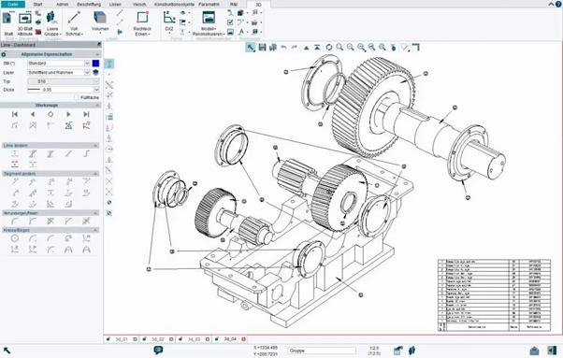
5
Notes:
SAY: Before we wrap up the course, let’s review what we have learned today.
During this course, we have
<READ the bullets from the slide.>
GO to next slide.

Slide 6
Who Uses CAD?
Computer-aided design is used in a wide variety of professions.
CAD software is used heavily within various architecture, arts and engineering projects.
CAD use cases are specific to industry and job functions.
●●●
6
Notes:
SAY:
The purpose of epidemiology in public health practice is to
discover the agent, host, and environmental factors that affect health;
determine the relative importance of causes of illness, disability, and death;
identify those segments of the population that have the greatest risk from specific causes of ill health; and
evaluate the effectiveness of health programs and services in improving population health.
GO to next slide.

Slide 7
Who Uses CAD?
Professions that use CAD tools include, but are not limited to:
Architects
Engineers
City planners
Graphic designers
Animation illustrators
Drafters
●●●
7
Notes:
SAY:
The purpose of epidemiology in public health practice is to
discover the agent, host, and environmental factors that affect health;
determine the relative importance of causes of illness, disability, and death;
identify those segments of the population that have the greatest risk from specific causes of ill health; and
evaluate the effectiveness of health programs and services in improving population health.
GO to next slide.

Slide 8
Who Uses CAD?
Fashion designers
Interior designers
Exterior designers
Game designers
Product designers
Industrial designers
Manufacturers
8
Notes:
SAY:
The purpose of epidemiology in public health practice is to
discover the agent, host, and environmental factors that affect health;
determine the relative importance of causes of illness, disability, and death;
identify those segments of the population that have the greatest risk from specific causes of ill health; and
evaluate the effectiveness of health programs and services in improving population health.
GO to next slide.

Slide 9
Benefits of CAD
Compared to traditional technical sketching and manual drafting, the use of CAD design tools can have significant benefits for engineers and designers:
Lower production costs for designs;
Quicker project completion due to efficient workflow and design process;
●●●
9
Notes:
SAY:
The purpose of epidemiology in public health practice is to
discover the agent, host, and environmental factors that affect health;
determine the relative importance of causes of illness, disability, and death;
identify those segments of the population that have the greatest risk from specific causes of ill health; and
evaluate the effectiveness of health programs and services in improving population health.
GO to next slide.

Slide 10
Benefits of CAD
Changes can be made independent of other design details, without the need to completely re-do a sketch;
Higher quality designs with documentation (such as angles, measurements, presets) built into the file;
Use of digital files can make collaborating with colleagues more simple.
●●●
10
Notes:
SAY:
The purpose of epidemiology in public health practice is to
discover the agent, host, and environmental factors that affect health;
determine the relative importance of causes of illness, disability, and death;
identify those segments of the population that have the greatest risk from specific causes of ill health; and
evaluate the effectiveness of health programs and services in improving population health.
GO to next slide.

Slide 11
Benefits of CAD
Clearer designs, better legibility and ease of interpretation by collaborators, as handmade drawings are not as clear or detailed;
Software features can support generative design, solid modeling, and other technical functions.
11
Notes:
SAY:
The purpose of epidemiology in public health practice is to
discover the agent, host, and environmental factors that affect health;
determine the relative importance of causes of illness, disability, and death;
identify those segments of the population that have the greatest risk from specific causes of ill health; and
evaluate the effectiveness of health programs and services in improving population health.
GO to next slide.

Slide 12
Tools Used in CAD
A number of CAD tools exist to assist designers and engineers. Some CAD tools are tailored to fit specific use cases and industries, such as industrial design or architecture.
Other CAD software tools can be used to support a variety of industries and project types.
●●●
12
Notes:
SAY:
The purpose of epidemiology in public health practice is to
discover the agent, host, and environmental factors that affect health;
determine the relative importance of causes of illness, disability, and death;
identify those segments of the population that have the greatest risk from specific causes of ill health; and
evaluate the effectiveness of health programs and services in improving population health.
GO to next slide.

Slide 13
Tools Used in CAD
Some widely-used CAD tools are:
MicroStation (offered by Bentley Systems)
AutoCAD (offered by Autodesk)
CorelCAD
IronCAD
CADTalk
SolidWorks
●●●
13
Notes:
SAY:
The purpose of epidemiology in public health practice is to
discover the agent, host, and environmental factors that affect health;
determine the relative importance of causes of illness, disability, and death;
identify those segments of the population that have the greatest risk from specific causes of ill health; and
evaluate the effectiveness of health programs and services in improving population health.
GO to next slide.

Slide 14
Tools Used in CAD
Onshape
Catia
LibreCAD
OpenSCAD
Vectorworks
Solid Edge
Altium Designer
14
Notes:
SAY:
The purpose of epidemiology in public health practice is to
discover the agent, host, and environmental factors that affect health;
determine the relative importance of causes of illness, disability, and death;
identify those segments of the population that have the greatest risk from specific causes of ill health; and
evaluate the effectiveness of health programs and services in improving population health.
GO to next slide.

Slide 16
Conclusion
Computer-aided design is a way to digitally create 2D drawings and 3D models of real-world products—before they're ever manufactured.
With 3D CAD, you can share, review, simulate, and modify designs easily, opening doors to innovative and differentiated products that get to market fast.
16
Notes:
SAY:
The purpose of epidemiology in public health practice is to
discover the agent, host, and environmental factors that affect health;
determine the relative importance of causes of illness, disability, and death;
identify those segments of the population that have the greatest risk from specific causes of ill health; and
evaluate the effectiveness of health programs and services in improving population health.
GO to next slide.

Slide 17
Thanks To StudyMafia.org

