Slide 1
StudyMafia.Org
Blindness
Submitted To: Submitted By:
Studymafia.org Studymafia.org

Slide 2
Table Contents
Definition
Introduction
Symptoms of Blindness
Causes of Blindness
Risk-Factors of Blindness
Prevention of Blindness
Diagnosis of Blindness
Treatment of Blindness
Conclusion
2
Notes:
SAY: Before we wrap up the course, let’s review what we have learned today.
During this course, we have
<READ the bullets from the slide.>
GO to next slide.

Slide 3
Definition
Blindness is the inability to see anything, including light.
3
Notes:
SAY: Before we wrap up the course, let’s review what we have learned today.
During this course, we have
<READ the bullets from the slide.>
GO to next slide.

Slide 4
Introduction
If you’re partially blind, you have limited vision. For example, you may have blurry vision or the inability to distinguish the shapes of objects. Complete blindness means you can’t see at all.
Legal blindness refers to vision that’s highly compromised. What a person with regular vision can see from 200 feet away, a legally blind person can see from only 20 feet away.
Seek medical attention right away if you suddenly lose the ability to see.
4
Notes:
SAY: Before we wrap up the course, let’s review what we have learned today.
During this course, we have
<READ the bullets from the slide.>
GO to next slide.

Slide 5
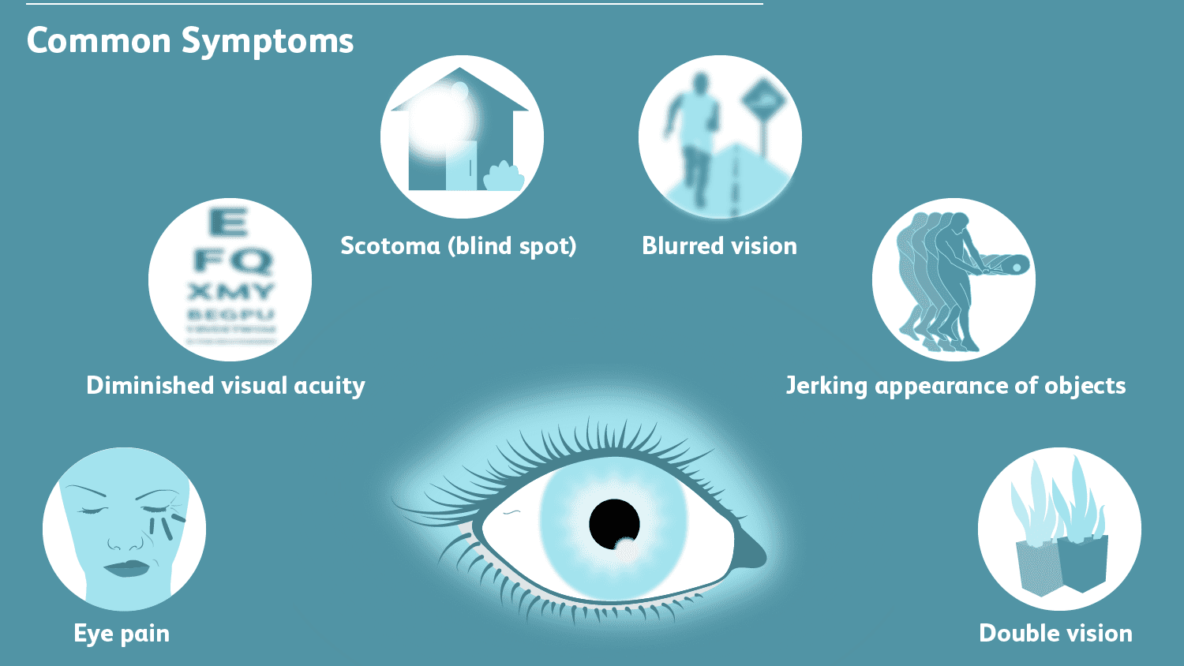
Symptoms of Blindness
5
Notes:
SAY: Before we wrap up the course, let’s review what we have learned today.
During this course, we have
<READ the bullets from the slide.>
GO to next slide.

Slide 6
Causes of Blindness
Glaucoma refers to different eye conditions that can damage your optic nerve, which carries visual information from your eyes to your brain.
Macular degeneration destroys the part of your eye that enables you to see details.
Cataracts cause cloudy vision. They’re more common in older people.
●●●
6
Notes:
SAY:
The purpose of epidemiology in public health practice is to
discover the agent, host, and environmental factors that affect health;
determine the relative importance of causes of illness, disability, and death;
identify those segments of the population that have the greatest risk from specific causes of ill health; and
evaluate the effectiveness of health programs and services in improving population health.
GO to next slide.

Slide 7
Causes of Blindness
A lazy eye can make it difficult to see details. It may lead to vision loss.
Optic neuritis is inflammation that can cause temporary or permanent vision loss.
Retinitis pigmentosa refers to damage of the retina. It leads to blindness only in rare cases.
●●●
7
Notes:
SAY:
The purpose of epidemiology in public health practice is to
discover the agent, host, and environmental factors that affect health;
determine the relative importance of causes of illness, disability, and death;
identify those segments of the population that have the greatest risk from specific causes of ill health; and
evaluate the effectiveness of health programs and services in improving population health.
GO to next slide.

Slide 8
Causes of Blindness
The following conditions can impair vision or cause blindness in infants:
Infections, such as pink eye
Blocked tear ducts
Cataracts
Strabismus (crossed eyes)
Amblyopia (lazy eye)
●●●
8
Notes:
SAY:
The purpose of epidemiology in public health practice is to
discover the agent, host, and environmental factors that affect health;
determine the relative importance of causes of illness, disability, and death;
identify those segments of the population that have the greatest risk from specific causes of ill health; and
evaluate the effectiveness of health programs and services in improving population health.
GO to next slide.

Slide 9
Causes of Blindness
Ptosis (droopy eyelid)
Congenital glaucoma
Retinopathy of prematurity (ROP), which occurs in premature babies when the blood vessels that supply their retina aren’t fully developed
Visual inattention, or delayed development of your child’s visual system
9
Notes:
SAY:
The purpose of epidemiology in public health practice is to
discover the agent, host, and environmental factors that affect health;
determine the relative importance of causes of illness, disability, and death;
identify those segments of the population that have the greatest risk from specific causes of ill health; and
evaluate the effectiveness of health programs and services in improving population health.
GO to next slide.

Slide 10
Risk-Factors of Blindness
The following categories of people are at risk for blindness:
People with eye diseases, such as macular degeneration and glaucoma
People with diabetes
People who have a stroke
●●●
10
Notes:
SAY:
The purpose of epidemiology in public health practice is to
discover the agent, host, and environmental factors that affect health;
determine the relative importance of causes of illness, disability, and death;
identify those segments of the population that have the greatest risk from specific causes of ill health; and
evaluate the effectiveness of health programs and services in improving population health.
GO to next slide.

Slide 11
Risk-Factors of Blindness
People undergoing eye surgery
People who work with or near sharp objects or toxic chemicals
Premature babies
11
Notes:
SAY:
The purpose of epidemiology in public health practice is to
discover the agent, host, and environmental factors that affect health;
determine the relative importance of causes of illness, disability, and death;
identify those segments of the population that have the greatest risk from specific causes of ill health; and
evaluate the effectiveness of health programs and services in improving population health.
GO to next slide.

Slide 12
Prevention of Blindness
To detect eye diseases and help prevent vision loss, get regular eye examinations.
If you receive a diagnosis of certain eye conditions, such as glaucoma, treatment with medication can help prevent blindness.
If you notice symptoms of vision loss between routine visits, make an appointment with their eye doctor immediately.
12
Notes:
SAY:
The purpose of epidemiology in public health practice is to
discover the agent, host, and environmental factors that affect health;
determine the relative importance of causes of illness, disability, and death;
identify those segments of the population that have the greatest risk from specific causes of ill health; and
evaluate the effectiveness of health programs and services in improving population health.
GO to next slide.

Slide 13
Diagnosis of Blindness
A thorough eye exam by an optometrist will help determine the cause of your blindness or partial loss of vision.
Your eye doctor will administer a series of tests that measure:
The clarity of your vision
The function of your eye muscles
How your pupils react to light
●●●
13
Notes:
SAY:
The purpose of epidemiology in public health practice is to
discover the agent, host, and environmental factors that affect health;
determine the relative importance of causes of illness, disability, and death;
identify those segments of the population that have the greatest risk from specific causes of ill health; and
evaluate the effectiveness of health programs and services in improving population health.
GO to next slide.

Slide 14
Diagnosis of Blindness
A pediatrician will screen your baby for eye problems shortly after birth. At 6 months of age, have an eye doctor or pediatrician check your child again for visual acuity, focus, and eye alignment.
The doctor will look at your baby’s eye structures and see whether they can follow a light or colorful object with their eyes.
14
Notes:
SAY:
The purpose of epidemiology in public health practice is to
discover the agent, host, and environmental factors that affect health;
determine the relative importance of causes of illness, disability, and death;
identify those segments of the population that have the greatest risk from specific causes of ill health; and
evaluate the effectiveness of health programs and services in improving population health.
GO to next slide.

Slide 15
Treatment of Blindness
In some cases of vision impairment, one or more of the following may help restore vision:
Eyeglasses
Contact lenses
Surgery
Medication
●●●
15
Notes:
SAY:
The purpose of epidemiology in public health practice is to
discover the agent, host, and environmental factors that affect health;
determine the relative importance of causes of illness, disability, and death;
identify those segments of the population that have the greatest risk from specific causes of ill health; and
evaluate the effectiveness of health programs and services in improving population health.
GO to next slide.

Slide 16
Treatment of Blindness
If you experience partial blindness that can’t be corrected, your doctor will provide guidance on how to function with limited vision.
For example, you can use a magnifying glass to read, increase the text size on your computer, and use audio clocks and audiobooks.
●●●
16
Notes:
SAY:
The purpose of epidemiology in public health practice is to
discover the agent, host, and environmental factors that affect health;
determine the relative importance of causes of illness, disability, and death;
identify those segments of the population that have the greatest risk from specific causes of ill health; and
evaluate the effectiveness of health programs and services in improving population health.
GO to next slide.

Slide 17
Treatment of Blindness
Complete blindness requires approaching life in a new way and learning new skills. For example, you may need to learn how to:
Read braille
Use a guide dog
Organize your home so you can easily find things and stay safe
Fold money in distinct ways to distinguish bill amounts
17
Notes:
SAY:
The purpose of epidemiology in public health practice is to
discover the agent, host, and environmental factors that affect health;
determine the relative importance of causes of illness, disability, and death;
identify those segments of the population that have the greatest risk from specific causes of ill health; and
evaluate the effectiveness of health programs and services in improving population health.
GO to next slide.

Slide 18
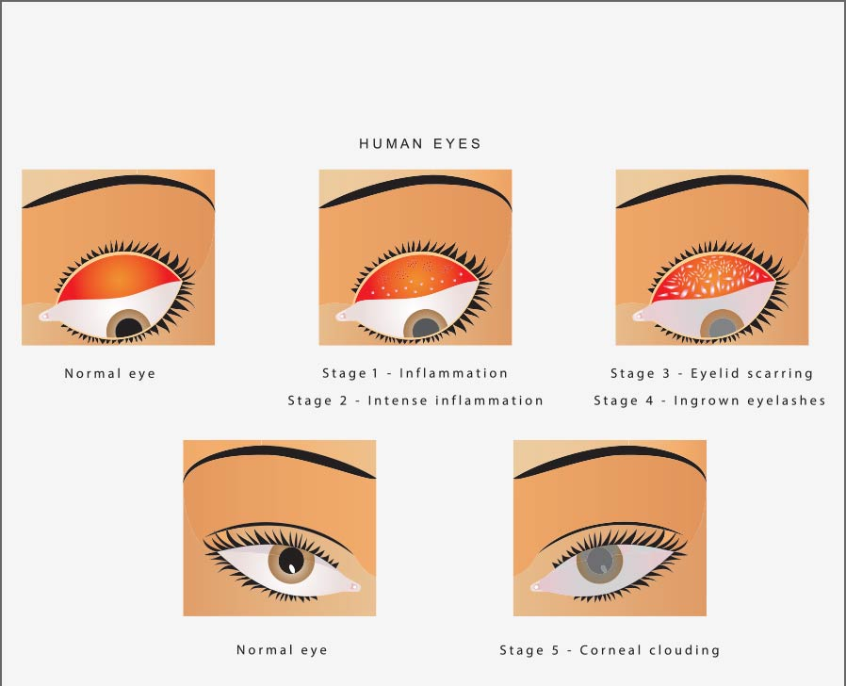

Slide 19
Conclusion
A person’s long-term outlook for restoring vision and slowing vision loss is better when treatment is preventive and sought immediately.
Surgery can effectively treat cataracts. They don’t necessarily result in blindness.
19
Notes:
SAY:
The purpose of epidemiology in public health practice is to
discover the agent, host, and environmental factors that affect health;
determine the relative importance of causes of illness, disability, and death;
identify those segments of the population that have the greatest risk from specific causes of ill health; and
evaluate the effectiveness of health programs and services in improving population health.
GO to next slide.

Slide 20
References
Google.com
Wikipedia.org
Studymafia.org
Slidespanda.com

Slide 21
Thanks To StudyMafia.org

