Slide 1
StudyMafia.Org
Back Care
Submitted To: Submitted By:
Studymafia.org Studymafia.org

Slide 2
Table Contents
Definition
Introduction
Purpose of Back Care
Contraindications of Back Care
Articles Needed for Back Care
Massage Techniques of Back Care
Procedure of Back Care
Conclusion
2
Notes:
SAY: Before we wrap up the course, let’s review what we have learned today.
During this course, we have
<READ the bullets from the slide.>
GO to next slide.

Slide 3
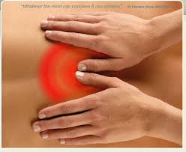
Definition
Scientific form of massaging the back using different massaging strokes to provide cutaneous stimulation and thus promote comfort.
3
Notes:
SAY: Before we wrap up the course, let’s review what we have learned today.
During this course, we have
<READ the bullets from the slide.>
GO to next slide.

Slide 4
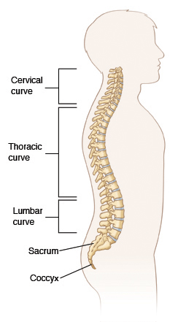
4
Notes:
SAY: Before we wrap up the course, let’s review what we have learned today.
During this course, we have
<READ the bullets from the slide.>
GO to next slide.

Slide 5
Purpose of Back Care
To relieve muscle tension
To promote physical and mental relaxation.
To relieve insomnia
To stimulate blood circulation
To assess the condition of skin
To prevent bedsore
5
Notes:
SAY:
The purpose of epidemiology in public health practice is to
discover the agent, host, and environmental factors that affect health;
determine the relative importance of causes of illness, disability, and death;
identify those segments of the population that have the greatest risk from specific causes of ill health; and
evaluate the effectiveness of health programs and services in improving population health.
GO to next slide.

Slide 6
Contraindications of Back Care
Patients with
Rib fracture
Burns
Immediate post operative period after coronary artery bypass graft
Spinal injuries
Surgeries on back
Lotion or oil
\
6
Notes:
SAY:
The purpose of epidemiology in public health practice is to
discover the agent, host, and environmental factors that affect health;
determine the relative importance of causes of illness, disability, and death;
identify those segments of the population that have the greatest risk from specific causes of ill health; and
evaluate the effectiveness of health programs and services in improving population health.
GO to next slide.

Slide 7
Articles Needed For Back Care
Lotion or oil
Bath towel
Bath blanket
Soap
Wash cloth
Warm water in basin
Mackintosh and draw sheet
If patient requires hygienic care, it should be provided, followed by massage
\
7
Notes:
SAY:
The purpose of epidemiology in public health practice is to
discover the agent, host, and environmental factors that affect health;
determine the relative importance of causes of illness, disability, and death;
identify those segments of the population that have the greatest risk from specific causes of ill health; and
evaluate the effectiveness of health programs and services in improving population health.
GO to next slide.

Slide 8
Massage Techniques of Back Care
Effleurage
They are long sweeping strokes that alternate between firm and light pressure and which can be performed using the palm of the hand or the fingertips.
The knots and tension in the muscles tend to get broken with this massage technique.
●●●
8
Notes:
SAY:
The purpose of epidemiology in public health practice is to
discover the agent, host, and environmental factors that affect health;
determine the relative importance of causes of illness, disability, and death;
identify those segments of the population that have the greatest risk from specific causes of ill health; and
evaluate the effectiveness of health programs and services in improving population health.
GO to next slide.

Slide 9
Massage Techniques of Back Care
Petrissage
This is the technique of kneading the muscles of the body to attain deeper massage penetration.
The thumbs and the knuckles of the fingers are used to knead the muscles of the body and to squeeze them to prepare them for the other massage techniques that follow.
●●●
9
Notes:
SAY:
The purpose of epidemiology in public health practice is to
discover the agent, host, and environmental factors that affect health;
determine the relative importance of causes of illness, disability, and death;
identify those segments of the population that have the greatest risk from specific causes of ill health; and
evaluate the effectiveness of health programs and services in improving population health.
GO to next slide.

Slide 10
Massage Techniques of Back Care
Tapotement or Rhythmic Tapping
As the name suggests, it consists of rhythmic tapping that uses the fists of the cupped hands.
This helps to loosen and relax the muscles being manipulated and also helps to energize them.
●●●
10
Notes:
SAY:
The purpose of epidemiology in public health practice is to
discover the agent, host, and environmental factors that affect health;
determine the relative importance of causes of illness, disability, and death;
identify those segments of the population that have the greatest risk from specific causes of ill health; and
evaluate the effectiveness of health programs and services in improving population health.
GO to next slide.

Slide 11
Massage Techniques of Back Care
Friction
This move seeks to create heat to bring about relaxation of the muscles.
The palms of the hand are rubbed together vigorously with each other, or they are rubbed onto the skin of the person being massaged in order to produce heat by friction
●●●
11
Notes:
SAY:
The purpose of epidemiology in public health practice is to
discover the agent, host, and environmental factors that affect health;
determine the relative importance of causes of illness, disability, and death;
identify those segments of the population that have the greatest risk from specific causes of ill health; and
evaluate the effectiveness of health programs and services in improving population health.
GO to next slide.

Slide 12
Massage Techniques of Back Care
Vibration or Shaking
This helps to loosen up the muscles by using a back and forth action of the fingertips or the heel of the hand over the skin.
The muscles of the body are litreally shaken up to loosen and relax the muscles.
●●●
12
Notes:
SAY:
The purpose of epidemiology in public health practice is to
discover the agent, host, and environmental factors that affect health;
determine the relative importance of causes of illness, disability, and death;
identify those segments of the population that have the greatest risk from specific causes of ill health; and
evaluate the effectiveness of health programs and services in improving population health.
GO to next slide.

Slide 13
Procedure of Back Care
Explain the procedure and the position to the patient.
Adjust bed to comfortable height.
Adjust light, temperature and sound within room.
Close curtains around bed. Lower the side rails and help patient assume prone or side lying position (sim’s position)
●●●
13
Notes:
SAY:
The purpose of epidemiology in public health practice is to
discover the agent, host, and environmental factors that affect health;
determine the relative importance of causes of illness, disability, and death;
identify those segments of the population that have the greatest risk from specific causes of ill health; and
evaluate the effectiveness of health programs and services in improving population health.
GO to next slide.

Slide 14
Procedure of Back Care
Expose patient’s back, shoulders, upper arms, and buttocks. Cover remainder of body.
Wash your hands with warm water.
Inform patient that lotion will feel cool and wet
Apply hands first to sacral area massaging in circular motion, stroke upwards from buttocks to shoulders
14
Notes:
SAY:
The purpose of epidemiology in public health practice is to
discover the agent, host, and environmental factors that affect health;
determine the relative importance of causes of illness, disability, and death;
identify those segments of the population that have the greatest risk from specific causes of ill health; and
evaluate the effectiveness of health programs and services in improving population health.
GO to next slide.

Slide 15
Procedure of Back Care
Continue in one smooth stroke from upper back to arm and laterally alongside of back, down to iliac crest.
Do not take hands off from patient’s back till the end of the procedure.
Continue massage pattern effleurage for at least 3 minutes.
●●●
15
Notes:
SAY:
The purpose of epidemiology in public health practice is to
discover the agent, host, and environmental factors that affect health;
determine the relative importance of causes of illness, disability, and death;
identify those segments of the population that have the greatest risk from specific causes of ill health; and
evaluate the effectiveness of health programs and services in improving population health.
GO to next slide.

Slide 16
Procedure of Back Care
Perform petrissage along upward along one side of spine from buttock to shoulders.
Perform tapotement for 2 minutes.
Apply other remaining massaging techniques for at least 2 minutes.
Apply oil or lubricants to back as required.
●●●
16
Notes:
SAY:
The purpose of epidemiology in public health practice is to
discover the agent, host, and environmental factors that affect health;
determine the relative importance of causes of illness, disability, and death;
identify those segments of the population that have the greatest risk from specific causes of ill health; and
evaluate the effectiveness of health programs and services in improving population health.
GO to next slide.

Slide 17
Procedure of Back Care
Wipe excess lubricant from patients back with bath towel/ tissue.
Retie gown or assist pajamas.
Help patient to comfortable position. Raise side rails as needed
Disposed of soiled towel and wash hands.
Record response to back massage and condition of skin.
●●●
17
Notes:
SAY:
The purpose of epidemiology in public health practice is to
discover the agent, host, and environmental factors that affect health;
determine the relative importance of causes of illness, disability, and death;
identify those segments of the population that have the greatest risk from specific causes of ill health; and
evaluate the effectiveness of health programs and services in improving population health.
GO to next slide.

Slide 18
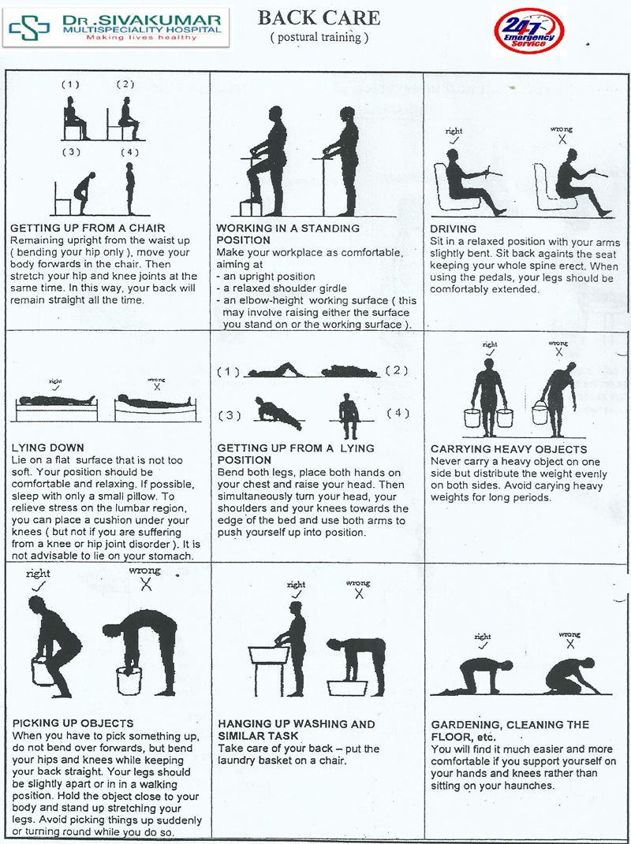

Slide 19
Conclusion
Back care consists of cleaning and massaging back (from shoulder to lower level of the buttocks) by using scientific form of required strokes for maximizing cutaneous stimulation, comfort and emotional relaxation as well.
19
Notes:
SAY:
The purpose of epidemiology in public health practice is to
discover the agent, host, and environmental factors that affect health;
determine the relative importance of causes of illness, disability, and death;
identify those segments of the population that have the greatest risk from specific causes of ill health; and
evaluate the effectiveness of health programs and services in improving population health.
GO to next slide.

Slide 20
Thanks To StudyMafia.org

