Slide 1
StudyMafia.Org
Anger
Management
Submitted To: Submitted By:
Studymafia.org Studymafia.org

Slide 2
Table Contents
Definition
Introduction
Causes of Anger
Management of Anger
Conclusion
2
Notes:
SAY: Before we wrap up the course, let’s review what we have learned today.
During this course, we have
<READ the bullets from the slide.>
GO to next slide.

Slide 3
Definition
Anger can make you feel as though you’re at the mercy of an unpredictable and powerful emotion.
3
Notes:
SAY: Before we wrap up the course, let’s review what we have learned today.
During this course, we have
<READ the bullets from the slide.>
GO to next slide.

Slide 4
Introduction
Anger is “an emotional state that varies in intensity from mild irritation to intense fury and rage,” according to Charles Spielberger, PhD, a psychologist who specializes in the study of anger.
Like other emotions, it is accompanied by physiological and biological changes; when you get angry, your heart rate and blood pressure go up, as do the levels of your energy hormones, adrenaline, and noradrenaline.
4
Notes:
SAY: Before we wrap up the course, let’s review what we have learned today.
During this course, we have
<READ the bullets from the slide.>
GO to next slide.

Slide 5
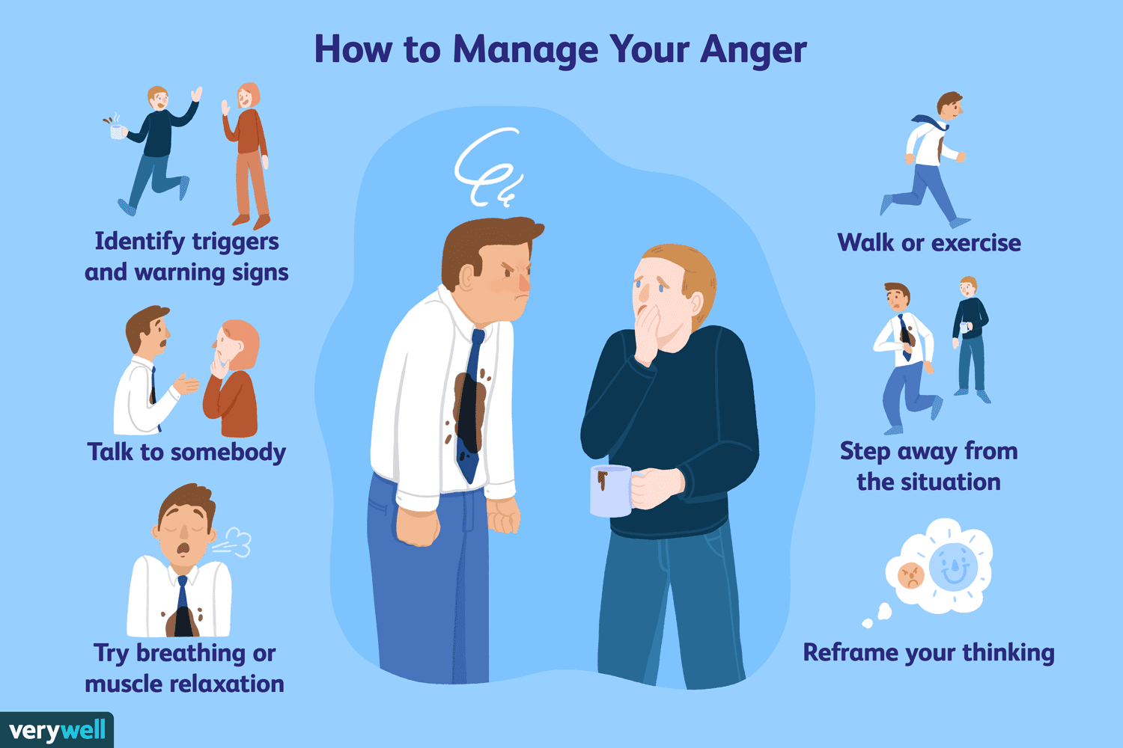
5
Notes:
SAY: Before we wrap up the course, let’s review what we have learned today.
During this course, we have
<READ the bullets from the slide.>
GO to next slide.

Slide 6
Causes of Anger
Anger can be caused by both external and internal events.
You could be angry at a specific person (such as a coworker or supervisor) or event (a traffic jam, a canceled flight), or your anger could be caused by worrying or brooding about your personal problems.
Memories of traumatic or enraging events can also trigger angry feelings.
6
Notes:
SAY:
The purpose of epidemiology in public health practice is to
discover the agent, host, and environmental factors that affect health;
determine the relative importance of causes of illness, disability, and death;
identify those segments of the population that have the greatest risk from specific causes of ill health; and
evaluate the effectiveness of health programs and services in improving population health.
GO to next slide.

Slide 8
Management of Anger
The goal of anger management is to reduce both your emotional feelings and the physiological arousal that anger causes.
You can’t get rid of, or avoid, the things or the people that enrage you, nor can you change them, but you can learn to control your reactions.
●●●
8
Notes:
SAY:
The purpose of epidemiology in public health practice is to
discover the agent, host, and environmental factors that affect health;
determine the relative importance of causes of illness, disability, and death;
identify those segments of the population that have the greatest risk from specific causes of ill health; and
evaluate the effectiveness of health programs and services in improving population health.
GO to next slide.

Slide 9
Management of Anger
Relaxation
Simple relaxation tools, such as deep breathing and relaxing imagery, can help calm down angry feelings. There are books and courses that can teach you relaxation techniques, and once you learn the techniques, you can call upon them in any situation.
●●●
9
Notes:
SAY:
The purpose of epidemiology in public health practice is to
discover the agent, host, and environmental factors that affect health;
determine the relative importance of causes of illness, disability, and death;
identify those segments of the population that have the greatest risk from specific causes of ill health; and
evaluate the effectiveness of health programs and services in improving population health.
GO to next slide.

Slide 10
Management of Anger
Breathe deeply, from your diaphragm; breathing from your chest won’t relax you. Picture your breath coming up from your “gut.”
Slowly repeat a calm word or phrase such as “relax,” “take it easy.” Repeat it to yourself while breathing deeply.
●●●
10
Notes:
SAY:
The purpose of epidemiology in public health practice is to
discover the agent, host, and environmental factors that affect health;
determine the relative importance of causes of illness, disability, and death;
identify those segments of the population that have the greatest risk from specific causes of ill health; and
evaluate the effectiveness of health programs and services in improving population health.
GO to next slide.

Slide 11
Management of Anger
Cognitive restructuring
Simply put, this means changing the way you think. Angry people tend to curse, swear, or speak in highly colorful terms that reflect their inner thoughts.
When you’re angry, your thinking can get very exaggerated and overly dramatic. Try replacing these thoughts with more rational ones.
●●●
11
Notes:
SAY:
The purpose of epidemiology in public health practice is to
discover the agent, host, and environmental factors that affect health;
determine the relative importance of causes of illness, disability, and death;
identify those segments of the population that have the greatest risk from specific causes of ill health; and
evaluate the effectiveness of health programs and services in improving population health.
GO to next slide.

Slide 12
Management of Anger
Problem solving
Sometimes, our anger and frustration are caused by very real and inescapable problems in our lives. Not all anger is misplaced, and often it’s a healthy, natural response to these difficulties.
There is also a cultural belief that every problem has a solution, and it adds to our frustration to find out that this isn’t always the case.
●●●
12
Notes:
SAY:
The purpose of epidemiology in public health practice is to
discover the agent, host, and environmental factors that affect health;
determine the relative importance of causes of illness, disability, and death;
identify those segments of the population that have the greatest risk from specific causes of ill health; and
evaluate the effectiveness of health programs and services in improving population health.
GO to next slide.

Slide 13
Management of Anger
Better communication
Angry people tend to jump to—and act on—conclusions, and some of those conclusions can be very inaccurate.
The first thing to do if you’re in a heated discussion is slow down and think through your responses.
●●●
13
Notes:
SAY:
The purpose of epidemiology in public health practice is to
discover the agent, host, and environmental factors that affect health;
determine the relative importance of causes of illness, disability, and death;
identify those segments of the population that have the greatest risk from specific causes of ill health; and
evaluate the effectiveness of health programs and services in improving population health.
GO to next slide.

Slide 14
Management of Anger
Using humor
“Silly humor” can help defuse rage in a number of ways. For one thing, it can help you get a more balanced perspective.
When you get angry and call someone a name or refer to them in some imaginative phrase, stop and picture what that word would literally look like.
●●●
14
Notes:
SAY:
The purpose of epidemiology in public health practice is to
discover the agent, host, and environmental factors that affect health;
determine the relative importance of causes of illness, disability, and death;
identify those segments of the population that have the greatest risk from specific causes of ill health; and
evaluate the effectiveness of health programs and services in improving population health.
GO to next slide.

Slide 15
Management of Anger
Changing your environment
Sometimes it’s our immediate surroundings that give us cause for irritation and fury.
Problems and responsibilities can weigh on you and make you feel angry at the “trap” you seem to have fallen into and all the people and things that form that trap.
●●●
15
Notes:
SAY:
The purpose of epidemiology in public health practice is to
discover the agent, host, and environmental factors that affect health;
determine the relative importance of causes of illness, disability, and death;
identify those segments of the population that have the greatest risk from specific causes of ill health; and
evaluate the effectiveness of health programs and services in improving population health.
GO to next slide.

Slide 16
Management of Anger
Timing:
If you and your spouse tend to fight when you discuss things at night—perhaps you’re tired, or distracted, or maybe it’s just habit—try changing the times when you talk about important matters so these talks don’t turn into arguments.
●●●
16
Notes:
SAY:
The purpose of epidemiology in public health practice is to
discover the agent, host, and environmental factors that affect health;
determine the relative importance of causes of illness, disability, and death;
identify those segments of the population that have the greatest risk from specific causes of ill health; and
evaluate the effectiveness of health programs and services in improving population health.
GO to next slide.

Slide 17
Management of Anger
Avoidance:
If your child’s chaotic room makes you furious every time you walk by it, shut the door. Don’t make yourself look at what infuriates you.
Don’t say, “well, my child should clean up the room so I won’t have to be angry!” That’s not the point. The point is to keep yourself calm.
●●●
17
Notes:
SAY:
The purpose of epidemiology in public health practice is to
discover the agent, host, and environmental factors that affect health;
determine the relative importance of causes of illness, disability, and death;
identify those segments of the population that have the greatest risk from specific causes of ill health; and
evaluate the effectiveness of health programs and services in improving population health.
GO to next slide.

Slide 18
Management of Anger
Finding alternatives:
If your daily commute through traffic leaves you in a state of rage and frustration, give yourself a project—learn or map out a different route, one that’s less congested or more scenic.
Or find another alternative, such as a bus or commuter train.
18
Notes:
SAY:
The purpose of epidemiology in public health practice is to
discover the agent, host, and environmental factors that affect health;
determine the relative importance of causes of illness, disability, and death;
identify those segments of the population that have the greatest risk from specific causes of ill health; and
evaluate the effectiveness of health programs and services in improving population health.
GO to next slide.

Slide 20
Conclusion
Learning the skills and techniques of successfully managing anger is a lot like learning a new language.
You can never learn “whole language,” because you can spend the rest of your life learning nuances, local phrases, and new vocabulary. Anger is an emotion that is exceedingly complex.
20
Notes:
SAY:
The purpose of epidemiology in public health practice is to
discover the agent, host, and environmental factors that affect health;
determine the relative importance of causes of illness, disability, and death;
identify those segments of the population that have the greatest risk from specific causes of ill health; and
evaluate the effectiveness of health programs and services in improving population health.
GO to next slide.

Slide 21
Thanks To StudyMafia.org

