Slide 1
StudyMafia.Org
Adrenaline
Submitted To: Submitted By:
Studymafia.org Studymafia.org

Slide 2
Table Contents
Definition
Introduction
What does Adrenaline do?
About Adrenaline
Adrenaline as a Medication
Side Effects of Adrenaline
Disorders Caused by Adrenaline
Conclusion
2
Notes:
SAY: Before we wrap up the course, let’s review what we have learned today.
During this course, we have
<READ the bullets from the slide.>
GO to next slide.

Slide 3
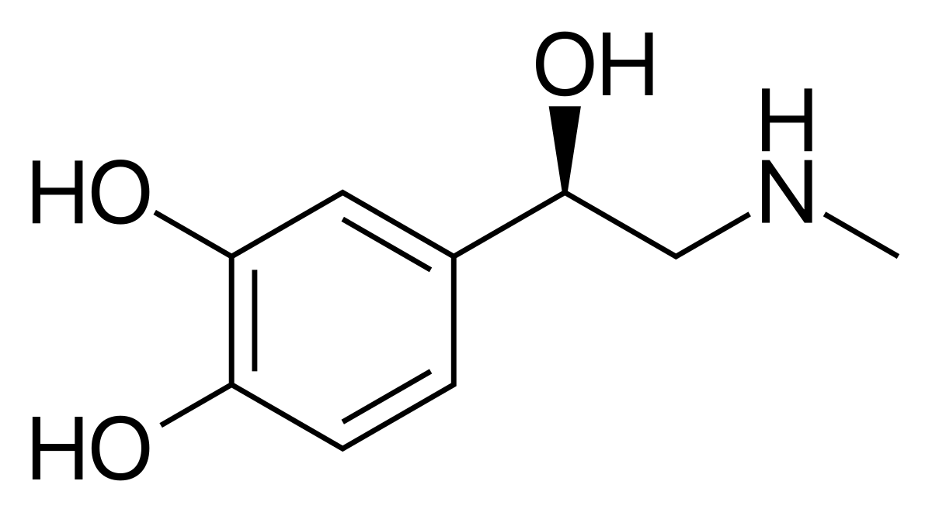
Definition
Epinephrine, also known as adrenaline, is both a neurotransmitter and a hormone. It plays an important role in your body’s “fight-or-flight” response. It’s also used as a medication to treat many life-threatening conditions.
3
Notes:
SAY: Before we wrap up the course, let’s review what we have learned today.
During this course, we have
<READ the bullets from the slide.>
GO to next slide.

Slide 4
Introduction
Epinephrine, also called adrenaline, is both a hormone and a neurotransmitter. As a hormone, it’s made and released by your adrenal glands, which are hat-shaped glands that sit on top of each kidney.
As a central nervous system neurotransmitter, it’s a chemical messenger that helps transmit nerve signals across nerve endings to another nerve cell, muscle cell or gland cell.
4
Notes:
SAY: Before we wrap up the course, let’s review what we have learned today.
During this course, we have
<READ the bullets from the slide.>
GO to next slide.

Slide 5
5
Notes:
SAY: Before we wrap up the course, let’s review what we have learned today.
During this course, we have
<READ the bullets from the slide.>
GO to next slide.

Slide 6
What does Adrenaline do?
As a neurotransmitter, epinephrine plays a small role. Only a small amount is produced in your nerves.
It plays a role in metabolism, attention, focus, panic and excitement.
Abnormal levels are linked to sleep disorders, anxiety, hypertension and lowered immunity.
●●●
6
Notes:
SAY:
The purpose of epidemiology in public health practice is to
discover the agent, host, and environmental factors that affect health;
determine the relative importance of causes of illness, disability, and death;
identify those segments of the population that have the greatest risk from specific causes of ill health; and
evaluate the effectiveness of health programs and services in improving population health.
GO to next slide.

Slide 7
What does Adrenaline do?
Epinephrine’s major action is in its role as a hormone.
Epinephrine is released by your adrenal glands in response to stress.
This reaction causes a number of changes in your body and is known as the fight-or-flight response.
7
Notes:
SAY:
The purpose of epidemiology in public health practice is to
discover the agent, host, and environmental factors that affect health;
determine the relative importance of causes of illness, disability, and death;
identify those segments of the population that have the greatest risk from specific causes of ill health; and
evaluate the effectiveness of health programs and services in improving population health.
GO to next slide.

Slide 8
About Adrenaline
The fight-or-flight response refers to your body’s response to a stressful situation, such as needing to escape danger (moving away from a growling dog) or facing a fear (giving a speech for school or work).
The term comes from the choice our ancestors faced when confronted with a dangerous situation — to stay and fight or run to safety.
●●●
8
Notes:
SAY:
The purpose of epidemiology in public health practice is to
discover the agent, host, and environmental factors that affect health;
determine the relative importance of causes of illness, disability, and death;
identify those segments of the population that have the greatest risk from specific causes of ill health; and
evaluate the effectiveness of health programs and services in improving population health.
GO to next slide.

Slide 9
About Adrenaline
During the fight-or-flight response, you (your brain) perceive danger. Next, nerves in an area of your brain called the hypothalamus send a signal down your spinal cord, then out to your body.
The neurotransmitter that transmits your brain’s nervous system message of what to do is norepinephrine (noradrenaline).
●●●
9
Notes:
SAY:
The purpose of epidemiology in public health practice is to
discover the agent, host, and environmental factors that affect health;
determine the relative importance of causes of illness, disability, and death;
identify those segments of the population that have the greatest risk from specific causes of ill health; and
evaluate the effectiveness of health programs and services in improving population health.
GO to next slide.

Slide 10
About Adrenaline
Eyes: Pupils dilate to let more light in to better see more of your surroundings.
Skin: Skin turns pale as blood vessels receive a signal to divert blood to areas more in need of your blood’s oxygen, such as your muscles, so you can fight or run away.
Muscles: Muscles receive more blood flow and oxygen so they can react with greater strength and speed.
●●●
10
Notes:
SAY:
The purpose of epidemiology in public health practice is to
discover the agent, host, and environmental factors that affect health;
determine the relative importance of causes of illness, disability, and death;
identify those segments of the population that have the greatest risk from specific causes of ill health; and
evaluate the effectiveness of health programs and services in improving population health.
GO to next slide.

Slide 11
About Adrenaline
Heart: Heart pumps harder and faster to deliver more oxygenated blood to areas most in need, like your muscles. Blood pressure also increases.
Liver: Stored glycogen in your liver is converted to glucose to provide more energy.
Airways: Breathing is deeper and faster. Your airways open up so more oxygen is delivered to the blood, which goes to your muscles.
●●●
11
Notes:
SAY:
The purpose of epidemiology in public health practice is to
discover the agent, host, and environmental factors that affect health;
determine the relative importance of causes of illness, disability, and death;
identify those segments of the population that have the greatest risk from specific causes of ill health; and
evaluate the effectiveness of health programs and services in improving population health.
GO to next slide.

Slide 12
About Adrenaline
The neurotransmitter noradrenaline also reaches your adrenal gland, which releases the hormones adrenaline (epinephrine) and noradrenaline (norepinephrine).
These hormones travel through your blood to all parts of your body. They reach your eyes, heart, airways, blood vessels in your skin and your adrenal gland again.
●●●
12
Notes:
SAY:
The purpose of epidemiology in public health practice is to
discover the agent, host, and environmental factors that affect health;
determine the relative importance of causes of illness, disability, and death;
identify those segments of the population that have the greatest risk from specific causes of ill health; and
evaluate the effectiveness of health programs and services in improving population health.
GO to next slide.

Slide 13
About Adrenaline
The “message” to these organs and tissues is to continue to do react until you’re out of danger.
This is a simple description of the fight-or-flight response. Other parts of your nervous system are also involved, as well as other organ systems, hormones and neurotransmitters.
13
Notes:
SAY:
The purpose of epidemiology in public health practice is to
discover the agent, host, and environmental factors that affect health;
determine the relative importance of causes of illness, disability, and death;
identify those segments of the population that have the greatest risk from specific causes of ill health; and
evaluate the effectiveness of health programs and services in improving population health.
GO to next slide.

Slide 14
Adrenaline as a Medication
Cardiac arrest/cardiopulmonary resuscitation (CPR): Epinephrine stimulates your heart.
Eye surgery: Epinephrine helps keep your pupils dilated.
Septic shock: Epinephrine increases your blood pressure.
Asthma: Epinephrine opens airways and decreases airway spasms.
●●●
14
Notes:
SAY:
The purpose of epidemiology in public health practice is to
discover the agent, host, and environmental factors that affect health;
determine the relative importance of causes of illness, disability, and death;
identify those segments of the population that have the greatest risk from specific causes of ill health; and
evaluate the effectiveness of health programs and services in improving population health.
GO to next slide.

Slide 15
Side Effects of Adrenaline
Allergic reactions like skin rash, itching or hives, swelling of your face, lips or tongue.
Breathing problems.
Chest pain.
Fast heartbeat.
Vomiting.
High blood pressure.
Nervousness.
●●●
15
Notes:
SAY:
The purpose of epidemiology in public health practice is to
discover the agent, host, and environmental factors that affect health;
determine the relative importance of causes of illness, disability, and death;
identify those segments of the population that have the greatest risk from specific causes of ill health; and
evaluate the effectiveness of health programs and services in improving population health.
GO to next slide.

Slide 16
Side Effects of Adrenaline
Palpitations.
Seizures.
Tremor.
Trouble passing urine or change in the amount of urine.
Trouble sleeping.
16
Notes:
SAY:
The purpose of epidemiology in public health practice is to
discover the agent, host, and environmental factors that affect health;
determine the relative importance of causes of illness, disability, and death;
identify those segments of the population that have the greatest risk from specific causes of ill health; and
evaluate the effectiveness of health programs and services in improving population health.
GO to next slide.

Slide 17
Disorders Caused by Adrenaline
Anxiety.
Depression.
Headaches.
Sleeping problems.
Low blood sugar (hypoglycemia).
Changes in blood pressure, heart rate.
High blood pressure (hypertension).
Rapid or irregular heartbeat.
●●●
17
Notes:
SAY:
The purpose of epidemiology in public health practice is to
discover the agent, host, and environmental factors that affect health;
determine the relative importance of causes of illness, disability, and death;
identify those segments of the population that have the greatest risk from specific causes of ill health; and
evaluate the effectiveness of health programs and services in improving population health.
GO to next slide.

Slide 18
Disorders Caused by Adrenaline
Excessive sweating.
Cold or pale skin.
Severe headaches.
Nervous feeling, jitters.
Epinephrine overdose, which can lead to high blood pressure, stroke and death.
Pheochromocytoma, which is an adrenal gland tumor.
18
Notes:
SAY:
The purpose of epidemiology in public health practice is to
discover the agent, host, and environmental factors that affect health;
determine the relative importance of causes of illness, disability, and death;
identify those segments of the population that have the greatest risk from specific causes of ill health; and
evaluate the effectiveness of health programs and services in improving population health.
GO to next slide.

Slide 20
Conclusion
Epinephrine, also known as adrenaline, is both a neurotransmitter and a hormone. It plays an important role in your body's “fight-or-flight” response.
It's also used as a medication to treat many life-threatening conditions.
20
Notes:
SAY:
The purpose of epidemiology in public health practice is to
discover the agent, host, and environmental factors that affect health;
determine the relative importance of causes of illness, disability, and death;
identify those segments of the population that have the greatest risk from specific causes of ill health; and
evaluate the effectiveness of health programs and services in improving population health.
GO to next slide.

Slide 21
Thanks To StudyMafia.org

