Slide 1
StudyMafia.Org
Lungs Anatomy
Submitted To: Submitted By:
Studymafia.org Studymafia.org

Slide 2
Table Contents
Introduction
Anatomical Position and Relations
Lung Structure
Vasculature
Nerve Supply
Lymphatic Drainage
Conclusion
2
Notes:
SAY: Before we wrap up the course, let’s review what we have learned today.
During this course, we have
<READ the bullets from the slide.>
GO to next slide.

Slide 3
Introduction
The lungs, which is the organ for respiration is a paired cone shaped organs lying in the thoracic cavity separated from each other by the heart and other structures in the mediastinum.
Each lung has a base resting on the diaphragm and an apex extending superiorly to a point approximately 2.5 cm superior to the clavicle. It also has a medial surface and with three borders- anterior, posterior and inferior.
●●●
3
Notes:
SAY: Before we wrap up the course, let’s review what we have learned today.
During this course, we have
<READ the bullets from the slide.>
GO to next slide.

Slide 4
Introduction
The lungs are the organs of respiration. They are located in the thorax, either side of the mediastinum.
The function of the lungs is to oxygenate blood. They achieve this by bringing inspired air into close contact with oxygen-poor blood in the pulmonary capillaries.
●●●
4
Notes:
SAY: Before we wrap up the course, let’s review what we have learned today.
During this course, we have
<READ the bullets from the slide.>
GO to next slide.

Slide 5
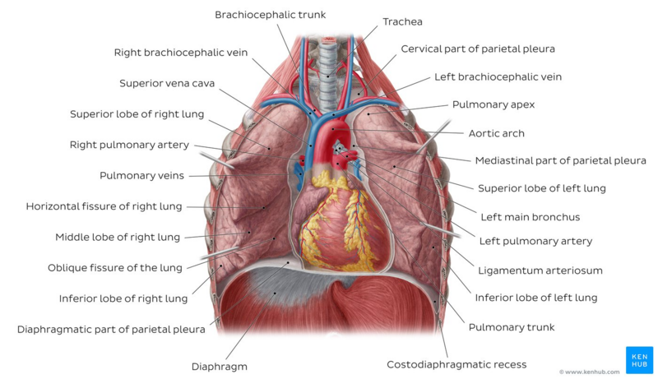
Introduction
5
Notes:
SAY:
The purpose of epidemiology in public health practice is to
discover the agent, host, and environmental factors that affect health;
determine the relative importance of causes of illness, disability, and death;
identify those segments of the population that have the greatest risk from specific causes of ill health; and
evaluate the effectiveness of health programs and services in improving population health.
GO to next slide.

Slide 6
Anatomical Position and Relations
The lungs lie either side of the mediastinum, within the thoracic cavity. Each lung is surrounded by a pleural cavity, which is formed by the visceral and parietal pleura.
They are suspended from the mediastinum by the lung root – a collection of structures entering and leaving the lungs. The medial surfaces of both lungs lie in close proximity to several mediastinal structures.
●●●
6
Notes:
SAY: Before we wrap up the course, let’s review what we have learned today.
During this course, we have
<READ the bullets from the slide.>
GO to next slide.

Slide 7
Anatomical Position and Relations
The lungs lie either side of the mediastinum, within the thoracic cavity. Each lung is surrounded by a pleural cavity, which is formed by the visceral and parietal pleura.
They are suspended from the mediastinum by the lung root – a collection of structures entering and leaving the lungs. The medial surfaces of both lungs lie in close proximity to several mediastinal structures.
7
Notes:
SAY: Before we wrap up the course, let’s review what we have learned today.
During this course, we have
<READ the bullets from the slide.>
GO to next slide.

Slide 8
Lung Structure
The lungs are roughly cone shaped, with an apex, base, three surfaces and three borders. The left lung is slightly smaller than the right – this is due to the presence of the heart.
Each lung consists of:
Apex – The blunt superior end of the lung. It projects upwards, above the level of the 1st rib and into the floor of the neck.
Base – The inferior surface of the lung, which sits on the diaphragm.
●●●
8
Notes:
SAY:
The purpose of epidemiology in public health practice is to
discover the agent, host, and environmental factors that affect health;
determine the relative importance of causes of illness, disability, and death;
identify those segments of the population that have the greatest risk from specific causes of ill health; and
evaluate the effectiveness of health programs and services in improving population health.
GO to next slide.

Slide 9
Lung Structure
Lobes (two or three) – These are separated by fissures within the lung.
Surfaces (three) – These correspond to the area of the thorax that they face. They are named costal, mediastinal and diaphragmatic.
Borders (three) – The edges of the lungs, named the anterior, inferior and posterior borders.
9
Notes:
SAY:
The purpose of epidemiology in public health practice is to
discover the agent, host, and environmental factors that affect health;
determine the relative importance of causes of illness, disability, and death;
identify those segments of the population that have the greatest risk from specific causes of ill health; and
evaluate the effectiveness of health programs and services in improving population health.
GO to next slide.

Slide 10
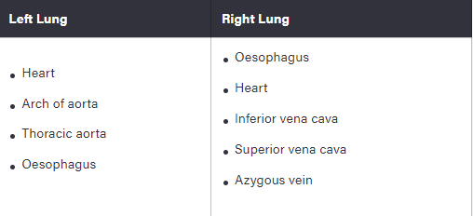
Lung Structure

Slide 11
Vasculature
The lungs are supplied with deoxygenated blood by the paired pulmonary arteries. Once the blood has received oxygenation, it leaves the lungs via four pulmonary veins (two for each lung).
The bronchi, lung roots, visceral pleura and supporting lung tissues require an extra nutritive blood supply. This is delivered by the bronchial arteries, which arise from the descending aorta.
The bronchial veins provide venous drainage. The right bronchial vein drains into the azygos vein, whilst the left drains into the accessory hemiazygos vein.
11
Notes:
SAY:
The purpose of epidemiology in public health practice is to
discover the agent, host, and environmental factors that affect health;
determine the relative importance of causes of illness, disability, and death;
identify those segments of the population that have the greatest risk from specific causes of ill health; and
evaluate the effectiveness of health programs and services in improving population health.
GO to next slide.

Slide 12
Nerve Supply
The nerves of the lungs are derived from the pulmonary plexuses. They feature sympathetic, parasympathetic and visceral afferent fibres:
Parasympathetic – derived from the vagus nerve. They stimulate secretion from the bronchial glands, contraction of the bronchial smooth muscle, and vasodilation of the pulmonary vessels.
●●●
12
Notes:
SAY:
The purpose of epidemiology in public health practice is to
discover the agent, host, and environmental factors that affect health;
determine the relative importance of causes of illness, disability, and death;
identify those segments of the population that have the greatest risk from specific causes of ill health; and
evaluate the effectiveness of health programs and services in improving population health.
GO to next slide.

Slide 13
Nerve Supply
Sympathetic – derived from the sympathetic trunks. They stimulate relaxation of the bronchial smooth muscle, and vasoconstriction of the pulmonary vessels.
Visceral afferent – conduct pain impulses to the sensory ganglion of the vagus nerve.
13
Notes:
SAY:
The purpose of epidemiology in public health practice is to
discover the agent, host, and environmental factors that affect health;
determine the relative importance of causes of illness, disability, and death;
identify those segments of the population that have the greatest risk from specific causes of ill health; and
evaluate the effectiveness of health programs and services in improving population health.
GO to next slide.

Slide 14
Lymphatic Drainage
The lymphatic vessels of the lung arise from two lymphatic plexuses:
Superficial (subpleural) – drains the lung parenchyma.
Deep – drains the structures of the lung root.
Both these plexuses empty into the trachebronchial nodes – located around the bifurcation of the trachea and the main bronchi. From here, lymph passes into the right and left bronchomediastinal trunks.
14
Notes:
SAY:
The purpose of epidemiology in public health practice is to
discover the agent, host, and environmental factors that affect health;
determine the relative importance of causes of illness, disability, and death;
identify those segments of the population that have the greatest risk from specific causes of ill health; and
evaluate the effectiveness of health programs and services in improving population health.
GO to next slide.

Slide 15
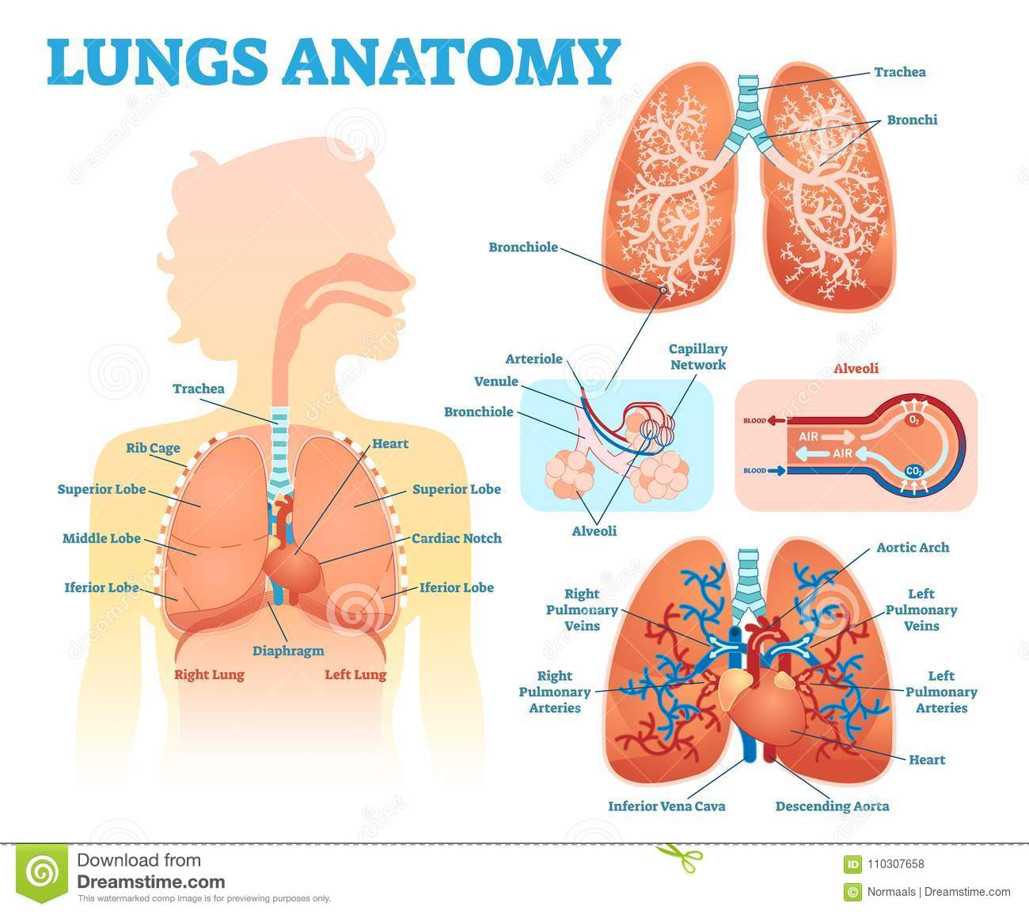
15
Notes:
SAY:
The purpose of epidemiology in public health practice is to
discover the agent, host, and environmental factors that affect health;
determine the relative importance of causes of illness, disability, and death;
identify those segments of the population that have the greatest risk from specific causes of ill health; and
evaluate the effectiveness of health programs and services in improving population health.
GO to next slide.

Slide 16
Conclusion
The lungs are the major organs of the respiratory system, and are divided into sections, or lobes. The right lung has three lobes and is slightly larger than the left lung, which has two lobes. The lungs are separated by the mediastinum.
This area contains the heart, trachea, esophagus, and many lymph nodes.
16
Notes:
SAY:
The purpose of epidemiology in public health practice is to
discover the agent, host, and environmental factors that affect health;
determine the relative importance of causes of illness, disability, and death;
identify those segments of the population that have the greatest risk from specific causes of ill health; and
evaluate the effectiveness of health programs and services in improving population health.
GO to next slide.

Slide 17
References
Google.com
Wikipedia.org
Studymafia.org
Slidespanda.com

Slide 18
Thanks To StudyMafia.org

