Slide 1
StudyMafia.Org
Cholera
Submitted To: Submitted By:
Studymafia.org Studymafia.org

Slide 2
Table Contents
Definition
Introduction
Symptoms of Cholera
When to see a Doctor
Causes of Cholera
Risk-Factors of Cholera
Complications of Cholera
Prevention of Cholera
Treatment of Cholera
Conclusion
2
Notes:
SAY: Before we wrap up the course, let’s review what we have learned today.
During this course, we have
<READ the bullets from the slide.>
GO to next slide.

Slide 3
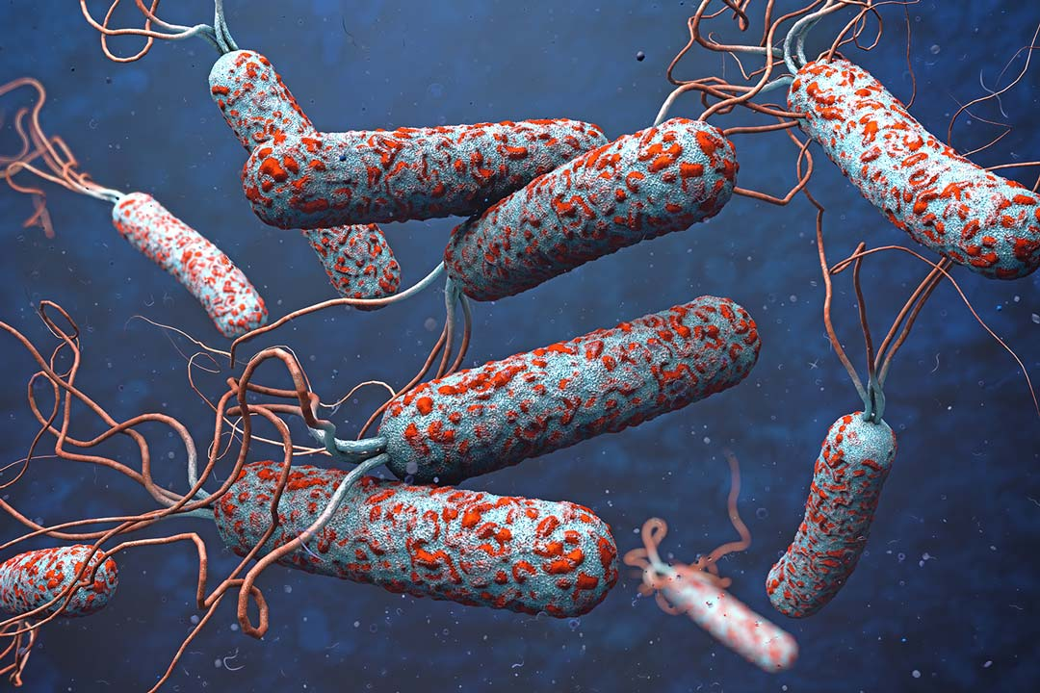
Definition
Cholera is a bacterial disease usually spread through contaminated water. Cholera causes severe diarrhea and dehydration. Left untreated, cholera can be fatal within hours, even in previously healthy people.
3
Notes:
SAY: Before we wrap up the course, let’s review what we have learned today.
During this course, we have
<READ the bullets from the slide.>
GO to next slide.

Slide 4
Introduction
Modern sewage and water treatment have virtually eliminated cholera in industrialized countries. But cholera still exists in Africa, Southeast Asia and Haiti. The risk of a cholera epidemic is highest when poverty, war or natural disasters force people to live in crowded conditions without adequate sanitation.
Cholera is easily treated. Death from severe dehydration can be prevented with a simple and inexpensive rehydration solution.
4
Notes:
SAY: Before we wrap up the course, let’s review what we have learned today.
During this course, we have
<READ the bullets from the slide.>
GO to next slide.

Slide 5
Symptoms of Cholera
Most people exposed to the cholera bacterium (Vibrio cholerae) don't become ill and don't know they've been infected. But because they shed cholera bacteria in their stool for seven to 14 days, they can still infect others through contaminated water.
Most cases of cholera that cause symptoms cause mild or moderate diarrhea that's often hard to tell apart from diarrhea caused by other problems. Others develop more-serious signs and symptoms of cholera, usually within a few days of infection.
5
Notes:
SAY: Before we wrap up the course, let’s review what we have learned today.
During this course, we have
<READ the bullets from the slide.>
GO to next slide.

Slide 6
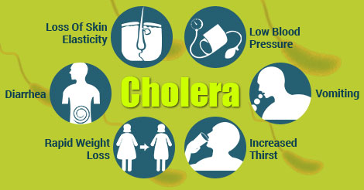
Symptoms of Cholera
6
Notes:
SAY: Before we wrap up the course, let’s review what we have learned today.
During this course, we have
<READ the bullets from the slide.>
GO to next slide.

Slide 7
When to see a doctor
The risk of cholera is slight in industrialized nations. Even in areas where it exists you're not likely to become infected if you follow food safety recommendations. Still, cases of cholera occur throughout the world. If you develop severe diarrhea after visiting an area with active cholera, see your doctor.
If you have diarrhea, especially severe diarrhea, and think you might have been exposed to cholera, seek treatment right away. Severe dehydration is a medical emergency that requires immediate care.
7
Notes:
SAY: Before we wrap up the course, let’s review what we have learned today.
During this course, we have
<READ the bullets from the slide.>
GO to next slide.

Slide 8
Causes of Cholera
Contaminated water supplies are the main source of cholera infection. The bacterium can be found in:
Surface or well water: Contaminated public wells are frequent sources of large-scale cholera outbreaks. People living in crowded conditions without adequate sanitation are especially at risk.
Seafood: Eating raw or undercooked seafood, especially shellfish, that comes from certain places can expose you to cholera bacteria. Most recent cases of cholera in the United States have been traced to seafood from the Gulf of Mexico.
●●●
8
Notes:
SAY:
The purpose of epidemiology in public health practice is to
discover the agent, host, and environmental factors that affect health;
determine the relative importance of causes of illness, disability, and death;
identify those segments of the population that have the greatest risk from specific causes of ill health; and
evaluate the effectiveness of health programs and services in improving population health.
GO to next slide.

Slide 9
Causes of Cholera
Raw fruits and vegetables: Raw, unpeeled fruits and vegetables are a frequent source of cholera infection in areas where there's cholera. In developing countries, uncomposted manure fertilizers or irrigation water containing raw sewage can contaminate produce in the field.
Grains: In regions where cholera is widespread, grains such as rice and millet that are contaminated after cooking and kept at room temperature for several hours can grow cholera bacteria.
9
Notes:
SAY:
The purpose of epidemiology in public health practice is to
discover the agent, host, and environmental factors that affect health;
determine the relative importance of causes of illness, disability, and death;
identify those segments of the population that have the greatest risk from specific causes of ill health; and
evaluate the effectiveness of health programs and services in improving population health.
GO to next slide.

Slide 10
Risk factors of Cholera
Poor sanitary conditions: Cholera is more likely to flourish in situations where a sanitary environment — including a safe water supply — is difficult to maintain. Such conditions are common to refugee camps, impoverished countries, and areas afflicted by famine, war or natural disasters.
Reduced or nonexistent stomach acid: Cholera bacteria can't survive in an acidic environment, and ordinary stomach acid often serves as a defense against infection. But people with low levels of stomach acid — such as children, older adults, and people who take antacids, H-2 blockers or proton pump inhibitors — lack this protection, so they're at greater risk of cholera.
●●●
10
Notes:
SAY:
The purpose of epidemiology in public health practice is to
discover the agent, host, and environmental factors that affect health;
determine the relative importance of causes of illness, disability, and death;
identify those segments of the population that have the greatest risk from specific causes of ill health; and
evaluate the effectiveness of health programs and services in improving population health.
GO to next slide.

Slide 11
Risk factors of Cholera
Household exposure: You're at increased risk of cholera if you live with someone who has the disease.
Type O blood: For reasons that aren't entirely clear, people with type O blood are twice as likely to develop cholera compared with people with other blood types.
Raw or undercooked shellfish: Although industrialized nations no longer have large-scale cholera outbreaks, eating shellfish from waters known to harbor the bacteria greatly increases your risk.
11
Notes:
SAY:
The purpose of epidemiology in public health practice is to
discover the agent, host, and environmental factors that affect health;
determine the relative importance of causes of illness, disability, and death;
identify those segments of the population that have the greatest risk from specific causes of ill health; and
evaluate the effectiveness of health programs and services in improving population health.
GO to next slide.

Slide 12
Complications of Cholera
Low blood sugar (hypoglycemia): Dangerously low levels of blood sugar (glucose) — the body's main energy source — can occur when people become too ill to eat. Children are at greatest risk of this complication, which can cause seizures, unconsciousness and even death.
Low potassium levels: People with cholera lose large quantities of minerals, including potassium, in their stools. Very low potassium levels interfere with heart and nerve function and are life-threatening.
●●●
12
Notes:
SAY:
The purpose of epidemiology in public health practice is to
discover the agent, host, and environmental factors that affect health;
determine the relative importance of causes of illness, disability, and death;
identify those segments of the population that have the greatest risk from specific causes of ill health; and
evaluate the effectiveness of health programs and services in improving population health.
GO to next slide.

Slide 13
Complications of Cholera
Kidney failure: When the kidneys lose their filtering ability, excess amounts of fluids, some electrolytes and wastes build up in the body — a potentially life-threatening condition. In people with cholera, kidney failure often accompanies shock.
13
Notes:
SAY:
The purpose of epidemiology in public health practice is to
discover the agent, host, and environmental factors that affect health;
determine the relative importance of causes of illness, disability, and death;
identify those segments of the population that have the greatest risk from specific causes of ill health; and
evaluate the effectiveness of health programs and services in improving population health.
GO to next slide.

Slide 14
Prevention of Cholera
If you're traveling to areas known to have cholera, your risk of contracting the disease is extremely low if you follow these precautions:
Wash your hands with soap and water frequently, especially after using the toilet and before handling food. Rub soapy, wet hands together for at least 15 seconds before rinsing. If soap and water aren't available, use an alcohol-based hand sanitizer.
Drink only safe water, including bottled water or water you've boiled or disinfected yourself. Use bottled water even to brush your teeth.
●●●
14
Notes:
SAY:
The purpose of epidemiology in public health practice is to
discover the agent, host, and environmental factors that affect health;
determine the relative importance of causes of illness, disability, and death;
identify those segments of the population that have the greatest risk from specific causes of ill health; and
evaluate the effectiveness of health programs and services in improving population health.
GO to next slide.

Slide 15
Prevention of Cholera
Eat food that's completely cooked and hot and avoid street vendor food, if possible. If you do buy a meal from a street vendor, make sure it's cooked in your presence and served hot.
Avoid sushi, as well as raw or improperly cooked fish and seafood of any kind.
Stick to fruits and vegetables that you can peel yourself, such as bananas, oranges and avocados. Stay away from salads and fruits that can't be peeled, such as grapes and berries.
15
Notes:
SAY:
The purpose of epidemiology in public health practice is to
discover the agent, host, and environmental factors that affect health;
determine the relative importance of causes of illness, disability, and death;
identify those segments of the population that have the greatest risk from specific causes of ill health; and
evaluate the effectiveness of health programs and services in improving population health.
GO to next slide.

Slide 16
Treatment of Cholera
Rehydration: The goal is to replace lost fluids and electrolytes using a simple rehydration solution, oral rehydration salts (ORS). The ORS solution is available as a powder that can be made with boiled or bottled water.
Intravenous fluids: Most people with cholera can be helped by oral rehydration alone, but severely dehydrated people might also need intravenous fluids.
●●●
16
Notes:
SAY:
The purpose of epidemiology in public health practice is to
discover the agent, host, and environmental factors that affect health;
determine the relative importance of causes of illness, disability, and death;
identify those segments of the population that have the greatest risk from specific causes of ill health; and
evaluate the effectiveness of health programs and services in improving population health.
GO to next slide.

Slide 17
Treatment of Cholera
Antibiotics: While not a necessary part of cholera treatment, some antibiotics can reduce cholera-related diarrhea and shorten how long it lasts in severely ill people.
Zinc supplements: Research has shown that zinc might decrease diarrhea and shorten how long it lasts in children with cholera.
17
Notes:
SAY:
The purpose of epidemiology in public health practice is to
discover the agent, host, and environmental factors that affect health;
determine the relative importance of causes of illness, disability, and death;
identify those segments of the population that have the greatest risk from specific causes of ill health; and
evaluate the effectiveness of health programs and services in improving population health.
GO to next slide.

Slide 18
Conclusion
Cholera is an ongoing disease amongst the world's poorest and most disadvantaged communities. Treatment may be effective on an individual basis, but the rapid spread of cholera outbreaks renders communities too overwhelmed to contain them.
18
Notes:
SAY:
The purpose of epidemiology in public health practice is to
discover the agent, host, and environmental factors that affect health;
determine the relative importance of causes of illness, disability, and death;
identify those segments of the population that have the greatest risk from specific causes of ill health; and
evaluate the effectiveness of health programs and services in improving population health.
GO to next slide.

Slide 19
References
Google.com
Wikipedia.org
Studymafia.org
Slidespanda.com

Slide 20
Thanks To StudyMafia.org

