Slide 1
StudyMafia.Org
Antenatal Diet
Submitted To: Submitted By:
Studymafia.org Studymafia.org

Slide 2
Table Contents
Introduction
Dietary and Caloric Recommendations
Fluid Intake During Pregnancy
Beneficial Foods
Foods to Avoid
Guidelines for Safe Food Handling
Results
Sample Diet Chart
Conclusion
2
Notes:
SAY: Before we wrap up the course, let’s review what we have learned today.
During this course, we have
<READ the bullets from the slide.>
GO to next slide.

Slide 3
Introduction
The Academy of Nutrition and Dietetics recommends the following key components of a healthy lifestyle during pregnancy:
Appropriate weight gain
A balanced diet
Regular exercise
Appropriate and timely vitamin and mineral supplementation
3
Notes:
SAY: Before we wrap up the course, let’s review what we have learned today.
During this course, we have
<READ the bullets from the slide.>
GO to next slide.

Slide 4
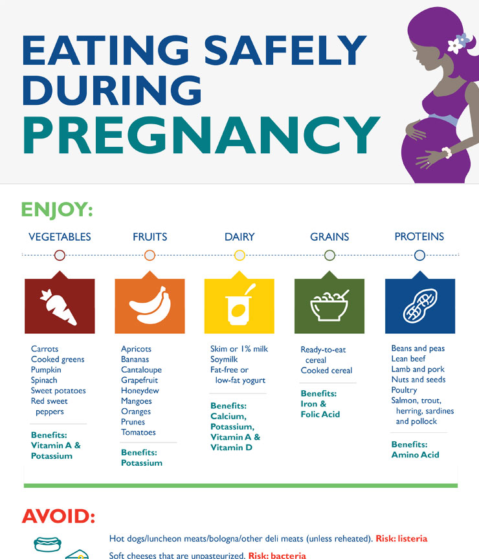
Introduction
4
Notes:
SAY: Before we wrap up the course, let’s review what we have learned today.
During this course, we have
<READ the bullets from the slide.>
GO to next slide.

Slide 5
Dietary and Caloric Recommendations
To maintain a healthy pregnancy, approximately 300 extra calories are needed each day. These calories should come from a balanced diet of protein, fruits, vegetables and whole grains. Sweets and fats should be kept to a minimum.
A healthy, well-balanced diet can also help to reduce some pregnancy symptoms, such as nausea and constipation.
5
Notes:
SAY: Before we wrap up the course, let’s review what we have learned today.
During this course, we have
<READ the bullets from the slide.>
GO to next slide.

Slide 6
Fluid Intake During Pregnancy
You can take in enough fluids by drinking several glasses of water each day, in addition to the fluids in juices and soups. Talk to your health care provider or midwife about restricting your intake of caffeine and artificial sweeteners.
Avoid all forms of alcohol.
6
Notes:
SAY:
The purpose of epidemiology in public health practice is to
discover the agent, host, and environmental factors that affect health;
determine the relative importance of causes of illness, disability, and death;
identify those segments of the population that have the greatest risk from specific causes of ill health; and
evaluate the effectiveness of health programs and services in improving population health.
GO to next slide.

Slide 7
Beneficial foods
Vegetables: carrots, sweet potatoes, pumpkin, spinach, cooked greens, tomatoes and red sweet peppers (for vitamin A and potassium)
Fruits: cantaloupe, honeydew, mangoes, prunes, bananas, apricots, oranges, and red or pink grapefruit (for potassium)
●●●
7
Notes:
SAY:
The purpose of epidemiology in public health practice is to
discover the agent, host, and environmental factors that affect health;
determine the relative importance of causes of illness, disability, and death;
identify those segments of the population that have the greatest risk from specific causes of ill health; and
evaluate the effectiveness of health programs and services in improving population health.
GO to next slide.

Slide 8
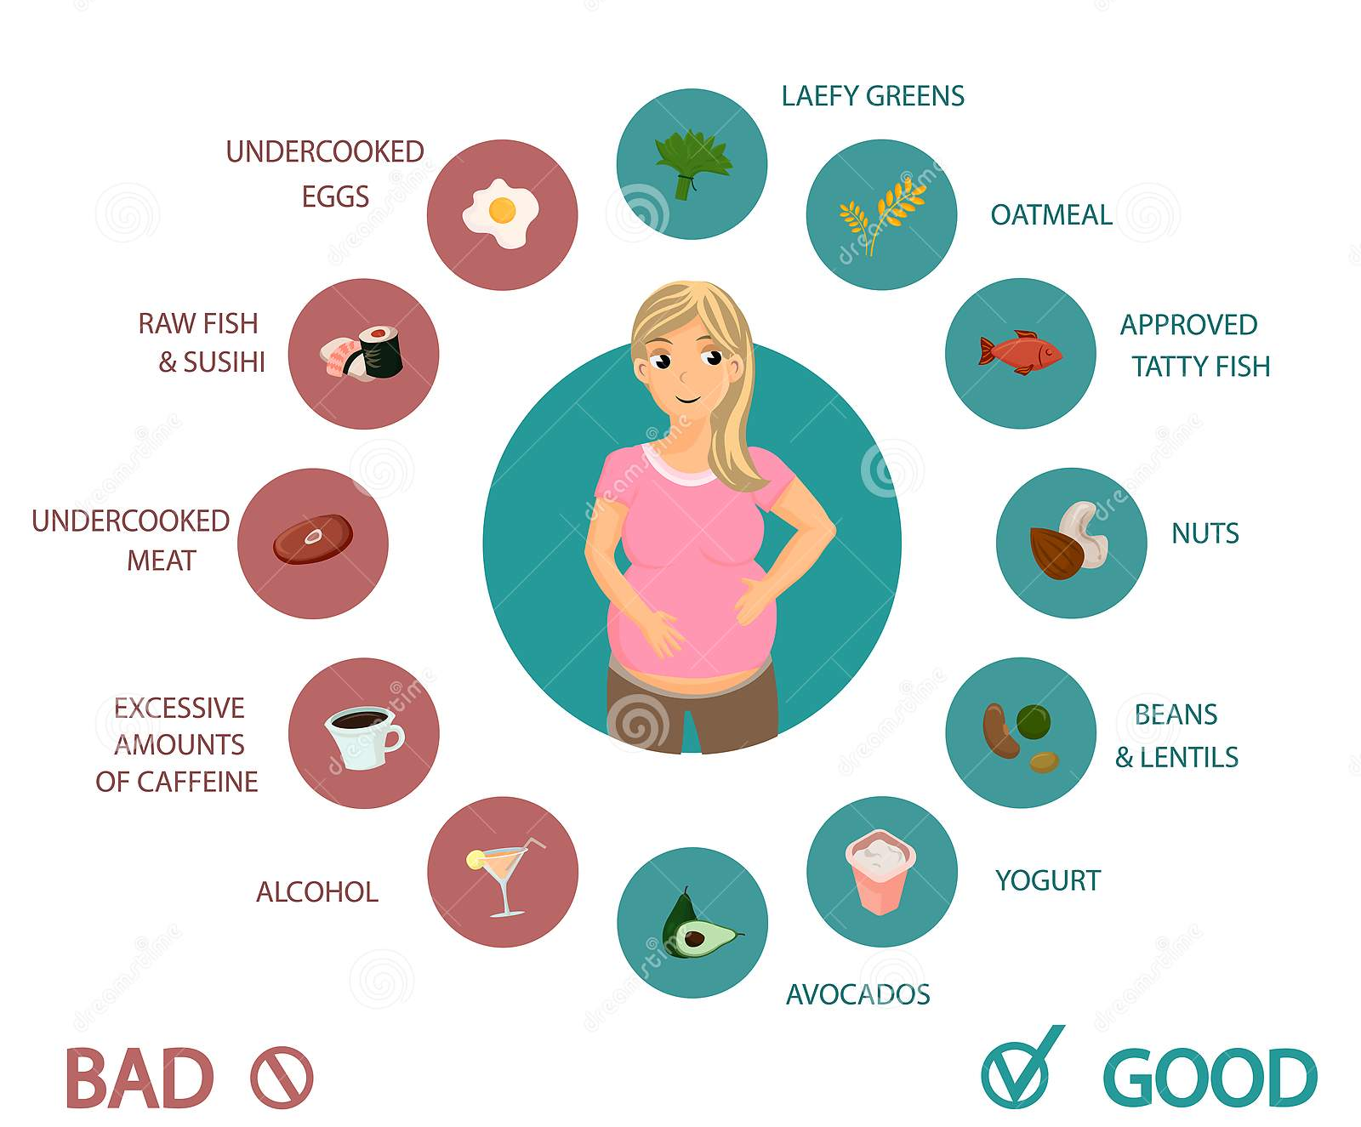
Beneficial Foods
●●●
8
Notes:
SAY:
The purpose of epidemiology in public health practice is to
discover the agent, host, and environmental factors that affect health;
determine the relative importance of causes of illness, disability, and death;
identify those segments of the population that have the greatest risk from specific causes of ill health; and
evaluate the effectiveness of health programs and services in improving population health.
GO to next slide.

Slide 9
Beneficial foods
Dairy: fat-free or low-fat yogurt, skim or 1% milk, soymilk (for calcium, potassium, vitamins A and D)
Grains: ready-to-eat cereals/cooked cereals (for iron and folic acid)
Proteins: beans and peas; nuts and seeds; lean beef, lamb and pork; salmon, trout, herring, sardines and pollock
9
Notes:
SAY:
The purpose of epidemiology in public health practice is to
discover the agent, host, and environmental factors that affect health;
determine the relative importance of causes of illness, disability, and death;
identify those segments of the population that have the greatest risk from specific causes of ill health; and
evaluate the effectiveness of health programs and services in improving population health.
GO to next slide.

Slide 10
Foods to avoid
Unpasteurized milk and foods made with unpasteurized milk (soft cheeses, including feta, queso blanco and fresco, Camembert, brie or blue-veined cheeses—unless labeled “made with pasteurized milk")
Hot dogs and luncheon meats (unless they are heated until steaming hot before serving)
●●●
10
Notes:
SAY:
The purpose of epidemiology in public health practice is to
discover the agent, host, and environmental factors that affect health;
determine the relative importance of causes of illness, disability, and death;
identify those segments of the population that have the greatest risk from specific causes of ill health; and
evaluate the effectiveness of health programs and services in improving population health.
GO to next slide.

Slide 11
Foods to avoid
Raw and undercooked seafood, eggs and meat. Do not eat sushi made with raw fish (cooked sushi is safe).
Refrigerated pâté and meat spreads
Refrigerated smoked seafood
11
Notes:
SAY:
The purpose of epidemiology in public health practice is to
discover the agent, host, and environmental factors that affect health;
determine the relative importance of causes of illness, disability, and death;
identify those segments of the population that have the greatest risk from specific causes of ill health; and
evaluate the effectiveness of health programs and services in improving population health.
GO to next slide.

Slide 12
Guidelines for Safe Food Handling
Wash. Rinse all raw produce thoroughly under running tap water before eating, cutting or cooking.
Clean. Wash your hands, knives, countertops and cutting boards after handling and preparing uncooked foods.
Cook. Cook beef, pork or poultry to a safe internal temperature verified by a food thermometer.
Chill. Promptly refrigerate all perishable food.
12
Notes:
SAY:
The purpose of epidemiology in public health practice is to
discover the agent, host, and environmental factors that affect health;
determine the relative importance of causes of illness, disability, and death;
identify those segments of the population that have the greatest risk from specific causes of ill health; and
evaluate the effectiveness of health programs and services in improving population health.
GO to next slide.

Slide 13
Results
Bad diet can cause:
Premature birth
Low birth weight
Feeble, weak
Inability to breast feed
Deformed babies
complications at birth
Depression
Babies have fewer brain cells
●●●
13
Notes:
SAY:
The purpose of epidemiology in public health practice is to
discover the agent, host, and environmental factors that affect health;
determine the relative importance of causes of illness, disability, and death;
identify those segments of the population that have the greatest risk from specific causes of ill health; and
evaluate the effectiveness of health programs and services in improving population health.
GO to next slide.

Slide 14
Results
Good diet can cause :
Reduces fatigue and helps manage stress
Increases endurance and strengthening muscles
Help relieve back pressure
Improve posture and balance
Improve circulation & lowers blood pressure
Helps prepare for the strain of labor.
Improve self image.
Regain figure faster.
14
Notes:
SAY:
The purpose of epidemiology in public health practice is to
discover the agent, host, and environmental factors that affect health;
determine the relative importance of causes of illness, disability, and death;
identify those segments of the population that have the greatest risk from specific causes of ill health; and
evaluate the effectiveness of health programs and services in improving population health.
GO to next slide.

Slide 15
Sample Diet Chart
15
Notes:
SAY:
The purpose of epidemiology in public health practice is to
discover the agent, host, and environmental factors that affect health;
determine the relative importance of causes of illness, disability, and death;
identify those segments of the population that have the greatest risk from specific causes of ill health; and
evaluate the effectiveness of health programs and services in improving population health.
GO to next slide.

Slide 16
Conclusion
For women who are overweight or obese, antenatal dietary and lifestyle advice has health benefits for infants, without an increase in the risk of harm.
Continued follow-up into childhood will be important to assess the longer-term effects of a reduction in high infant birth weight on risk of child obesity
16
Notes:
SAY:
The purpose of epidemiology in public health practice is to
discover the agent, host, and environmental factors that affect health;
determine the relative importance of causes of illness, disability, and death;
identify those segments of the population that have the greatest risk from specific causes of ill health; and
evaluate the effectiveness of health programs and services in improving population health.
GO to next slide.

Slide 17
References
Google.com
Wikipedia.org
Studymafia.org
Slidespanda.com

Slide 18
Thanks To StudyMafia.org

