Slide 1
StudyMafia.Org
Wilms Tumor
Submitted To: Submitted By:
Studymafia.org Studymafia.org

Slide 2
Table Contents
Definition
Introduction
Symptoms of Wilms' Tumor
Causes of Wilms' Tumor
Risk-Factors of Wilms' Tumor
Prevention of Wilms' Tumor
Diagnosis of Wilms' Tumor
Treatment of Wilms' Tumor
Conclusion
2
Notes:
SAY: Before we wrap up the course, let’s review what we have learned today.
During this course, we have
<READ the bullets from the slide.>
GO to next slide.

Slide 3
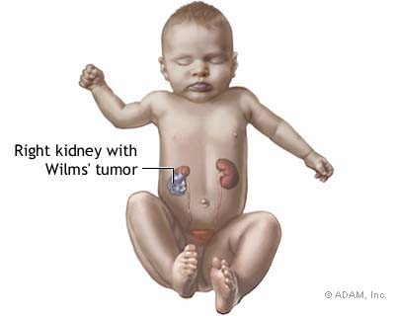
Definition
Wilms' tumor is a rare kidney cancer that primarily affects children. Also known as nephroblastoma, it's the most common cancer of the kidneys in children.
3
Notes:
SAY: Before we wrap up the course, let’s review what we have learned today.
During this course, we have
<READ the bullets from the slide.>
GO to next slide.

Slide 4
Introduction
Wilms' tumor most often affects children ages 3 to 4 and becomes much less common after age 5.
Wilms' tumor most often occurs in just one kidney, though it can sometimes be found in both kidneys at the same time.
Over the years, advancements in the diagnosis and treatment of Wilms' tumor have greatly improved the outlook (prognosis) for children with this disease.
4
Notes:
SAY: Before we wrap up the course, let’s review what we have learned today.
During this course, we have
<READ the bullets from the slide.>
GO to next slide.

Slide 5
Symptoms of Wilms' Tumor
5
Notes:
SAY: Before we wrap up the course, let’s review what we have learned today.
During this course, we have
<READ the bullets from the slide.>
GO to next slide.

Slide 6
Causes of Wilms' Tumor
It's not clear what causes Wilms' tumor, but in rare cases, heredity may play a role.
Cancer begins when cells develop errors in their DNA. The errors allow the cells to grow and divide uncontrollably and to go on living when other cells would die.
●●●
6
Notes:
SAY:
The purpose of epidemiology in public health practice is to
discover the agent, host, and environmental factors that affect health;
determine the relative importance of causes of illness, disability, and death;
identify those segments of the population that have the greatest risk from specific causes of ill health; and
evaluate the effectiveness of health programs and services in improving population health.
GO to next slide.

Slide 7
Causes of Wilms' Tumor
The accumulating cells form a tumor. In Wilms' tumor, this process occurs in the kidney cells.
In rare cases, the errors in DNA that lead to Wilms' tumor are passed from a parent to the child. In most cases, there is no known connection between parents and children that may lead to cancer.
7
Notes:
SAY:
The purpose of epidemiology in public health practice is to
discover the agent, host, and environmental factors that affect health;
determine the relative importance of causes of illness, disability, and death;
identify those segments of the population that have the greatest risk from specific causes of ill health; and
evaluate the effectiveness of health programs and services in improving population health.
GO to next slide.

Slide 8
Risk factors of Wilms' Tumor
African-American race. In the United States, African-American children have a slightly higher risk of developing Wilms' tumor than children of other races. Asian-American children appear to have a lower risk than children of other races.
Family history of Wilms' tumor. If someone in your child's family has had Wilms' tumor, then your child has an increased risk of developing the disease.
●●●
8
Notes:
SAY:
The purpose of epidemiology in public health practice is to
discover the agent, host, and environmental factors that affect health;
determine the relative importance of causes of illness, disability, and death;
identify those segments of the population that have the greatest risk from specific causes of ill health; and
evaluate the effectiveness of health programs and services in improving population health.
GO to next slide.

Slide 9
Risk factors of Wilms' Tumor
Aniridia. In aniridia (an-ih-RID-e-uh), the iris — the colored portion of the eye — forms only partially or not at all.
Hemihypertrophy. Hemihypertrophy (hem-e-hi-PUR-truh-fee) means one side of the body or a part of the body is noticeably larger than the other side.
9
Notes:
SAY:
The purpose of epidemiology in public health practice is to
discover the agent, host, and environmental factors that affect health;
determine the relative importance of causes of illness, disability, and death;
identify those segments of the population that have the greatest risk from specific causes of ill health; and
evaluate the effectiveness of health programs and services in improving population health.
GO to next slide.

Slide 10
Prevention of Wilms' Tumor
Wilms' tumor can't be prevented by anything you or your child can do.
If your child has risk factors for Wilms' tumor (such as known associated syndromes), the doctor may recommend periodic kidney ultrasounds to look for kidney abnormalities.
Although this screening can't prevent Wilms' tumor, it may help detect the disease at an early stage.
10
Notes:
SAY:
The purpose of epidemiology in public health practice is to
discover the agent, host, and environmental factors that affect health;
determine the relative importance of causes of illness, disability, and death;
identify those segments of the population that have the greatest risk from specific causes of ill health; and
evaluate the effectiveness of health programs and services in improving population health.
GO to next slide.

Slide 11
Diagnosis of Wilms' Tumor
A physical exam. The doctor will look for possible signs of Wilms' tumor.
Blood and urine tests. These lab tests can't detect Wilms' tumor, but they can indicate how well the kidneys are working and uncover certain kidney problems or low blood counts.
Imaging tests. Tests that create images of the kidneys help the doctor determine whether your child has a kidney tumor
11
Notes:
SAY:
The purpose of epidemiology in public health practice is to
discover the agent, host, and environmental factors that affect health;
determine the relative importance of causes of illness, disability, and death;
identify those segments of the population that have the greatest risk from specific causes of ill health; and
evaluate the effectiveness of health programs and services in improving population health.
GO to next slide.

Slide 12
Treatment of Wilms' Tumor
Treatment for Wilms' tumor may begin with surgery to remove all or part of a kidney (nephrectomy). Surgery is also used to confirm the diagnosis — the tissue removed during surgery is sent to a lab to determine whether it's cancerous and what type of cancer is in the tumor.
Chemotherapy uses powerful drugs to kill cancer cells throughout the body. Treatment for Wilms' tumor usually involves a combination of drugs, given through a vein, that work together to kill cancer cells.
●●●
12
Notes:
SAY:
The purpose of epidemiology in public health practice is to
discover the agent, host, and environmental factors that affect health;
determine the relative importance of causes of illness, disability, and death;
identify those segments of the population that have the greatest risk from specific causes of ill health; and
evaluate the effectiveness of health programs and services in improving population health.
GO to next slide.

Slide 13
Treatment of Wilms' Tumor
Depending on the stage of the tumor, radiation therapy may be recommended. Radiation therapy uses high-energy beams to kill cancer cells.
Your child's doctor may recommend participating in a clinical trial. These research studies allow your child a chance at the latest cancer treatments, but they can't guarantee a cure.
13
Notes:
SAY:
The purpose of epidemiology in public health practice is to
discover the agent, host, and environmental factors that affect health;
determine the relative importance of causes of illness, disability, and death;
identify those segments of the population that have the greatest risk from specific causes of ill health; and
evaluate the effectiveness of health programs and services in improving population health.
GO to next slide.

Slide 14
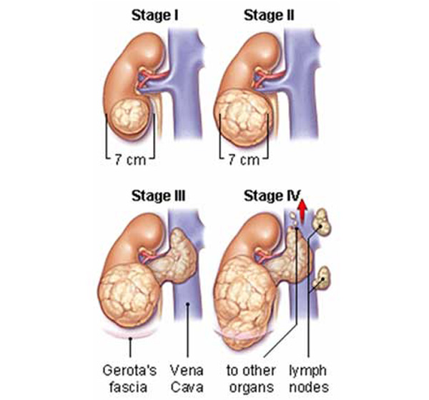

Slide 15
Conclusion
Wilms tumor is a form of kidney cancer that primarily develops in children. Nearly all cases of Wilms tumor are diagnosed before the age of 10, with two-thirds being found before age 5.
Wilms tumor is often first noticed because of abdominal swelling or a mass in the kidney that can be felt upon physical examination.
15
Notes:
SAY:
The purpose of epidemiology in public health practice is to
discover the agent, host, and environmental factors that affect health;
determine the relative importance of causes of illness, disability, and death;
identify those segments of the population that have the greatest risk from specific causes of ill health; and
evaluate the effectiveness of health programs and services in improving population health.
GO to next slide.

Slide 16
References
Google.com
Wikipedia.org
Studymafia.org
Slidespanda.com

Slide 17
Thanks To StudyMafia.org

