Slide 1
StudyMafia.Org
Web-Development
Submitted To: Submitted By:
Studymafia.org Studymafia.org

Slide 2
Table Contents
Definition
Introduction
Classification
Frontend Roadmap
Backend Roadmap
Full-Stack Developer
What does Developer do?
Tools Used
Conclusion
2
Notes:
SAY: Before we wrap up the course, let’s review what we have learned today.
During this course, we have
<READ the bullets from the slide.>
GO to next slide.

Slide 3
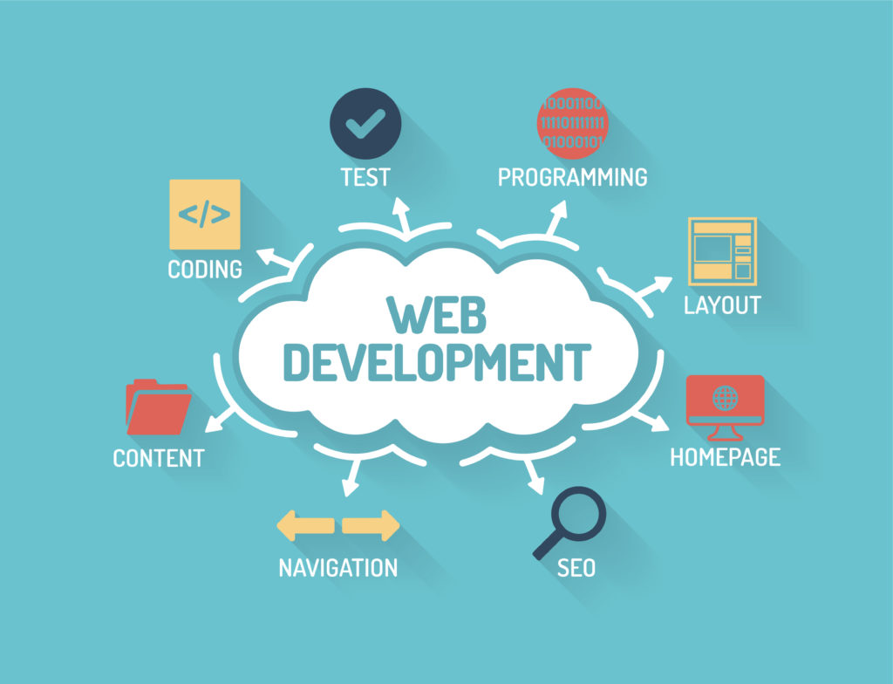
Definition
The word Web Development is made up of two words:
Web: It refers to websites, web pages or anything that works over the internet.
Development: Building the application from scratch.
3
Notes:
SAY: Before we wrap up the course, let’s review what we have learned today.
During this course, we have
<READ the bullets from the slide.>
GO to next slide.

Slide 4
Introduction
Web development refers to the building, creating, and maintaining of websites. It includes aspects such as web design, web publishing, web programming, and database management.
It is the creation of an application that works over the internet i.e. websites.
The term development is usually reserved for the actual construction of these things (that is to say, the programming of sites). The basic tools involved are programming languages called HTML (Hypertext Markup Language), CSS (Cascading Style Sheets), and JavaScript.
4
Notes:
SAY: Before we wrap up the course, let’s review what we have learned today.
During this course, we have
<READ the bullets from the slide.>
GO to next slide.

Slide 5
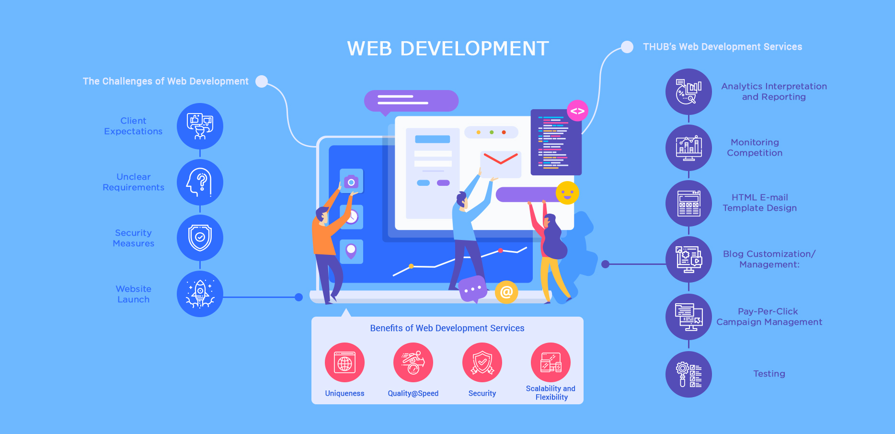
5
Notes:
SAY: Before we wrap up the course, let’s review what we have learned today.
During this course, we have
<READ the bullets from the slide.>
GO to next slide.

Slide 6
Classification
Web Development can be classified into two ways:
Frontend Development: The part of a website that the user interacts directly is termed as front end. It is also referred to as the ‘client side’ of the application.
Backend Development: Backend is the server side of a website. It is the part of the website that users cannot see and interact. It is the portion of software that does not come in direct contact with the users. It is used to store and arrange data.
6
Notes:
SAY: Before we wrap up the course, let’s review what we have learned today.
During this course, we have
<READ the bullets from the slide.>
GO to next slide.

Slide 7
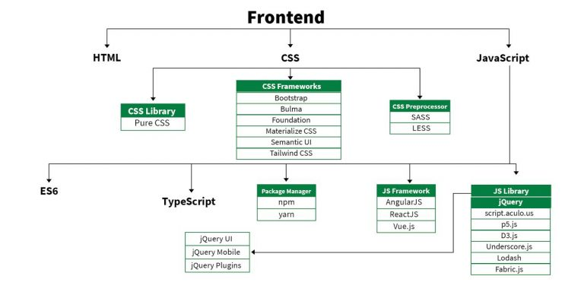
Frontend Roadmap
●●●
7
Notes:
SAY: Before we wrap up the course, let’s review what we have learned today.
During this course, we have
<READ the bullets from the slide.>
GO to next slide.

Slide 8
Frontend Roadmap
HTML: HTML stands for HyperText Markup Language. It is used to design the front end portion of web pages using markup language. It acts as a skeleton for a website since it is used to make the structure of a website.
CSS: Cascading Style Sheets fondly referred to as CSS is a simply designed language intended to simplify the process of making web pages presentable. It is used to style our website.
JavaScript: JavaScript is a scripting language used to provide a dynamic behavior to our website.
●●●
8
Notes:
SAY: Before we wrap up the course, let’s review what we have learned today.
During this course, we have
<READ the bullets from the slide.>
GO to next slide.

Slide 9
Frontend Roadmap
Bootstrap: Bootstrap is a free and open-source tool collection for creating responsive websites and web applications.
It is the most popular CSS framework for developing responsive, mobile-first websites. Nowadays, the websites are perfect for all the browsers (IE, Firefox, and Chrome) and for all sizes of screens (Desktop, Tablets, Phablets, and Phones).
Bootstrap 4
Bootstrap 5
●●●
9
Notes:
SAY: Before we wrap up the course, let’s review what we have learned today.
During this course, we have
<READ the bullets from the slide.>
GO to next slide.

Slide 10
Frontend Roadmap
Frontend Frameworks and Libraries:
AngularJS
React.js
VueJS
jQuery
Bootstrap
Material UI
Tailwind CSS
jQuery UI
10
Notes:
SAY: Before we wrap up the course, let’s review what we have learned today.
During this course, we have
<READ the bullets from the slide.>
GO to next slide.

Slide 11
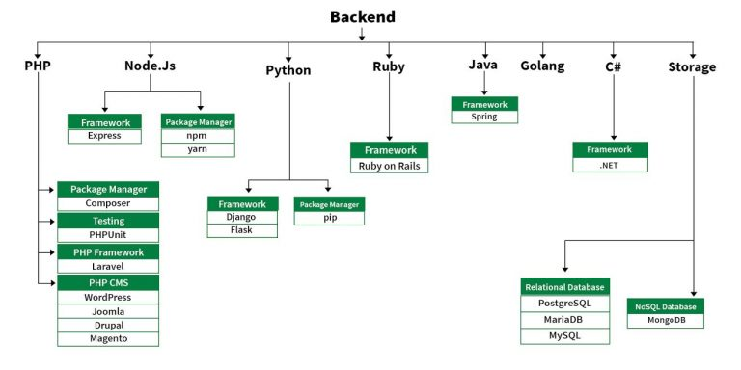
Backend Roadmap
●●●
11
Notes:
SAY:
The purpose of epidemiology in public health practice is to
discover the agent, host, and environmental factors that affect health;
determine the relative importance of causes of illness, disability, and death;
identify those segments of the population that have the greatest risk from specific causes of ill health; and
evaluate the effectiveness of health programs and services in improving population health.
GO to next slide.

Slide 12
Backend Roadmap
PHP: PHP is a server-side scripting language designed specifically for web development.
Java: Java is one of the most popular and widely used programming language. It is highly scalable.
Python: Python is a programming language that lets you work quickly and integrate systems more efficiently.
Node.js: Node.js is an open source and cross-platform runtime environment for executing JavaScript code outside a browser.
●●●
12
Notes:
SAY:
The purpose of epidemiology in public health practice is to
discover the agent, host, and environmental factors that affect health;
determine the relative importance of causes of illness, disability, and death;
identify those segments of the population that have the greatest risk from specific causes of ill health; and
evaluate the effectiveness of health programs and services in improving population health.
GO to next slide.

Slide 13
Backend Roadmap
Back End Frameworks
The list of back end frameworks are:
Express,
Django,
Rails,
Laravel,
Spring, etc.
13
Notes:
SAY:
The purpose of epidemiology in public health practice is to
discover the agent, host, and environmental factors that affect health;
determine the relative importance of causes of illness, disability, and death;
identify those segments of the population that have the greatest risk from specific causes of ill health; and
evaluate the effectiveness of health programs and services in improving population health.
GO to next slide.

Slide 14
Full-Stack Developer
A Full-Stack Developer is someone familiar with both front- and back-end development. They are generalists, adept at wearing both hats, and familiar with every layer of development. Obviously, employers want to hire Full-Stack Developers – according to an Indeed study, they are the fourth-most in-demand job in tech.
If the title is contentious, it’s in the generalist nature of the position. Developers who specialize in the front-end or back-end often bristle at the notion that someone could be equally adept at both – the expression “jack-of-all-trades, master of none” comes to mind.
14
Notes:
SAY:
The purpose of epidemiology in public health practice is to
discover the agent, host, and environmental factors that affect health;
determine the relative importance of causes of illness, disability, and death;
identify those segments of the population that have the greatest risk from specific causes of ill health; and
evaluate the effectiveness of health programs and services in improving population health.
GO to next slide.

Slide 15
What Does Web-Developer Do?
Translating wireframe designs into working code
Creating the architecture and content of a site
Building in functionality and responsivity
Making a site go live
Updating and renovating sites
Troubleshooting, fixing bugs, and glitches
15
Notes:
SAY:
The purpose of epidemiology in public health practice is to
discover the agent, host, and environmental factors that affect health;
determine the relative importance of causes of illness, disability, and death;
identify those segments of the population that have the greatest risk from specific causes of ill health; and
evaluate the effectiveness of health programs and services in improving population health.
GO to next slide.

Slide 16
Tools Used
WordPress
Joomla!
Drupal
TYPO3
Adobe Experience Manager
Sketch – A toolkit for digital designs
InVision Cloud – A leading digital product design platform
Sublime Text – A code editor for advanced website design
Foundation – A family of front-end frameworks
Chrome DevTools – Tools from the popular browser that facilitate web development
16
Notes:
SAY:
The purpose of epidemiology in public health practice is to
discover the agent, host, and environmental factors that affect health;
determine the relative importance of causes of illness, disability, and death;
identify those segments of the population that have the greatest risk from specific causes of ill health; and
evaluate the effectiveness of health programs and services in improving population health.
GO to next slide.

Slide 17
Conclusion
In today's Web development, a good page design is essential. A bad design will lead to the loss of visitors and that can lead to a loss of business. In general, a good page layout has to satisfy the basic elements of a good page design.
This includes color contrast, text organization, font selection, style of a page, page size, graphics used, and consistency. In order to create a well-designed page for a specific audience.
17
Notes:
SAY:
The purpose of epidemiology in public health practice is to
discover the agent, host, and environmental factors that affect health;
determine the relative importance of causes of illness, disability, and death;
identify those segments of the population that have the greatest risk from specific causes of ill health; and
evaluate the effectiveness of health programs and services in improving population health.
GO to next slide.

Slide 18
References
Google.com
Wikipedia.org
Studymafia.org
Slidespanda.com

Slide 19
Thanks To StudyMafia.org

