Slide 1
StudyMafia.Org
Urinary Tract Infection
Submitted To: Submitted By:
Studymafia.org Studymafia.org

Slide 2
Table of Content
Urinary Tract Infection
Symptoms
Causes
Risk factors
Treatment
Complications
Preventions
Conclusion

Slide 3
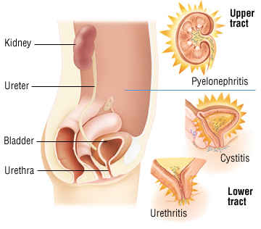

Slide 4
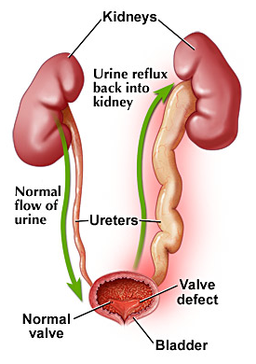
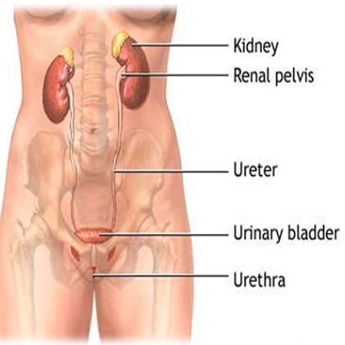
Urinary Tract Infection
Pyelonephritis
Upper UTI
Ureteritis
Vesico-ureteral Reflux
Cystitis
Lower UTI
Urethritis

Slide 5
Upper Urinary tract (Kidney, Ureter)-
Less common but More dangerous,
Long term therapy
Lower Urinary tract (Bladder, Urethra)-
More common but Less dangerous
Short term therapy

Slide 6
Organisms-
Mostly Gram Negative (E.coli, Klebsiella, Proteus, Pseudomonas, Enterobacter,)
Others- Staphylococcus, Viral, Fungal, …
Single in acute, mixed in chronic
Entry-
Mostly from lower to upper (Ascending ),
Some times
Directly from the surrounding sites or
From blood (bacterimia)

Slide 7
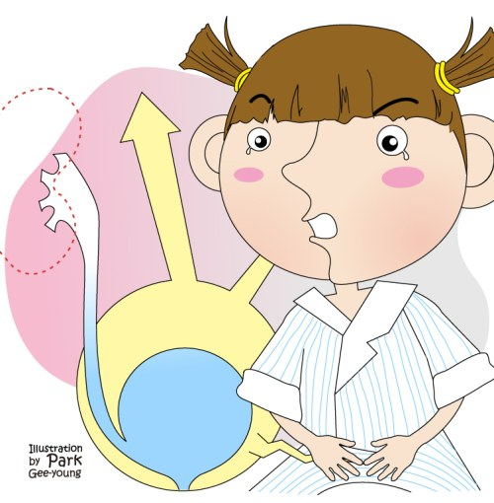
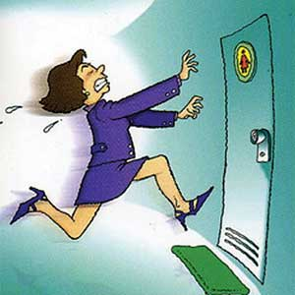
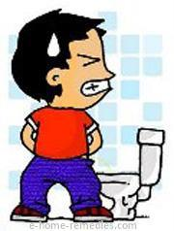
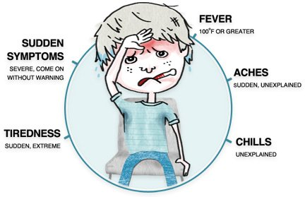
Symptoms

Slide 8
Symptoms- (Severe Pain During UTI)
Systemic symptoms- myalgia, vomiting, weakness etc.
Pain (Pelvic, Rectal, lower abdomen or renal angle)
Pungent smell of urine
Dysuria (Burning),
Denies urination (Fear of Urination)
Discharge through urethra
Discoloration of urine (Haematuria, Pyuria, Haziness, Clouding)
Urgency
Temperature (Fever with chills)
Incomplete emptying (Retention)
Incontinence of urine

Slide 9
More common in Females- Anatomical differences
Other part involved -
Prostate, Epididymis
More common if-
Stones
Strictures
Stents (Urinary Catheter)
Structural abnormality
Straight entry of ureter
Sexually active
Store urine (Faulty urinary habit)
Surgical (abdomen)
Scanty fluid intake
Semiconscious (Unconscious),
Site trauma,

Slide 10
Causes
The most common UTIs occur mainly in women and affect the bladder and urethra.
Infection of the bladder (cystitis). This type of UTI is usually caused by Escherichia coli (E. coli), a type of bacteria commonly found in the gastrointestinal (GI) tract. However, sometimes other bacteria are responsible.
Sexual intercourse may lead to cystitis, but you don't have to be sexually active to develop it. All women are at risk of cystitis because of their anatomy — specifically, the short distance from the urethra to the anus and the urethral opening to the bladder.
Infection of the urethra (urethritis). This type of UTI can occur when GI bacteria spread from the anus to the urethra. Also, because the female urethra is close to the vagina, sexually transmitted infections, such as herpes, gonorrhea, chlamydia and mycoplasma, can cause urethritis.

Slide 11
Risk factors
Risk factors specific to women for UTIs include:
Female anatomy. A woman has a shorter urethra than a man does, which shortens the distance that bacteria must travel to reach the bladder.
Sexual activity. Sexually active women tend to have more UTIs than do women who aren't sexually active. Having a new sexual partner also increases your risk.
Certain types of birth control. Women who use diaphragms for birth control may be at higher risk, as well as women who use spermicidal agents.
Menopause. After menopause, a decline in circulating estrogen causes changes in the urinary tract that make you more vulnerable to infection.

Slide 12
Treatment of UTI
Increased Fluid Intake and Voiding
Analgesics, Antipyretics, Anti-inflammatory (NSAIDs)
Alteration of pH
Alkalizers – Potassium Citrate, Baking Soda,
Beware of
Dilution (1:10) of syrup (Gastric irritant)- 30 ml in 300ml
Not with Nalidixic acid, Nitrofurantoin, Methenamine
Proteus which split urea and produce ammonia and make urine alkaline.
Acidify with vitamin C, Mandelic acid (Syrup of Ammonium Mandelate) and Cranberry (Karaunda)

Slide 13
Urinary analgesics (Local)-
Phenazopyridine (Symptomatic relief only, No antibacterial property, Urine becomes orange red)
Urinary antiseptics-
Nitrofurantoin-
Generates nitro-anion superoxide to damage bacterial DNA,
Dark brown urine,
Peripheral neuritis, Intra-hepatic cholestasis
Antagonism with Nalidixic acid
Methenamine –
Releases formaldehyde in acidic urine,
Antagonism with sulfonamides

Slide 14
Antimicrobials------------------------(Q-BACTS)
Quinolones -(Nalidixic acid, Norfloxacin……)
Betalactams- Ampicillin/ Amoxicillin,
Aminogycosides- Gentamicin, Amikacin, …
Cephalosporins- Third generation
Tetracyclines -
Sulfonamides and Cotrimoxazole
Other Antimicrobials-
Chloramphenicol, Methicillin, Carbenicillin etc……..

Slide 15
Prophylaxis for UTI- Needed in
Catherised,
Uncorrectable anatomical abnormalities
Inoperable prostate,
Septicemia,
Immuno-compromised,
Trauma
Note-
In patients with impaired renal functions avoid
Nitrofurnatoin, Nalidixic acid,
Aminoglycosides,
Potassium salt, and Acidifying agents

Slide 16
V
V
V

Slide 17
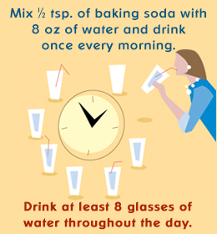

Slide 18
Complications
Complications of a UTI may include:
Recurrent infections, especially in women who experience two or more UTIs in a six-month period or four or more within a year.
Permanent kidney damage from an acute or chronic kidney infection (pyelonephritis) due to an untreated UTI.
Increased risk in pregnant women of delivering low birth weight or premature infants.
Urethral narrowing (stricture) in men from recurrent urethritis, previously seen with gonococcal urethritis.
Sepsis, a potentially life-threatening complication of an infection, especially if the infection works its way up your urinary tract to your kidneys.

Slide 20
Conclusion
Urinary tract infections (UTIs) typically respond very well to treatment. A UTI can be uncomfortable before you start treatment, but once your healthcare provider identifies the type of bacteria and prescribes the right antibiotic medication, your symptoms should improve quickly.
It’s important to keep taking your medication for the entire amount of time your healthcare provider prescribed. If you have frequent UTIs or if your symptoms aren’t improving, your provider may test to see if it’s an antibiotic-resistant infection.

Slide 21
References
Google.com
Wikipedia.org
Studymafia.org
Slidespanda.com

Slide 22
Thanks To StudyMafia.org

