Slide 1
StudyMafia.Org
Syphillis
Submitted To: Submitted By:
Studymafia.org Studymafia.org

Slide 2
Table Contents
Definition
Introduction
Symptoms of Syphilis
Types of Syphilis
Causes of Syphilis
Risk-Factors of Syphilis
Complications of Syphilis
Prevention of Syphilis
Diagnosis of Syphilis
Treatment of Syphilis
Conclusion
2
Notes:
SAY: Before we wrap up the course, let’s review what we have learned today.
During this course, we have
<READ the bullets from the slide.>
GO to next slide.

Slide 3
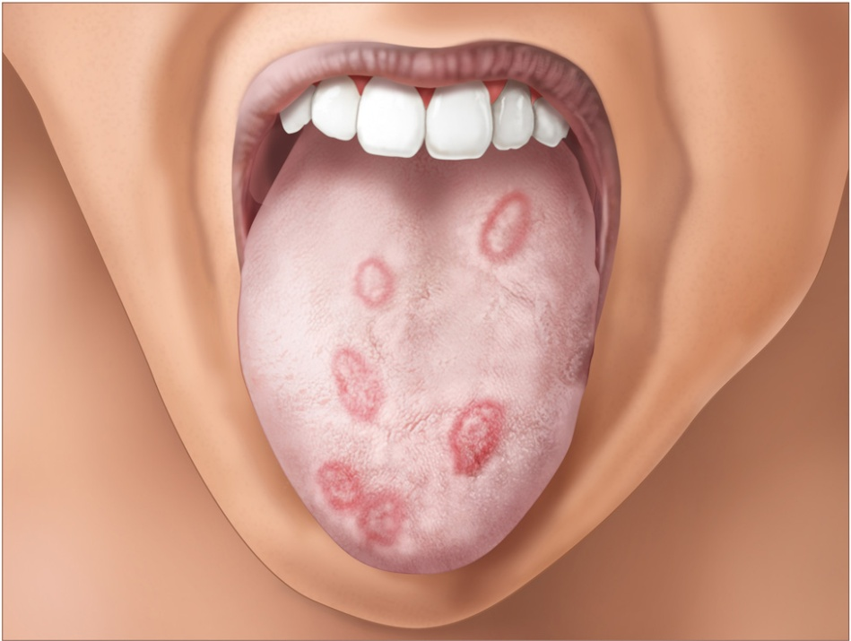
Definition
Syphilis is a bacterial infection usually spread by sexual contact. The disease starts as a painless sore — typically on the genitals, rectum or mouth. Syphilis spreads from person to person via skin or mucous membrane contact with these sores.
3
Notes:
SAY: Before we wrap up the course, let’s review what we have learned today.
During this course, we have
<READ the bullets from the slide.>
GO to next slide.

Slide 4
Introduction
After the initial infection, the syphilis bacteria can remain inactive in the body for decades before becoming active again. Early syphilis can be cured, sometimes with a single shot (injection) of penicillin.
Without treatment, syphilis can severely damage the heart, brain or other organs, and can be life-threatening. Syphilis can also be passed from mothers to unborn children.
4
Notes:
SAY: Before we wrap up the course, let’s review what we have learned today.
During this course, we have
<READ the bullets from the slide.>
GO to next slide.

Slide 5
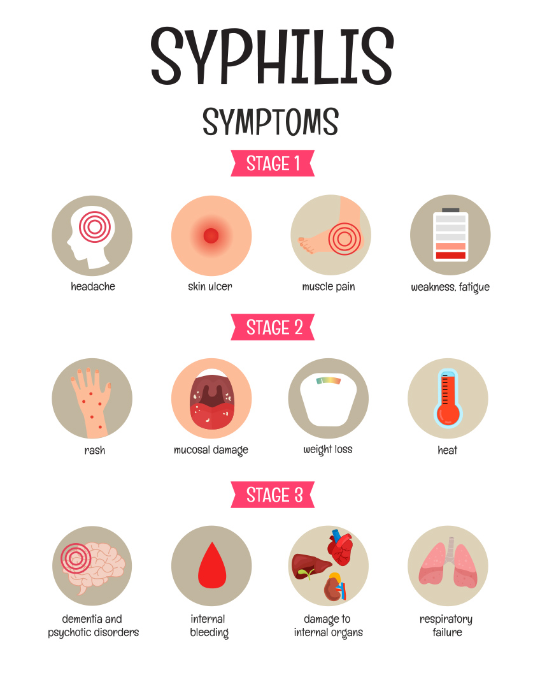
Symptoms of Syphilis
5
Notes:
SAY: Before we wrap up the course, let’s review what we have learned today.
During this course, we have
<READ the bullets from the slide.>
GO to next slide.

Slide 6
Types of Syphilis
Primary Syphilis
The first sign of syphilis is a small sore, called a chancre (SHANG-kur). The sore appears at the spot where the bacteria entered your body. While most people infected with syphilis develop only one chancre, some people develop several of them.
●●●
6
Notes:
SAY: Before we wrap up the course, let’s review what we have learned today.
During this course, we have
<READ the bullets from the slide.>
GO to next slide.

Slide 7
Types of Syphilis
Secondary syphilis
Within a few weeks of the original chancre healing, you may experience a rash that begins on your trunk but eventually covers your entire body — even the palms of your hands and the soles of your feet.
This rash is usually not itchy and may be accompanied by wartlike sores in your mouth or genital area. Some people also experience hair loss, muscle aches, a fever, a sore throat and swollen lymph nodes.
●●●
7
Notes:
SAY: Before we wrap up the course, let’s review what we have learned today.
During this course, we have
<READ the bullets from the slide.>
GO to next slide.

Slide 8
Types of Syphilis
Latent syphilis
If you aren't treated for syphilis, the disease moves from the secondary stage to the hidden (latent) stage, when you have no symptoms. The latent stage can last for years. Signs and symptoms may never return, or the disease may progress to the third (tertiary) stage.
Tertiary syphilis
About 15% to 30% of people infected with syphilis who don't get treatment will develop complications known as tertiary syphilis. In the late stage, the disease may damage the brain, nerves, eyes, heart, blood vessels, liver, bones and joints.
●●●
8
Notes:
SAY: Before we wrap up the course, let’s review what we have learned today.
During this course, we have
<READ the bullets from the slide.>
GO to next slide.

Slide 9
Types of Syphilis
Neurosyphilis
At any stage, syphilis can spread and, among other damage, cause damage to the brain and nervous system and the eye.
Congenital syphilis
Babies born to women who have syphilis can become infected through the placenta or during birth. Most newborns with congenital syphilis have no symptoms, although some experience a rash on the palms of their hands and the soles of their feet.
9
Notes:
SAY: Before we wrap up the course, let’s review what we have learned today.
During this course, we have
<READ the bullets from the slide.>
GO to next slide.

Slide 10
Causes of Syphilis
The cause of syphilis is a bacterium called Treponema pallidum. The most common way syphilis is spread is through contact with an infected person's sore during sexual activity. The bacteria enter the body through minor cuts or abrasions in the skin or mucous membranes. Syphilis is contagious during its primary and secondary stages, and sometimes in the early latent period.
Less commonly, syphilis may spread through direct contact with an active lesion, such as during kissing. It can also be passed from mothers to their babies during pregnancy or childbirth.
●●●
10
Notes:
SAY:
The purpose of epidemiology in public health practice is to
discover the agent, host, and environmental factors that affect health;
determine the relative importance of causes of illness, disability, and death;
identify those segments of the population that have the greatest risk from specific causes of ill health; and
evaluate the effectiveness of health programs and services in improving population health.
GO to next slide.

Slide 11
Causes of Syphilis
Syphilis can't be spread by using the same toilet, bathtub, clothing or eating utensils, or from doorknobs, swimming pools or hot tubs.
Once cured, syphilis doesn't return on its own. However, you can become reinfected if you have contact with someone's syphilis sore.
11
Notes:
SAY:
The purpose of epidemiology in public health practice is to
discover the agent, host, and environmental factors that affect health;
determine the relative importance of causes of illness, disability, and death;
identify those segments of the population that have the greatest risk from specific causes of ill health; and
evaluate the effectiveness of health programs and services in improving population health.
GO to next slide.

Slide 12
Risk factors of Syphilis
You face an increased risk of acquiring syphilis if you:
Engage in unprotected sex
Have sex with multiple partners
Are a man who has sex with men
Are infected with HIV, the virus that causes AIDS
12
Notes:
SAY:
The purpose of epidemiology in public health practice is to
discover the agent, host, and environmental factors that affect health;
determine the relative importance of causes of illness, disability, and death;
identify those segments of the population that have the greatest risk from specific causes of ill health; and
evaluate the effectiveness of health programs and services in improving population health.
GO to next slide.

Slide 13
Complications of Syphilis
Without treatment, syphilis can lead to damage throughout your body. Syphilis also increases the risk of HIV infection and can cause problems during pregnancy. Treatment can help prevent future damage but can't repair or reverse damage that's already occurred.
Small bumps or tumors
In the late stage of syphilis, bumps (gummas) can develop on the skin, bones, liver or any other organ. Gummas usually disappear after treatment with antibiotics.
●●●
13
Notes:
SAY:
The purpose of epidemiology in public health practice is to
discover the agent, host, and environmental factors that affect health;
determine the relative importance of causes of illness, disability, and death;
identify those segments of the population that have the greatest risk from specific causes of ill health; and
evaluate the effectiveness of health programs and services in improving population health.
GO to next slide.

Slide 14
Complications of Syphilis
Neurological problems
Syphilis can cause a number of problems with the nervous system, including:
Headache
Stroke
Meningitis
Hearing loss
Visual problems, including blindness
Dementia
Loss of pain and temperature sensations
Sexual dysfunction in men
Bladder incontinence
●●●
14
Notes:
SAY:
The purpose of epidemiology in public health practice is to
discover the agent, host, and environmental factors that affect health;
determine the relative importance of causes of illness, disability, and death;
identify those segments of the population that have the greatest risk from specific causes of ill health; and
evaluate the effectiveness of health programs and services in improving population health.
GO to next slide.

Slide 15
Complications of Syphilis
Cardiovascular problems
These may include bulging and swelling of the aorta — your body's major artery — and of other blood vessels. Syphilis may also damage heart valves.
HIV infection
Adults with sexually transmitted syphilis or other genital ulcers have an estimated two- to fivefold increased risk of contracting HIV. A syphilis sore can bleed easily, providing an easy way for HIV to enter the bloodstream during sexual activity.
15
Notes:
SAY:
The purpose of epidemiology in public health practice is to
discover the agent, host, and environmental factors that affect health;
determine the relative importance of causes of illness, disability, and death;
identify those segments of the population that have the greatest risk from specific causes of ill health; and
evaluate the effectiveness of health programs and services in improving population health.
GO to next slide.

Slide 16
Prevention of Syphilis
There is no vaccine for syphilis. To help prevent the spread of syphilis, follow these suggestions:
Abstain or be monogamous. The only certain way to avoid syphilis is to avoid (abstain from) having sex. The next-best option is to have mutually monogamous sex in which both partners have sex only with each other and neither partner is infected.
Use a latex condom. Condoms can reduce your risk of contracting syphilis, but only if the condom covers the syphilis sores.
Avoid recreational drugs. Misuse of alcohol or other drugs can inhibit your judgment and lead to unsafe sexual practices.
16
Notes:
SAY:
The purpose of epidemiology in public health practice is to
discover the agent, host, and environmental factors that affect health;
determine the relative importance of causes of illness, disability, and death;
identify those segments of the population that have the greatest risk from specific causes of ill health; and
evaluate the effectiveness of health programs and services in improving population health.
GO to next slide.

Slide 17
Diagnosis of Syphilis
Syphilis can be diagnosed by testing samples of:
Blood: Blood tests can confirm the presence of antibodies that the body produces to fight infection. The antibodies to the syphilis-causing bacteria remain in your body for years, so the test can be used to determine a current or past infection.
Cerebrospinal fluid: If it's suspected that you have nervous system complications of syphilis, your doctor may also suggest collecting a sample of cerebrospinal fluid through a lumbar puncture.
17
Notes:
SAY:
The purpose of epidemiology in public health practice is to
discover the agent, host, and environmental factors that affect health;
determine the relative importance of causes of illness, disability, and death;
identify those segments of the population that have the greatest risk from specific causes of ill health; and
evaluate the effectiveness of health programs and services in improving population health.
GO to next slide.

Slide 18
Treatment of Syphilis
Medication
When diagnosed and treated in its early stages, syphilis is easy to cure. The preferred treatment at all stages is penicillin, an antibiotic medication that can kill the organism that causes syphilis. If you're allergic to penicillin, your doctor may suggest another antibiotic or recommend penicillin desensitization.
●●●
18
Notes:
SAY:
The purpose of epidemiology in public health practice is to
discover the agent, host, and environmental factors that affect health;
determine the relative importance of causes of illness, disability, and death;
identify those segments of the population that have the greatest risk from specific causes of ill health; and
evaluate the effectiveness of health programs and services in improving population health.
GO to next slide.

Slide 19
Treatment of Syphilis
After you're treated for syphilis, your doctor will ask you to:
Have periodic blood tests and exams to make sure you're responding to the usual dosage of penicillin. Your specific follow-up will depend on the stage of syphilis you're diagnosed with.
Avoid sexual contact with new partners until the treatment is completed and blood tests indicate the infection has been cured.
Notify your sex partners so that they can be tested and get treatment if necessary.
Be tested for HIV infection.
19
Notes:
SAY:
The purpose of epidemiology in public health practice is to
discover the agent, host, and environmental factors that affect health;
determine the relative importance of causes of illness, disability, and death;
identify those segments of the population that have the greatest risk from specific causes of ill health; and
evaluate the effectiveness of health programs and services in improving population health.
GO to next slide.

Slide 20
Conclusion
Syphilis is a curable disease, but can cause substantial morbidity and mortality if left untreated. Prompt diagnosis and treatment is important.
20
Notes:
SAY:
The purpose of epidemiology in public health practice is to
discover the agent, host, and environmental factors that affect health;
determine the relative importance of causes of illness, disability, and death;
identify those segments of the population that have the greatest risk from specific causes of ill health; and
evaluate the effectiveness of health programs and services in improving population health.
GO to next slide.

Slide 21
References
Google.com
Wikipedia.org
Studymafia.org
Slidespanda.com

Slide 22
Thanks To StudyMafia.org

