Slide 1
StudyMafia.Org
Rheumatoid Arthritis
Submitted To: Submitted By:
Studymafia.org Studymafia.org

Slide 2
Table Contents
Definition
Introduction
Symptoms of Rheumatoid Arthritis
Causes of Rheumatoid Arthritis
Risk-Factors of Rheumatoid Arthritis
Complications of Rheumatoid Arthritis
Diagnosis of Rheumatoid Arthritis
Treatment of Rheumatoid Arthritis
Conclusion
2
Notes:
SAY: Before we wrap up the course, let’s review what we have learned today.
During this course, we have
<READ the bullets from the slide.>
GO to next slide.

Slide 3
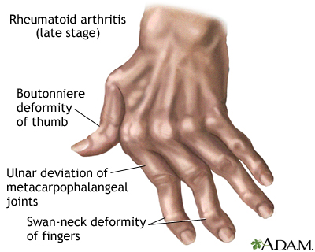
Definition
Rheumatoid arthritis is a chronic inflammatory disorder that can affect more than just your joints.
3
Notes:
SAY: Before we wrap up the course, let’s review what we have learned today.
During this course, we have
<READ the bullets from the slide.>
GO to next slide.

Slide 4
Introduction
An autoimmune disorder, rheumatoid arthritis occurs when your immune system mistakenly attacks your own body's tissues.
Unlike the wear-and-tear damage of osteoarthritis, rheumatoid arthritis affects the lining of your joints, causing a painful swelling that can eventually result in bone erosion and joint deformity.
The inflammation associated with rheumatoid arthritis is what can damage other parts of the body as well.
4
Notes:
SAY: Before we wrap up the course, let’s review what we have learned today.
During this course, we have
<READ the bullets from the slide.>
GO to next slide.

Slide 5
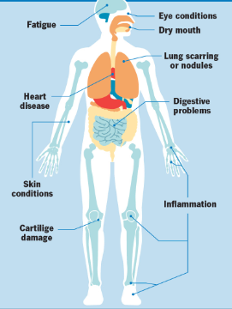
Symptoms of Rheumatoid Arthritis
5
Notes:
SAY: Before we wrap up the course, let’s review what we have learned today.
During this course, we have
<READ the bullets from the slide.>
GO to next slide.

Slide 6
Causes of Rheumatoid Arthritis
Rheumatoid arthritis is an autoimmune disease. Normally, your immune system helps protect your body from infection and disease. In rheumatoid arthritis, your immune system attacks healthy tissue in your joints.
It can also cause medical problems with your heart, lungs, nerves, eyes and skin.
●●●
6
Notes:
SAY:
The purpose of epidemiology in public health practice is to
discover the agent, host, and environmental factors that affect health;
determine the relative importance of causes of illness, disability, and death;
identify those segments of the population that have the greatest risk from specific causes of ill health; and
evaluate the effectiveness of health programs and services in improving population health.
GO to next slide.

Slide 7
Causes of Rheumatoid Arthritis
Doctors don't know what starts this process, although a genetic component appears likely.
While your genes don't actually cause rheumatoid arthritis, they can make you more likely to react to environmental factors — such as infection with certain viruses and bacteria — that may trigger the disease.
7
Notes:
SAY:
The purpose of epidemiology in public health practice is to
discover the agent, host, and environmental factors that affect health;
determine the relative importance of causes of illness, disability, and death;
identify those segments of the population that have the greatest risk from specific causes of ill health; and
evaluate the effectiveness of health programs and services in improving population health.
GO to next slide.

Slide 8
Risk factors of Rheumatoid Arthritis
Your sex. Women are more likely than men to develop rheumatoid arthritis.
Age. Rheumatoid arthritis can occur at any age, but it most commonly begins in middle age.
Family history. If a member of your family has rheumatoid arthritis, you may have an increased risk of the disease.
●●●
8
Notes:
SAY:
The purpose of epidemiology in public health practice is to
discover the agent, host, and environmental factors that affect health;
determine the relative importance of causes of illness, disability, and death;
identify those segments of the population that have the greatest risk from specific causes of ill health; and
evaluate the effectiveness of health programs and services in improving population health.
GO to next slide.

Slide 9
Risk factors of Rheumatoid Arthritis
Smoking. Cigarette smoking increases your risk of developing rheumatoid arthritis, particularly if you have a genetic predisposition for developing the disease. Smoking also appears to be associated with greater disease severity.
Excess weight. People who are overweight appear to be at a somewhat higher risk of developing rheumatoid arthritis.
9
Notes:
SAY:
The purpose of epidemiology in public health practice is to
discover the agent, host, and environmental factors that affect health;
determine the relative importance of causes of illness, disability, and death;
identify those segments of the population that have the greatest risk from specific causes of ill health; and
evaluate the effectiveness of health programs and services in improving population health.
GO to next slide.

Slide 10
Complications of Rheumatoid Arthritis
Osteoporosis. Rheumatoid arthritis itself, along with some medications used for treating rheumatoid arthritis, can increase your risk of osteoporosis — a condition that weakens your bones and makes them more prone to fracture.
Rheumatoid nodules. These firm bumps of tissue most commonly form around pressure points, such as the elbows. However, these nodules can form anywhere in the body, including the heart and lungs.
●●●
10
Notes:
SAY:
The purpose of epidemiology in public health practice is to
discover the agent, host, and environmental factors that affect health;
determine the relative importance of causes of illness, disability, and death;
identify those segments of the population that have the greatest risk from specific causes of ill health; and
evaluate the effectiveness of health programs and services in improving population health.
GO to next slide.

Slide 11
Complications of Rheumatoid Arthritis
Dry eyes and mouth. People who have rheumatoid arthritis are much more likely to develop Sjogren's syndrome, a disorder that decreases the amount of moisture in the eyes and mouth.
Infections. Rheumatoid arthritis itself and many of the medications used to combat it can impair the immune system, leading to increased infections. Protect yourself with vaccinations to prevent diseases such as influenza, pneumonia, shingles and COVID-19.
●●●
11
Notes:
SAY:
The purpose of epidemiology in public health practice is to
discover the agent, host, and environmental factors that affect health;
determine the relative importance of causes of illness, disability, and death;
identify those segments of the population that have the greatest risk from specific causes of ill health; and
evaluate the effectiveness of health programs and services in improving population health.
GO to next slide.

Slide 12
Complications of Rheumatoid Arthritis
Abnormal body composition. The proportion of fat to lean mass is often higher in people who have rheumatoid arthritis, even in those who have a normal body mass index (BMI).
Carpal tunnel syndrome. If rheumatoid arthritis affects your wrists, the inflammation can compress the nerve that serves most of your hand and fingers.
Heart problems. Rheumatoid arthritis can increase your risk of hardened and blocked arteries, as well as inflammation of the sac that encloses your heart.
●●●
12
Notes:
SAY:
The purpose of epidemiology in public health practice is to
discover the agent, host, and environmental factors that affect health;
determine the relative importance of causes of illness, disability, and death;
identify those segments of the population that have the greatest risk from specific causes of ill health; and
evaluate the effectiveness of health programs and services in improving population health.
GO to next slide.

Slide 13
Complications of Rheumatoid Arthritis
Lung disease. People with rheumatoid arthritis have an increased risk of inflammation and scarring of the lung tissues, which can lead to progressive shortness of breath.
Lymphoma. Rheumatoid arthritis increases the risk of lymphoma, a group of blood cancers that develop in the lymph system.
13
Notes:
SAY:
The purpose of epidemiology in public health practice is to
discover the agent, host, and environmental factors that affect health;
determine the relative importance of causes of illness, disability, and death;
identify those segments of the population that have the greatest risk from specific causes of ill health; and
evaluate the effectiveness of health programs and services in improving population health.
GO to next slide.

Slide 14
Diagnosis of Rheumatoid Arthritis
Blood tests
People with rheumatoid arthritis often have an elevated erythrocyte sedimentation rate (ESR, also known as sed rate) or C-reactive protein (CRP) level, which may indicate the presence of an inflammatory process in the body.
Imaging tests
Your doctor may recommend X-rays to help track the progression of rheumatoid arthritis in your joints over time. MRI and ultrasound tests can help your doctor judge the severity of the disease in your body.
14
Notes:
SAY:
The purpose of epidemiology in public health practice is to
discover the agent, host, and environmental factors that affect health;
determine the relative importance of causes of illness, disability, and death;
identify those segments of the population that have the greatest risk from specific causes of ill health; and
evaluate the effectiveness of health programs and services in improving population health.
GO to next slide.

Slide 15
Treatment of Rheumatoid Arthritis
NSAIDs. Nonsteroidal anti-inflammatory drugs (NSAIDs) can relieve pain and reduce inflammation.
Steroids. Corticosteroid medications, such as prednisone, reduce inflammation and pain and slow joint damage.
Conventional DMARDs. These drugs can slow the progression of rheumatoid arthritis and save the joints and other tissues from permanent damage.
Targeted synthetic DMARDs. Baricitinib (Olumiant), tofacitinib (Xeljanz) and upadacitinib (Rinvoq) may be used if conventional DMARDs and biologics haven't been effective.
●●●
15
Notes:
SAY:
The purpose of epidemiology in public health practice is to
discover the agent, host, and environmental factors that affect health;
determine the relative importance of causes of illness, disability, and death;
identify those segments of the population that have the greatest risk from specific causes of ill health; and
evaluate the effectiveness of health programs and services in improving population health.
GO to next slide.

Slide 16
Treatment of Rheumatoid Arthritis
Therapy
Your doctor may refer you to a physical or occupational therapist who can teach you exercises to help keep your joints flexible. For example, you may want to pick up an object using your forearms.
Surgery
Surgery may help restore your ability to use your joint. It can also reduce pain and improve function.
16
Notes:
SAY:
The purpose of epidemiology in public health practice is to
discover the agent, host, and environmental factors that affect health;
determine the relative importance of causes of illness, disability, and death;
identify those segments of the population that have the greatest risk from specific causes of ill health; and
evaluate the effectiveness of health programs and services in improving population health.
GO to next slide.

Slide 17
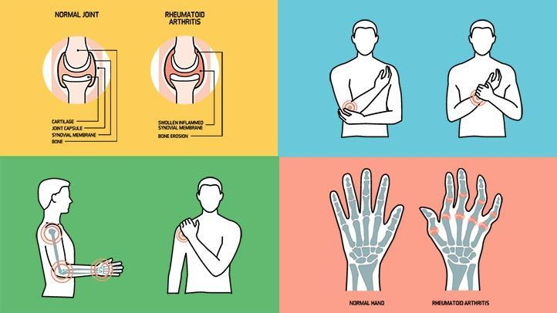

Slide 18
Conclusion
RA is a chronic disease that requires interventions to modify disease progression. While initial presentations are related to joint inflammation, long-term sequelae can include extra-skeletal manifestations.
The most recent RA guidelines are from ACR 2015 and EULAR 2016.
18
Notes:
SAY:
The purpose of epidemiology in public health practice is to
discover the agent, host, and environmental factors that affect health;
determine the relative importance of causes of illness, disability, and death;
identify those segments of the population that have the greatest risk from specific causes of ill health; and
evaluate the effectiveness of health programs and services in improving population health.
GO to next slide.

Slide 19
References
Google.com
Wikipedia.org
Studymafia.org
Slidespanda.com

Slide 20
Thanks To StudyMafia.org

