Slide 1
StudyMafia.Org
Pulmonary Embolism
Submitted To: Submitted By:
Studymafia.org Studymafia.org

Slide 2
Table of Content
What is a pulmonary embolism?
Pathogenesis
Symptoms
Causes
Risk Factors
How is a pulmonary embolism diagnosed?
How is a pulmonary embolism Treated?
Prevention
Conclusion

Slide 3
What is a pulmonary embolism?
A pulmonary embolism (PE) is a blood clot that occurs in the lungs.
It can damage part of the lung due to:
restricted blood flow
decreased oxygen levels in the blood
effects on other organs

Slide 4
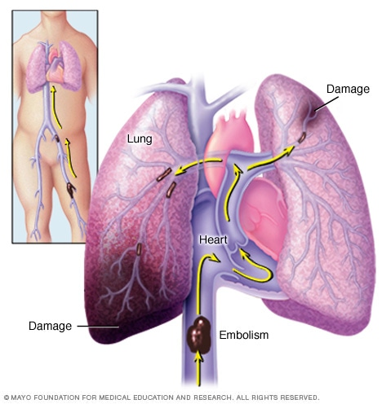

Slide 5
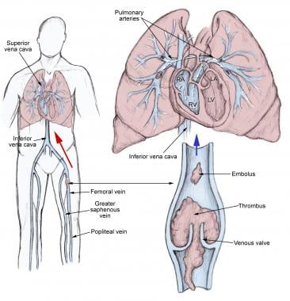
Pathogenesis

Slide 6
Symptoms
Pulmonary embolism symptoms can vary greatly, depending on how much of your lung is involved, the size of the clots, and whether you have underlying lung or heart disease.
Common signs and symptoms include:
Shortness of breath. This symptom typically appears suddenly and always gets worse with exertion.

Slide 7
Symptoms….
Chest pain. You may feel like you're having a heart attack. The pain is often sharp and felt when you breathe in deeply, often stopping you from being able to take a deep breath. It can also be felt when you cough, bend or stoop.
Cough. The cough may produce bloody or blood-streaked sputum

Slide 8
What causes a pulmonary embolism?
Blood clots can form for a variety of reasons. PEs are most often caused by deep vein thrombosis (DVT), a condition in which blood clots form in veins deep in the body. The blood clots that most often cause PEs begin in the legs or pelvis.
Blood clots in the deep veins of the body can have several different causes, including:
Injury or damage. Injuries like bone fractures or muscle tears can cause damage to blood vessels, leading to clots.

Slide 9
What causes a pulmonary embolism?
Inactivity. During long periods of inactivity, gravity causes blood to collect in the lowest areas of your body, which may lead to a blood clot. This could occur if you’re sitting for a lengthy trip or if you’re lying in bed recovering from an illness.
Medical conditions. Some health conditions cause blood to clot easily, which can lead to PE. Treatments that involve surgery often lead to short-term bed rest or limited movement, which can make clotting more likely. Also, certain medical therapies for cancer can have side effects such as clotting in the blood. This puts you at risk for DVT and PE.

Slide 10
Risk factors
Medical conditions and treatments
Heart disease
Cancer
Surgery
Disorders that affect clotting
Prolonged immobility
Bed rest
Long trips

Slide 11
Other risk factors
Smoking. For reasons that aren't well understood, tobacco use predisposes some people to blood clot formation, especially when combined with other risk factors.
Being overweight. Excess weight increases the risk of blood clots — particularly in people with other risk factors.
Supplemental estrogen. The estrogen in birth control pills and in hormone replacement therapy can increase clotting factors in your blood, especially if you smoke or are overweight.
Pregnancy. The weight of the baby pressing on veins in the pelvis can slow blood return from the legs. Clots are more likely to form when blood slows or pools.

Slide 12
How is a pulmonary embolism diagnosed?
Chest X-ray. This is a standard, noninvasive test that lets a doctor see your heart and lungs to look for other obvious causes of your symptoms. A PE can not be diagnosed with this test. The most common finding of a PE on a chest X-ray is “normal.”
Electrocardiography (ECG). An ECG measures your heart’s electrical activity. A PE can not be diagnosed on an ECG. This test will check for other causes of chest pain.
Computed tomography pulmonary angiography (CTPA). This test is the first-choice diagnostic imaging method because it’s sensitive and specific for the diagnosis of PE. However, it requires the use of intravenous (IV) contrast.

Slide 13
How is a pulmonary embolism diagnosed?
Magnetic resonance pulmonary angiography (MRPA). This is not recommended as a first-line test for diagnosing PE, but it may be an imaging option to diagnose PE in people who can neither receive a CTPA nor a VQ scan.
Venography. A venogram is an invasive test that is rarely used for the diagnosis of only a DVT. This is a specialized X-ray of the veins in your legs and also requires the use of contrast.
Pulmonary angiography A pulmonary angiography is an invasive test that’s rarely used to diagnose an acute PE. It involves making a small incision so a doctor can guide specialized tools through your veins.

Slide 14
How is a pulmonary embolism treated?
Anticoagulants. Also called blood thinners, medications such as heparin and warfarin prevent new clots from forming in your blood. They can save your life in an emergency situation. Another commonly used category of anticoagulant is the direct oral anticoagulants (DOACs), such as rivaroxaban (Xarelto) and apixaban (Eliquis).
Clot dissolvers (thrombolytics). These drugs break down a clot to improve blood flow and perfusion. They are reserved for people hospitalized in emergency situations because side effects may include dangerous bleeding problems.

Slide 15
How is a pulmonary embolism treated?
Catheter directed methods. These are used for clot removal and breakdown. A thin tube called a catheter will suction out, break down, or dissolve clots in your pulmonary artery.
Open surgery. Doctors use open surgery only in emergency situations when:
minimally invasive catheter directed methods are not available
medications aren’t working to break up the clot
medications are contraindicated or carry too many risks for the patient

Slide 16
Prevention
Blood thinners
Compression stockings
Leg elevation
Physical activity
Pneumatic compression

Slide 17
Prevention while traveling
Drink plenty of fluids
Take a break from sitting
Fidget in your seat
Wear support stockings

Slide 18
How serious is a pulmonary embolism?
A pulmonary embolism may dissolve on its own; it is seldom fatal when diagnosed and treated properly. However, if left untreated, it can be serious, leading to other medical complications, including death. A pulmonary embolism can:
Cause heart damage.
Be life-threatening, depending on the size of the clot.

Slide 19
Conclusion
With effective and timely treatment, most people who experience a pulmonary embolism can make a full recovery.
The condition carries a high risk of fatality. However, early treatment can dramatically reduce this risk.
The period of highest risk is in this hours after the embolism first occurs. The outlook is also worse if the embolism was caused by an underlying condition, such as a type of cancer.
However, most people with pulmonary embolism can make a full recovery.

Slide 20
References
Google.com
Wikipedia.org
Studymafia.org
Slidespanda.com

Slide 21
Thanks To StudyMafia.org

