Slide 1
StudyMafia.Org
Psychotherapy
Submitted To: Submitted By:
Studymafia.org Studymafia.org

Slide 2
Table Contents
Definition
Introduction
Signs of Psychotherapy
Why it is Done?
Preparation of Psychotherapy
Expectations of Psychotherapy
Types of Psychotherapy
Length of Psychotherapy
Results of Psychotherapy
Conclusion
2
Notes:
SAY: Before we wrap up the course, let’s review what we have learned today.
During this course, we have
<READ the bullets from the slide.>
GO to next slide.

Slide 3
Definition
Psychotherapy is a general term for treating mental health problems by talking with a psychiatrist, psychologist or other mental health provider.
3
Notes:
SAY: Before we wrap up the course, let’s review what we have learned today.
During this course, we have
<READ the bullets from the slide.>
GO to next slide.

Slide 4
Introduction
During psychotherapy, you learn about your condition and your moods, feelings, thoughts and behaviors. Psychotherapy helps you learn how to take control of your life and respond to challenging situations with healthy coping skills.
There are many types of psychotherapy, each with its own approach. The type of psychotherapy that's right for you depends on your individual situation. Psychotherapy is also known as talk therapy, counseling, psychosocial therapy or, simply, therapy.
4
Notes:
SAY: Before we wrap up the course, let’s review what we have learned today.
During this course, we have
<READ the bullets from the slide.>
GO to next slide.

Slide 5
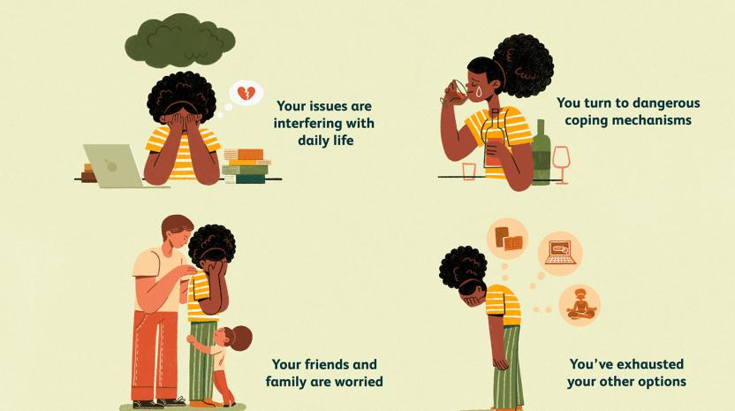
Signs of
Psychotherapy
5
Notes:
SAY: Before we wrap up the course, let’s review what we have learned today.
During this course, we have
<READ the bullets from the slide.>
GO to next slide.

Slide 6
Why it's done
Psychotherapy can be helpful in treating most mental health problems, including:
Anxiety disorders, such as obsessive-compulsive disorder (OCD), phobias, panic disorder or post-traumatic stress disorder (PTSD)
Mood disorders, such as depression or bipolar disorder
Addictions, such as alcoholism, drug dependence or compulsive gambling
●●●
6
Notes:
SAY: Before we wrap up the course, let’s review what we have learned today.
During this course, we have
<READ the bullets from the slide.>
GO to next slide.

Slide 7
Why it's done
Eating disorders, such as anorexia or bulimia
Personality disorders, such as borderline personality disorder or dependent personality disorder
Schizophrenia or other disorders that cause detachment from reality (psychotic disorders)
Not everyone who benefits from psychotherapy is diagnosed with a mental illness.
●●●
7
Notes:
SAY: Before we wrap up the course, let’s review what we have learned today.
During this course, we have
<READ the bullets from the slide.>
GO to next slide.

Slide 8
Why it's done
Psychotherapy can help with a number of life's stresses and conflicts that can affect anyone. For example, it may help you:
Resolve conflicts with your partner or someone else in your life
Relieve anxiety or stress due to work or other situations
Cope with major life changes, such as divorce, the death of a loved one or the loss of a job
●●●
8
Notes:
SAY: Before we wrap up the course, let’s review what we have learned today.
During this course, we have
<READ the bullets from the slide.>
GO to next slide.

Slide 9
Why it's done
Learn to manage unhealthy reactions, such as road rage or passive-aggressive behavior
Come to terms with an ongoing or serious physical health problem, such as diabetes, cancer or long-term (chronic) pain
Recover from physical or sexual abuse or witnessing violence
Cope with sexual problems, whether they're due to a physical or psychological cause
Sleep better, if you have trouble getting to sleep or staying asleep (insomnia)
9
Notes:
SAY: Before we wrap up the course, let’s review what we have learned today.
During this course, we have
<READ the bullets from the slide.>
GO to next slide.

Slide 10
Preparation of
Psychotherapy
Find a therapist:
Get a referral from a doctor, health insurance plan, friend or other trusted source. Many employers offer counseling services or referrals through employee assistance programs (EAPs).
Or you can find a therapist on your own, for instance, by looking for a professional association on the Internet.
●●●
10
Notes:
SAY:
The purpose of epidemiology in public health practice is to
discover the agent, host, and environmental factors that affect health;
determine the relative importance of causes of illness, disability, and death;
identify those segments of the population that have the greatest risk from specific causes of ill health; and
evaluate the effectiveness of health programs and services in improving population health.
GO to next slide.

Slide 11
Preparation of
Psychotherapy
Understand the costs: If you have health insurance, find out what coverage it offers for psychotherapy. Some health plans cover only a certain number of psychotherapy sessions a year. Also, talk to your therapist about fees and payment options.
Review your concerns: Before your first appointment, think about what issues you'd like to work on. While you also can sort this out with your therapist, having some sense in advance may provide a good starting point.
11
Notes:
SAY:
The purpose of epidemiology in public health practice is to
discover the agent, host, and environmental factors that affect health;
determine the relative importance of causes of illness, disability, and death;
identify those segments of the population that have the greatest risk from specific causes of ill health; and
evaluate the effectiveness of health programs and services in improving population health.
GO to next slide.

Slide 12
Expectations of
Psychotherapy
The first session is also an opportunity for you to interview your therapist to see if his or her approach and personality are going to work for you. Make sure you understand:
What type of therapy will be used
The goals of your treatment
The length of each session
How many therapy sessions you may need
12
Notes:
SAY:
The purpose of epidemiology in public health practice is to
discover the agent, host, and environmental factors that affect health;
determine the relative importance of causes of illness, disability, and death;
identify those segments of the population that have the greatest risk from specific causes of ill health; and
evaluate the effectiveness of health programs and services in improving population health.
GO to next slide.

Slide 13
Types of
Psychotherapy
Cognitive behavioral therapy (CBT), which helps you identify unhealthy, negative beliefs and behaviors and replace them with healthy, positive ones
Dialectical behavior therapy, a type of CBT that teaches behavioral skills to help you handle stress, manage your emotions and improve your relationships with others
Acceptance and commitment therapy, which helps you become aware of and accept your thoughts and feelings and commit to making changes, increasing your ability to cope with and adjust to situations
●●●
13
Notes:
SAY:
The purpose of epidemiology in public health practice is to
discover the agent, host, and environmental factors that affect health;
determine the relative importance of causes of illness, disability, and death;
identify those segments of the population that have the greatest risk from specific causes of ill health; and
evaluate the effectiveness of health programs and services in improving population health.
GO to next slide.

Slide 14
Types of
Psychotherapy
Psychodynamic and psychoanalysis therapies, which focus on increasing your awareness of unconscious thoughts and behaviors, developing new insights into your motivations, and resolving conflicts
Interpersonal psychotherapy, which focuses on addressing problems with your current relationships with other people to improve your interpersonal skills — how you relate to others, such as family, friends and colleagues
Supportive psychotherapy, which reinforces your ability to cope with stress and difficult situations
14
Notes:
SAY:
The purpose of epidemiology in public health practice is to
discover the agent, host, and environmental factors that affect health;
determine the relative importance of causes of illness, disability, and death;
identify those segments of the population that have the greatest risk from specific causes of ill health; and
evaluate the effectiveness of health programs and services in improving population health.
GO to next slide.

Slide 15
Length of
Psychotherapy
The number of psychotherapy sessions you need — as well as how frequently you need to see your therapist — depends on such factors as:
Your particular mental illness or situation
Severity of your symptoms
How long you've had symptoms or have been dealing with your situation
How quickly you make progress
●●●
15
Notes:
SAY:
The purpose of epidemiology in public health practice is to
discover the agent, host, and environmental factors that affect health;
determine the relative importance of causes of illness, disability, and death;
identify those segments of the population that have the greatest risk from specific causes of ill health; and
evaluate the effectiveness of health programs and services in improving population health.
GO to next slide.

Slide 16
Length of
Psychotherapy
How much stress you're experiencing
How much your mental health concerns interfere with day-to-day life
How much support you receive from family members and others
Cost and insurance limitations
It may take only weeks to help you cope with a short-term situation. Or, treatment may last a year or longer if you have a long-term mental illness or other long-term concerns.
16
Notes:
SAY:
The purpose of epidemiology in public health practice is to
discover the agent, host, and environmental factors that affect health;
determine the relative importance of causes of illness, disability, and death;
identify those segments of the population that have the greatest risk from specific causes of ill health; and
evaluate the effectiveness of health programs and services in improving population health.
GO to next slide.

Slide 17
Results of
Psychotherapy
Make sure you feel comfortable with your therapist. If you don't, look for another therapist with whom you feel more at ease.
Approach therapy as a partnership. Therapy is most effective when you're an active participant and share in decision-making. Make sure you and your therapist agree about the major issues and how to tackle them. Together, you can set goals and measure progress over time.
●●●
17
Notes:
SAY:
The purpose of epidemiology in public health practice is to
discover the agent, host, and environmental factors that affect health;
determine the relative importance of causes of illness, disability, and death;
identify those segments of the population that have the greatest risk from specific causes of ill health; and
evaluate the effectiveness of health programs and services in improving population health.
GO to next slide.

Slide 18
Results of
Psychotherapy
Be open and honest. Success depends on willingness to share your thoughts, feelings and experiences, and to consider new insights, ideas and ways of doing things.
Stick to your treatment plan. If you feel down or lack motivation, it may be tempting to skip psychotherapy sessions. Doing so can disrupt your progress. Try to attend all sessions and to give some thought to what you want to discuss.
●●●
18
Notes:
SAY:
The purpose of epidemiology in public health practice is to
discover the agent, host, and environmental factors that affect health;
determine the relative importance of causes of illness, disability, and death;
identify those segments of the population that have the greatest risk from specific causes of ill health; and
evaluate the effectiveness of health programs and services in improving population health.
GO to next slide.

Slide 19
Results of
Psychotherapy
Don't expect instant results. Working on emotional issues can be painful and may require hard work. You may need several sessions before you begin to see improvement.
Do your homework between sessions. If your therapist asks you to document your thoughts in a journal or do other activities outside of your therapy sessions, follow through. These homework assignments can help you apply what you've learned in the therapy sessions to your life.
19
Notes:
SAY:
The purpose of epidemiology in public health practice is to
discover the agent, host, and environmental factors that affect health;
determine the relative importance of causes of illness, disability, and death;
identify those segments of the population that have the greatest risk from specific causes of ill health; and
evaluate the effectiveness of health programs and services in improving population health.
GO to next slide.

Slide 20
Conclusion
Psychotherapy is highly effective; numerous meta-analyses of thousands of studies have underscored the effectiveness of psychotherapy treatment.
20
Notes:
SAY:
The purpose of epidemiology in public health practice is to
discover the agent, host, and environmental factors that affect health;
determine the relative importance of causes of illness, disability, and death;
identify those segments of the population that have the greatest risk from specific causes of ill health; and
evaluate the effectiveness of health programs and services in improving population health.
GO to next slide.

Slide 21
References
Google.com
Wikipedia.org
Studymafia.org
Slidespanda.com

Slide 22
Thanks To StudyMafia.org

