Slide 1
StudyMafia.Org
Protein-Energy Malnutrition
Submitted To: Submitted By:
Studymafia.org Studymafia.org

Slide 2
Table Contents
Definition
Introduction
Symptoms of PEM
Classification of PEM
Causes of PEM
Complications of PEM
Prevention of PEM
Diagnosis of PEM
Treatment of PEM
Conclusion
2
Notes:
SAY: Before we wrap up the course, let’s review what we have learned today.
During this course, we have
<READ the bullets from the slide.>
GO to next slide.

Slide 3
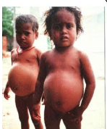
Definition
Protein-energy malnutrition or PEM is the condition of lack of energy due to the deficiency of all the macronutrients and many micronutrients.
3
Notes:
SAY: Before we wrap up the course, let’s review what we have learned today.
During this course, we have
<READ the bullets from the slide.>
GO to next slide.

Slide 4
Introduction
It can occur suddenly or gradually. It can be graded as mild, moderate or severe. In developing countries, it affects children who are not provided with calories and proteins. In developed countries, it affects the older generation.
PEM can be treated by providing a balanced diet. The micronutrients should be taken twice, the daily recommended allowance until recovery.
4
Notes:
SAY: Before we wrap up the course, let’s review what we have learned today.
During this course, we have
<READ the bullets from the slide.>
GO to next slide.

Slide 5
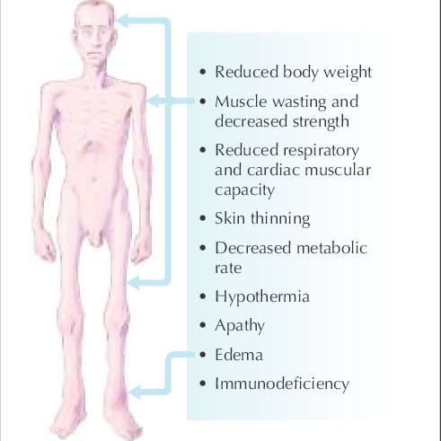
Symptoms of PEM
5
Notes:
SAY: Before we wrap up the course, let’s review what we have learned today.
During this course, we have
<READ the bullets from the slide.>
GO to next slide.

Slide 6
Classification of PEM
Primary PEM
This type of protein-energy malnutrition is found in children. It is rarely found in the elders, the main cause being depression. It can also be caused due to child or elder abuse. In children, PEM is primarily of two types:
Kwashiorkor
Marasmus
●●●
6
Notes:
SAY: Before we wrap up the course, let’s review what we have learned today.
During this course, we have
<READ the bullets from the slide.>
GO to next slide.

Slide 7
Classification of PEM
Kwashiorkor
This occurs due to the abandonment of breastfeeding before the actual age due to the birth of a younger sibling.
It causes leakage of the cell membrane, releasing the intravascular fluid and proteins. This results in oedema.
●●●
7
Notes:
SAY: Before we wrap up the course, let’s review what we have learned today.
During this course, we have
<READ the bullets from the slide.>
GO to next slide.

Slide 8
Classification of PEM
Marasmus
Weight Loss
Fat and muscle depletion
Most common in developing countries.
More common than Kwashiorkor
Prevalent in children younger than those affected by Kwashiorkor
8
Notes:
SAY: Before we wrap up the course, let’s review what we have learned today.
During this course, we have
<READ the bullets from the slide.>
GO to next slide.

Slide 9
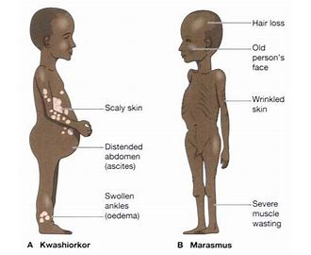
Classification of PEM
●●●
9
Notes:
SAY: Before we wrap up the course, let’s review what we have learned today.
During this course, we have
<READ the bullets from the slide.>
GO to next slide.

Slide 10
Classification of PEM
Secondary PEM
It is caused due to disorders in the gastrointestinal tract.
It can be caused due to infections, hyperthyroidism, trauma, burns, and other critical illnesses.
It decreases appetite and impairs nutrient metabolism
10
Notes:
SAY: Before we wrap up the course, let’s review what we have learned today.
During this course, we have
<READ the bullets from the slide.>
GO to next slide.

Slide 11
Causes of PEM
Unsuitable dietary choices.
Having a low income.
Difficulty obtaining food.
Various physical and mental health conditions.
11
Notes:
SAY:
The purpose of epidemiology in public health practice is to
discover the agent, host, and environmental factors that affect health;
determine the relative importance of causes of illness, disability, and death;
identify those segments of the population that have the greatest risk from specific causes of ill health; and
evaluate the effectiveness of health programs and services in improving population health.
GO to next slide.

Slide 12
Complications of PEM
Treatment of PEM can cause complications (refeeding syndrome), including fluid overload, electrolyte deficits, hyperglycemia, cardiac arrhythmias, and diarrhea.
Diarrhea is usually mild and resolves; however, diarrhea in patients with severe
●●●
12
Notes:
SAY:
The purpose of epidemiology in public health practice is to
discover the agent, host, and environmental factors that affect health;
determine the relative importance of causes of illness, disability, and death;
identify those segments of the population that have the greatest risk from specific causes of ill health; and
evaluate the effectiveness of health programs and services in improving population health.
GO to next slide.

Slide 13
Complications of PEM
PEU occasionally causes severe dehydration or death. Causes of diarrhea (eg, sorbitol used in elixir tube feedings, Clostridium difficile if the patient has received an antibiotic) may be correctable.
Osmotic diarrhea due to excess calories is rare in adults and should be considered only when other causes have been excluded.
13
Notes:
SAY:
The purpose of epidemiology in public health practice is to
discover the agent, host, and environmental factors that affect health;
determine the relative importance of causes of illness, disability, and death;
identify those segments of the population that have the greatest risk from specific causes of ill health; and
evaluate the effectiveness of health programs and services in improving population health.
GO to next slide.

Slide 14
Prevention of PEM
Promotion of breast feeding
Development of low cost weaning
Nutrition education and promotion of correct feeding practices
Family planning and spacing of births
Immunisation
Food fortification
Early diagnosis and treatment
14
Notes:
SAY:
The purpose of epidemiology in public health practice is to
discover the agent, host, and environmental factors that affect health;
determine the relative importance of causes of illness, disability, and death;
identify those segments of the population that have the greatest risk from specific causes of ill health; and
evaluate the effectiveness of health programs and services in improving population health.
GO to next slide.

Slide 15
Diagnosis of PEM
PEM can be diagnosed by identifying the dietary history of the patient.
The measurement of height and weight, fat distribution, anthropometric measurements of lean body mass should be examined.
The Body Mass Index or BMI is calculated to measure the severity of PEM.
●●●
15
Notes:
SAY:
The purpose of epidemiology in public health practice is to
discover the agent, host, and environmental factors that affect health;
determine the relative importance of causes of illness, disability, and death;
identify those segments of the population that have the greatest risk from specific causes of ill health; and
evaluate the effectiveness of health programs and services in improving population health.
GO to next slide.

Slide 16
Diagnosis of PEM
Laboratory tests such as measurement of serum albumin, total lymphocyte count, transferrin and response to skin antigens can help to detect the severity of Protein Energy Malnutrition.
The decreased level of hormones, lipids, fats, cholesterol, prealbumin, insulin-like growth factor, fibronectin, calcium, magnesium, and phosphate can also help to diagnose PEM.
16
Notes:
SAY:
The purpose of epidemiology in public health practice is to
discover the agent, host, and environmental factors that affect health;
determine the relative importance of causes of illness, disability, and death;
identify those segments of the population that have the greatest risk from specific causes of ill health; and
evaluate the effectiveness of health programs and services in improving population health.
GO to next slide.

Slide 17
Treatment of PEM
Protein Energy Malnutrition can be treated in the following ways:
Oral feeding
Avoiding lactose
Supportive care
Reduction in poverty
●●●
17
Notes:
SAY:
The purpose of epidemiology in public health practice is to
discover the agent, host, and environmental factors that affect health;
determine the relative importance of causes of illness, disability, and death;
identify those segments of the population that have the greatest risk from specific causes of ill health; and
evaluate the effectiveness of health programs and services in improving population health.
GO to next slide.

Slide 18
Treatment of PEM
Improving nutritional education and public health measures
Starvation can be treated by providing a balanced diet
Multivitamin supplements
Treat infections and fluid and electrolyte abnormalities, in severe cases
18
Notes:
SAY:
The purpose of epidemiology in public health practice is to
discover the agent, host, and environmental factors that affect health;
determine the relative importance of causes of illness, disability, and death;
identify those segments of the population that have the greatest risk from specific causes of ill health; and
evaluate the effectiveness of health programs and services in improving population health.
GO to next slide.

Slide 19
Conclusion
Protein-energy malnutrition (PEM) is a common occurrence in end-stage renal disease (ESRD) patients before the start of dialysis, and it becomes even more common after patients start on peritoneal dialysis or hemodialysis .
It is now well established that PEM is one of the most important predictors of survival in ESRD patients
19
Notes:
SAY:
The purpose of epidemiology in public health practice is to
discover the agent, host, and environmental factors that affect health;
determine the relative importance of causes of illness, disability, and death;
identify those segments of the population that have the greatest risk from specific causes of ill health; and
evaluate the effectiveness of health programs and services in improving population health.
GO to next slide.

Slide 20
References
Google.com
Wikipedia.org
Studymafia.org
Slidespanda.com

Slide 21
Thanks To StudyMafia.org

