Slide 1
StudyMafia.Org
Protein Structures
Submitted To: Submitted By:
Studymafia.org Studymafia.org

Slide 2
Table Contents
Definition
Introduction
Levels of protein structure
Structural domain
Protein structure determination
Protein structure databases
Conclusion
2
Notes:
SAY: Before we wrap up the course, let’s review what we have learned today.
During this course, we have
<READ the bullets from the slide.>
GO to next slide.

Slide 3
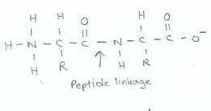
Definition
Protein structure is the three-dimensional arrangement of atoms in an amino acid-chain molecule. Proteins are polymers – specifically polypeptides – formed from sequences of amino acids, the monomers of the polymer.
3
Notes:
SAY: Before we wrap up the course, let’s review what we have learned today.
During this course, we have
<READ the bullets from the slide.>
GO to next slide.

Slide 4
Introduction
Proteins form by amino acids undergoing condensation reactions, in which the amino acids lose one water molecule per reaction in order to attach to one another with a peptide bond. By convention, a chain under 30 amino acids is often identified as a peptide, rather than a protein.
To be able to perform their biological function, proteins fold into one or more specific spatial conformations driven by a number of non-covalent interactions such as hydrogen bonding, ionic interactions, Van der Waals forces, and hydrophobic packing.
4
Notes:
SAY: Before we wrap up the course, let’s review what we have learned today.
During this course, we have
<READ the bullets from the slide.>
GO to next slide.

Slide 5
Levels of protein structure
Primary structure:
The primary structure of a protein refers to the sequence of amino acids in the polypeptide chain. The primary structure is held together by peptide bonds that are made during the process of protein biosynthesis.
The two ends of the polypeptide chain are referred to as the carboxyl terminus (C-terminus) and the amino terminus (N-terminus) based on the nature of the free group on each extremity.
●●●
5
Notes:
SAY: Before we wrap up the course, let’s review what we have learned today.
During this course, we have
<READ the bullets from the slide.>
GO to next slide.

Slide 6
Levels of protein structure
Secondary structure :
It refers to highly regular local sub-structures on the actual polypeptide backbone chain. Two main types of secondary structure, the α-helix and the β-strand or β-sheets, were suggested in 1951 by Linus Pauling et al.
These secondary structures are defined by patterns of hydrogen bonds between the main-chain peptide groups.
●●●
6
Notes:
SAY: Before we wrap up the course, let’s review what we have learned today.
During this course, we have
<READ the bullets from the slide.>
GO to next slide.

Slide 7
Levels of protein structure
Tertiary structure:
It refers to the three-dimensional structure created by a single protein molecule (a single polypeptide chain). It may include one or several domains. The α-helixes and β-pleated-sheets are folded into a compact globular structure.
The folding is driven by the non-specific hydrophobic interactions, the burial of hydrophobic residues from water, but the structure is stable only when the parts of a protein domain are locked into place by specific tertiary interactions, such as salt bridges, hydrogen bonds, and the tight packing of side chains and disulfide bonds.
●●●
7
Notes:
SAY: Before we wrap up the course, let’s review what we have learned today.
During this course, we have
<READ the bullets from the slide.>
GO to next slide.

Slide 8
Levels of protein structure
Quaternary structure
It is the three-dimensional structure consisting of the aggregation of two or more individual polypeptide chains (subunits) that operate as a single functional unit (multimer). The resulting multimer is stabilized by the same non-covalent interactions and disulfide bonds as in tertiary structure.
There are many possible quaternary structure organizations. Complexes of two or more polypeptides (i.e. multiple subunits) are called multimers.
8
Notes:
SAY: Before we wrap up the course, let’s review what we have learned today.
During this course, we have
<READ the bullets from the slide.>
GO to next slide.

Slide 9
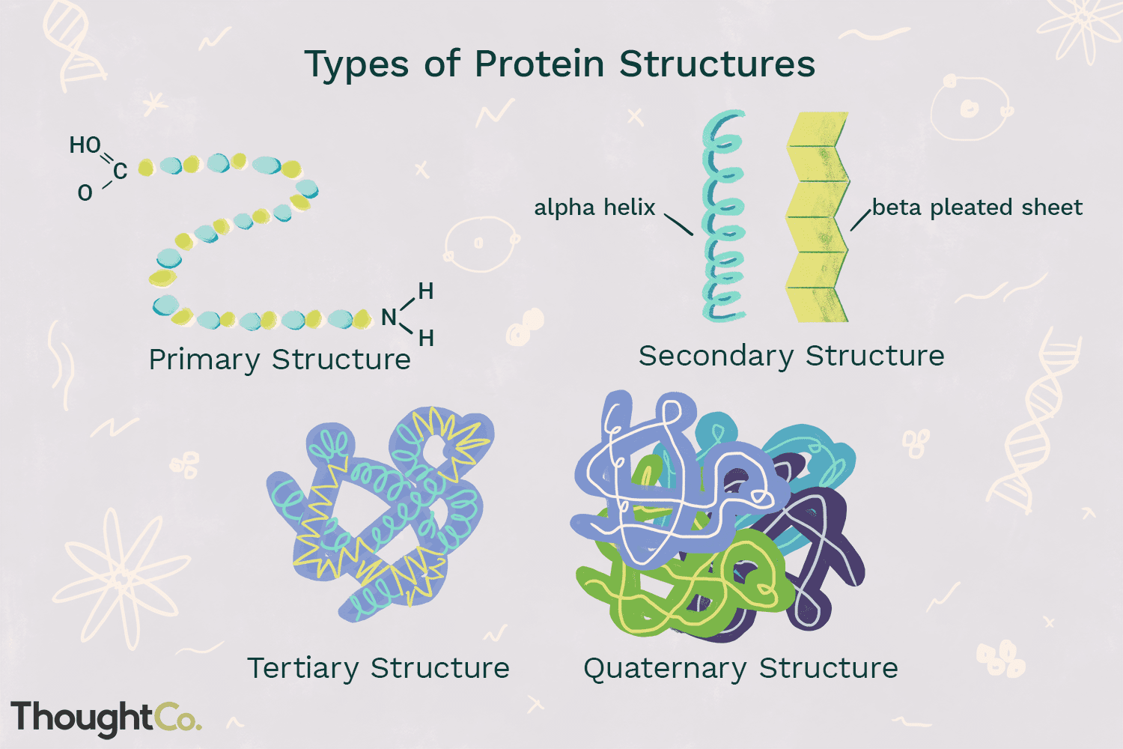
9
Notes:
SAY:
The purpose of epidemiology in public health practice is to
discover the agent, host, and environmental factors that affect health;
determine the relative importance of causes of illness, disability, and death;
identify those segments of the population that have the greatest risk from specific causes of ill health; and
evaluate the effectiveness of health programs and services in improving population health.
GO to next slide.

Slide 10
Structural domain
A structural domain is an element of the protein's overall structure that is self-stabilizing and often folds independently of the rest of the protein chain.
Many domains are not unique to the protein products of one gene or one gene family but instead appear in a variety of proteins.
Domains often are named and singled out because they figure prominently in the biological function of the protein they belong to; for example, the "calcium-binding domain of calmodulin"
10
Notes:
SAY: Before we wrap up the course, let’s review what we have learned today.
During this course, we have
<READ the bullets from the slide.>
GO to next slide.

Slide 11
Protein structure determination
Around 90% of the protein structures available in the Protein Data Bank have been determined by X-ray crystallography.
This method allows one to measure the three-dimensional (3-D) density distribution of electrons in the protein, in the crystallized state, and thereby infer the 3-D coordinates of all the atoms to be determined to a certain resolution.
Roughly 9% of the known protein structures have been obtained by nuclear magnetic resonance (NMR) techniques.
11
Notes:
SAY:
The purpose of epidemiology in public health practice is to
discover the agent, host, and environmental factors that affect health;
determine the relative importance of causes of illness, disability, and death;
identify those segments of the population that have the greatest risk from specific causes of ill health; and
evaluate the effectiveness of health programs and services in improving population health.
GO to next slide.

Slide 12
Protein structure databases
A protein structure database is a database that is modeled around the various experimentally determined protein structures.
The aim of most protein structure databases is to organize and annotate the protein structures, providing the biological community access to the experimental data in a useful way.
Data included in protein structure databases often includes 3D coordinates as well as experimental information, such as unit cell dimensions and angles for x-ray crystallography determined structures.
12
Notes:
SAY:
The purpose of epidemiology in public health practice is to
discover the agent, host, and environmental factors that affect health;
determine the relative importance of causes of illness, disability, and death;
identify those segments of the population that have the greatest risk from specific causes of ill health; and
evaluate the effectiveness of health programs and services in improving population health.
GO to next slide.

Slide 13
Conclusion
Proteins are built as chains of amino acids, which then fold into unique three-dimensional shapes. Bonding within protein molecules helps stabilize their structure, and the final folded forms of proteins are well-adapted for their functions.
13
Notes:
SAY:
The purpose of epidemiology in public health practice is to
discover the agent, host, and environmental factors that affect health;
determine the relative importance of causes of illness, disability, and death;
identify those segments of the population that have the greatest risk from specific causes of ill health; and
evaluate the effectiveness of health programs and services in improving population health.
GO to next slide.

Slide 14
References
Google.com
Wikipedia.org
Studymafia.org
Slidespanda.com

Slide 15
Thanks To StudyMafia.org

