Slide 1
StudyMafia.Org
Power Of Media
Submitted To: Submitted By:
Studymafia.org Studymafia.org

Slide 2
Table Contents
Definition
Introduction
Types of Media
History of Media
Power of Media
Conclusion
2
Notes:
SAY: Before we wrap up the course, let’s review what we have learned today.
During this course, we have
<READ the bullets from the slide.>
GO to next slide.

Slide 3
Definition
Media is the plural form of medium, which (broadly speaking) describes any channel of communication. This can include anything from printed paper to digital data, and encompasses art, news, educational content and numerous other forms of information. Anything that can reach or influence people, including phones, television, and the Internet can be considered a form of media.
3
Notes:
SAY: Before we wrap up the course, let’s review what we have learned today.
During this course, we have
<READ the bullets from the slide.>
GO to next slide.

Slide 4
Introduction
In modern times, media are gravitating more and more towards the digital side of this field.
Modern digital media include all forms of communication that are transmitted electronically across the world through computer networks and fiber optic cables.
Some of these modern forms of media, such as the Internet or social media (Facebook, Twitter, Instagram, etc.) have completely revolutionized our world.
4
Notes:
SAY: Before we wrap up the course, let’s review what we have learned today.
During this course, we have
<READ the bullets from the slide.>
GO to next slide.

Slide 5
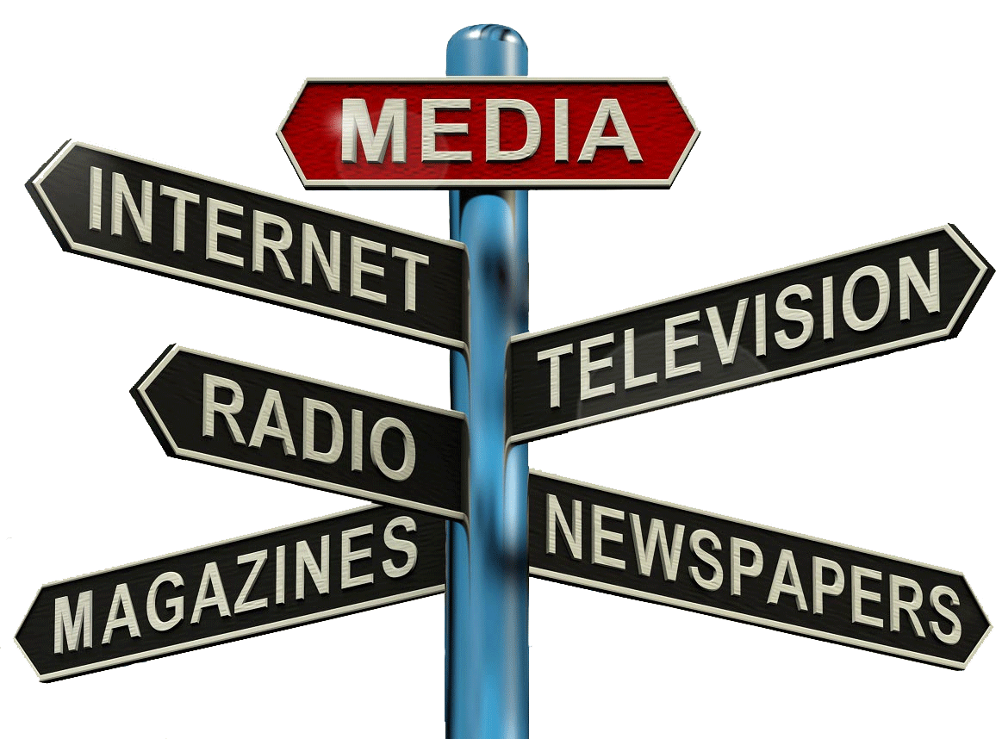
Types of Media
5
Notes:
SAY: Before we wrap up the course, let’s review what we have learned today.
During this course, we have
<READ the bullets from the slide.>
GO to next slide.

Slide 6
History of Media
Traditional media includes newspapers, journals, radio, television, magazines, and even billboards. Traditional media is broadly divided into two subcategories: print media and broadcast media.
Print media is the oldest form of media and includes all types of printed paper publications, such as newspapers, magazines, books, reports, clinical journals, leaflets, essays etc.
Broadcast Media was introduced at the beginning of the 20th century in the form of radio and (later) television
6
Notes:
SAY: Before we wrap up the course, let’s review what we have learned today.
During this course, we have
<READ the bullets from the slide.>
GO to next slide.

Slide 7
Power of Media
Media is an essential attribute of democratic polity as both work hand in glove with each other. If democracy is the government of the people, media is the voice of the people.
Media could not breathe independently and one of the factor that could be held responsible for this sorry state of affairs is the obstructed and failed democratic form of government.
●●●
7
Notes:
SAY:
The purpose of epidemiology in public health practice is to
discover the agent, host, and environmental factors that affect health;
determine the relative importance of causes of illness, disability, and death;
identify those segments of the population that have the greatest risk from specific causes of ill health; and
evaluate the effectiveness of health programs and services in improving population health.
GO to next slide.

Slide 8
Power of Media
Media is the only force that can ensure the flow of information.
If restricted, hindered or obstructed in any way, masses remain ignorant, ignorant of their rights, their duties to the state, their needs and the role that they can play for the betterment of the society and the country they live in.
●●●
8
Notes:
SAY:
The purpose of epidemiology in public health practice is to
discover the agent, host, and environmental factors that affect health;
determine the relative importance of causes of illness, disability, and death;
identify those segments of the population that have the greatest risk from specific causes of ill health; and
evaluate the effectiveness of health programs and services in improving population health.
GO to next slide.

Slide 9
Power of Media
Media's role in imparting education to the masses cannot be stressed enough.
Online lectures and speeches of the professors, scholars and intellectuals are playing a significant role in imparting formal and technical education to the masses.
●●●
9
Notes:
SAY:
The purpose of epidemiology in public health practice is to
discover the agent, host, and environmental factors that affect health;
determine the relative importance of causes of illness, disability, and death;
identify those segments of the population that have the greatest risk from specific causes of ill health; and
evaluate the effectiveness of health programs and services in improving population health.
GO to next slide.

Slide 10
Power of Media
Media's role in creating awareness among the masses regarding the political, social and economic scenario cannot be overemphasized.
Owing to the growth of TV channels and newspapers, people today are more aware and educated about the surroundings and the steps taken by the government
●●●
10
Notes:
SAY:
The purpose of epidemiology in public health practice is to
discover the agent, host, and environmental factors that affect health;
determine the relative importance of causes of illness, disability, and death;
identify those segments of the population that have the greatest risk from specific causes of ill health; and
evaluate the effectiveness of health programs and services in improving population health.
GO to next slide.

Slide 11
Power of Media
Media is promoting public participation in the decision-making of the state machinery.
The skilled and bold personalities of the anchor persons raise people's voice, analyse government's actions and get the expert opinion.
●●●
11
Notes:
SAY:
The purpose of epidemiology in public health practice is to
discover the agent, host, and environmental factors that affect health;
determine the relative importance of causes of illness, disability, and death;
identify those segments of the population that have the greatest risk from specific causes of ill health; and
evaluate the effectiveness of health programs and services in improving population health.
GO to next slide.

Slide 12
Power of Media
Media has also played a significant role in bringing the world at our doorstep. It produces and introduces different lifestyles in the world, changes moods and behavior, braves the bold topics through dramas and talk shows.
It also suggests the new household styles, guides the youth to new opportunities and creates civic sense
●●●
12
Notes:
SAY:
The purpose of epidemiology in public health practice is to
discover the agent, host, and environmental factors that affect health;
determine the relative importance of causes of illness, disability, and death;
identify those segments of the population that have the greatest risk from specific causes of ill health; and
evaluate the effectiveness of health programs and services in improving population health.
GO to next slide.

Slide 13
Power of Media
Media also helps in providing religious knowledge by the competent scholars, answering the queries of public to solve their problems.
It highlights religious events and promotes sectarian harmony.
●●●
13
Notes:
SAY:
The purpose of epidemiology in public health practice is to
discover the agent, host, and environmental factors that affect health;
determine the relative importance of causes of illness, disability, and death;
identify those segments of the population that have the greatest risk from specific causes of ill health; and
evaluate the effectiveness of health programs and services in improving population health.
GO to next slide.

Slide 14
Power of Media
Despite frequent martial laws, other factors that stand responsible for the poor growth of independent media could be indifferent attitude illiteracy, poverty, unawareness, attitude of indifference towards the political decisions, lack of interest in state affairs, political instability and political pressures and problems.
●●●
14
Notes:
SAY:
The purpose of epidemiology in public health practice is to
discover the agent, host, and environmental factors that affect health;
determine the relative importance of causes of illness, disability, and death;
identify those segments of the population that have the greatest risk from specific causes of ill health; and
evaluate the effectiveness of health programs and services in improving population health.
GO to next slide.

Slide 15
Power of Media
There are certain ethics and do's and don'ts of media channels and press to shape the discipline of journalism so that they may seek truth, convey information, ideas and opinions with transparency and accuracy.
These ethics advise the media personals to report and interpret honestly, striking for accuracy, fairness and disclosure of all essential facts and urge the necessary correction of errors.
15
Notes:
SAY:
The purpose of epidemiology in public health practice is to
discover the agent, host, and environmental factors that affect health;
determine the relative importance of causes of illness, disability, and death;
identify those segments of the population that have the greatest risk from specific causes of ill health; and
evaluate the effectiveness of health programs and services in improving population health.
GO to next slide.

Slide 16
Conclusion
Media is regarded as the most powerful weapon of 21st century. It is as lethal a weapon as a nuke.
It has the capability to convert day into night and night into day, a hero into a villain and a villain into hero.
16
Notes:
SAY:
The purpose of epidemiology in public health practice is to
discover the agent, host, and environmental factors that affect health;
determine the relative importance of causes of illness, disability, and death;
identify those segments of the population that have the greatest risk from specific causes of ill health; and
evaluate the effectiveness of health programs and services in improving population health.
GO to next slide.

Slide 17
References
Google.com
Wikipedia.org
Studymafia.org
Slidespanda.com

Slide 18
Thanks To StudyMafia.org

