Slide 1
StudyMafia.Org
Placenta
Previa
Submitted To: Submitted By:
Studymafia.org Studymafia.org

Slide 2
Table of Content
Introduction
Definition of Placenta previa
Pathophysiology
Cause of Placenta previa
Risk Factors
Types
Signs and Symptoms
Diagnosis
Management
Complications

Slide 3
Introduction
Placenta previa is the attachment of the placenta to the wall of the uterus in a location that completely or partially covers the uterine outlet (opening of the cervix).
Bleeding after the 20th week of gestation is the main symptom of placenta previa.
An ultrasound examination is used to establish the diagnosis of placenta previa.
Cesarean delivery is required for complete placenta previa.

Slide 4
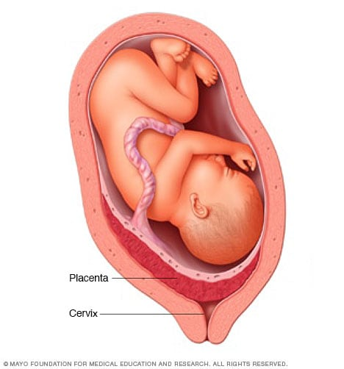
Placenta Previa

Slide 5
Definition
Placenta previa is a condition wherein the placenta of a pregnant woman is implanted abnormally in the uterus.
It accounts for the most incidents of bleeding in the third trimester of pregnancy.

Slide 6
Pathophysiology
The placenta implants on the lower part of the uterus.
The lower uterine segment separates from the upper segment as the cervix starts to dilate.
The placenta is unable to stretch and accommodate the shape of the cervix, resulting in bleeding.

Slide 7
Cause
The cause of placenta previa is unknown, but it is more common in women who have a history of uterine surgeries (cesarean sections, dilation and curettage), infections with endometritis, and a previous placenta previa.
It is also more common in those women who currently have a multiple gestation with a large placenta. Smoking is also a contributing factor.

Slide 8
Risk Factors
Placenta previa is dangerous if not detected early. However, it is also highly preventable once you get to know the risk factors.
Advanced maternal age. Women who are over the age of 35 years old are at an increased risk of developing placenta previa.
Multiple gestations. The uterus which has accommodated more than one fetus has an increased risk for placenta previa.

Slide 9
Risk Factors………
Increased parity. Women who have given birth to a lot of children have an increased chance of having placenta previa.
Past caesarean births. Giving birth via caesarean delivery predisposes the woman to placenta previa on her next childbearing.
Past uterine curettage. Scars from a past curettage can affect the implantation of the uterus and lead to placenta previa.

Slide 10
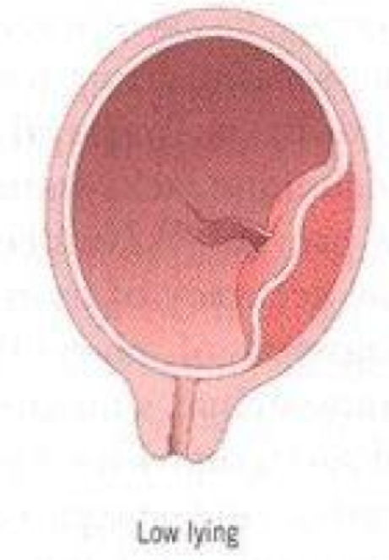
Types
LOW-LYING
The placenta implants in the lower uterine segment but does not reach the cervical os; often this type of placenta previa moves upward as the pregnancy progresses, eliminating bleeding complications later.

Slide 11
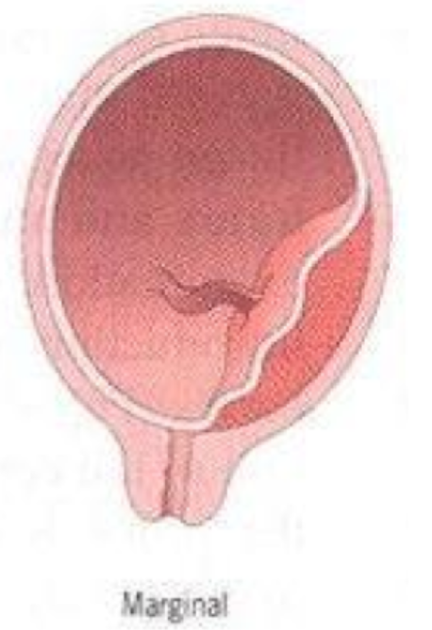
Types…..
MARGINAL
The edge of the placenta is at the edge of the internal os; the mother may be able to deliver vaginally.

Slide 12
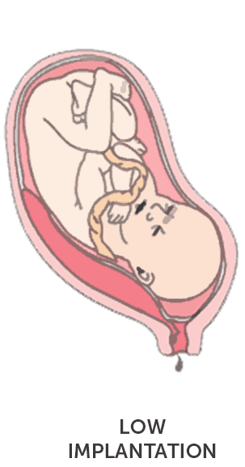
Types…..
PARTIAL
The placenta partially covers the cervical os;as the pregnancy progresses and the cervix begins to efface and dilate, the bleeding occurs.

Slide 13
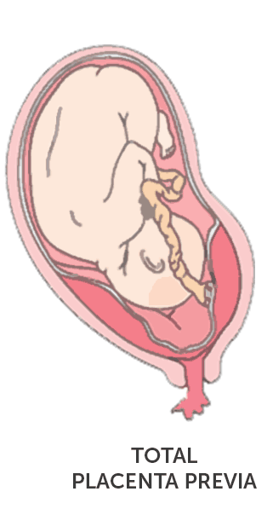
Types…..
COMPLETE OR TOTAL
The placenta covers the entire cervical os; usually requires an emergency cesarean section.

Slide 14
Signs and Symptoms
The following signs and symptoms for placenta previa must be detected immediately by the health care providers to avoid risking the life of the fetus.
Bright red bleeding. When the placenta is unable to stretch to accommodate the shape of the cervix, bleeding will occur suddenly that could frighten the woman.
Painless. Bleeding in placenta previa is not painless and may also stop as abruptly as it had begun.

Slide 15
Diagnostic Tests
To diagnose placenta previa, the patient must undergo the following diagnostic procedure.
Ultrasound. Early detection of placenta previa is always possible through ultrasonography. It is the most common and initial diagnostic test that could confirm the diagnosis.

Slide 16
Medical Management
Medical interventions are necessary to ensure that the safety of both mother and fetus are still intact.
Intravenous therapy. This would be prescribed by the physician to replace the blood that was lost during bleeding.
Avoid vaginal examinations. This may initiate hemorrhage that is fatal for both the mother and the baby.
Attach external monitoring equipment. To monitor the uterine contractions and record fetal heart sounds, an external equipment is preferred than the internal monitoring equipment.

Slide 17
Surgical Management
Surgical interventions are carried out once the condition of both the mother and the fetus has reached a critical stage and their lives are exposed to undeniable danger.
Cesarean delivery. Although the best way to deliver a baby is through normal delivery, if the placenta has obstructed more than 30% of the cervical os it would be hard for the fetus to get past the placenta through normal delivery. Cesarean birth is then recommended by the physician.

Slide 18
Complications
If you have placenta previa, your health care provider will monitor you and your baby to reduce the risk of these serious complications:
Bleeding. Severe, possibly life-threatening vaginal bleeding (hemorrhage) can occur during labor, delivery or in the first few hours after delivery.
Preterm birth. Severe bleeding may prompt an emergency C-section before your baby is full term.

Slide 19
References
Google.com
Wikipedia.org
Studymafia.org
Slidespanda.com

Slide 20
Thanks To StudyMafia.org

