Slide 1
StudyMafia.Org
Physiology Of Heart
Submitted To: Submitted By:
Studymafia.org Studymafia.org

Slide 2
Table Contents
Introduction
Cardiovascular system
Functions of the Heart
Structure of Heart
Intrinsic Conduction System
Cardiac Cycle
Conclusion
2
Notes:
SAY: Before we wrap up the course, let’s review what we have learned today.
During this course, we have
<READ the bullets from the slide.>
GO to next slide.

Slide 3
Introduction
The Heart is Located between the lungs in the centre and to the left of the midline It is cone shaped and about the size of your own clenched fist It Can never stop pumping
Primary Function is to drive blood through the cardiovascular system delivering Oxygenated blood to the tissues and organs of the body sufficient for their metabolic needs and Deoxygenated blood to the lungs for gaseous exchange
3
Notes:
SAY: Before we wrap up the course, let’s review what we have learned today.
During this course, we have
<READ the bullets from the slide.>
GO to next slide.

Slide 4
Cardiovascular system
The average human adult has 4-6 litres of blood repeatedly cycled throughout the body in a closed circulatory system.
It is called a closed system because the blood is contained within the heart and blood vessels at all time and blood always flows in a forward direction.
4
Notes:
SAY: Before we wrap up the course, let’s review what we have learned today.
During this course, we have
<READ the bullets from the slide.>
GO to next slide.

Slide 5
Functions of the Heart
Managing blood supply: Variations in the rate and force of heart contraction match blood flow to the changing metabolic needs of the tissues during rest, exercise, and changes in body position.
Producing blood pressure: Contractions of the heart produce blood pressure, which is needed for blood flow through the blood vessels.
Securing one-way blood flow: The valves of the heart secure a one-way blood flow through the heart and blood vessels.
Transmitting blood: The heart separates the pulmonary and systemic circulations, which ensures the flow of oxygenated blood to tissues.
●●●
5
Notes:
SAY:
The purpose of epidemiology in public health practice is to
discover the agent, host, and environmental factors that affect health;
determine the relative importance of causes of illness, disability, and death;
identify those segments of the population that have the greatest risk from specific causes of ill health; and
evaluate the effectiveness of health programs and services in improving population health.
GO to next slide.

Slide 6
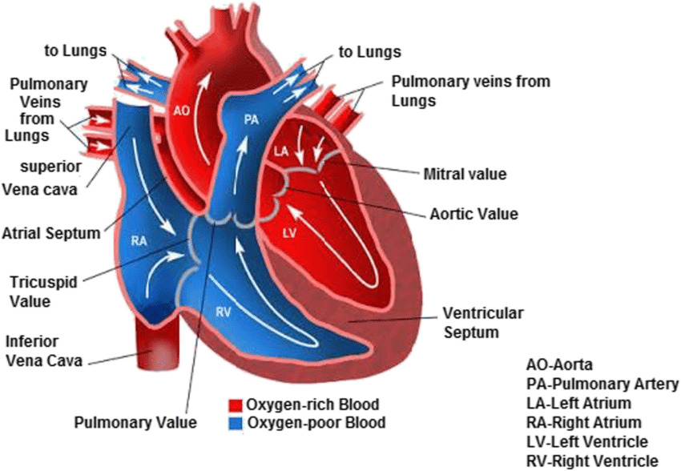
Structure of Heart
Human heart is divided into 4 chambers
• 2 Atria and 2 Ventricles – these are hollow chambers which receive blood
• They are surrounded by myocardial cells which are able to relax and contract
●●●
6
Notes:
SAY: Before we wrap up the course, let’s review what we have learned today.
During this course, we have
<READ the bullets from the slide.>
GO to next slide.

Slide 7
Structure of Heart
The cardiovascular system consists of circuits:
• Pulmonary circuit provides blood flow between the heart and lungs
• Systemic circuit allows blood to flow to and from the rest of the body
• Coronary circuit provides blood to the heart
The heart valves ensure that blood flows in one direction through the system
7
Notes:
SAY: Before we wrap up the course, let’s review what we have learned today.
During this course, we have
<READ the bullets from the slide.>
GO to next slide.

Slide 8
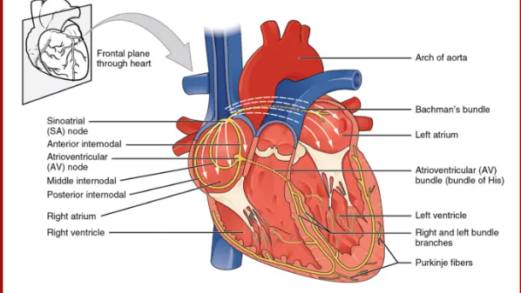
Intrinsic Conduction System
The spontaneous contractions of the cardiac muscle cells occurs in a regular and continuous way, giving rhythm to the heart.
●●●
8
Notes:
SAY:
The purpose of epidemiology in public health practice is to
discover the agent, host, and environmental factors that affect health;
determine the relative importance of causes of illness, disability, and death;
identify those segments of the population that have the greatest risk from specific causes of ill health; and
evaluate the effectiveness of health programs and services in improving population health.
GO to next slide.

Slide 9
Intrinsic Conduction System
Cardiac muscle cells: Cardiac muscle cells can and do contract spontaneously and independently, even if all nervous connections are severed.
Rhythms: Although cardiac muscles can beat independently, the muscle cells in the different areas of the heart have different rhythms.
Intrinsic conduction system: The intrinsic conduction system, or the nodal system, that is built into the heart tissue sets the basic rhythm.
Composition: The intrinsic conduction system is composed of a special tissue found nowhere else in the body; it is much like a cross between a muscle and nervous tissue.
●●●
9
Notes:
SAY:
The purpose of epidemiology in public health practice is to
discover the agent, host, and environmental factors that affect health;
determine the relative importance of causes of illness, disability, and death;
identify those segments of the population that have the greatest risk from specific causes of ill health; and
evaluate the effectiveness of health programs and services in improving population health.
GO to next slide.

Slide 10
Intrinsic Conduction System
Function: This system causes heart muscle depolarization in only one direction- from the atria to the ventricles; it enforces a contraction rate of approximately 75 beats per minute on the heart, thus the heart beats as a coordinated unit.
Sinoatrial (SA) node: The SA node has the highest rate of depolarization in the whole system, so it can start the beat and set the pace for the whole heart; thus the term “pacemaker“.
Atrial contraction: From the SA node, the impulse spread through the atria to the AV node, and then the atria contract.
●●●
10
Notes:
SAY:
The purpose of epidemiology in public health practice is to
discover the agent, host, and environmental factors that affect health;
determine the relative importance of causes of illness, disability, and death;
identify those segments of the population that have the greatest risk from specific causes of ill health; and
evaluate the effectiveness of health programs and services in improving population health.
GO to next slide.

Slide 11
Intrinsic Conduction System
Ventricular contraction: It then passes through the AV bundle, the bundle branches, and the Purkinje fibers, resulting in a “wringing” contraction of the ventricles that begins at the heart apex and moves toward the atria.
Ejection: This contraction effectively ejects blood superiorly into the large arteries leaving the heart.
●●●
11
Notes:
SAY:
The purpose of epidemiology in public health practice is to
discover the agent, host, and environmental factors that affect health;
determine the relative importance of causes of illness, disability, and death;
identify those segments of the population that have the greatest risk from specific causes of ill health; and
evaluate the effectiveness of health programs and services in improving population health.
GO to next slide.

Slide 12
Intrinsic Conduction System
The conduction system occurs systematically through:
SA node: The depolarization wave is initiated by the sinoatrial node.
Atrial myocardium: The wave then successively passes through the atrial myocardium.
Atrioventricular node: The depolarization wave then spreads to the AV node, and then the atria contract.
AV bundle: It then passes rapidly through the AV bundle.
Bundle branches and Purkinje fibers: The wave then continues on through the right and left bundle branches, and then to the Purkinje fibers in the ventricular walls, resulting in a contraction that ejects blood, leaving the heart.
12
Notes:
SAY:
The purpose of epidemiology in public health practice is to
discover the agent, host, and environmental factors that affect health;
determine the relative importance of causes of illness, disability, and death;
identify those segments of the population that have the greatest risk from specific causes of ill health; and
evaluate the effectiveness of health programs and services in improving population health.
GO to next slide.

Slide 13
Cardiac Cycle
In a healthy heart, the atria contract simultaneously, then, as they start to relax, contraction of the ventricles begin.
Systole: Systole means heart contraction.
Diastole: Diastole means heart relaxation.
Cardiac cycle: The term cardiac cycle refers to the events of one complete heart beat, during which both atria and ventricles contract and then relax.
Length: The average heart beats approximately 75 times per minute, so the length of the cardiac cycle is normally about 0.8 second.
13
Notes:
SAY:
The purpose of epidemiology in public health practice is to
discover the agent, host, and environmental factors that affect health;
determine the relative importance of causes of illness, disability, and death;
identify those segments of the population that have the greatest risk from specific causes of ill health; and
evaluate the effectiveness of health programs and services in improving population health.
GO to next slide.

Slide 14
Conclusion
The heart is an essential, powerful organ that constantly pumps oxygen and nutrients around the body. If a person is born with congenital heart disease, or if damage occurs due to illness or other factors, the heart’s function may diminish, and this can lead to life threatening complications, such as heart failure.
If the heart stops, a person cannot survive for long. Staying active and maintaining a healthful diet are two ways to protect the heart.
14
Notes:
SAY:
The purpose of epidemiology in public health practice is to
discover the agent, host, and environmental factors that affect health;
determine the relative importance of causes of illness, disability, and death;
identify those segments of the population that have the greatest risk from specific causes of ill health; and
evaluate the effectiveness of health programs and services in improving population health.
GO to next slide.

Slide 15
References
Google.com
Wikipedia.org
Studymafia.org
Slidespanda.com

Slide 16
Thanks To StudyMafia.org

