Slide 1
StudyMafia.Org
Natural Resources
Submitted To: Submitted By:
Studymafia.org Studymafia.org

Slide 2
Table Contents
Definition
Introduction
Types of Natural Resources
About Resources
Why Conserve?
Ways to Conserve
Conclusion
2
Notes:
SAY: Before we wrap up the course, let’s review what we have learned today.
During this course, we have
<READ the bullets from the slide.>
GO to next slide.

Slide 3
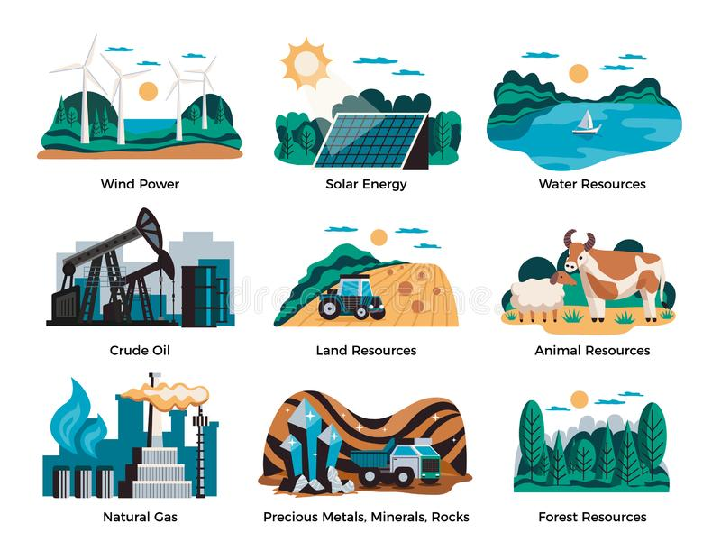
Definition
Natural resources can be defined as the resources that exist (on the planet) independent of human actions.
3
Notes:
SAY: Before we wrap up the course, let’s review what we have learned today.
During this course, we have
<READ the bullets from the slide.>
GO to next slide.

Slide 4
Introduction
These are the resources that are found in the environment and are developed without the intervention of humans.
Natural resources are naturally occurring materials that are useful to man or could be useful under conceivable technological, economic or social circumstances or supplies drawn from the earth, supplies such as food, building and clothing materials, fertilizers, metals, water and geothermal power.
4
Notes:
SAY: Before we wrap up the course, let’s review what we have learned today.
During this course, we have
<READ the bullets from the slide.>
GO to next slide.

Slide 5
Types of Natural Resources
Renewable: resources that are available in infinite quantity and can be used repeatedly are called renewable resources. Example: Forest, wind, water, etc.
Non-Renewable: resources that are limited in abundance due to their non-renewable nature and whose availability may run out in the future are called non-renewable resources. Examples include fossil fuels, minerals, etc.
●●●
5
Notes:
SAY: Before we wrap up the course, let’s review what we have learned today.
During this course, we have
<READ the bullets from the slide.>
GO to next slide.

Slide 6
Types of Natural Resources
6
Notes:
SAY: Before we wrap up the course, let’s review what we have learned today.
During this course, we have
<READ the bullets from the slide.>
GO to next slide.

Slide 7
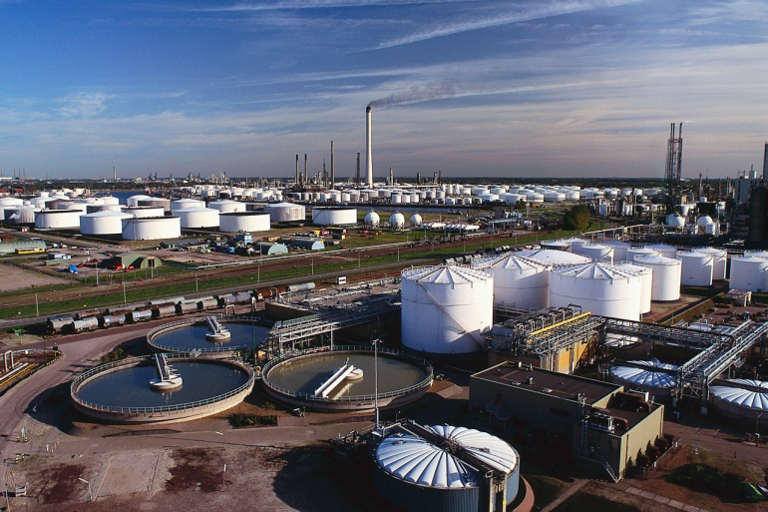
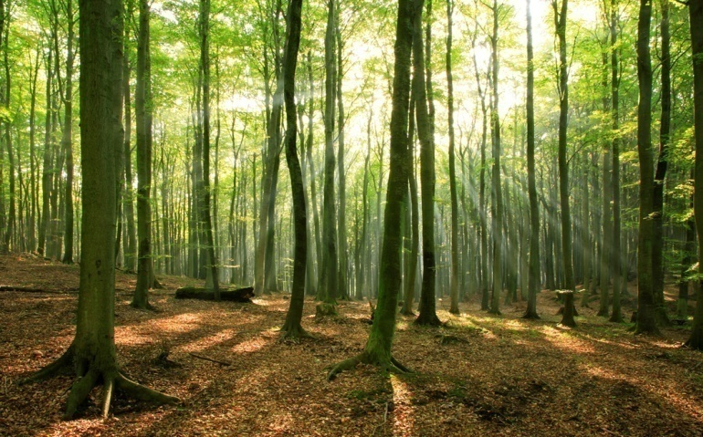
Types of Natural Resources
7
Notes:
SAY:
The purpose of epidemiology in public health practice is to
discover the agent, host, and environmental factors that affect health;
determine the relative importance of causes of illness, disability, and death;
identify those segments of the population that have the greatest risk from specific causes of ill health; and
evaluate the effectiveness of health programs and services in improving population health.
GO to next slide.

Slide 8
About Resources
FOREST RESOURCES
Forest are important renewable renewable natural resources. Trees, shrubs and herbs dominate forest ecosystem. 33% of the world’s area consists of forest lands. Insects, birds and animals live there. Native forest has naturally growing plants and trees.
Man-made forest consists of species of trees, shrubs, etc., grown by man. Boreal coniferous forests are found around the Arctic Sea, 550 to 650 north latitude .Temperate forests are found on either side of the earth 300 to 550 latitude north.
●●●
8
Notes:
SAY:
The purpose of epidemiology in public health practice is to
discover the agent, host, and environmental factors that affect health;
determine the relative importance of causes of illness, disability, and death;
identify those segments of the population that have the greatest risk from specific causes of ill health; and
evaluate the effectiveness of health programs and services in improving population health.
GO to next slide.

Slide 9
About Resources
MINERAL RESOURCES
• Minerals are non-renewable natural resources. They occur naturally as in organic, crystalline solids with physical properties. There are thousands of minerals in the world. • A nation’s economy depends mainly on minerals which are used by man everyday for various activities.
On the basis of usage of minerals, there are two types of Human civilization namely Bronze Age and Iron Age. We extract about 74m.metric tons of iron and steel per year.
●●●
9
Notes:
SAY:
The purpose of epidemiology in public health practice is to
discover the agent, host, and environmental factors that affect health;
determine the relative importance of causes of illness, disability, and death;
identify those segments of the population that have the greatest risk from specific causes of ill health; and
evaluate the effectiveness of health programs and services in improving population health.
GO to next slide.

Slide 10
About Resources
SOIL RESOURCES
• Soil is the most finite and valuable resource upon which we depend for our basic amenities of life. So, we should preserve soil by all means. The total area of India is 328.73 mha. of which the potential area is 264.5 mha.
About 187.8 m ha of land have been degraded due to water shortage, wind erosion, salinity, alkalinity and water-logging. Soil is thin covering over land containing organic materials, living organisms, air and water.
●●●
10
Notes:
SAY:
The purpose of epidemiology in public health practice is to
discover the agent, host, and environmental factors that affect health;
determine the relative importance of causes of illness, disability, and death;
identify those segments of the population that have the greatest risk from specific causes of ill health; and
evaluate the effectiveness of health programs and services in improving population health.
GO to next slide.

Slide 11
About Resources
WATER RESOURCES
Water is an elixir of life. It is a renewable and indispensable natural resource. The volume of water on the earth is 1.4 billion cu km of which 93% is sea water, 4.1% is fresh water on land, 0.2% is glaciers and 0.0001% is humidity of air.
The amount of underground water is 8 million cu.km. • Totally 97% of earth’s surface is filled with water. If earth is flat, it will be two feet under water. About 1% of water is needed by man.
●●●
11
Notes:
SAY:
The purpose of epidemiology in public health practice is to
discover the agent, host, and environmental factors that affect health;
determine the relative importance of causes of illness, disability, and death;
identify those segments of the population that have the greatest risk from specific causes of ill health; and
evaluate the effectiveness of health programs and services in improving population health.
GO to next slide.

Slide 12
About Resources
ENERGY RESOURCES:
A major natural resource that all Americans rely on is petroleum fuel (oil or natural gas). Petroleum is an earth material that forms within the Earth and can be burned to produce heat and electricity or made into gasoline.
Other fuels are coal, uranium, and alternative energy (wind, tidal, solar).
12
Notes:
SAY:
The purpose of epidemiology in public health practice is to
discover the agent, host, and environmental factors that affect health;
determine the relative importance of causes of illness, disability, and death;
identify those segments of the population that have the greatest risk from specific causes of ill health; and
evaluate the effectiveness of health programs and services in improving population health.
GO to next slide.

Slide 13
Why Conserve?
Water is a renewable natural resource. We use it for drinking, producing electricity, irrigation, in various industries and for a number of activities. Its scarcity would cause loss of vegetation, adverse effect on flora and fauna, erosion of soil, etc.
Plants and animals provide a wide range of industrial and biological materials. Also, it assists in the manufacturing of medicine and for various other uses.
●●●
13
Notes:
SAY:
The purpose of epidemiology in public health practice is to
discover the agent, host, and environmental factors that affect health;
determine the relative importance of causes of illness, disability, and death;
identify those segments of the population that have the greatest risk from specific causes of ill health; and
evaluate the effectiveness of health programs and services in improving population health.
GO to next slide.

Slide 14
Why Conserve?
It takes millions of years for the formation of natural resources.
Fossil fuels are of great importance. A lot of energy is produced from coal, oil and natural gas all of which are fossil fuels.
Land resources support natural vegetation, wildlife, transport. The land also provides us food, cloth, shelter, and other basic needs.
●●●
14
Notes:
SAY:
The purpose of epidemiology in public health practice is to
discover the agent, host, and environmental factors that affect health;
determine the relative importance of causes of illness, disability, and death;
identify those segments of the population that have the greatest risk from specific causes of ill health; and
evaluate the effectiveness of health programs and services in improving population health.
GO to next slide.

Slide 15
Why Conserve?
Forest is the most important natural resource which helps in economic development. Forest provides paper, furniture, timber, medicine, gum, etc.
Also, it maintains a balance in the ecosystem. Moreover, it prevents soil erosion and protects wildlife.
15
Notes:
SAY:
The purpose of epidemiology in public health practice is to
discover the agent, host, and environmental factors that affect health;
determine the relative importance of causes of illness, disability, and death;
identify those segments of the population that have the greatest risk from specific causes of ill health; and
evaluate the effectiveness of health programs and services in improving population health.
GO to next slide.

Slide 16
Ways to Conserve
Environment education must be imparted by including the same in the curricula of the schools.
National Parks are making an effort for the safety of the natural resources.
By reducing, reusing and recycling of non-renewable resources.
Non-human species must be disturbed only to meet the basic needs.
●●●
16
Notes:
SAY:
The purpose of epidemiology in public health practice is to
discover the agent, host, and environmental factors that affect health;
determine the relative importance of causes of illness, disability, and death;
identify those segments of the population that have the greatest risk from specific causes of ill health; and
evaluate the effectiveness of health programs and services in improving population health.
GO to next slide.

Slide 17
Ways to Conserve
Planting of more and more trees to save our forest resources.
Seeking alternatives to non-renewable resources.
By increased use of bio-gas and bio-fuels.
By preventing the dumping of industrial wastes into the river bodies. This is a measure to protect the rich marine life.
●●●
17
Notes:
SAY:
The purpose of epidemiology in public health practice is to
discover the agent, host, and environmental factors that affect health;
determine the relative importance of causes of illness, disability, and death;
identify those segments of the population that have the greatest risk from specific causes of ill health; and
evaluate the effectiveness of health programs and services in improving population health.
GO to next slide.

Slide 18
Ways to Conserve
Overgrazing must be prevented. Also, poaching of animals must be controlled.
Practicing crop rotation techniques helps in maintaining the fertility of the soil.
Burning of fossil fuels emits carbon-di-oxide which is a major greenhouse gas. It is responsible for the greenhouse effect. Thus, the burning of fossil fuels must be controlled.
18
Notes:
SAY:
The purpose of epidemiology in public health practice is to
discover the agent, host, and environmental factors that affect health;
determine the relative importance of causes of illness, disability, and death;
identify those segments of the population that have the greatest risk from specific causes of ill health; and
evaluate the effectiveness of health programs and services in improving population health.
GO to next slide.

Slide 19
Conclusion
Natural resources are a present for the creation. These help in satisfying the human needs to its fullest. Furthermore, the rational use of natural resources maintains the earth’s atmosphere.
Also, the wise use leads to protection of bio-diversity. Humans cannot imagine their lives without natural resources. Thus, the conservation of the same is essential.
19
Notes:
SAY:
The purpose of epidemiology in public health practice is to
discover the agent, host, and environmental factors that affect health;
determine the relative importance of causes of illness, disability, and death;
identify those segments of the population that have the greatest risk from specific causes of ill health; and
evaluate the effectiveness of health programs and services in improving population health.
GO to next slide.

Slide 20
References
Google.com
Wikipedia.org
Studymafia.org
Slidespanda.com

Slide 21
Thanks To StudyMafia.org

