Slide 1
StudyMafia.Org
Lymphoma
Submitted To: Submitted By:
Studymafia.org Studymafia.org

Slide 2
Table Contents
Definition
Introduction
Symptoms of Lymphoma
Causes of Lymphoma
Risk-Factors of Lymphoma
Diagnosis of Lymphoma
Treatment of Lymphoma
Conclusion
2
Notes:
SAY: Before we wrap up the course, let’s review what we have learned today.
During this course, we have
<READ the bullets from the slide.>
GO to next slide.

Slide 3
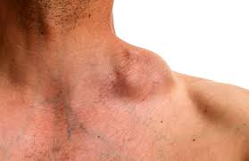
Definition
Lymphoma is a cancer of the lymphatic system, which is part of the body's germ-fighting network.
3
Notes:
SAY: Before we wrap up the course, let’s review what we have learned today.
During this course, we have
<READ the bullets from the slide.>
GO to next slide.

Slide 4
Introduction
The lymphatic system includes the lymph nodes (lymph glands), spleen, thymus gland and bone marrow. Lymphoma can affect all those areas as well as other organs throughout the body.
Lymphoma treatment may involve chemotherapy, immunotherapy medications, radiation therapy, a bone marrow transplant or some combination of these.
4
Notes:
SAY: Before we wrap up the course, let’s review what we have learned today.
During this course, we have
<READ the bullets from the slide.>
GO to next slide.

Slide 5
Types of Lymphoma
Chronic lymphocytic leukemia
Cutaneous B-cell lymphoma
Cutaneous T-cell lymphoma
Hodgkin's lymphoma (Hodgkin's disease)
Non-Hodgkin's lymphoma
Waldenstrom macroglobulinemia
5
Notes:
SAY: Before we wrap up the course, let’s review what we have learned today.
During this course, we have
<READ the bullets from the slide.>
GO to next slide.

Slide 6
Symptoms of Lymphoma
6
Notes:
SAY: Before we wrap up the course, let’s review what we have learned today.
During this course, we have
<READ the bullets from the slide.>
GO to next slide.

Slide 7
Causes of Lymphoma
Doctors aren't sure what causes lymphoma. But it begins when a disease-fighting white blood cell called a lymphocyte develops a genetic mutation.
The mutation tells the cell to multiply rapidly, causing many diseased lymphocytes that continue multiplying.
●●●
7
Notes:
SAY:
The purpose of epidemiology in public health practice is to
discover the agent, host, and environmental factors that affect health;
determine the relative importance of causes of illness, disability, and death;
identify those segments of the population that have the greatest risk from specific causes of ill health; and
evaluate the effectiveness of health programs and services in improving population health.
GO to next slide.

Slide 8
Causes of Lymphoma
The mutation also allows the cells to go on living when other normal cells would die. This causes too many diseased and ineffective lymphocytes in your lymph nodes and causes the lymph nodes, spleen and liver to swell.
8
Notes:
SAY:
The purpose of epidemiology in public health practice is to
discover the agent, host, and environmental factors that affect health;
determine the relative importance of causes of illness, disability, and death;
identify those segments of the population that have the greatest risk from specific causes of ill health; and
evaluate the effectiveness of health programs and services in improving population health.
GO to next slide.

Slide 9
Risk factors of Lymphoma
Your age. Some types of lymphoma are more common in young adults, while others are most often diagnosed in people over 55.
Developing certain infections. Some infections are associated with an increased risk of lymphoma, including the Epstein-Barr virus and Helicobacter pylori infection.
●●●
9
Notes:
SAY:
The purpose of epidemiology in public health practice is to
discover the agent, host, and environmental factors that affect health;
determine the relative importance of causes of illness, disability, and death;
identify those segments of the population that have the greatest risk from specific causes of ill health; and
evaluate the effectiveness of health programs and services in improving population health.
GO to next slide.

Slide 10
Risk factors of Lymphoma
Being male. Males are slightly more likely to develop lymphoma than are females.
Having an impaired immune system. Lymphoma is more common in people with immune system diseases or in people who take drugs that suppress their immune system.
10
Notes:
SAY:
The purpose of epidemiology in public health practice is to
discover the agent, host, and environmental factors that affect health;
determine the relative importance of causes of illness, disability, and death;
identify those segments of the population that have the greatest risk from specific causes of ill health; and
evaluate the effectiveness of health programs and services in improving population health.
GO to next slide.

Slide 11
Diagnosis of Lymphoma
Physical exam. Your doctor checks for swollen lymph nodes, including in your neck, underarm and groin, as well as a swollen spleen or liver.
Removing a lymph node for testing. Your doctor may recommend a lymph node biopsy procedure to remove all or part of a lymph node for laboratory testing.
●●●
11
Notes:
SAY:
The purpose of epidemiology in public health practice is to
discover the agent, host, and environmental factors that affect health;
determine the relative importance of causes of illness, disability, and death;
identify those segments of the population that have the greatest risk from specific causes of ill health; and
evaluate the effectiveness of health programs and services in improving population health.
GO to next slide.

Slide 12
Diagnosis of Lymphoma
Blood tests. Blood tests to count the number of cells in a sample of your blood can give your doctor clues about your diagnosis.
Removing a sample of bone marrow for testing. A bone marrow aspiration and biopsy procedure involves inserting a needle into your hipbone to remove a sample of bone marrow.
●●●
12
Notes:
SAY:
The purpose of epidemiology in public health practice is to
discover the agent, host, and environmental factors that affect health;
determine the relative importance of causes of illness, disability, and death;
identify those segments of the population that have the greatest risk from specific causes of ill health; and
evaluate the effectiveness of health programs and services in improving population health.
GO to next slide.

Slide 13
Diagnosis of Lymphoma
Imaging tests. Your doctor may recommend imaging tests to look for signs of lymphoma in other areas of your body. Tests may include CT, MRI and positron emission tomography (PET).
13
Notes:
SAY:
The purpose of epidemiology in public health practice is to
discover the agent, host, and environmental factors that affect health;
determine the relative importance of causes of illness, disability, and death;
identify those segments of the population that have the greatest risk from specific causes of ill health; and
evaluate the effectiveness of health programs and services in improving population health.
GO to next slide.

Slide 14
Treatment of Lymphoma
Active surveillance. Some forms of lymphoma are very slow growing. You and your doctor may decide to wait to treat your lymphoma when it causes signs and symptoms that interfere with your daily activities.
Chemotherapy. Chemotherapy uses drugs to destroy fast-growing cells, such as cancer cells.
●●●
14
Notes:
SAY:
The purpose of epidemiology in public health practice is to
discover the agent, host, and environmental factors that affect health;
determine the relative importance of causes of illness, disability, and death;
identify those segments of the population that have the greatest risk from specific causes of ill health; and
evaluate the effectiveness of health programs and services in improving population health.
GO to next slide.

Slide 15
Treatment of Lymphoma
Radiation therapy. Radiation therapy uses high-powered beams of energy, such as X-rays and protons, to kill cancer cells.
Bone marrow transplant. A bone marrow transplant, also known as a stem cell transplant, involves using high doses of chemotherapy and radiation to suppress your bone marrow.
15
Notes:
SAY:
The purpose of epidemiology in public health practice is to
discover the agent, host, and environmental factors that affect health;
determine the relative importance of causes of illness, disability, and death;
identify those segments of the population that have the greatest risk from specific causes of ill health; and
evaluate the effectiveness of health programs and services in improving population health.
GO to next slide.

Slide 16
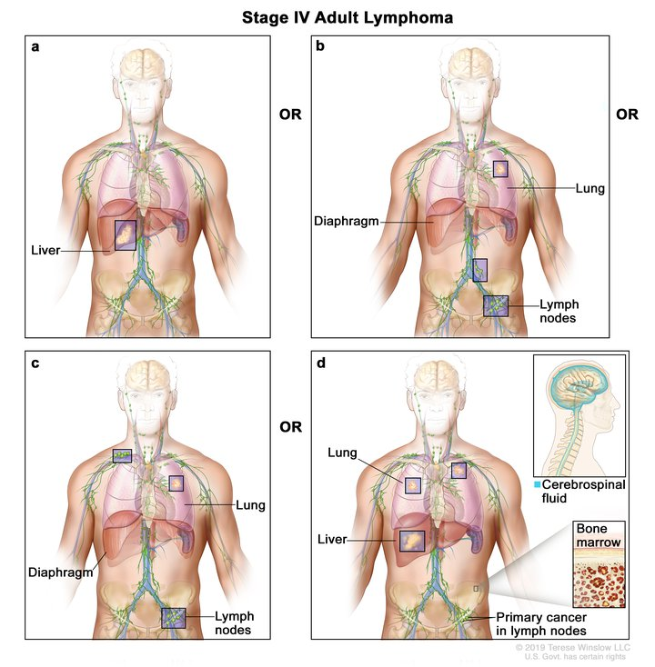

Slide 17
Conclusion
Lymphoma is a cancer of the lymphatic system, which is part of the body's germ-fighting network.
Lymphoma can affect all those areas as well as other organs throughout the body.
17
Notes:
SAY:
The purpose of epidemiology in public health practice is to
discover the agent, host, and environmental factors that affect health;
determine the relative importance of causes of illness, disability, and death;
identify those segments of the population that have the greatest risk from specific causes of ill health; and
evaluate the effectiveness of health programs and services in improving population health.
GO to next slide.

Slide 18
References
Google.com
Wikipedia.org
Studymafia.org
Slidespanda.com

Slide 19
Thanks To StudyMafia.org

