Slide 1
StudyMafia.Org
Intestinal Obstruction
Submitted To: Submitted By:
Studymafia.org Studymafia.org

Slide 2
Table Contents
Definition
Introduction
Symptoms of Intestinal Obstruction
Causes of Intestinal Obstruction
Risk-Factors of Intestinal Obstruction
Complications of Intestinal Obstruction
Diagnosis of Intestinal Obstruction
Treatment of Intestinal Obstruction
Conclusion
2
Notes:
SAY: Before we wrap up the course, let’s review what we have learned today.
During this course, we have
<READ the bullets from the slide.>
GO to next slide.

Slide 3
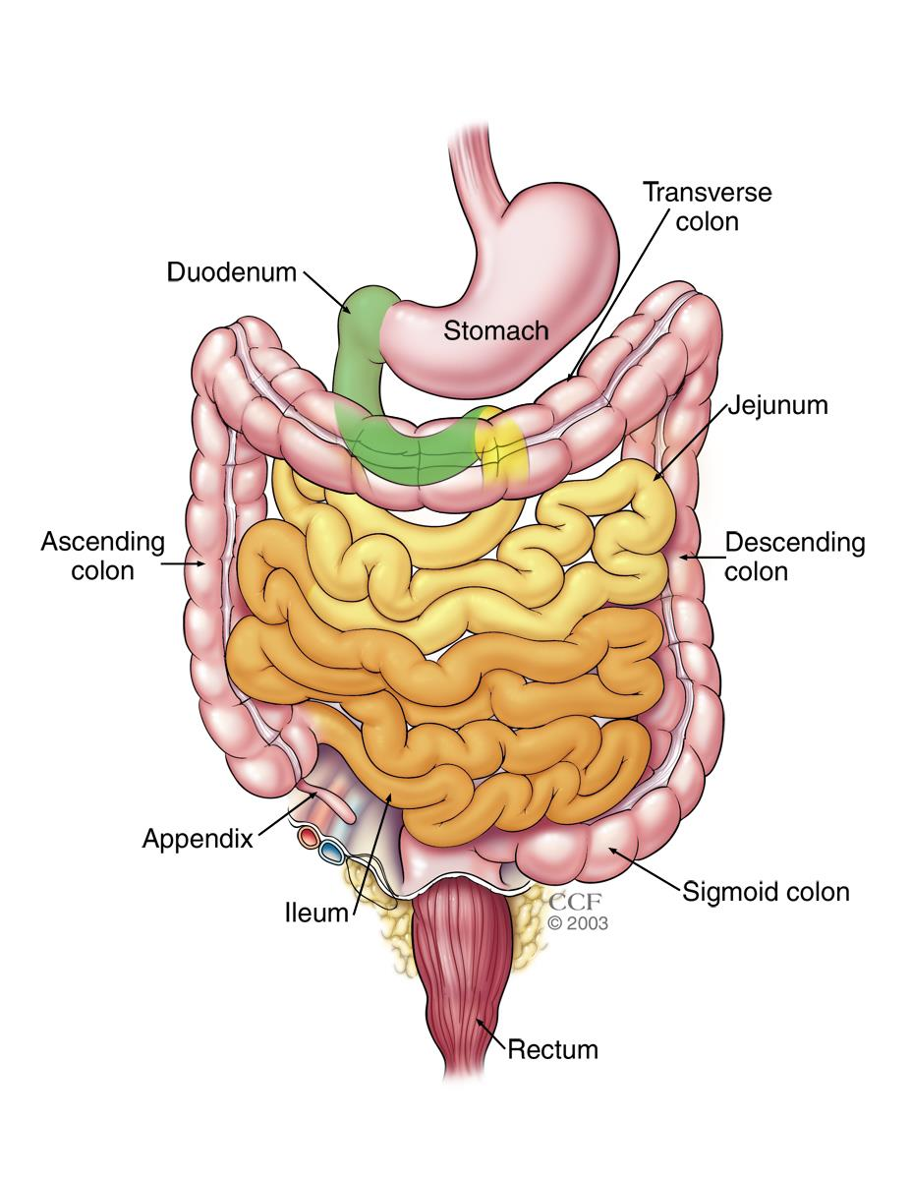
Definition
Intestinal obstruction is a blockage that keeps food or liquid from passing through your small intestine or large intestine (colon)
3
Notes:
SAY: Before we wrap up the course, let’s review what we have learned today.
During this course, we have
<READ the bullets from the slide.>
GO to next slide.

Slide 4
Introduction
Causes of intestinal obstruction may include fibrous bands of tissue (adhesions) in the abdomen that form after surgery; hernias; colon cancer; certain medications; or strictures from an inflamed intestine caused by certain conditions, such as Crohn's disease or diverticulitis.
Without treatment, the blocked parts of the intestine can die, leading to serious problems.
4
Notes:
SAY: Before we wrap up the course, let’s review what we have learned today.
During this course, we have
<READ the bullets from the slide.>
GO to next slide.

Slide 5
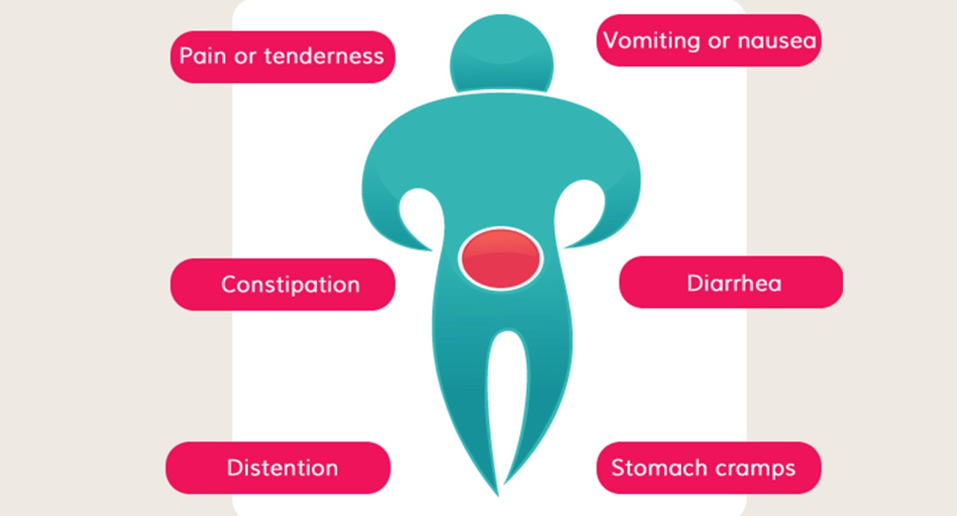
Symptoms of Intestinal Obstruction
5
Notes:
SAY: Before we wrap up the course, let’s review what we have learned today.
During this course, we have
<READ the bullets from the slide.>
GO to next slide.

Slide 6
Causes of Intestinal Obstruction
The most common causes of intestinal obstruction in adults are:
Intestinal adhesions — bands of fibrous tissue in the abdominal cavity that can form after abdominal or pelvic surgery
Hernias — portions of intestine that protrude into another part of your body
Colon cancer
●●●
6
Notes:
SAY:
The purpose of epidemiology in public health practice is to
discover the agent, host, and environmental factors that affect health;
determine the relative importance of causes of illness, disability, and death;
identify those segments of the population that have the greatest risk from specific causes of ill health; and
evaluate the effectiveness of health programs and services in improving population health.
GO to next slide.

Slide 7
Causes of Intestinal Obstruction
Other possible causes of intestinal obstruction include:
Inflammatory bowel diseases, such as Crohn's disease
Diverticulitis — a condition in which small, bulging pouches (diverticula) in the digestive tract become inflamed or infected
Twisting of the colon (volvulus)
Impacted feces
7
Notes:
SAY:
The purpose of epidemiology in public health practice is to
discover the agent, host, and environmental factors that affect health;
determine the relative importance of causes of illness, disability, and death;
identify those segments of the population that have the greatest risk from specific causes of ill health; and
evaluate the effectiveness of health programs and services in improving population health.
GO to next slide.

Slide 8
Risk factors of Intestinal Obstruction
Abdominal or pelvic surgery, which often causes adhesions — a common intestinal obstruction
Crohn's disease, which can cause the intestine's walls to thicken, narrowing the passageway
Cancer in your abdomen
8
Notes:
SAY:
The purpose of epidemiology in public health practice is to
discover the agent, host, and environmental factors that affect health;
determine the relative importance of causes of illness, disability, and death;
identify those segments of the population that have the greatest risk from specific causes of ill health; and
evaluate the effectiveness of health programs and services in improving population health.
GO to next slide.

Slide 9
Complications of Intestinal Obstruction
Tissue death. Intestinal obstruction can cut off the blood supply to part of your intestine. Lack of blood causes the intestinal wall to die. Tissue death can result in a tear (perforation) in the intestinal wall, which can lead to infection.
●●●
9
Notes:
SAY:
The purpose of epidemiology in public health practice is to
discover the agent, host, and environmental factors that affect health;
determine the relative importance of causes of illness, disability, and death;
identify those segments of the population that have the greatest risk from specific causes of ill health; and
evaluate the effectiveness of health programs and services in improving population health.
GO to next slide.

Slide 10
Complications of Intestinal Obstruction
Infection. Peritonitis is the medical term for infection in the abdominal cavity. It's a life-threatening condition that requires immediate medical and often surgical attention.
10
Notes:
SAY:
The purpose of epidemiology in public health practice is to
discover the agent, host, and environmental factors that affect health;
determine the relative importance of causes of illness, disability, and death;
identify those segments of the population that have the greatest risk from specific causes of ill health; and
evaluate the effectiveness of health programs and services in improving population health.
GO to next slide.

Slide 11
Diagnosis of Intestinal Obstruction
Physical exam. Your doctor will ask about your medical history and your symptoms. He or she will also do a physical exam to assess your situation.
X-ray. To confirm a diagnosis of intestinal obstruction, your doctor may recommend an abdominal X-ray. However, some intestinal obstructions can't be seen using standard X-rays.
●●●
11
Notes:
SAY:
The purpose of epidemiology in public health practice is to
discover the agent, host, and environmental factors that affect health;
determine the relative importance of causes of illness, disability, and death;
identify those segments of the population that have the greatest risk from specific causes of ill health; and
evaluate the effectiveness of health programs and services in improving population health.
GO to next slide.

Slide 12
Diagnosis of Intestinal Obstruction
Computerized tomography (CT). A CT scan combines a series of X-ray images taken from different angles to produce cross-sectional images.
Ultrasound. When an intestinal obstruction occurs in children, ultrasound is often the preferred type of imaging.
Air or barium enema. An air or barium enema allows for enhanced imaging of the colon. This may be done for certain suspected causes of obstruction.
12
Notes:
SAY:
The purpose of epidemiology in public health practice is to
discover the agent, host, and environmental factors that affect health;
determine the relative importance of causes of illness, disability, and death;
identify those segments of the population that have the greatest risk from specific causes of ill health; and
evaluate the effectiveness of health programs and services in improving population health.
GO to next slide.

Slide 13
Treatment of Intestinal Obstruction
This process may include:
Placing an intravenous (IV) line into a vein in your arm so that fluids can be given
Putting a tube through your nose and into your stomach (nasogastric tube)to suck out air and fluid and relieve abdominal swelling
Placing a thin, flexible tube (catheter) into your bladder to drain urine and collect it for testing
●●●
13
Notes:
SAY:
The purpose of epidemiology in public health practice is to
discover the agent, host, and environmental factors that affect health;
determine the relative importance of causes of illness, disability, and death;
identify those segments of the population that have the greatest risk from specific causes of ill health; and
evaluate the effectiveness of health programs and services in improving population health.
GO to next slide.

Slide 14
Treatment of Intestinal Obstruction
If you have an obstruction in which some food and fluid can still get through (partial obstruction), you may not need further treatment after you've been stabilized.
Your doctor may recommend a special low-fiber diet that is easier for your partially blocked intestine to process. If the obstruction does not clear on its own, you may need surgery to relieve the obstruction.
14
Notes:
SAY:
The purpose of epidemiology in public health practice is to
discover the agent, host, and environmental factors that affect health;
determine the relative importance of causes of illness, disability, and death;
identify those segments of the population that have the greatest risk from specific causes of ill health; and
evaluate the effectiveness of health programs and services in improving population health.
GO to next slide.

Slide 15
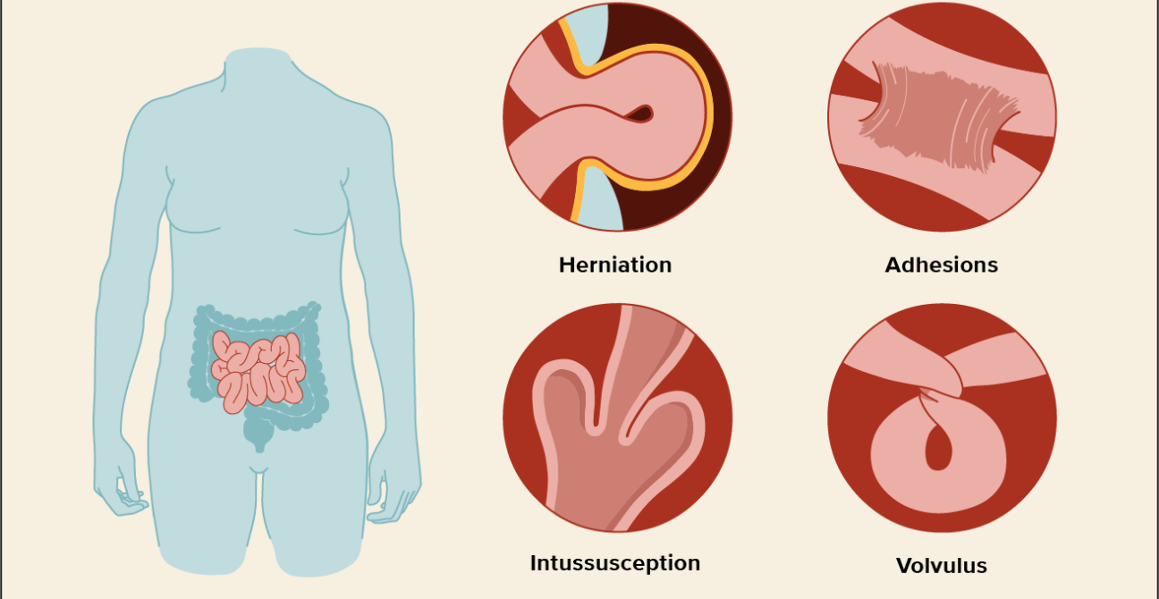

Slide 16
Conclusion
Intestinal obstruction still remains a common and important surgical emergency.
Obstruction due to adhesions is increasing in incidence due to increased abdominal & pelvic surgeries.
16
Notes:
SAY:
The purpose of epidemiology in public health practice is to
discover the agent, host, and environmental factors that affect health;
determine the relative importance of causes of illness, disability, and death;
identify those segments of the population that have the greatest risk from specific causes of ill health; and
evaluate the effectiveness of health programs and services in improving population health.
GO to next slide.

Slide 17
References
Google.com
Wikipedia.org
Studymafia.org
Slidespanda.com

Slide 18
Thanks To StudyMafia.org

