Slide 1
StudyMafia.Org
Hospital Acquired
Infections
Submitted To: Submitted By:
Studymafia.org Studymafia.org

Slide 2
Table of Content
What are Hospital Acquired Infections?
Types of Hospital Acquired Infections
Causes
Symptoms
Who Is at Risk?
Diagnosis
Treatment of HAI
Preventions
Conclusion

Slide 3
What are Hospital Acquired Infections?
Hospital acquired infections (HAI), medically termed as nosocomial infections, are infections that are acquired by patients admitted in the hospital wards, as well as by hospital staff, including doctors and nurses who work at the hospital.
The most common HAI are caused by bacteria. Fungi and viruses also cause HAI, but to a far lesser extent.

Slide 4
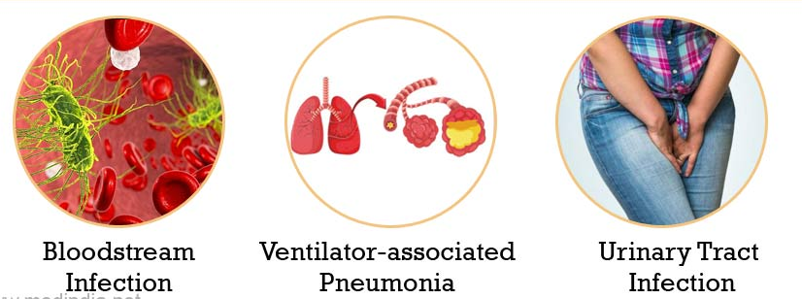
Types of Hospital Acquired Infections

Slide 5
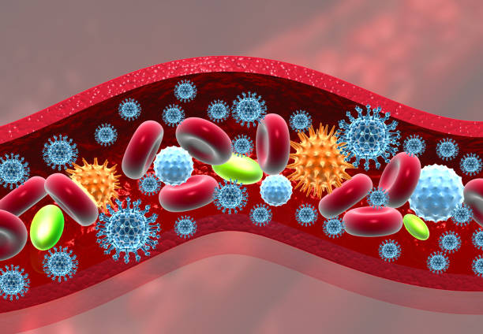
Types of Hospital Acquired Infections..
Bloodstream Infection (BSI): This type of infection is technically termed as septicemia. It occurs when an infection in any part of the body enters the bloodstream and spreads rapidly to other parts of the body.
Septicemia can be life-threatening and must be treated quickly. Catheter-related bloodstream infections (CRBI) are very common in a hospital setting.

Slide 6
Types of Hospital Acquired Infections..
Ventilator-associated Pneumonia (VAP): This type of infection occurs in patients who are on mechanical ventilator support in an intensive care unit (ICU). The patients are usually critically ill and elderly, who are highly susceptible to respiratory infections like pneumonia.

Slide 7
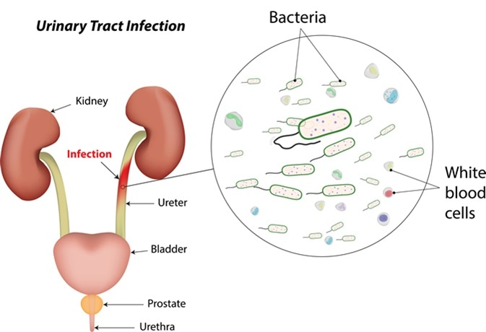
Types of Hospital Acquired Infections..
Urinary Tract Infection (UTI): This type of infection affects the urinary tract. UTI is usually caused by bacteria.
In certain cases, it is caused by fungi and occasionally by viruses. Infection can occur in the lower urinary tract, involving the bladder (cystitis) or the upper urinary tract, involving the kidneys (pyelonephritis).

Slide 8
Types of Hospital Acquired Infections..
Surgical Site Infection (SSI): This is one of the most common types of infection in the operating room. SSI can be caused as a result of not following strict aseptic practices, before, during, and after the surgery.

Slide 9
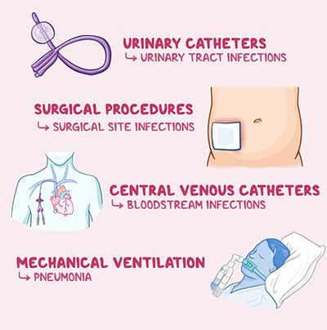
Causes

Slide 10
Symptoms
Symptoms of HAIs will vary by type. The most common types of HAIs are:
urinary tract infections (UTIs)
surgical site infections
gastroenteritis
meningitis
pneumonia

Slide 11
Who is at risk?
Anyone admitted to a healthcare facility is at risk for contracting a HAI. For some bacteria, your risks may also depend on:
your hospital roommate
age, especially if you’re more than 70 years old
how long you’ve been using antibiotics
whether or not you have a urinary catheter
prolonged ICU stay
if you’ve been in a coma
if you’ve experienced shock
any trauma you’ve experienced

Slide 12
How are nosocomial infections diagnosed?
Many doctors can diagnose a HAI by sight and symptoms alone. Inflammation and/or a rash at the site of infection can also be an indication. Infections prior to your stay that become complicated don’t count as HAIs. But you should still tell your doctor if any new symptoms appear during your stay.
You also may be required to talk a blood and urine test as to identify the infection.

Slide 13
How are nosocomial infections treated?
Treatments for these infections depend on the infection type. Your doctor will likely recommend antibiotics and bed rest. Also, they’ll remove any foreign devices such as catheters as soon as medically appropriate.
To encourage a natural healing process and prevent dehydration, your doctor will encourage a healthy diet, fluid intake, and rest.

Slide 14
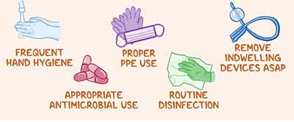
Prevention

Slide 15
Conclusion
As a final thought, these harmful infections could arise as a result of poor adherence to cleaning protocols, hand hygiene or not implementing alternative interventions such as automated disinfection technologies. As it was shown numerous times in the literature and peer-reviewed papers, manual cleaning only is not sufficient to eliminate contamination at a safe level for patients and staff.
Implementing infection control and prevention measures that include the use of automated no-touch technologies such as UV-C light and hydrogen peroxide vapour alongside manual cleaning will improve outcomes and reduce rates of infection.

Slide 16
References
Google.com
Wikipedia.org
Studymafia.org
Slidespanda.com

Slide 17
Thanks To StudyMafia.org

