Slide 1
StudyMafia.Org
Gout
Submitted To: Submitted By:
Studymafia.org Studymafia.org

Slide 2
Table Contents
Definition
Introduction
Types of Gout
Symptoms of Gout
Causes of Gout
Risk-Factors of Gout
Complications of Gout
Diagnosis of Gout
Treatment of Gout
Prevention of Gout
Conclusion
2
Notes:
SAY: Before we wrap up the course, let’s review what we have learned today.
During this course, we have
<READ the bullets from the slide.>
GO to next slide.

Slide 3
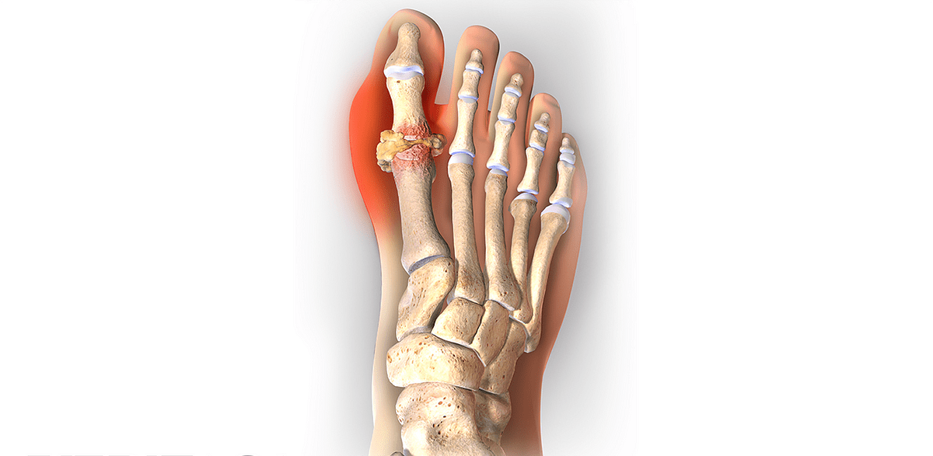
Definition
Gout is a common and complex form of arthritis that can affect anyone.
3
Notes:
SAY: Before we wrap up the course, let’s review what we have learned today.
During this course, we have
<READ the bullets from the slide.>
GO to next slide.

Slide 4
Introduction
It's characterized by sudden, severe attacks of pain, swelling, redness and tenderness in one or more joints, most often in the big toe.
An attack of gout can occur suddenly, often waking you up in the middle of the night with the sensation that your big toe is on fire. The affected joint is hot, swollen and so tender that even the weight of the bedsheet on it may seem intolerable.
Gout symptoms may come and go, but there are ways to manage symptoms and prevent flares.
4
Notes:
SAY: Before we wrap up the course, let’s review what we have learned today.
During this course, we have
<READ the bullets from the slide.>
GO to next slide.

Slide 5
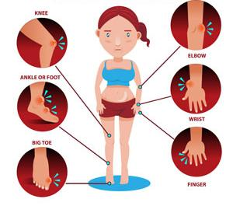
Symptoms of Gout
5
Notes:
SAY: Before we wrap up the course, let’s review what we have learned today.
During this course, we have
<READ the bullets from the slide.>
GO to next slide.

Slide 6
Causes of Gout
Gout occurs when urate crystals accumulate in your joint, causing the inflammation and intense pain of a gout attack.
Urate crystals can form when you have high levels of uric acid in your blood. Your body produces uric acid when it breaks down purines — substances that are found naturally in your body.
Purines are also found in certain foods, including red meat and organ meats, such as liver. Purine-rich seafood includes anchovies, sardines, mussels, scallops, trout and tuna.
●●●
6
Notes:
SAY:
The purpose of epidemiology in public health practice is to
discover the agent, host, and environmental factors that affect health;
determine the relative importance of causes of illness, disability, and death;
identify those segments of the population that have the greatest risk from specific causes of ill health; and
evaluate the effectiveness of health programs and services in improving population health.
GO to next slide.

Slide 7
Causes of Gout
Alcoholic beverages, especially beer, and drinks sweetened with fruit sugar (fructose) promote higher levels of uric acid.
Normally, uric acid dissolves in your blood and passes through your kidneys into your urine. But sometimes either your body produces too much uric acid or your kidneys excrete too little uric acid.
When this happens, uric acid can build up, forming sharp, needlelike urate crystals in a joint or surrounding tissue that cause pain, inflammation and swelling.
7
Notes:
SAY:
The purpose of epidemiology in public health practice is to
discover the agent, host, and environmental factors that affect health;
determine the relative importance of causes of illness, disability, and death;
identify those segments of the population that have the greatest risk from specific causes of ill health; and
evaluate the effectiveness of health programs and services in improving population health.
GO to next slide.

Slide 8
Risk factors of Gout
Diet. Eating a diet rich in red meat and shellfish and drinking beverages sweetened with fruit sugar (fructose) increase levels of uric acid, which increase your risk of gout. Alcohol consumption, especially of beer, also increases the risk of gout.
Weight. If you're overweight, your body produces more uric acid and your kidneys have a more difficult time eliminating uric acid.
●●●
8
Notes:
SAY:
The purpose of epidemiology in public health practice is to
discover the agent, host, and environmental factors that affect health;
determine the relative importance of causes of illness, disability, and death;
identify those segments of the population that have the greatest risk from specific causes of ill health; and
evaluate the effectiveness of health programs and services in improving population health.
GO to next slide.

Slide 9
Risk factors of Gout
Medical conditions. Certain diseases and conditions increase your risk of gout. These include untreated high blood pressure and chronic conditions such as diabetes, obesity.
Certain medications. Low-dose aspirin and some medications used to control hypertension — including thiazide diuretics, angiotensin-converting enzyme (ACE) inhibitors and beta blockers — also can increase uric acid levels.
●●●
9
Notes:
SAY:
The purpose of epidemiology in public health practice is to
discover the agent, host, and environmental factors that affect health;
determine the relative importance of causes of illness, disability, and death;
identify those segments of the population that have the greatest risk from specific causes of ill health; and
evaluate the effectiveness of health programs and services in improving population health.
GO to next slide.

Slide 10
Risk factors of Gout
Family history of gout. If other members of your family have had gout, you're more likely to develop the disease.
Age and sex. Gout occurs more often in men, primarily because women tend to have lower uric acid levels.
Recent surgery or trauma. Experiencing recent surgery or trauma can sometimes trigger a gout attack. In some people, receiving a vaccination can trigger a gout flare.
10
Notes:
SAY:
The purpose of epidemiology in public health practice is to
discover the agent, host, and environmental factors that affect health;
determine the relative importance of causes of illness, disability, and death;
identify those segments of the population that have the greatest risk from specific causes of ill health; and
evaluate the effectiveness of health programs and services in improving population health.
GO to next slide.

Slide 11
Complications of Gout
Recurrent gout.
Some people may never experience gout signs and symptoms again. Others may experience gout several times each year.
Medications may help prevent gout attacks in people with recurrent gout. If left untreated, gout can cause erosion and destruction of a joint.
●●●
11
Notes:
SAY:
The purpose of epidemiology in public health practice is to
discover the agent, host, and environmental factors that affect health;
determine the relative importance of causes of illness, disability, and death;
identify those segments of the population that have the greatest risk from specific causes of ill health; and
evaluate the effectiveness of health programs and services in improving population health.
GO to next slide.

Slide 12
Complications of Gout
Advanced gout.
Untreated gout may cause deposits of urate crystals to form under the skin in nodules called tophi (TOE-fie).
Tophi can develop in several areas, such as your fingers, hands, feet, elbows or Achilles tendons along the backs of your ankles.
Kidney stones.
Urate crystals may collect in the urinary tracts of people with gout, causing kidney stones.
12
Notes:
SAY:
The purpose of epidemiology in public health practice is to
discover the agent, host, and environmental factors that affect health;
determine the relative importance of causes of illness, disability, and death;
identify those segments of the population that have the greatest risk from specific causes of ill health; and
evaluate the effectiveness of health programs and services in improving population health.
GO to next slide.

Slide 13
Diagnosis of Gout
Joint fluid test. Your doctor may use a needle to draw fluid from your affected joint. Urate crystals may be visible when the fluid is examined under a microscope.
Blood test. Your doctor may recommend a blood test to measure the levels of uric acid in your blood. Blood test results can be misleading, though.
Some people have high uric acid levels, but never experience gout. And some people have signs and symptoms of gout, but don't have unusual levels of uric acid in their blood.
●●●
13
Notes:
SAY:
The purpose of epidemiology in public health practice is to
discover the agent, host, and environmental factors that affect health;
determine the relative importance of causes of illness, disability, and death;
identify those segments of the population that have the greatest risk from specific causes of ill health; and
evaluate the effectiveness of health programs and services in improving population health.
GO to next slide.

Slide 14
Diagnosis of Gout
X-ray imaging. Joint X-rays can be helpful to rule out other causes of joint inflammation.
Ultrasound. This test uses sound waves to detect urate crystals in joints or in tophi.
Dual-energy computerized tomography (DECT). This test combines X-ray images taken from many different angles to visualize urate crystals in joints.
14
Notes:
SAY:
The purpose of epidemiology in public health practice is to
discover the agent, host, and environmental factors that affect health;
determine the relative importance of causes of illness, disability, and death;
identify those segments of the population that have the greatest risk from specific causes of ill health; and
evaluate the effectiveness of health programs and services in improving population health.
GO to next slide.

Slide 15
Treatment of Gout
Medications to treat gout attacks
Nonsteroidal anti-inflammatory drugs (NSAIDs). NSAIDs include over-the-counter options such as ibuprofen (Advil, Motrin IB, others)
Colchicine. Your doctor may recommend colchicine (Colcrys, Gloperba, Mitigare), an anti-inflammatory drug that effectively reduces gout pain.
Corticosteroids. Corticosteroid medications, such as prednisone, may control gout inflammation and pain
15
Notes:
SAY:
The purpose of epidemiology in public health practice is to
discover the agent, host, and environmental factors that affect health;
determine the relative importance of causes of illness, disability, and death;
identify those segments of the population that have the greatest risk from specific causes of ill health; and
evaluate the effectiveness of health programs and services in improving population health.
GO to next slide.

Slide 16
Prevention of Gout
Choose healthier beverages. Limit alcoholic beverages and drinks sweetened with fruit sugar (fructose). Instead, drink plenty of nonalcoholic beverages, especially water.
Avoid foods high in purines. Red meat and organ meats, such as liver, are especially high in purines. Purine-rich seafood includes anchovies, sardines, mussels, scallops, trout and tuna.
Exercise regularly and lose weight. Keeping your body at a healthy weight reduces your risk of gout. Choose low-impact activities such as walking, bicycling and swimming.
16
Notes:
SAY:
The purpose of epidemiology in public health practice is to
discover the agent, host, and environmental factors that affect health;
determine the relative importance of causes of illness, disability, and death;
identify those segments of the population that have the greatest risk from specific causes of ill health; and
evaluate the effectiveness of health programs and services in improving population health.
GO to next slide.

Slide 17
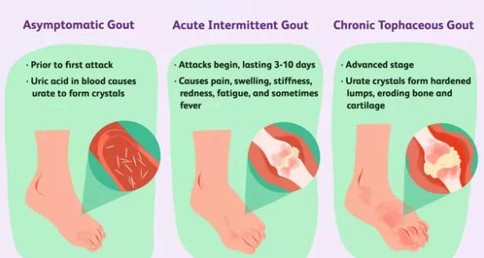

Slide 18
Conclusion
In conclusion, gout is a very common form of arthritis that may be increasing in prevalence as a result of changes in diet, lifestyle and environmental factors.
18
Notes:
SAY:
The purpose of epidemiology in public health practice is to
discover the agent, host, and environmental factors that affect health;
determine the relative importance of causes of illness, disability, and death;
identify those segments of the population that have the greatest risk from specific causes of ill health; and
evaluate the effectiveness of health programs and services in improving population health.
GO to next slide.

Slide 19
References
Google.com
Wikipedia.org
Studymafia.org
Slidespanda.com

Slide 20
Thanks To StudyMafia.org

