Slide 1
StudyMafia.Org
Glaucoma
Submitted To: Submitted By:
Studymafia.org Studymafia.org

Slide 2
Table Contents
Definition
Introduction
Symptoms of Glaucoma
Causes of Glaucoma
Risk-Factors of Glaucoma
Complications of Glaucoma
Diagnosis of Glaucoma
Treatment of Glaucoma
Conclusion
2
Notes:
SAY: Before we wrap up the course, let’s review what we have learned today.
During this course, we have
<READ the bullets from the slide.>
GO to next slide.

Slide 3
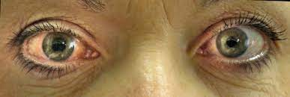
Definition
Glaucoma is a group of eye conditions that damage the optic nerve, the health of which is vital for good vision
3
Notes:
SAY: Before we wrap up the course, let’s review what we have learned today.
During this course, we have
<READ the bullets from the slide.>
GO to next slide.

Slide 4
Introduction
Many forms of glaucoma have no warning signs. The effect is so gradual that you may not notice a change in vision until the condition is at an advanced stage.
Because vision loss due to glaucoma can't be recovered, it's important to have regular eye exams that include measurements of your eye pressure so a diagnosis can be made in its early stages and treated appropriately. If glaucoma is recognized early, vision loss can be slowed or prevented.
If you have the condition, you'll generally need treatment for the rest of your life.
4
Notes:
SAY: Before we wrap up the course, let’s review what we have learned today.
During this course, we have
<READ the bullets from the slide.>
GO to next slide.

Slide 5
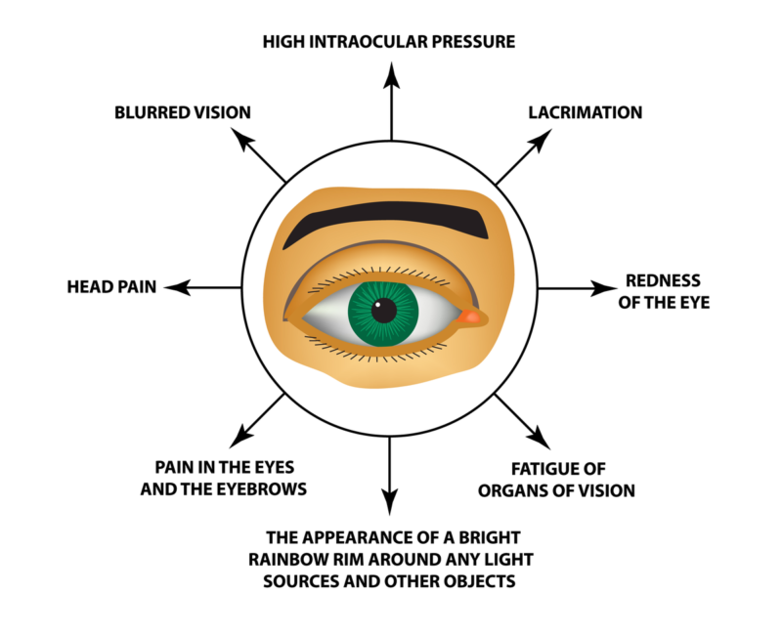
Symptoms of Glaucoma
5
Notes:
SAY: Before we wrap up the course, let’s review what we have learned today.
During this course, we have
<READ the bullets from the slide.>
GO to next slide.

Slide 6
Causes of Glaucoma
Glaucoma is the result of damage to the optic nerve. As this nerve gradually deteriorates, blind spots develop in your visual field. For reasons that doctors don't fully understand, this nerve damage is usually related to increased pressure in the eye.
Elevated eye pressure is due to a buildup of a fluid (aqueous humor) that flows throughout the inside of your eye.
●●●
6
Notes:
SAY:
The purpose of epidemiology in public health practice is to
discover the agent, host, and environmental factors that affect health;
determine the relative importance of causes of illness, disability, and death;
identify those segments of the population that have the greatest risk from specific causes of ill health; and
evaluate the effectiveness of health programs and services in improving population health.
GO to next slide.

Slide 7
Causes of Glaucoma
This internal fluid normally drains out through a tissue called the trabecular meshwork at the angle where the iris and cornea meet. When fluid is overproduced or the drainage system doesn't work properly, the fluid can't flow out at its normal rate and eye pressure increases.
Glaucoma tends to run in families. In some people, scientists have identified genes related to high eye pressure and optic nerve damage.
7
Notes:
SAY:
The purpose of epidemiology in public health practice is to
discover the agent, host, and environmental factors that affect health;
determine the relative importance of causes of illness, disability, and death;
identify those segments of the population that have the greatest risk from specific causes of ill health; and
evaluate the effectiveness of health programs and services in improving population health.
GO to next slide.

Slide 8
Types of Glaucoma
Open-angle glaucoma
Open-angle glaucoma is the most common form of the disease. The drainage angle formed by the cornea and iris remains open, but the trabecular meshwork is partially blocked.
This causes pressure in the eye to gradually increase. This pressure damages the optic nerve. It happens so slowly that you may lose vision before you're even aware of a problem.
●●●
8
Notes:
SAY:
The purpose of epidemiology in public health practice is to
discover the agent, host, and environmental factors that affect health;
determine the relative importance of causes of illness, disability, and death;
identify those segments of the population that have the greatest risk from specific causes of ill health; and
evaluate the effectiveness of health programs and services in improving population health.
GO to next slide.

Slide 9
Types of Glaucoma
Angle-closure glaucoma
Angle-closure glaucoma, also called closed-angle glaucoma, occurs when the iris bulges forward to narrow or block the drainage angle formed by the cornea and iris.
As a result, fluid can't circulate through the eye and pressure increases. Some people have narrow drainage angles, putting them at increased risk of angle-closure glaucoma.
●●●
9
Notes:
SAY:
The purpose of epidemiology in public health practice is to
discover the agent, host, and environmental factors that affect health;
determine the relative importance of causes of illness, disability, and death;
identify those segments of the population that have the greatest risk from specific causes of ill health; and
evaluate the effectiveness of health programs and services in improving population health.
GO to next slide.

Slide 10
Types of Glaucoma
Normal-tension glaucoma
In normal-tension glaucoma, your optic nerve becomes damaged even though your eye pressure is within the normal range. No one knows the exact reason for this.
You may have a sensitive optic nerve, or you may have less blood being supplied to your optic nerve. This limited blood flow could be caused by atherosclerosis — the buildup of fatty deposits.
●●●
10
Notes:
SAY:
The purpose of epidemiology in public health practice is to
discover the agent, host, and environmental factors that affect health;
determine the relative importance of causes of illness, disability, and death;
identify those segments of the population that have the greatest risk from specific causes of ill health; and
evaluate the effectiveness of health programs and services in improving population health.
GO to next slide.

Slide 11
Types of Glaucoma
Glaucoma in children
It's possible for infants and children to have glaucoma. It may be present from birth or develop in the first few years of life. The optic nerve damage may be caused by drainage blockages or an underlying medical condition.
Pigmentary glaucoma
In pigmentary glaucoma, pigment granules from your iris build up in the drainage channels, slowing or blocking fluid exiting your eye
11
Notes:
SAY:
The purpose of epidemiology in public health practice is to
discover the agent, host, and environmental factors that affect health;
determine the relative importance of causes of illness, disability, and death;
identify those segments of the population that have the greatest risk from specific causes of ill health; and
evaluate the effectiveness of health programs and services in improving population health.
GO to next slide.

Slide 12
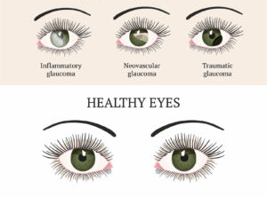

Slide 13
Risk factors of Glaucoma
Because chronic forms of glaucoma can destroy vision before any signs or symptoms are apparent, be aware of these risk factors:
Having high internal eye pressure (intraocular pressure)
Being over age 60
Being black, Asian or Hispanic
Having a family history of glaucoma
●●●
13
Notes:
SAY:
The purpose of epidemiology in public health practice is to
discover the agent, host, and environmental factors that affect health;
determine the relative importance of causes of illness, disability, and death;
identify those segments of the population that have the greatest risk from specific causes of ill health; and
evaluate the effectiveness of health programs and services in improving population health.
GO to next slide.

Slide 14
Risk factors of Glaucoma
Having certain medical conditions, such as diabetes, heart disease, high blood pressure and sickle cell anemia
Having corneas that are thin in the center
Being extremely nearsighted or farsighted
Having had an eye injury or certain types of eye surgery
Taking corticosteroid medications, especially eyedrops, for a long time
14
Notes:
SAY:
The purpose of epidemiology in public health practice is to
discover the agent, host, and environmental factors that affect health;
determine the relative importance of causes of illness, disability, and death;
identify those segments of the population that have the greatest risk from specific causes of ill health; and
evaluate the effectiveness of health programs and services in improving population health.
GO to next slide.

Slide 15
Prevention of Glaucoma
Get regular dilated eye examinations.
Regular comprehensive eye exams can help detect glaucoma in its early stages, before significant damage occurs.
As a general rule, the American Academy of Ophthalmology recommends having a comprehensive eye exam every five to 10 years if you're under 40 years old; every two to four years if you're 40 to 54 years old; every one to three years if you're 55 to 64 years old; and every one to two years if you're older than 65.
●●●
15
Notes:
SAY:
The purpose of epidemiology in public health practice is to
discover the agent, host, and environmental factors that affect health;
determine the relative importance of causes of illness, disability, and death;
identify those segments of the population that have the greatest risk from specific causes of ill health; and
evaluate the effectiveness of health programs and services in improving population health.
GO to next slide.

Slide 16
Prevention of Glaucoma
Know your family's eye health history. Glaucoma tends to run in families. If you're at increased risk, you may need more frequent screening.
Exercise safely. Regular, moderate exercise may help prevent glaucoma by reducing eye pressure. Talk with your doctor about an appropriate exercise program.
●●●
16
Notes:
SAY:
The purpose of epidemiology in public health practice is to
discover the agent, host, and environmental factors that affect health;
determine the relative importance of causes of illness, disability, and death;
identify those segments of the population that have the greatest risk from specific causes of ill health; and
evaluate the effectiveness of health programs and services in improving population health.
GO to next slide.

Slide 17
Prevention of Glaucoma
Take prescribed eyedrops regularly. Glaucoma eyedrops can significantly reduce the risk that high eye pressure will progress to glaucoma. To be effective, eyedrops prescribed by your doctor need to be used regularly even if you have no symptoms.
Wear eye protection. Serious eye injuries can lead to glaucoma. Wear eye protection when using power tools or playing high-speed racket sports in enclosed courts.
17
Notes:
SAY:
The purpose of epidemiology in public health practice is to
discover the agent, host, and environmental factors that affect health;
determine the relative importance of causes of illness, disability, and death;
identify those segments of the population that have the greatest risk from specific causes of ill health; and
evaluate the effectiveness of health programs and services in improving population health.
GO to next slide.

Slide 18
Diagnosis of Glaucoma
Measuring intraocular pressure (tonometry)
Testing for optic nerve damage with a dilated eye examination and imaging tests
Checking for areas of vision loss (visual field test)
Measuring corneal thickness (pachymetry)
Inspecting the drainage angle (gonioscopy)
18
Notes:
SAY:
The purpose of epidemiology in public health practice is to
discover the agent, host, and environmental factors that affect health;
determine the relative importance of causes of illness, disability, and death;
identify those segments of the population that have the greatest risk from specific causes of ill health; and
evaluate the effectiveness of health programs and services in improving population health.
GO to next slide.

Slide 19
Treatment of Glaucoma
The damage caused by glaucoma can't be reversed. But treatment and regular checkups can help slow or prevent vision loss, especially if you catch the disease in its early stages.
Glaucoma is treated by lowering your eye pressure (intraocular pressure). Depending on your situation, your options may include prescription eyedrops, oral medications, laser treatment, surgery or a combination of any of these.
19
Notes:
SAY:
The purpose of epidemiology in public health practice is to
discover the agent, host, and environmental factors that affect health;
determine the relative importance of causes of illness, disability, and death;
identify those segments of the population that have the greatest risk from specific causes of ill health; and
evaluate the effectiveness of health programs and services in improving population health.
GO to next slide.

Slide 20
Conclusion
Glaucoma is a common eye disease that is usually associated with an elevated intraocular pressure.
Treatment options for patients with glaucoma include medications, laser therapy, and incisional surgery.
20
Notes:
SAY:
The purpose of epidemiology in public health practice is to
discover the agent, host, and environmental factors that affect health;
determine the relative importance of causes of illness, disability, and death;
identify those segments of the population that have the greatest risk from specific causes of ill health; and
evaluate the effectiveness of health programs and services in improving population health.
GO to next slide.

Slide 21
References
Google.com
Wikipedia.org
Studymafia.org
Slidespanda.com

Slide 22
Thanks To StudyMafia.org

