Slide 1
StudyMafia.Org
Emphysema
Submitted To: Submitted By:
Studymafia.org Studymafia.org

Slide 2
Table Contents
Definition
Introduction
Symptoms of Emphysema
When to see a Doctor
Causes of Emphysema
Risk-Factors of Emphysema
Complications of Emphysema
Diagnosis of Emphysema
Treatment of Emphysema
Conclusion
2
Notes:
SAY: Before we wrap up the course, let’s review what we have learned today.
During this course, we have
<READ the bullets from the slide.>
GO to next slide.

Slide 3
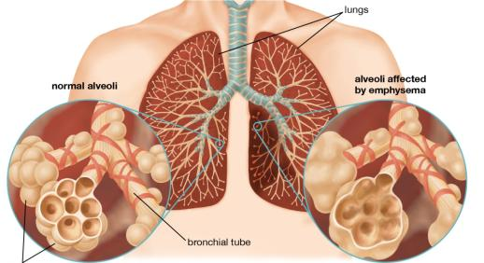
Definition
Emphysema is a lung condition that causes shortness of breath. In people with emphysema, the air sacs in the lungs (alveoli) are damaged.
3
Notes:
SAY: Before we wrap up the course, let’s review what we have learned today.
During this course, we have
<READ the bullets from the slide.>
GO to next slide.

Slide 4
Introduction
When you exhale, the damaged alveoli don't work properly and old air becomes trapped, leaving no room for fresh, oxygen-rich air to enter.
Most people with emphysema also have chronic bronchitis. Chronic bronchitis is inflammation of the tubes that carry air to your lungs (bronchial tubes), which leads to a persistent cough.
4
Notes:
SAY: Before we wrap up the course, let’s review what we have learned today.
During this course, we have
<READ the bullets from the slide.>
GO to next slide.

Slide 5
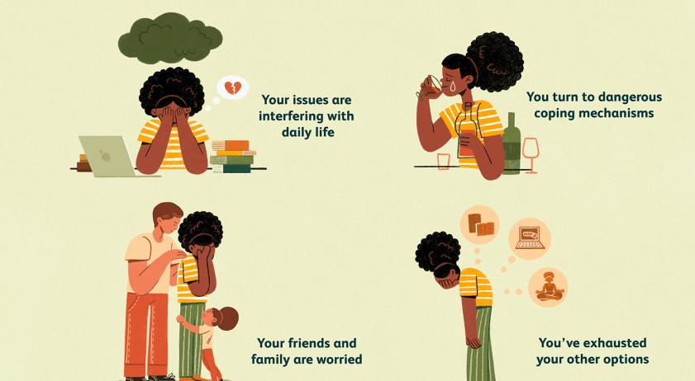
Symptoms of Emphysema
5
Notes:
SAY: Before we wrap up the course, let’s review what we have learned today.
During this course, we have
<READ the bullets from the slide.>
GO to next slide.

Slide 6
When to see a doctor
See your doctor if you've had unexplained shortness of breath for several months, especially if it's getting worse or it's interfering with your daily activities. Don't ignore it by telling yourself it's because you're aging or out of shape. Seek immediate medical attention if:
You're so short of breath, you can't climb stairs
Your lips or fingernails turn blue or gray with exertion
You're not mentally alert
6
Notes:
SAY: Before we wrap up the course, let’s review what we have learned today.
During this course, we have
<READ the bullets from the slide.>
GO to next slide.

Slide 7
Causes of Emphysema
The main cause of emphysema is long-term exposure to airborne irritants, including:
Tobacco smoke
Marijuana smoke
Air pollution
Chemical fumes and dust
Rarely, emphysema is caused by an inherited deficiency of a protein that protects the elastic structures in the lungs. It's called alpha-1-antitrypsin deficiency emphysema.
7
Notes:
SAY:
The purpose of epidemiology in public health practice is to
discover the agent, host, and environmental factors that affect health;
determine the relative importance of causes of illness, disability, and death;
identify those segments of the population that have the greatest risk from specific causes of ill health; and
evaluate the effectiveness of health programs and services in improving population health.
GO to next slide.

Slide 8
Risk factors of Emphysema
Smoking. Emphysema is most likely to develop in cigarette smokers, but cigar and pipe smokers also are susceptible. The risk for all types of smokers increases with the number of years and amount of tobacco smoked.
Age. Although the lung damage that occurs in emphysema develops gradually, most people with tobacco-related emphysema begin to experience symptoms of the disease between the ages of 40 and 60.
●●●
8
Notes:
SAY:
The purpose of epidemiology in public health practice is to
discover the agent, host, and environmental factors that affect health;
determine the relative importance of causes of illness, disability, and death;
identify those segments of the population that have the greatest risk from specific causes of ill health; and
evaluate the effectiveness of health programs and services in improving population health.
GO to next slide.

Slide 9
Risk factors of Emphysema
Occupational exposure to fumes or dust. If you breathe fumes from certain chemicals or dust from grain, cotton, wood or mining products, you're more likely to develop emphysema. This risk is even greater if you smoke.
Exposure to indoor and outdoor pollution. Breathing indoor pollutants, such as fumes from heating fuel, as well as outdoor pollutants — car exhaust, for instance — increases your risk of emphysema.
●●●
9
Notes:
SAY:
The purpose of epidemiology in public health practice is to
discover the agent, host, and environmental factors that affect health;
determine the relative importance of causes of illness, disability, and death;
identify those segments of the population that have the greatest risk from specific causes of ill health; and
evaluate the effectiveness of health programs and services in improving population health.
GO to next slide.

Slide 10
Risk factors of Emphysema
Exposure to secondhand smoke. Secondhand smoke, also known as passive or environmental tobacco smoke, is smoke that you inadvertently inhale from someone else's cigarette, pipe or cigar. Being around secondhand smoke increases your risk of emphysema.
10
Notes:
SAY:
The purpose of epidemiology in public health practice is to
discover the agent, host, and environmental factors that affect health;
determine the relative importance of causes of illness, disability, and death;
identify those segments of the population that have the greatest risk from specific causes of ill health; and
evaluate the effectiveness of health programs and services in improving population health.
GO to next slide.

Slide 11
Complications of Emphysema
Collapsed lung (pneumothorax). A collapsed lung can be life-threatening in people who have severe emphysema, because the function of their lungs is already so compromised. This is uncommon but serious when it occurs.
Heart problems. Emphysema can increase the pressure in the arteries that connect the heart and lungs. This can cause a condition called cor pulmonale, in which a section of the heart expands and weakens.
●●●
11
Notes:
SAY:
The purpose of epidemiology in public health practice is to
discover the agent, host, and environmental factors that affect health;
determine the relative importance of causes of illness, disability, and death;
identify those segments of the population that have the greatest risk from specific causes of ill health; and
evaluate the effectiveness of health programs and services in improving population health.
GO to next slide.

Slide 12
Complications of Emphysema
Large holes in the lungs (bullae). Some people with emphysema develop empty spaces in the lungs called bullae. They can be as large as half the lung. In addition to reducing the amount of space available for the lung to expand, giant bullae can increase your risk of pneumothorax.
12
Notes:
SAY:
The purpose of epidemiology in public health practice is to
discover the agent, host, and environmental factors that affect health;
determine the relative importance of causes of illness, disability, and death;
identify those segments of the population that have the greatest risk from specific causes of ill health; and
evaluate the effectiveness of health programs and services in improving population health.
GO to next slide.

Slide 13
Diagnosis of Emphysema
Imaging tests
A chest X-ray can help support a diagnosis of advanced emphysema and rule out other causes of shortness of breath. But the chest X-ray can also show normal findings if you have emphysema.
Lab tests
Blood taken from an artery in your wrist can be tested to determine how well your lungs transfer oxygen into, and remove carbon dioxide from, your bloodstream.
●●●
13
Notes:
SAY:
The purpose of epidemiology in public health practice is to
discover the agent, host, and environmental factors that affect health;
determine the relative importance of causes of illness, disability, and death;
identify those segments of the population that have the greatest risk from specific causes of ill health; and
evaluate the effectiveness of health programs and services in improving population health.
GO to next slide.

Slide 14
Diagnosis of Emphysema
Lung function tests
These noninvasive tests measure how much air your lungs can hold and how well the air flows in and out of your lungs. They can also measure how well your lungs deliver oxygen to your bloodstream. One of the most common tests uses a simple instrument called a spirometer, which you blow into.
14
Notes:
SAY:
The purpose of epidemiology in public health practice is to
discover the agent, host, and environmental factors that affect health;
determine the relative importance of causes of illness, disability, and death;
identify those segments of the population that have the greatest risk from specific causes of ill health; and
evaluate the effectiveness of health programs and services in improving population health.
GO to next slide.

Slide 15
Treatment of Emphysema
Medications:
Bronchodilators. These drugs can help relieve coughing, shortness of breath and breathing problems by relaxing constricted airways.
Antibiotics. If you have a bacterial infection, like acute bronchitis or pneumonia, antibiotics are appropriate.
●●●
15
Notes:
SAY:
The purpose of epidemiology in public health practice is to
discover the agent, host, and environmental factors that affect health;
determine the relative importance of causes of illness, disability, and death;
identify those segments of the population that have the greatest risk from specific causes of ill health; and
evaluate the effectiveness of health programs and services in improving population health.
GO to next slide.

Slide 16
Treatment of Emphysema
Therapy:
Pulmonary rehabilitation. A pulmonary rehabilitation program can teach you breathing exercises and techniques that may help reduce your breathlessness and improve your ability to exercise.
Nutrition therapy. You'll also receive advice about proper nutrition.
●●●
16
Notes:
SAY:
The purpose of epidemiology in public health practice is to
discover the agent, host, and environmental factors that affect health;
determine the relative importance of causes of illness, disability, and death;
identify those segments of the population that have the greatest risk from specific causes of ill health; and
evaluate the effectiveness of health programs and services in improving population health.
GO to next slide.

Slide 17
Treatment of Emphysema
Surgery:
Depending on the severity of your emphysema, your doctor may suggest one or more different types of surgery, including:
Lung volume reduction surgery. In this procedure, surgeons remove small wedges of damaged lung tissue. Removing the diseased tissue helps the remaining lung tissue expand and work more efficiently and helps improve breathing.
17
Notes:
SAY:
The purpose of epidemiology in public health practice is to
discover the agent, host, and environmental factors that affect health;
determine the relative importance of causes of illness, disability, and death;
identify those segments of the population that have the greatest risk from specific causes of ill health; and
evaluate the effectiveness of health programs and services in improving population health.
GO to next slide.

Slide 18
Conclusion
As emphysema is a known risk factor for lung cancer, its evaluation could be used as a potential factor for identification of a high-risk population. The evaluation of emphysema progression can be added to low-dose CT screening programmes to inform and incite participants to stop smoking.
18
Notes:
SAY:
The purpose of epidemiology in public health practice is to
discover the agent, host, and environmental factors that affect health;
determine the relative importance of causes of illness, disability, and death;
identify those segments of the population that have the greatest risk from specific causes of ill health; and
evaluate the effectiveness of health programs and services in improving population health.
GO to next slide.

Slide 19
References
Google.com
Wikipedia.org
Studymafia.org
Slidespanda.com

Slide 20
Thanks To StudyMafia.org

