Slide 1
StudyMafia.Org
DNA Replication
Submitted To: Submitted By:
Studymafia.org Studymafia.org

Slide 2
Table Contents
Definition
Introduction
Steps of DNA Replication
Role of Enzymes
DNA Replication Process
Conclusion
2
Notes:
SAY: Before we wrap up the course, let’s review what we have learned today.
During this course, we have
<READ the bullets from the slide.>
GO to next slide.

Slide 3
Definition
In the process of DNA replication, the DNA makes multiple copies of itself.
It is a biological polymerisation, which proceeds in the sequence of initiation, elongation, and termination. It is an enzyme-catalysed reaction.
DNA Polymerase is the main enzyme in the replication process.
3
Notes:
SAY: Before we wrap up the course, let’s review what we have learned today.
During this course, we have
<READ the bullets from the slide.>
GO to next slide.

Slide 4
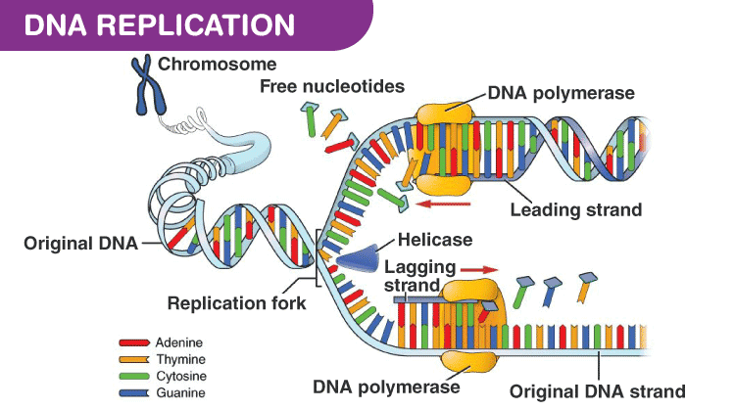
Introduction
4
Notes:
SAY: Before we wrap up the course, let’s review what we have learned today.
During this course, we have
<READ the bullets from the slide.>
GO to next slide.

Slide 5
Steps of DNA replication
Initiation
DNA replication demands a high degree of accuracy because even a minute mistake would result in mutations. Thus, replication cannot initiate randomly at any point in DNA.
For the replication to begin there is a particular region called the origin of replication. This is the point where the replication originates.
●●●
5
Notes:
SAY:
The purpose of epidemiology in public health practice is to
discover the agent, host, and environmental factors that affect health;
determine the relative importance of causes of illness, disability, and death;
identify those segments of the population that have the greatest risk from specific causes of ill health; and
evaluate the effectiveness of health programs and services in improving population health.
GO to next slide.

Slide 6
Steps of DNA replication
Elongation
As the strands are separated, the polymerase enzymes start synthesising the complementary sequence in each of the strands. The parental strands will act as a template for newly synthesising daughter strands.
It is to be noted that elongation is unidirectional i.e. DNA is always polymerised only in the 5′ to 3′ direction.
●●●
6
Notes:
SAY:
The purpose of epidemiology in public health practice is to
discover the agent, host, and environmental factors that affect health;
determine the relative importance of causes of illness, disability, and death;
identify those segments of the population that have the greatest risk from specific causes of ill health; and
evaluate the effectiveness of health programs and services in improving population health.
GO to next slide.

Slide 7
Steps of DNA replication
Termination
Termination of replication occurs in different ways in different organisms. In E.coli like organisms, chromosomes are circular.
And this happens when the two replication forks between the two terminals meet each other.
7
Notes:
SAY:
The purpose of epidemiology in public health practice is to
discover the agent, host, and environmental factors that affect health;
determine the relative importance of causes of illness, disability, and death;
identify those segments of the population that have the greatest risk from specific causes of ill health; and
evaluate the effectiveness of health programs and services in improving population health.
GO to next slide.

Slide 8
DNA Replication
8
Notes:
SAY:
The purpose of epidemiology in public health practice is to
discover the agent, host, and environmental factors that affect health;
determine the relative importance of causes of illness, disability, and death;
identify those segments of the population that have the greatest risk from specific causes of ill health; and
evaluate the effectiveness of health programs and services in improving population health.
GO to next slide.

Slide 9
Role of Enzymes
DNA replication is a highly enzyme-dependent process.
There are many enzymes involved in DNA replication, which includes the enzymes, DNA-dependent DNA polymerase, helicase, ligase, etc.
Among them, DNA-dependent DNA polymerase is the main enzyme.
●●●
9
Notes:
SAY:
The purpose of epidemiology in public health practice is to
discover the agent, host, and environmental factors that affect health;
determine the relative importance of causes of illness, disability, and death;
identify those segments of the population that have the greatest risk from specific causes of ill health; and
evaluate the effectiveness of health programs and services in improving population health.
GO to next slide.

Slide 10
Role of Enzymes
DNA-dependent DNA polymerase
It helps in the polymerisation, catalyses and regularises the whole process of DNA replication with the support of other enzymes.
Deoxyribonucleoside triphosphates are the substrate as well as the energy provider for the replication process.
●●●
10
Notes:
SAY:
The purpose of epidemiology in public health practice is to
discover the agent, host, and environmental factors that affect health;
determine the relative importance of causes of illness, disability, and death;
identify those segments of the population that have the greatest risk from specific causes of ill health; and
evaluate the effectiveness of health programs and services in improving population health.
GO to next slide.

Slide 11
Role of Enzymes
Helicase
Helicase is the enzyme, which unzips the DNA strands by breaking the hydrogen bonds between them. Thus, it helps in the formation of the replication fork.
Ligase
Ligase is the enzyme which joins together the Okazaki fragments of the discontinuous DNA strands.
●●●
11
Notes:
SAY:
The purpose of epidemiology in public health practice is to
discover the agent, host, and environmental factors that affect health;
determine the relative importance of causes of illness, disability, and death;
identify those segments of the population that have the greatest risk from specific causes of ill health; and
evaluate the effectiveness of health programs and services in improving population health.
GO to next slide.

Slide 12
Role of Enzymes
Primase
This enzyme helps in the synthesis of RNA primer complementary to the DNA template strand.
Endonucleases
These produce a single-stranded or a double-stranded cut in a DNA molecule.
Single-stranded Binding Proteins
It binds to single-stranded DNA and protects it from forming secondary structures.
12
Notes:
SAY:
The purpose of epidemiology in public health practice is to
discover the agent, host, and environmental factors that affect health;
determine the relative importance of causes of illness, disability, and death;
identify those segments of the population that have the greatest risk from specific causes of ill health; and
evaluate the effectiveness of health programs and services in improving population health.
GO to next slide.

Slide 13
DNA Replication Process
The DNA replication in prokaryotes takes place in the following place:
The two strands of DNA unwind at the origin of replication.
Helicase opens the DNA and replication forks are formed.
The DNA is coated by the single-strand binding proteins around the replication fork to prevent rewinding of DNA.
●●●
13
Notes:
SAY:
The purpose of epidemiology in public health practice is to
discover the agent, host, and environmental factors that affect health;
determine the relative importance of causes of illness, disability, and death;
identify those segments of the population that have the greatest risk from specific causes of ill health; and
evaluate the effectiveness of health programs and services in improving population health.
GO to next slide.

Slide 14
DNA Replication Process
Topoisomerase prevents the supercoiling of DNA.
RNA primers are synthesised by primase. These primers are complementary to the DNA strand.
DNA polymerase III starts adding nucleotides at the end of the primers.
The leading and lagging strands continue to elongate.
The primers are removed and the gaps are filled with DNA Polymerase I and sealed by ligase.
14
Notes:
SAY:
The purpose of epidemiology in public health practice is to
discover the agent, host, and environmental factors that affect health;
determine the relative importance of causes of illness, disability, and death;
identify those segments of the population that have the greatest risk from specific causes of ill health; and
evaluate the effectiveness of health programs and services in improving population health.
GO to next slide.

Slide 15
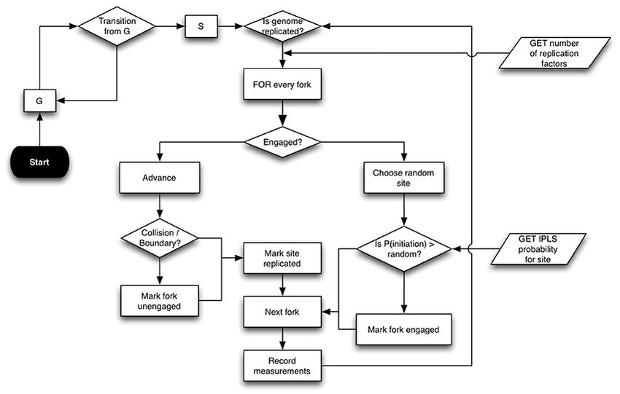
15
Notes:
SAY:
The purpose of epidemiology in public health practice is to
discover the agent, host, and environmental factors that affect health;
determine the relative importance of causes of illness, disability, and death;
identify those segments of the population that have the greatest risk from specific causes of ill health; and
evaluate the effectiveness of health programs and services in improving population health.
GO to next slide.

Slide 16
Conclusion
The result of DNA replication is two DNA molecules consisting of one new and one old chain of nucleotides.
This is why DNA replication is described as semi-conservative, half of the chain is part of the original DNA molecule, half is brand new.
16
Notes:
SAY:
The purpose of epidemiology in public health practice is to
discover the agent, host, and environmental factors that affect health;
determine the relative importance of causes of illness, disability, and death;
identify those segments of the population that have the greatest risk from specific causes of ill health; and
evaluate the effectiveness of health programs and services in improving population health.
GO to next slide.

Slide 17
References
Google.com
Wikipedia.org
Studymafia.org
Slidespanda.com

Slide 18
Thanks To StudyMafia.org

