Slide 1
StudyMafia.Org
Congenital Heart Disease
Submitted To: Submitted By:
Studymafia.org Studymafia.org

Slide 2
Table Contents
Definition
Introduction
Types of Congenital heart disease
Symptoms of Congenital heart disease
Causes of Congenital heart disease
Risk-Factors of Congenital heart disease
Complications of Congenital heart disease
Treatment of Congenital heart disease
Prevention of Congenital heart disease
Conclusion
2
Notes:
SAY: Before we wrap up the course, let’s review what we have learned today.
During this course, we have
<READ the bullets from the slide.>
GO to next slide.

Slide 3
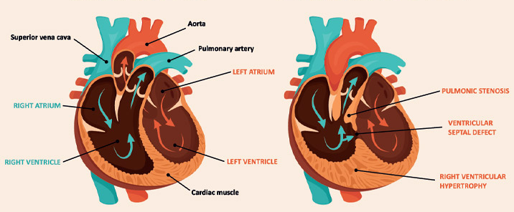
Definition
Congenital heart disease is one or more problems with the heart's structure that exist since birth. Congenital means that you're born with the condition. Congenital heart disease in adults and children can change the way blood flows through the heart.
3
Notes:
SAY: Before we wrap up the course, let’s review what we have learned today.
During this course, we have
<READ the bullets from the slide.>
GO to next slide.

Slide 4
Introduction
There are many different types of congenital heart defects.
Some types of congenital heart disease may be mild. But complex defects may cause life-threatening complications. However, advances in diagnosis and treatment continue to improve survival for those with congenital heart disease.
People with congenital heart disease need lifelong medical care. Treatment may include regular checkups (watchful waiting), medications or surgery.
4
Notes:
SAY: Before we wrap up the course, let’s review what we have learned today.
During this course, we have
<READ the bullets from the slide.>
GO to next slide.

Slide 5
Types of Congenital heart disease
Atrial septal defect (ASD)
Atrioventricular canal defect
Bicuspid aortic valve
Coarctation of the aorta
Congenital heart defects in children
Congenital mitral valve anomalies
Double-outlet right ventricle
Ebstein anomaly
Eisenmenger syndrome
●●●
5
Notes:
SAY: Before we wrap up the course, let’s review what we have learned today.
During this course, we have
<READ the bullets from the slide.>
GO to next slide.

Slide 6
Types of Congenital heart disease
Tetralogy of Fallot
Total anomalous pulmonary venous return (TAPVR)
Transposition of the great arteries
Tricuspid atresia
Truncus arteriosus
Vascular rings
Ventricular septal defect (VSD)
Wolff-Parkinson-White (WPW) syndrome
●●●
6
Notes:
SAY: Before we wrap up the course, let’s review what we have learned today.
During this course, we have
<READ the bullets from the slide.>
GO to next slide.

Slide 7
Types of Congenital heart disease
Hypoplastic left heart syndrome
Long QT syndrome
Partial anomalous pulmonary venous return
Patent ductus arteriosus (PDA)
Patent foramen ovale
Pulmonary atresia
Pulmonary atresia with intact ventricular septum
Pulmonary atresia with ventricular septal defect
Pulmonary valve stenosis
7
Notes:
SAY: Before we wrap up the course, let’s review what we have learned today.
During this course, we have
<READ the bullets from the slide.>
GO to next slide.

Slide 8
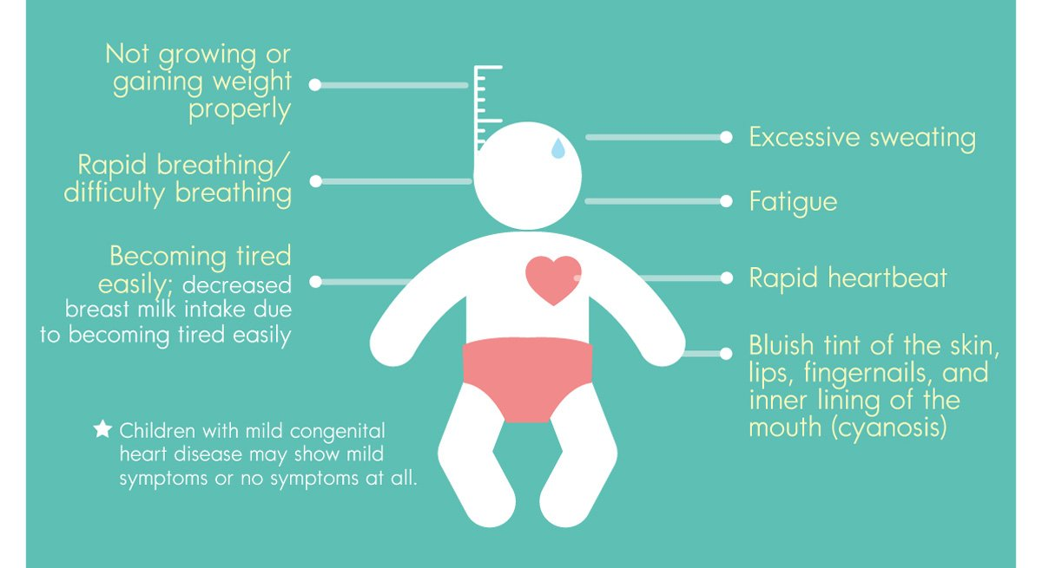
Symptoms of Congenital heart disease
8
Notes:
SAY: Before we wrap up the course, let’s review what we have learned today.
During this course, we have
<READ the bullets from the slide.>
GO to next slide.

Slide 9
Causes of Congenital heart disease
To understand congenital heart disease, it helps to know how the heart typically works.
The heart is divided into chambers — two upper chambers (atria) and two lower chambers (ventricles).
The right side of the heart moves blood to the lungs through blood vessels (pulmonary arteries).
In the lungs, blood picks up oxygen and then returns to the left side of your heart through the pulmonary veins.
The left side of the heart then pumps the blood through the aorta and out to the rest of the body.
9
Notes:
SAY:
The purpose of epidemiology in public health practice is to
discover the agent, host, and environmental factors that affect health;
determine the relative importance of causes of illness, disability, and death;
identify those segments of the population that have the greatest risk from specific causes of ill health; and
evaluate the effectiveness of health programs and services in improving population health.
GO to next slide.

Slide 10
Risk factors of Congenital heart disease
Genetics. Congenital heart disease appears to run in families (inherited). It's associated with many genetic syndromes.For instance, children with Down syndrome often have congenital heart defects.
German measles (rubella). Having rubella during pregnancy may affect how the baby's heart develops while in the womb.
Diabetes. Having type 1 or type 2 diabetes during pregnancy also may affect a baby's heart development.
●●●
10
Notes:
SAY:
The purpose of epidemiology in public health practice is to
discover the agent, host, and environmental factors that affect health;
determine the relative importance of causes of illness, disability, and death;
identify those segments of the population that have the greatest risk from specific causes of ill health; and
evaluate the effectiveness of health programs and services in improving population health.
GO to next slide.

Slide 11
Risk factors of Congenital heart disease
Medications. Taking certain medications while pregnant can cause congenital heart disease and other birth defects. Medications linked to heart defects include lithium for bipolar disorder and isotretinoin (Claravis, Myorisan, others), which is used to treat acne.
Alcohol. Drinking alcohol while pregnant has been linked to an increased risk of heart defects in the baby.
Smoking. If you smoke, quit. Smoking during pregnancy increases the risk of congenital heart defects in the baby.
11
Notes:
SAY:
The purpose of epidemiology in public health practice is to
discover the agent, host, and environmental factors that affect health;
determine the relative importance of causes of illness, disability, and death;
identify those segments of the population that have the greatest risk from specific causes of ill health; and
evaluate the effectiveness of health programs and services in improving population health.
GO to next slide.

Slide 12
Complications of Congenital heart disease
Irregular heartbeats (arrhythmias). Faulty heart signaling causes the heart to beat too fast, too slowly or irregularly.
Heart infection (endocarditis). Bacteria or other germs can enter the bloodstream and move to the inner lining of the heart (endocardium). Untreated, this infection can damage or destroy the heart valves or cause a stroke.
Stroke. A congenital heart defect can allow a blood clot to pass through the heart and travel to the brain, where it reduces or blocks blood supply.
●●●
12
Notes:
SAY:
The purpose of epidemiology in public health practice is to
discover the agent, host, and environmental factors that affect health;
determine the relative importance of causes of illness, disability, and death;
identify those segments of the population that have the greatest risk from specific causes of ill health; and
evaluate the effectiveness of health programs and services in improving population health.
GO to next slide.

Slide 13
Complications of Congenital heart disease
High blood pressure in the lung arteries (pulmonary hypertension). Some congenital heart defects send more blood to the lungs, causing pressure to build. This eventually causes the heart muscle to weaken and sometimes to fail.
Heart failure. Heart failure (congestive heart failure) means the heart can't pump enough blood to meet the body's needs.
13
Notes:
SAY:
The purpose of epidemiology in public health practice is to
discover the agent, host, and environmental factors that affect health;
determine the relative importance of causes of illness, disability, and death;
identify those segments of the population that have the greatest risk from specific causes of ill health; and
evaluate the effectiveness of health programs and services in improving population health.
GO to next slide.

Slide 14
Treatment of Congenital heart disease
mplantable heart devices. A device that helps control the heart rate (pacemaker) or that corrects life-threatening irregular heartbeats (implantable cardioverter-defibrillator or ICD) may help improve some of the complications associated with congenital heart disease in adults.
Catheter-based treatments. Some types of congenital heart disease in adults can be repaired using thin, flexible tubes called catheters. Such treatments allow a repair to be done without open-heart surgery.
●●●
14
Notes:
SAY:
The purpose of epidemiology in public health practice is to
discover the agent, host, and environmental factors that affect health;
determine the relative importance of causes of illness, disability, and death;
identify those segments of the population that have the greatest risk from specific causes of ill health; and
evaluate the effectiveness of health programs and services in improving population health.
GO to next slide.

Slide 15
Treatment of Congenital heart disease
Open-heart surgery. If catheter procedures can't fix a congenital heart defect, open-heart surgery may be needed.
Heart transplant. If a serious heart defect can't be repaired, a heart transplant might be an option.
Follow-up care may include regular health checkups and occasional bloodwork and imaging exams to screen for complications.
How often you'll need to see your health care provider will depend on whether your congenital heart disease is mild or complex.
15
Notes:
SAY:
The purpose of epidemiology in public health practice is to
discover the agent, host, and environmental factors that affect health;
determine the relative importance of causes of illness, disability, and death;
identify those segments of the population that have the greatest risk from specific causes of ill health; and
evaluate the effectiveness of health programs and services in improving population health.
GO to next slide.

Slide 16
Prevention of Congenital heart disease
Some types of congenital heart disease occur in families (inherited).
If you have or someone in your family has congenital heart disease, screening by a genetic counselor may help determine the risk of certain heart defects in future children.
16
Notes:
SAY:
The purpose of epidemiology in public health practice is to
discover the agent, host, and environmental factors that affect health;
determine the relative importance of causes of illness, disability, and death;
identify those segments of the population that have the greatest risk from specific causes of ill health; and
evaluate the effectiveness of health programs and services in improving population health.
GO to next slide.

Slide 17
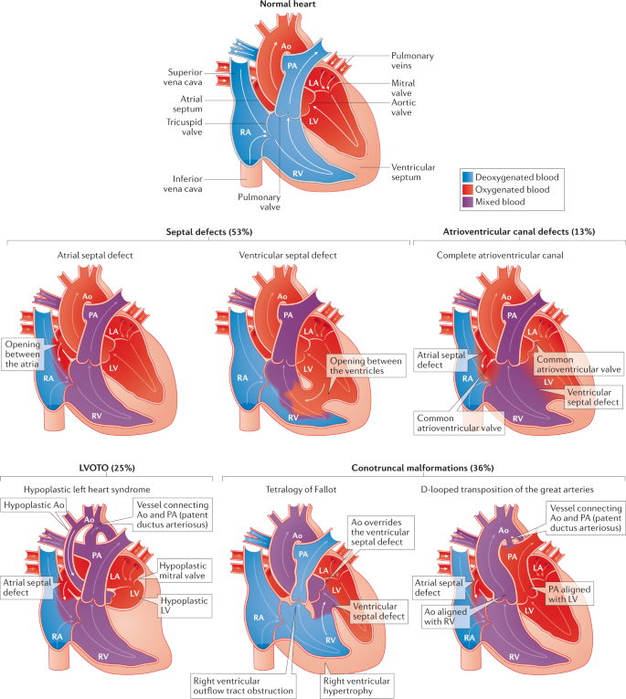

Slide 18
Conclusion
Congenital Heart Defects are very common in our setup and early detection of CHD is increasing.
Overall burden of CHD is also increasing therefore a proper population based study on a large scale is needed to estimate the prevalence accurately.
18
Notes:
SAY:
The purpose of epidemiology in public health practice is to
discover the agent, host, and environmental factors that affect health;
determine the relative importance of causes of illness, disability, and death;
identify those segments of the population that have the greatest risk from specific causes of ill health; and
evaluate the effectiveness of health programs and services in improving population health.
GO to next slide.

Slide 19
References
Google.com
Wikipedia.org
Studymafia.org
Slidespanda.com

Slide 20
Thanks To StudyMafia.org

