Slide 1
StudyMafia.Org
Chemical Reactions
Submitted To: Submitted By:
Studymafia.org Studymafia.org

Slide 2
Table Contents
Definition
Introduction
Concepts of Chemical Reactions
Types of Chemical Reactions
Points To remember
Conclusion
2
Notes:
SAY: Before we wrap up the course, let’s review what we have learned today.
During this course, we have
<READ the bullets from the slide.>
GO to next slide.

Slide 3
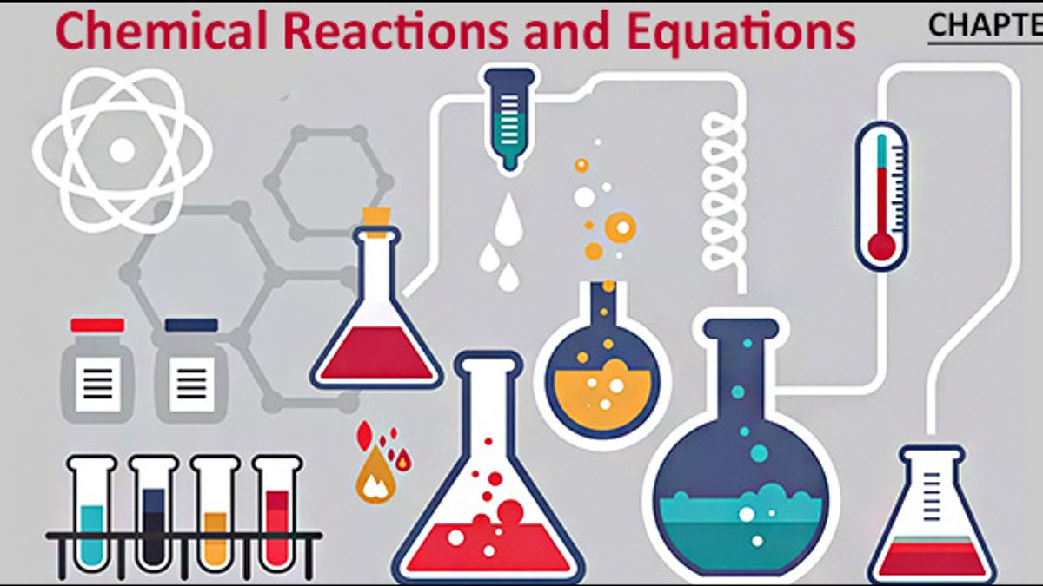
Definition
A chemical reaction is in which the bonds are broken within reactant molecules, and new bonds are formed within product molecules in order to form a new substance.
3
Notes:
SAY: Before we wrap up the course, let’s review what we have learned today.
During this course, we have
<READ the bullets from the slide.>
GO to next slide.

Slide 4
Introduction
A burning candle is the best example of physical and chemical change. Take a candle and light it. As time passes, we can observe that the candle changes to wax. If you cover the candle with a jar, it will extinguish.
In a physical change, there is basically a change of state of the substance but in the case of a chemical change mostly a new substance is formed in which either energy is given off or absorbed.
4
Notes:
SAY: Before we wrap up the course, let’s review what we have learned today.
During this course, we have
<READ the bullets from the slide.>
GO to next slide.

Slide 5
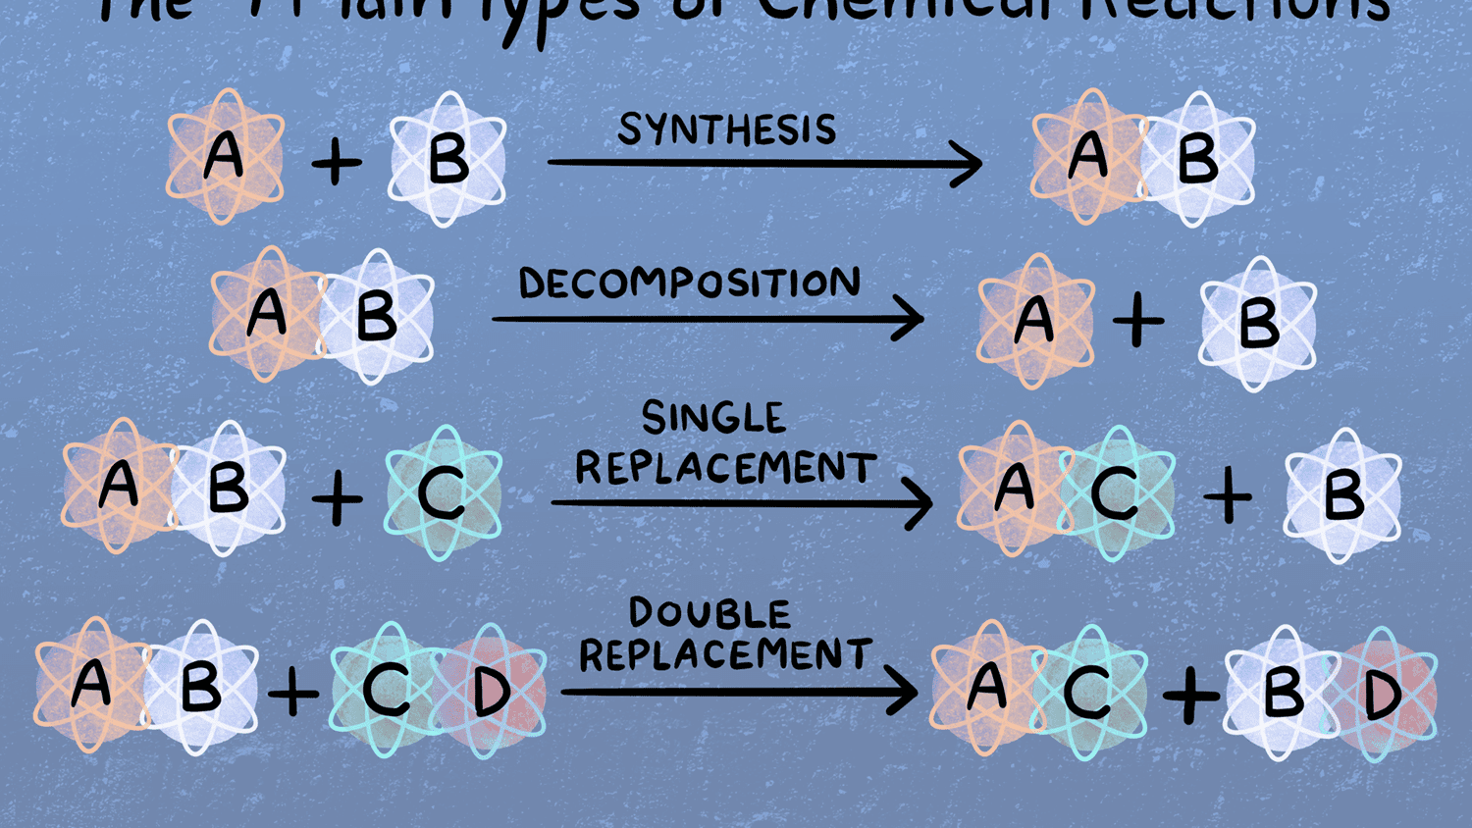
5
Notes:
SAY: Before we wrap up the course, let’s review what we have learned today.
During this course, we have
<READ the bullets from the slide.>
GO to next slide.

Slide 6
Concepts of Chemical Reactions
A Chemical Reaction is a process that occurs when two or more molecules interact to form a new product(s).
Compounds that interact to produce new compounds are called reactants whereas the newly formed compounds are called products.
●●●
6
Notes:
SAY:
The purpose of epidemiology in public health practice is to
discover the agent, host, and environmental factors that affect health;
determine the relative importance of causes of illness, disability, and death;
identify those segments of the population that have the greatest risk from specific causes of ill health; and
evaluate the effectiveness of health programs and services in improving population health.
GO to next slide.

Slide 7
Concepts of Chemical Reactions
Chemical reactions play an integral role in different industries, customs and even in our daily life. They are continuously happening in our general surroundings; for example, rusting of iron, pottery, fermentation of wine and so on.
In a chemical reaction, a chemical change must occur which is generally observed with physical changes like precipitation, heat production, colour change etc.
●●●
7
Notes:
SAY:
The purpose of epidemiology in public health practice is to
discover the agent, host, and environmental factors that affect health;
determine the relative importance of causes of illness, disability, and death;
identify those segments of the population that have the greatest risk from specific causes of ill health; and
evaluate the effectiveness of health programs and services in improving population health.
GO to next slide.

Slide 8
Concepts of Chemical Reactions
A reaction can take place between two atoms or ions or molecules, and they form a new bond and no atom is destroyed or created but a new product is formed from reactants.
The rate of reaction depends on and is affected by factors like pressure, temperature, the concentration of reactants.
8
Notes:
SAY:
The purpose of epidemiology in public health practice is to
discover the agent, host, and environmental factors that affect health;
determine the relative importance of causes of illness, disability, and death;
identify those segments of the population that have the greatest risk from specific causes of ill health; and
evaluate the effectiveness of health programs and services in improving population health.
GO to next slide.

Slide 9
Types of Chemical Reactions
Combustion Reaction
A combustion reaction is a reaction with a combustible material with an oxidizer to give an oxidized product. An oxidizer is a chemical a fuel requires to burn, generally oxygen. Consider the example of combustion of magnesium metal.
●●●
9
Notes:
SAY:
The purpose of epidemiology in public health practice is to
discover the agent, host, and environmental factors that affect health;
determine the relative importance of causes of illness, disability, and death;
identify those segments of the population that have the greatest risk from specific causes of ill health; and
evaluate the effectiveness of health programs and services in improving population health.
GO to next slide.

Slide 10
Types of Chemical Reactions
Decomposition Reaction
A Decomposition reaction is a reaction in which a single component breaks down into multiple products. Certain changes in energy in the environment have to be made like heat, light or electricity breaking bonds of the compound.
●●●
10
Notes:
SAY:
The purpose of epidemiology in public health practice is to
discover the agent, host, and environmental factors that affect health;
determine the relative importance of causes of illness, disability, and death;
identify those segments of the population that have the greatest risk from specific causes of ill health; and
evaluate the effectiveness of health programs and services in improving population health.
GO to next slide.

Slide 11
Types of Chemical Reactions
Neutralization Reaction
A Neutralization reaction is basically the reaction between an acid and a base giving salt and water as the products. The water molecule formed is by the combination of OH– ions and H+ ions. The overall pH of the products when a strong acid and a strong base undergo a neutralization reaction will be 7
●●●
11
Notes:
SAY:
The purpose of epidemiology in public health practice is to
discover the agent, host, and environmental factors that affect health;
determine the relative importance of causes of illness, disability, and death;
identify those segments of the population that have the greatest risk from specific causes of ill health; and
evaluate the effectiveness of health programs and services in improving population health.
GO to next slide.

Slide 12
Types of Chemical Reactions
Redox Reaction
A REDuction-OXidation reaction is a reaction in which there is a transfer of electrons between chemical species. Let us consider the example of an electrochemical cell-like redox reaction between Zinc and Hydrogen.
●●●
12
Notes:
SAY:
The purpose of epidemiology in public health practice is to
discover the agent, host, and environmental factors that affect health;
determine the relative importance of causes of illness, disability, and death;
identify those segments of the population that have the greatest risk from specific causes of ill health; and
evaluate the effectiveness of health programs and services in improving population health.
GO to next slide.

Slide 13
Types of Chemical Reactions
Precipitation or Double-Displacement Reaction
It is a type of displacement reaction in which two compounds react and consequently, their anions and cations switch places forming two new products. Consider the example of the reaction between silver nitrate and sodium chloride.
●●●
13
Notes:
SAY:
The purpose of epidemiology in public health practice is to
discover the agent, host, and environmental factors that affect health;
determine the relative importance of causes of illness, disability, and death;
identify those segments of the population that have the greatest risk from specific causes of ill health; and
evaluate the effectiveness of health programs and services in improving population health.
GO to next slide.

Slide 14
Types of Chemical Reactions
Synthesis Reaction
A Synthesis reaction is one of the most basic types of reaction wherein multiple simple compounds combine under certain physical conditions giving out a complex product. The product will always be a compound.
14
Notes:
SAY:
The purpose of epidemiology in public health practice is to
discover the agent, host, and environmental factors that affect health;
determine the relative importance of causes of illness, disability, and death;
identify those segments of the population that have the greatest risk from specific causes of ill health; and
evaluate the effectiveness of health programs and services in improving population health.
GO to next slide.

Slide 15
Points to Remember
In a chemical change, a new compound is formed but in a physical change, the substance changes its state of existence.
Atoms or ions or molecules which react to form a new substance are called reactants; the new atoms or molecules formed are products.
●●●
15
Notes:
SAY:
The purpose of epidemiology in public health practice is to
discover the agent, host, and environmental factors that affect health;
determine the relative importance of causes of illness, disability, and death;
identify those segments of the population that have the greatest risk from specific causes of ill health; and
evaluate the effectiveness of health programs and services in improving population health.
GO to next slide.

Slide 16
Points to Remember
A chemical reaction follows the law of conservation of mass. That is no atom is destroyed or created but only a new product is formed from reactants.
16
Notes:
SAY:
The purpose of epidemiology in public health practice is to
discover the agent, host, and environmental factors that affect health;
determine the relative importance of causes of illness, disability, and death;
identify those segments of the population that have the greatest risk from specific causes of ill health; and
evaluate the effectiveness of health programs and services in improving population health.
GO to next slide.

Slide 18
Conclusion
A chemical reaction is in which the bonds are broken within reactant molecules, and new bonds are formed within product molecules in order to form a new substance.
A chemical equation is nothing but a mathematical statement which symbolizes the product formation from reactants.
18
Notes:
SAY:
The purpose of epidemiology in public health practice is to
discover the agent, host, and environmental factors that affect health;
determine the relative importance of causes of illness, disability, and death;
identify those segments of the population that have the greatest risk from specific causes of ill health; and
evaluate the effectiveness of health programs and services in improving population health.
GO to next slide.

Slide 19
References
Google.com
Wikipedia.org
Studymafia.org
Slidespanda.com

Slide 20
Thanks To StudyMafia.org

