Slide 1
StudyMafia.Org
Cervical Cancer
Submitted To: Submitted By:
Studymafia.org Studymafia.org

Slide 2
Table Contents
Definition
Introduction
Symptoms of Cervical cancer
Causes of Cervical cancer
Types of Cervical cancer
Risk-Factors of Cervical cancer
Prevention of Cervical cancer
Diagnosis of Cervical cancer
Treatment of Cervical cancer
Conclusion
2
Notes:
SAY: Before we wrap up the course, let’s review what we have learned today.
During this course, we have
<READ the bullets from the slide.>
GO to next slide.

Slide 3
Definition
Cervical cancer is a type of cancer that occurs in the cells of the cervix — the lower part of the uterus that connects to the vagina.
3
Notes:
SAY: Before we wrap up the course, let’s review what we have learned today.
During this course, we have
<READ the bullets from the slide.>
GO to next slide.

Slide 4
Introduction
When exposed to HPV, the body's immune system typically prevents the virus from doing harm. In a small percentage of people, however, the virus survives for years, contributing to the process that causes some cervical cells to become cancer cells.
You can reduce your risk of developing cervical cancer by having screening tests and receiving a vaccine that protects against HPV infection.
4
Notes:
SAY: Before we wrap up the course, let’s review what we have learned today.
During this course, we have
<READ the bullets from the slide.>
GO to next slide.

Slide 5
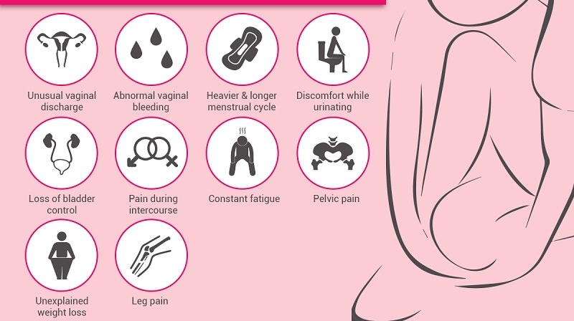
Symptoms of Cervical cancer
5
Notes:
SAY: Before we wrap up the course, let’s review what we have learned today.
During this course, we have
<READ the bullets from the slide.>
GO to next slide.

Slide 6
Causes of Cervical cancer
Cervical cancer begins when healthy cells in the cervix develop changes (mutations) in their DNA. A cell's DNA contains the instructions that tell a cell what to do.
Healthy cells grow and multiply at a set rate, eventually dying at a set time. The mutations tell the cells to grow and multiply out of control, and they don't die.
●●●
6
Notes:
SAY:
The purpose of epidemiology in public health practice is to
discover the agent, host, and environmental factors that affect health;
determine the relative importance of causes of illness, disability, and death;
identify those segments of the population that have the greatest risk from specific causes of ill health; and
evaluate the effectiveness of health programs and services in improving population health.
GO to next slide.

Slide 7
Causes of Cervical cancer
The accumulating abnormal cells form a mass (tumor). Cancer cells invade nearby tissues and can break off from a tumor to spread (metastasize) elsewhere in the body.
It isn't clear what causes cervical cancer, but it's certain that HPV plays a role. HPV is very common, and most people with the virus never develop cancer.
7
Notes:
SAY:
The purpose of epidemiology in public health practice is to
discover the agent, host, and environmental factors that affect health;
determine the relative importance of causes of illness, disability, and death;
identify those segments of the population that have the greatest risk from specific causes of ill health; and
evaluate the effectiveness of health programs and services in improving population health.
GO to next slide.

Slide 8
Types of Cervical cancer
Squamous cell carcinoma. This type of cervical cancer begins in the thin, flat cells (squamous cells) lining the outer part of the cervix, which projects into the vagina. Most cervical cancers are squamous cell carcinomas.
Adenocarcinoma. This type of cervical cancer begins in the column-shaped glandular cells that line the cervical canal.
8
Notes:
SAY:
The purpose of epidemiology in public health practice is to
discover the agent, host, and environmental factors that affect health;
determine the relative importance of causes of illness, disability, and death;
identify those segments of the population that have the greatest risk from specific causes of ill health; and
evaluate the effectiveness of health programs and services in improving population health.
GO to next slide.

Slide 9
Risk factors of Cervical cancer
Many sexual partners. The greater your number of sexual partners — and the greater your partner's number of sexual partners — the greater your chance of acquiring HPV.
Early sexual activity. Having sex at an early age increases your risk of HPV.
●●●
9
Notes:
SAY:
The purpose of epidemiology in public health practice is to
discover the agent, host, and environmental factors that affect health;
determine the relative importance of causes of illness, disability, and death;
identify those segments of the population that have the greatest risk from specific causes of ill health; and
evaluate the effectiveness of health programs and services in improving population health.
GO to next slide.

Slide 10
Risk factors of Cervical cancer
Other sexually transmitted infections (STIs). Having other STIs — such as chlamydia, gonorrhea, syphilis and HIV/AIDS — increases your risk of HPV.
A weakened immune system. Your immune system is weakened by another health condition and you have HPV.
Smoking. Smoking is associated with squamous cell cervical cancer.
10
Notes:
SAY:
The purpose of epidemiology in public health practice is to
discover the agent, host, and environmental factors that affect health;
determine the relative importance of causes of illness, disability, and death;
identify those segments of the population that have the greatest risk from specific causes of ill health; and
evaluate the effectiveness of health programs and services in improving population health.
GO to next slide.

Slide 11
Prevention of Cervical cancer
Ask your doctor about the HPV vaccine. Receiving a vaccination to prevent HPV infection may reduce your risk of cervical cancer and other HPV-related cancers. Ask your doctor whether an HPV vaccine is appropriate for you.
Have routine Pap tests. Pap tests can detect precancerous conditions of the cervix, so they can be monitored or treated in order to prevent cervical cancer.
●●●
11
Notes:
SAY:
The purpose of epidemiology in public health practice is to
discover the agent, host, and environmental factors that affect health;
determine the relative importance of causes of illness, disability, and death;
identify those segments of the population that have the greatest risk from specific causes of ill health; and
evaluate the effectiveness of health programs and services in improving population health.
GO to next slide.

Slide 12
Prevention of Cervical cancer
Practice safe sex. Reduce your risk of cervical cancer by taking measures to prevent sexually transmitted infections, such as using a condom every time you have sex and limiting the number of sexual partners you have.
Don't smoke. If you don't smoke, don't start. If you do smoke, talk to your doctor about strategies to help you quit.
12
Notes:
SAY:
The purpose of epidemiology in public health practice is to
discover the agent, host, and environmental factors that affect health;
determine the relative importance of causes of illness, disability, and death;
identify those segments of the population that have the greatest risk from specific causes of ill health; and
evaluate the effectiveness of health programs and services in improving population health.
GO to next slide.

Slide 13
Diagnosis of Cervical cancer
Screening tests can help detect cervical cancer and precancerous cells that may one day develop into cervical cancer. Most guidelines suggest beginning screening for cervical cancer and precancerous changes at age 21.
If cervical cancer is suspected, your doctor is likely to start with a thorough examination of your cervix. A special magnifying instrument (colposcope) is used to check for abnormal cells.
13
Notes:
SAY:
The purpose of epidemiology in public health practice is to
discover the agent, host, and environmental factors that affect health;
determine the relative importance of causes of illness, disability, and death;
identify those segments of the population that have the greatest risk from specific causes of ill health; and
evaluate the effectiveness of health programs and services in improving population health.
GO to next slide.

Slide 14
Treatment of Cervical cancer
Surgery
Early-stage cervical cancer is typically treated with surgery. Which operation is best for you will depend on the size of your cancer, its stage and whether you would like to consider becoming pregnant in the future.
Radiation
Radiation therapy uses high-powered energy beams, such as X-rays or protons, to kill cancer cells. Radiation therapy is often combined with chemotherapy as the primary treatment for locally advanced cervical cancers.
●●●
14
Notes:
SAY:
The purpose of epidemiology in public health practice is to
discover the agent, host, and environmental factors that affect health;
determine the relative importance of causes of illness, disability, and death;
identify those segments of the population that have the greatest risk from specific causes of ill health; and
evaluate the effectiveness of health programs and services in improving population health.
GO to next slide.

Slide 15
Treatment of Cervical cancer
Chemotherapy
Chemotherapy is a drug treatment that uses chemicals to kill cancer cells. It can be given through a vein or taken in pill form. Sometimes both methods are used.
Supportive (palliative) care
Palliative care is specialized medical care that focuses on providing relief from pain and other symptoms of a serious illness.
15
Notes:
SAY:
The purpose of epidemiology in public health practice is to
discover the agent, host, and environmental factors that affect health;
determine the relative importance of causes of illness, disability, and death;
identify those segments of the population that have the greatest risk from specific causes of ill health; and
evaluate the effectiveness of health programs and services in improving population health.
GO to next slide.

Slide 16
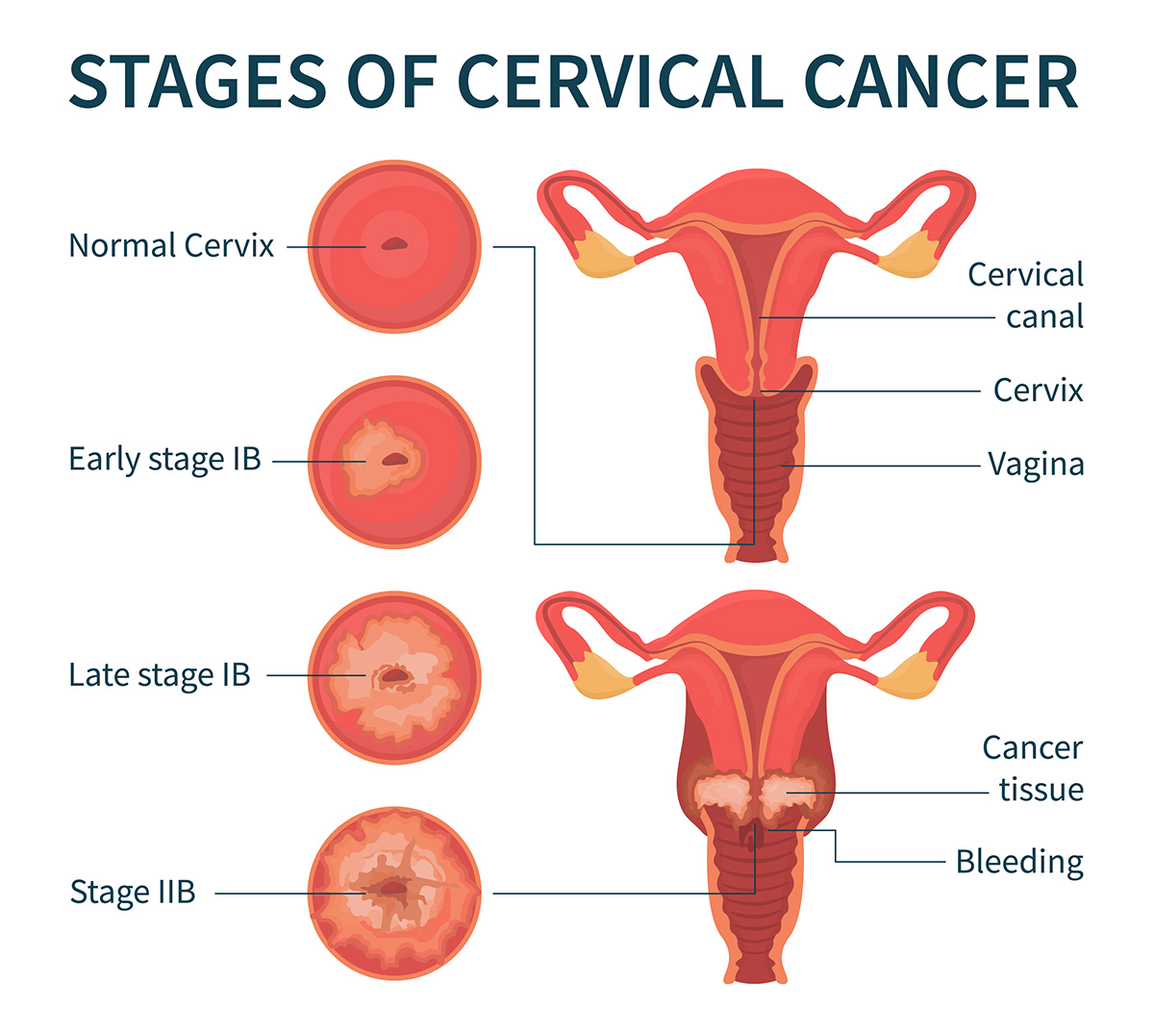

Slide 17
Conclusion
The overall knowledge of participants towards cervical cancer and its prevention was inadequate. The majority, > 80% of the participants lack knowledge that HPV is a causative agent of cervical cancer.
This is extremely worrying as the most important way to prevent cervical cancer is blocking HPV infection.
17
Notes:
SAY:
The purpose of epidemiology in public health practice is to
discover the agent, host, and environmental factors that affect health;
determine the relative importance of causes of illness, disability, and death;
identify those segments of the population that have the greatest risk from specific causes of ill health; and
evaluate the effectiveness of health programs and services in improving population health.
GO to next slide.

Slide 18
References
Google.com
Wikipedia.org
Studymafia.org
Slidespanda.com

Slide 19
Thanks To StudyMafia.org

