Slide 1
StudyMafia.Org
Cerbral Palsy
Submitted To: Submitted By:
Studymafia.org Studymafia.org

Slide 2
Table Contents
Definition
Introduction
Symptoms of Cerebral palsy
Causes of Cerebral palsy
Risk-Factors of Cerebral palsy
Complications of Cerebral palsy
Prevention of Cerebral palsy
Treatment of Cerebral palsy
Conclusion
2
Notes:
SAY: Before we wrap up the course, let’s review what we have learned today.
During this course, we have
<READ the bullets from the slide.>
GO to next slide.

Slide 3
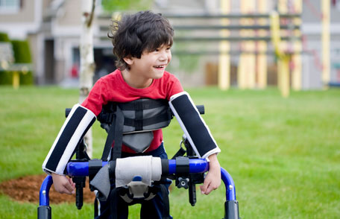
Definition
Cerebral palsy is a group of disorders that affect movement and muscle tone or posture. It's caused by damage that occurs to the immature, developing brain, most often before birth.
3
Notes:
SAY: Before we wrap up the course, let’s review what we have learned today.
During this course, we have
<READ the bullets from the slide.>
GO to next slide.

Slide 4
Introduction
People with cerebral palsy can have problems swallowing and commonly have eye muscle imbalance, in which the eyes don't focus on the same object. They also might have reduced range of motion at various joints of their bodies due to muscle stiffness.
The cause of cerebral palsy and its effect on function vary greatly. Some people with cerebral palsy can walk; others need assistance. Some people have intellectual disabilities, but others do not.
4
Notes:
SAY: Before we wrap up the course, let’s review what we have learned today.
During this course, we have
<READ the bullets from the slide.>
GO to next slide.

Slide 5
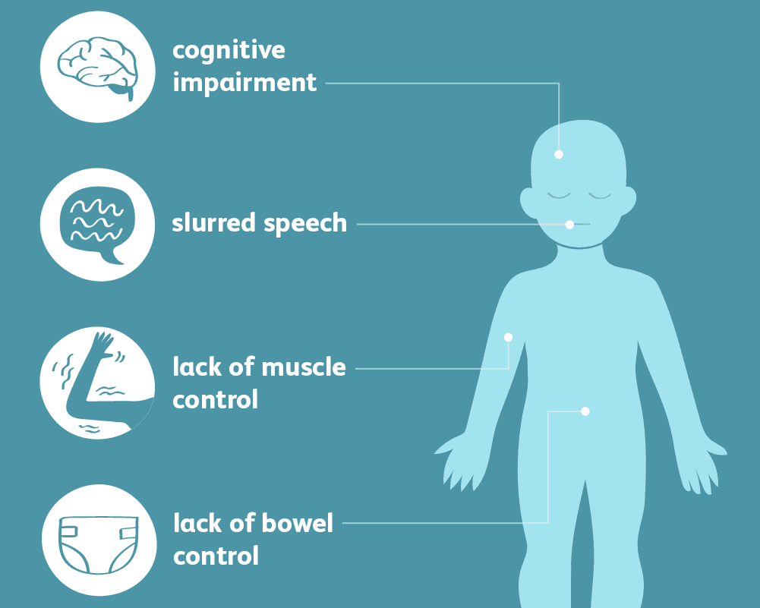
Symptoms of Cerebral palsy
5
Notes:
SAY: Before we wrap up the course, let’s review what we have learned today.
During this course, we have
<READ the bullets from the slide.>
GO to next slide.

Slide 6
Causes of Cerebral palsy
Gene mutations that result in genetic disorders or differences in brain development
Maternal infections that affect the developing fetus
Fetal stroke, a disruption of blood supply to the developing brain
Bleeding into the brain in the womb or as a newborn
●●●
6
Notes:
SAY:
The purpose of epidemiology in public health practice is to
discover the agent, host, and environmental factors that affect health;
determine the relative importance of causes of illness, disability, and death;
identify those segments of the population that have the greatest risk from specific causes of ill health; and
evaluate the effectiveness of health programs and services in improving population health.
GO to next slide.

Slide 7
Causes of Cerebral palsy
Infant infections that cause inflammation in or around the brain
Traumatic head injury to an infant, such as from a motor vehicle accident, fall or physical abuse
Lack of oxygen to the brain related to difficult labor or delivery, although birth-related asphyxia is much less commonly a cause than historically thought
7
Notes:
SAY:
The purpose of epidemiology in public health practice is to
discover the agent, host, and environmental factors that affect health;
determine the relative importance of causes of illness, disability, and death;
identify those segments of the population that have the greatest risk from specific causes of ill health; and
evaluate the effectiveness of health programs and services in improving population health.
GO to next slide.

Slide 8
Risk factors of Cerebral palsy
Maternal health
Cytomegalovirus. This common virus causes flu-like symptoms and can lead to birth defects if a mother has her first active infection during pregnancy.
German measles (rubella). This viral infection can be prevented with a vaccine.
Herpes. This infection can be passed from mother to child during pregnancy, affecting the womb and placenta.
●●●
8
Notes:
SAY:
The purpose of epidemiology in public health practice is to
discover the agent, host, and environmental factors that affect health;
determine the relative importance of causes of illness, disability, and death;
identify those segments of the population that have the greatest risk from specific causes of ill health; and
evaluate the effectiveness of health programs and services in improving population health.
GO to next slide.

Slide 9
Risk factors of Cerebral palsy
Maternal health
Syphilis. This is a sexually transmitted bacterial infection.
Toxoplasmosis. This infection is caused by a parasite found in contaminated food, soil and the feces of infected cats.
Zika virus infection. This infection is spread through mosquito bites and can affect fetal brain development.
●●●
9
Notes:
SAY:
The purpose of epidemiology in public health practice is to
discover the agent, host, and environmental factors that affect health;
determine the relative importance of causes of illness, disability, and death;
identify those segments of the population that have the greatest risk from specific causes of ill health; and
evaluate the effectiveness of health programs and services in improving population health.
GO to next slide.

Slide 10
Risk factors of Cerebral palsy
Maternal health
Intrauterine infections. This includes infections of the placenta or fetal membranes.
Exposure to toxins. One example is exposure to methyl mercury.
Other conditions. Other conditions affecting the mother that can slightly increase the risk.
●●●
10
Notes:
SAY:
The purpose of epidemiology in public health practice is to
discover the agent, host, and environmental factors that affect health;
determine the relative importance of causes of illness, disability, and death;
identify those segments of the population that have the greatest risk from specific causes of ill health; and
evaluate the effectiveness of health programs and services in improving population health.
GO to next slide.

Slide 11
Risk factors of Cerebral palsy
Infant illness
Bacterial meningitis. This bacterial infection causes inflammation in the membranes surrounding the brain and spinal cord.
Viral encephalitis. This viral infection similarly causes inflammation in the membranes surrounding the brain and spinal cord.
11
Notes:
SAY:
The purpose of epidemiology in public health practice is to
discover the agent, host, and environmental factors that affect health;
determine the relative importance of causes of illness, disability, and death;
identify those segments of the population that have the greatest risk from specific causes of ill health; and
evaluate the effectiveness of health programs and services in improving population health.
GO to next slide.

Slide 12
Complications of Cerebral palsy
Contracture:
Contracture is muscle tissue shortening due to severe muscle tightening that can be the result of spasticity. Contracture can inhibit bone growth, cause bones to bend, and result in joint deformities, dislocation or partial dislocation.
These can include hip dislocation, curvature of the spine (scoliosis) and other orthopedic deformities.
●●●
12
Notes:
SAY:
The purpose of epidemiology in public health practice is to
discover the agent, host, and environmental factors that affect health;
determine the relative importance of causes of illness, disability, and death;
identify those segments of the population that have the greatest risk from specific causes of ill health; and
evaluate the effectiveness of health programs and services in improving population health.
GO to next slide.

Slide 13
Complications of Cerebral palsy
Malnutrition. Swallowing or feeding problems can make it difficult for someone who has cerebral palsy, particularly an infant, to get enough nutrition.
Mental health conditions. People with cerebral palsy might have mental health conditions, such as depression. Social isolation and the challenges of coping with disabilities can contribute to depression. Behavioral problems can also occur.
●●●
13
Notes:
SAY:
The purpose of epidemiology in public health practice is to
discover the agent, host, and environmental factors that affect health;
determine the relative importance of causes of illness, disability, and death;
identify those segments of the population that have the greatest risk from specific causes of ill health; and
evaluate the effectiveness of health programs and services in improving population health.
GO to next slide.

Slide 14
Complications of Cerebral palsy
Heart and lung disease. People with cerebral palsy may develop heart disease, lung disease and breathing disorders. Problems with swallowing can result in respiratory problems, such as aspiration pneumonia.
Osteoarthritis. Pressure on joints or abnormal alignment of joints from muscle spasticity may lead to the early onset of this painful degenerative bone disease.
●●●
14
Notes:
SAY:
The purpose of epidemiology in public health practice is to
discover the agent, host, and environmental factors that affect health;
determine the relative importance of causes of illness, disability, and death;
identify those segments of the population that have the greatest risk from specific causes of ill health; and
evaluate the effectiveness of health programs and services in improving population health.
GO to next slide.

Slide 15
Complications of Cerebral palsy
Osteoporosis. Fractures due to low bone density can result from several factors such as lack of mobility, inadequate nutrition and anti-epileptic drug use.
Other complications. These can include sleep disorders, chronic pain, skin breakdown, intestinal problems and issues with oral health.
15
Notes:
SAY:
The purpose of epidemiology in public health practice is to
discover the agent, host, and environmental factors that affect health;
determine the relative importance of causes of illness, disability, and death;
identify those segments of the population that have the greatest risk from specific causes of ill health; and
evaluate the effectiveness of health programs and services in improving population health.
GO to next slide.

Slide 16
Prevention of Cerebral palsy
Make sure you're vaccinated. Getting vaccinated against diseases such as rubella, preferably before getting pregnant, might prevent an infection that could cause fetal brain damage.
Take care of yourself. The healthier you are heading into a pregnancy, the less likely you'll be to develop an infection that results in cerebral palsy.
●●●
16
Notes:
SAY:
The purpose of epidemiology in public health practice is to
discover the agent, host, and environmental factors that affect health;
determine the relative importance of causes of illness, disability, and death;
identify those segments of the population that have the greatest risk from specific causes of ill health; and
evaluate the effectiveness of health programs and services in improving population health.
GO to next slide.

Slide 17
Prevention of Cerebral palsy
Seek early and continuous prenatal care. Regular visits to your doctor during your pregnancy are a good way to reduce health risks to you and your unborn baby.
Avoid alcohol, tobacco and illegal drugs. These have been linked to cerebral palsy risk.
17
Notes:
SAY:
The purpose of epidemiology in public health practice is to
discover the agent, host, and environmental factors that affect health;
determine the relative importance of causes of illness, disability, and death;
identify those segments of the population that have the greatest risk from specific causes of ill health; and
evaluate the effectiveness of health programs and services in improving population health.
GO to next slide.

Slide 18
Treatment of Cerebral palsy
Muscle or nerve injections. To treat tightening of a specific muscle, your doctor might recommend injections of onabotulinumtoxinA (Botox), or another agent. The injections will need to be repeated about every three months.
Oral muscle relaxants. Drugs such as baclofen, tizanidine (Zanaflex), diazepam (Valium) or dantrolene (Dantrium) are often used to relax muscles.
●●●
18
Notes:
SAY:
The purpose of epidemiology in public health practice is to
discover the agent, host, and environmental factors that affect health;
determine the relative importance of causes of illness, disability, and death;
identify those segments of the population that have the greatest risk from specific causes of ill health; and
evaluate the effectiveness of health programs and services in improving population health.
GO to next slide.

Slide 19
Treatment of Cerebral palsy
Physical therapy. Muscle training and exercises can help your child's strength, flexibility, balance, motor development and mobility.
Occupational therapy. Occupational therapists work to help your child gain independence in daily activities and routines at home and school and in the community.
19
Notes:
SAY:
The purpose of epidemiology in public health practice is to
discover the agent, host, and environmental factors that affect health;
determine the relative importance of causes of illness, disability, and death;
identify those segments of the population that have the greatest risk from specific causes of ill health; and
evaluate the effectiveness of health programs and services in improving population health.
GO to next slide.

Slide 20
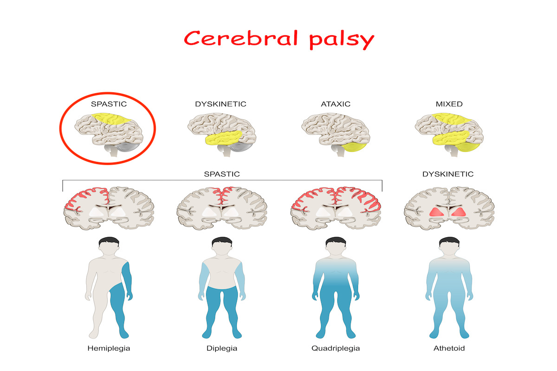

Slide 21
Conclusion
Most children with cerebral palsy are healthy, and can expect a normal life span. A small group of children with extremely severe cerebral palsy and associated conditions such as epilepsy may be at risk of reduced life expectancy (for example, they may develop recurrent chest infections or have prolonged seizures).
21
Notes:
SAY:
The purpose of epidemiology in public health practice is to
discover the agent, host, and environmental factors that affect health;
determine the relative importance of causes of illness, disability, and death;
identify those segments of the population that have the greatest risk from specific causes of ill health; and
evaluate the effectiveness of health programs and services in improving population health.
GO to next slide.

Slide 22
References
Google.com
Wikipedia.org
Studymafia.org
Slidespanda.com

Slide 23
Thanks To StudyMafia.org

