Slide 1
StudyMafia.Org
Bronchial Asthma
Submitted To: Submitted By:
Studymafia.org Studymafia.org

Slide 2
Table Contents
Definition
Introduction
Symptoms of Bronchial Asthma
Causes of Bronchial Asthma
Risk-Factors of Bronchial Asthma
Complications of Bronchial Asthma
Prevention of Bronchial Asthma
Diagnosis of Bronchial Asthma
Classification of Bronchial Asthma
Conclusion
2
Notes:
SAY: Before we wrap up the course, let’s review what we have learned today.
During this course, we have
<READ the bullets from the slide.>
GO to next slide.

Slide 3
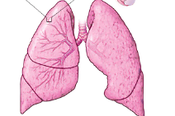
Definition
Bronchial asthma (or asthma) is a lung disease. Your airways get narrow and swollen and are blocked by excess mucus.
3
Notes:
SAY: Before we wrap up the course, let’s review what we have learned today.
During this course, we have
<READ the bullets from the slide.>
GO to next slide.

Slide 4
Introduction
Asthma is a condition in which your airways narrow and swell and may produce extra mucus. This can make breathing difficult and trigger coughing, a whistling sound (wheezing) when you breathe out and shortness of breath.
For some people, asthma is a minor nuisance. For others, it can be a major problem that interferes with daily activities and may lead to a life-threatening asthma attack.
4
Notes:
SAY: Before we wrap up the course, let’s review what we have learned today.
During this course, we have
<READ the bullets from the slide.>
GO to next slide.

Slide 5
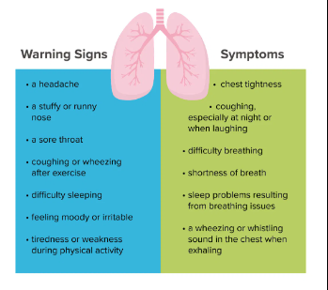
Symptoms of Bronchial Asthma
5
Notes:
SAY: Before we wrap up the course, let’s review what we have learned today.
During this course, we have
<READ the bullets from the slide.>
GO to next slide.

Slide 6
Causes of Bronchial Asthma
Asthma triggers are different from person to person and can include:
Airborne allergens, such as pollen, dust mites, mold spores, pet dander or particles of cockroach waste
Respiratory infections, such as the common cold
Physical activity
Cold air
Air pollutants and irritants, such as smoke
●●●
6
Notes:
SAY:
The purpose of epidemiology in public health practice is to
discover the agent, host, and environmental factors that affect health;
determine the relative importance of causes of illness, disability, and death;
identify those segments of the population that have the greatest risk from specific causes of ill health; and
evaluate the effectiveness of health programs and services in improving population health.
GO to next slide.

Slide 7
Causes of Bronchial Asthma
Certain medications, including beta blockers, aspirin, and nonsteroidal anti-inflammatory drugs, such as ibuprofen (Advil, Motrin IB, others) and naproxen sodium (Aleve)
Strong emotions and stress
Sulfites and preservatives added to some types of foods and beverages, including shrimp, dried fruit, processed potatoes, beer and wine
Gastroesophageal reflux disease (GERD), a condition in which stomach acids back up into your throat
7
Notes:
SAY:
The purpose of epidemiology in public health practice is to
discover the agent, host, and environmental factors that affect health;
determine the relative importance of causes of illness, disability, and death;
identify those segments of the population that have the greatest risk from specific causes of ill health; and
evaluate the effectiveness of health programs and services in improving population health.
GO to next slide.

Slide 8
Risk factors of Bronchial Asthma
A number of factors are thought to increase your chances of developing asthma. They include:
Having a blood relative with asthma, such as a parent or sibling
Having another allergic condition, such as atopic dermatitis — which causes red, itchy skin — or hay fever — which causes a runny nose, congestion and itchy eyes
●●●
8
Notes:
SAY:
The purpose of epidemiology in public health practice is to
discover the agent, host, and environmental factors that affect health;
determine the relative importance of causes of illness, disability, and death;
identify those segments of the population that have the greatest risk from specific causes of ill health; and
evaluate the effectiveness of health programs and services in improving population health.
GO to next slide.

Slide 9
Risk factors of Bronchial Asthma
Being overweight
Being a smoker
Exposure to secondhand smoke
Exposure to exhaust fumes or other types of pollution
Exposure to occupational triggers, such as chemicals used in farming, hairdressing and manufacturing
9
Notes:
SAY:
The purpose of epidemiology in public health practice is to
discover the agent, host, and environmental factors that affect health;
determine the relative importance of causes of illness, disability, and death;
identify those segments of the population that have the greatest risk from specific causes of ill health; and
evaluate the effectiveness of health programs and services in improving population health.
GO to next slide.

Slide 10
Complications of Bronchial Asthma
Signs and symptoms that interfere with sleep, work and other activities
Sick days from work or school during asthma flare-ups
A permanent narrowing of the tubes that carry air to and from your lungs (bronchial tubes), which affects how well you can breathe
Emergency room visits and hospitalizations for severe asthma attacks
Side effects from long-term use of some medications used to stabilize severe asthma
10
Notes:
SAY:
The purpose of epidemiology in public health practice is to
discover the agent, host, and environmental factors that affect health;
determine the relative importance of causes of illness, disability, and death;
identify those segments of the population that have the greatest risk from specific causes of ill health; and
evaluate the effectiveness of health programs and services in improving population health.
GO to next slide.

Slide 11
Prevention of Bronchial Asthma
Follow your asthma action plan. With your doctor and health care team, write a detailed plan for taking medications and managing an asthma attack. Then be sure to follow your plan.
Get vaccinated for influenza and pneumonia. Staying current with vaccinations can prevent flu and pneumonia from triggering asthma flare-ups.
●●●
11
Notes:
SAY:
The purpose of epidemiology in public health practice is to
discover the agent, host, and environmental factors that affect health;
determine the relative importance of causes of illness, disability, and death;
identify those segments of the population that have the greatest risk from specific causes of ill health; and
evaluate the effectiveness of health programs and services in improving population health.
GO to next slide.

Slide 12
Prevention of Bronchial Asthma
Identify and avoid asthma triggers. A number of outdoor allergens and irritants — ranging from pollen and mold to cold air and air pollution — can trigger asthma attacks.
Monitor your breathing. You may learn to recognize warning signs of an impending attack, such as slight coughing, wheezing or shortness of breath.
●●●
12
Notes:
SAY:
The purpose of epidemiology in public health practice is to
discover the agent, host, and environmental factors that affect health;
determine the relative importance of causes of illness, disability, and death;
identify those segments of the population that have the greatest risk from specific causes of ill health; and
evaluate the effectiveness of health programs and services in improving population health.
GO to next slide.

Slide 13
Prevention of Bronchial Asthma
Identify and treat attacks early. If you act quickly, you're less likely to have a severe attack. You also won't need as much medication to control your symptoms.
Pay attention to increasing quick-relief inhaler use. If you find yourself relying on your quick-relief inhaler, such as albuterol, your asthma isn't under control. See your doctor about adjusting your treatment.
●●●
13
Notes:
SAY:
The purpose of epidemiology in public health practice is to
discover the agent, host, and environmental factors that affect health;
determine the relative importance of causes of illness, disability, and death;
identify those segments of the population that have the greatest risk from specific causes of ill health; and
evaluate the effectiveness of health programs and services in improving population health.
GO to next slide.

Slide 14
Prevention of Bronchial Asthma
Take your medication as prescribed. Don't change your medications without first talking to your doctor, even if your asthma seems to be improving. It's a good idea to bring your medications with you to each doctor visit. Your doctor can make sure you're using your medications correctly and taking the right dose.
14
Notes:
SAY:
The purpose of epidemiology in public health practice is to
discover the agent, host, and environmental factors that affect health;
determine the relative importance of causes of illness, disability, and death;
identify those segments of the population that have the greatest risk from specific causes of ill health; and
evaluate the effectiveness of health programs and services in improving population health.
GO to next slide.

Slide 15
Diagnosis of Bronchial Asthma
You may be given lung function tests to determine how much air moves in and out as you breathe. These tests may include:
Spirometry. This test estimates the narrowing of your bronchial tubes by checking how much air you can exhale after a deep breath and how fast you can breathe out.
Peak flow. A peak flow meter is a simple device that measures how hard you can breathe out.
●●●
15
Notes:
SAY:
The purpose of epidemiology in public health practice is to
discover the agent, host, and environmental factors that affect health;
determine the relative importance of causes of illness, disability, and death;
identify those segments of the population that have the greatest risk from specific causes of ill health; and
evaluate the effectiveness of health programs and services in improving population health.
GO to next slide.

Slide 16
Diagnosis of Bronchial Asthma
Methacholine challenge. Methacholine is a known asthma trigger. When inhaled, it will cause your airways to narrow slightly. If you react to the methacholine, you likely have asthma. This test may be used even if your initial lung function test is normal.
Imaging tests. A chest X-ray can help identify any structural abnormalities or diseases (such as infection) that can cause or aggravate breathing problems.
●●●
16
Notes:
SAY:
The purpose of epidemiology in public health practice is to
discover the agent, host, and environmental factors that affect health;
determine the relative importance of causes of illness, disability, and death;
identify those segments of the population that have the greatest risk from specific causes of ill health; and
evaluate the effectiveness of health programs and services in improving population health.
GO to next slide.

Slide 17
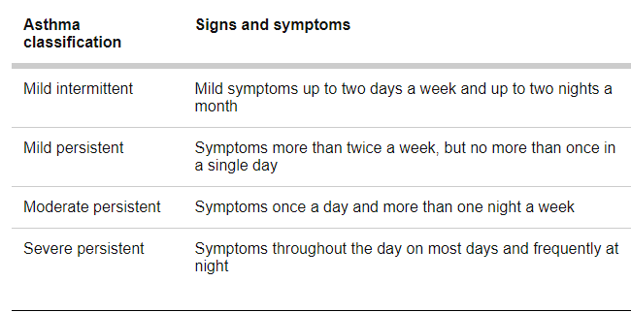
Classification of Bronchial Asthma
17
Notes:
SAY:
The purpose of epidemiology in public health practice is to
discover the agent, host, and environmental factors that affect health;
determine the relative importance of causes of illness, disability, and death;
identify those segments of the population that have the greatest risk from specific causes of ill health; and
evaluate the effectiveness of health programs and services in improving population health.
GO to next slide.

Slide 18
Conclusion
Asthma is a chronic (long-term) condition that affects the airways in the lungs. The airways are tubes that carry air in and out of your lungs. If you have asthma, the airways can become inflamed and narrowed at times.
This makes it harder for air to flow out of your airways when you breathe out.
18
Notes:
SAY:
The purpose of epidemiology in public health practice is to
discover the agent, host, and environmental factors that affect health;
determine the relative importance of causes of illness, disability, and death;
identify those segments of the population that have the greatest risk from specific causes of ill health; and
evaluate the effectiveness of health programs and services in improving population health.
GO to next slide.

Slide 19
References
Google.com
Wikipedia.org
Studymafia.org
Slidespanda.com

Slide 20
Thanks To StudyMafia.org

